Slide 1
Project: IEEE P802.15 Working Group for Wireless Personal Area Networks (WPANs)
Submission Title: [Overview of LED-ID]
Date Submitted: [11 July, 2010]
Source: [Yeong Min Jang, Sunwoong Choi, Muhammad Shahin Uddin, Nam Tuan Le]
[Kookmin University]
Address [Kookmin University, Seoul, Korea]
Voice:[82-2-910-5068], FAX: [82-2-910-5068], Email:[ yjang@kookmin.ac.kr]
Re: []
Abstract: [LED-ID Technology is the new paradigm in the identification technology environment. Illumination, identification and communications are simultaneously possible in LED-ID system. In this contribution we introduce the LED-ID system and its overview ]
Purpose: []
Notice: This document has been prepared to assist the IEEE P802.15. It is offered as a basis for discussion and is not binding on the contributing individual(s) or organization(s). The material in this document is subject to change in form and content after further study. The contributor(s) reserve(s) the right to add, amend or withdraw material contained herein.
Release: The contributor acknowledges and accepts that this contribution becomes the property of IEEE and may be made publicly available by P802.15.
Slide 1
Notes:
doc.: IEEE 802.15-09-0117-00-0007
<month year>

Slide 2
Contents
What is LED-ID ?
Components and Characteristics of LED-ID
Frequency Band
Superframe Structure
Comparison between LED-ID and RFID
Candidate Application/ Service Scenario
Conclusion

Slide 3
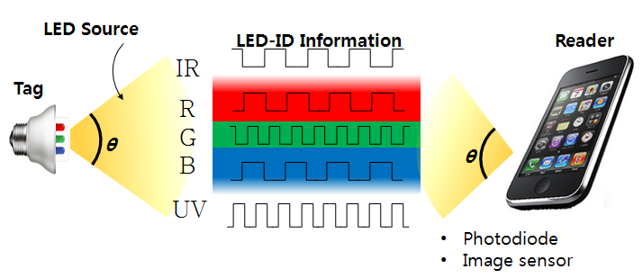
Definition of LED-ID
  Light Emitting Diode Identification (LED-ID) is a technology that uses communication via light waves (IR / Visible light/ UV) to exchange voice/video/data among one Tag (or Reader) to one or more identified Readers (or Tags).

Slide 4
  Components of LED-ID
  The main components of the LED-ID system are Reader and Tag
  Each Reader and Tag of LED-ID has at least one LED and Rx Module (PD/ Image sensor etc.)
Characteristics of LED-ID
  Low power consumption
  Harmless to human
  Green environment
  High security
  High speed read and write capability
  No interference with RF
  Support QoS

Slide 5
Classification of LED-ID Tag
  Active tag (ex. PD based)
  Semi-active tag (ex. Image Sensor based)
  Active tag (ex. PD based)
  Each Tag has LED and Photo-detector
  Internal power source
  Always energized in dimming mode
  Emits light using low power
  Life time depend upon mainly LED, Photo-detector and power source
  Semi-active tag (ex. Image Sensor based)
  Each Tag has LED and Photo-detector
  Power source only for local circuitry
  For communication purpose use energy comes from Reader
  Life time depend upon mainly LED, Photo-detector and power source

Slide 6
Frequency Band
UV (nm) | 10-380 | Solar blind (200~280 nm) High SNR High scattering > NLOS , penetration to fog High absorption > secure, covert and anti-jamming (to RF)
Visible Light (nm) | 380-780 | Visible to human eye Visible Light can be used every where Existing home network Infrastructure (Light etc.) Three dimensional positioning with accuracy up to several mm
IR (nm) | 780-1000 | Invisible to human eye Unregulated

Slide 7
Superframe Structure for LED-ID MAC
BI=aBaseSuperFrameDuration x 2^{BO}
IDD=aBaseSuperFrameDuration x 2^{IO}
CAP: Contention Access Period
IDP: Identification Period
CFP: Contention Free Period
GTS: Guaranteed Time Slots
BI: Beacon Interval
BO: Beacon Order
IDD: Identification Duration
IO: Identification Order
CAP(IDP)
CFP(GTS)
Beacon
Reserve timeslot for identified Readers
Discover ID of Readers
Candidate Protocols:
Protocols for IDP: Frame Slotted ALOHA, Query Tree
Protocols for CFP: TDMA

Slide 8
Comparison of ID Technologies
 | Bar Code | RFID (Passive) | LED-ID
Signal Format (Transmission medium) | Printed image | RF | LED light (Visible Light, IR UV, etc
Reliability | Wrinkled or smeared labels will not be read | Nearly flawless read rate | Flawless read rate
Readable through objects | No, must be line of sight | Yes | Depend on FOV
Security | No | Strong | Very Strong
Read speed | Slow | Fast | Variable Speed
Multiple tags | No | Yes | Yes
Updateable | No | Yes | Yes
Data type | Non real-time | Non real-time | Non real-time and real-time
Tag and reader position | Scanner needs to see the bar code to read it | No need to bring the tag near the reader | Need to bring within the FOV
QoS | No need | Not support QoS | Support QoS
Communication | Half-duplex | Duplex | Duplex
Possibility to use Existing Infrastructure | No, New setup | No, New setup | Yes Existing infrastructure may be used

Slide 9
Candidate Application/ Service Scenario
  Museum
  Product expo
  Advertisement
  Intelligent menu system (airplane, restaurant)
  Sign board
  Kiosk
  Indoor localization (LBS applications)
  Inventory management system
  Car parking
  Mobile cleaning robot
  Guiding system for blind person
  Supermarket/Department store and
  Entertainment /Movie/Amusement Park

Slide 10
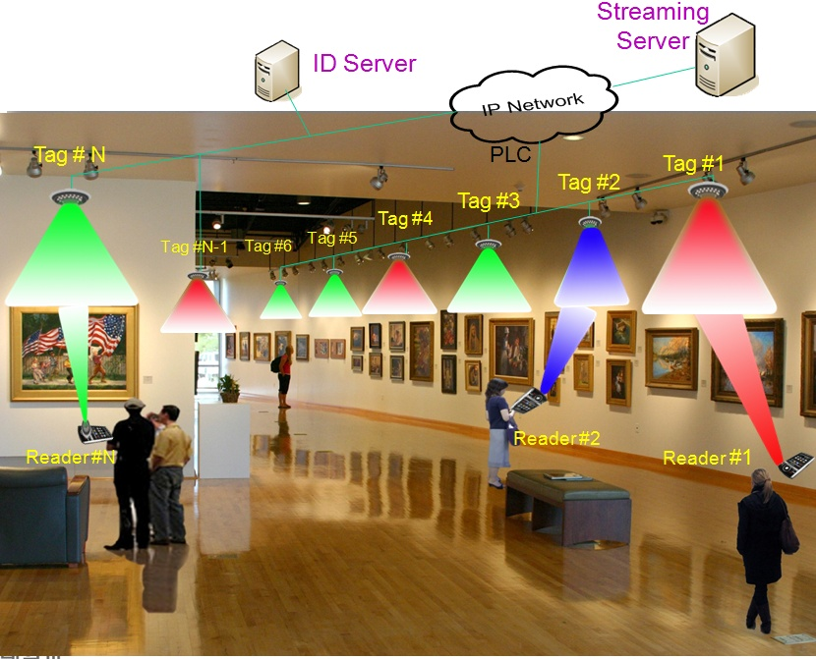
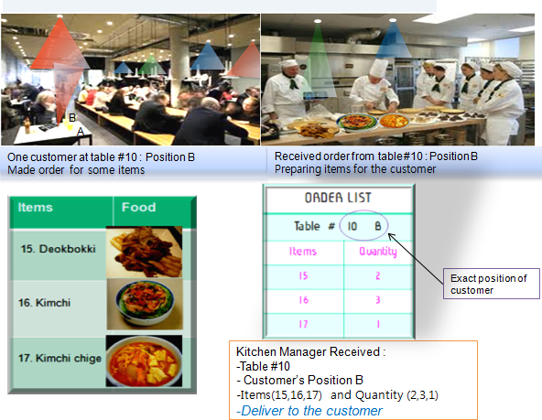
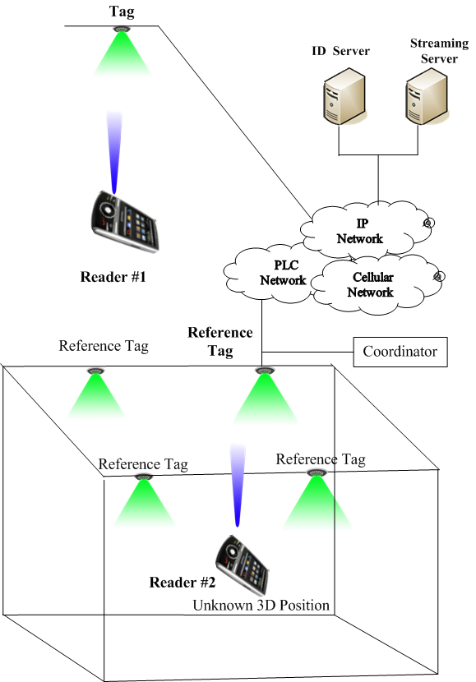
Museum Scenario
Mobile Cleaning Robots control
Restaurant Scenario
Indoor 3D Positioning

Slide 11
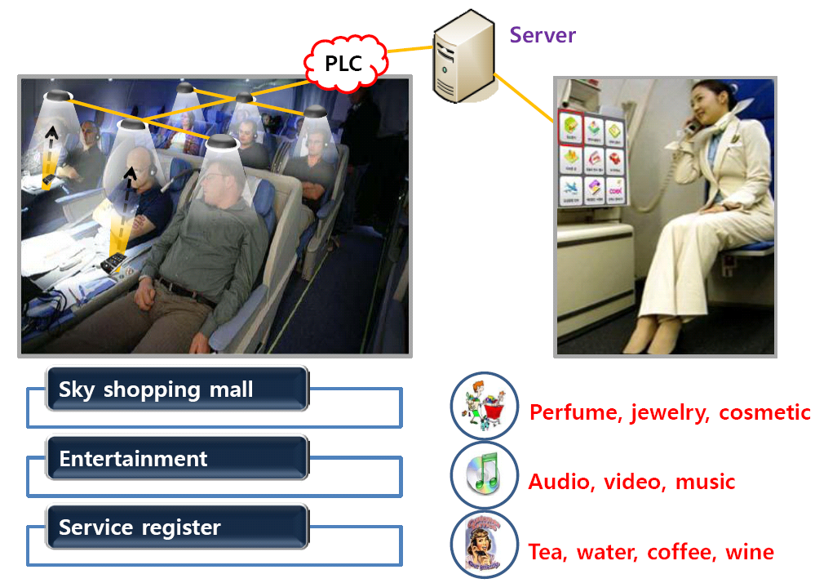
Air Plane Scenario

Slide 12
Recent Activity
  LED-ID MAC approach
    Identification technique combine with QoS data transmission
    Priority MAC
    Cooperative MAC
    Fast Efficient Anti-collision protocol
    Anti-collision protocol
Others
    Method to overcome the limitation of FOV
    Site diversity technique
    Fast link switching
    Enhance the coverage
    Fast and energy efficient link recovery

Slide 13
Conclusion
LEDID system is the new paradigm in the identification world
LED-ID system is support non QoS and QoS application
This system can be used for identification communication and illumination as well
LED-ID system may coexist with RFID, Barcode etc instead of replacement

