Slide 1
Project: IEEE P802.15 Working Group for Wireless Personal Area Networks (WPANs)
Submission Title: [Preliminary Proposal for FHSS PHY for 802.15.4k]
Date Submitted: [18 July 2011 ]
Source: [Matt Johnson] Company [Itron]
Address [2111 N Molter RD, Liberty Lake, WA 99019, USA]
Voice:[+1 509-891-3364], FAX: [+1 509-891-3896], E-Mail:[matt.johnson@itron.com]
Re: [ Response to CFP issued 10 May 2011, document 15-11-0147-02-004k]
Abstract: [This document describes a FHSS PHY that addresses the requirements of the 802.15.4k PAR]
Purpose: [Preliminary proposal for consideration of inclusion into 802.15.4k PHY.]
Notice: This document has been prepared to assist the IEEE P802.15. It is offered as a basis for discussion and is not binding on the contributing individual(s) or organization(s). The material in this document is subject to change in form and content after further study. The contributor(s) reserve(s) the right to add, amend or withdraw material contained herein.
Release: The contributor acknowledges and accepts that this contribution becomes the property of IEEE and may be made publicly available by P802.15.

Slide 2
Agenda
Background
FHSS System
Channel Coherence
Coexistence
Link Budget
MAC Considerations

Slide 3
Background: AMI Performance Expectations
20+ Year Endpoint Battery Life
All the electronics, not just the radio
Single Lithium-thionyl chloride A Cell (3.6 Ah)
Relatively Low Latency
5 minutes
99% Hourly Read Reliability
High link budget to support up to 100k endpoints/concentrator
Support for worldwide deployment

Slide 4
Background: Battery Considerations
Relatively Higher data rate = less TX & RX Time
Relative to the PAR guidance
Longer endpoint battery life
Optional unacknowledged uplink TX
Endpoint RX larger consumer of battery than TX

Slide 5
Two Ways to get to a High Link Budget
Broadband Spread Spectrum Systems
Robust against interference through processing gain
Narrowband Systems
Higher link through minimizing noise and interference
Simpler to implement for low cost devices

Slide 6
Why FHSS?
Frequency Diversity
Effective for diversity reception
Provides greater degrees of freedom in concentrator receiver design for high capacity systems
Greater concentrator deployment flexibility
Single antenna on tower – lower cost
No tower-mounted electronics – high reliability
Narrow-band FHSS has proven to have a high degree of interference immunity

Slide 7
Example Parameters
Narrowband FHSS System
≥ 100 Channels (915 ISM)
Channel BW of 100 to 200 kHz
Data Rate (based on 915 MHz ISM band)
Uplink 35 to 40 kbps
Downlink 10 to 40 kbps
FSK/GFSK Modulation

Slide 8
Channel Coherence
Based on measured PSR (in the real world):
In the 915 MHz band, we estimate channel coherence at 18 to 20 mSec
Interference
In 915 ISM there are a wide variety of non-standards-based systems
Ricean fading environment

Slide 9
Data Rate
Asymmetric data rates
Relatively higher uplink rate
Maximize payload for given channel coherence
Lower downlink rate
Lighten the load on limited endpoint computing resources
Typical download payloads are significant smaller and less frequent in AMI and sensor networks
Enable narrow bandwidth for improved interference immunity

Slide 10
Coexistence
By low duty cycle
Energy Detection impacts battery life
Follow the ETSI philosophy from the SRD rules:
LBT or Duty Cycle Limits if LBT not implemented

Slide 11
Bands
915 MHz
868 MHz
2.4 GHz
Perhaps other regional bands?
Will be defined in September Proposal

Slide 12
915 MHz Link Budget
Based on multiple network deployments
No single number can adequately describe penetration loss:
further discussion in the link budget session.

Slide 13
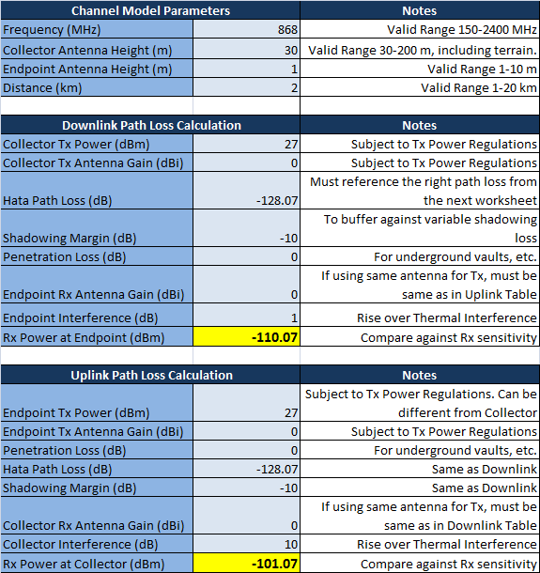
868 MHz Link Budget
Non Specific Use, 25 mW, ≤100 kHz Channels, 1 km range
Non Specific Use, 500 mW, ≤ 25 kHz Channels, 2 km range

Slide 14
MAC Considerations
Typical Operational Payloads are Relatively Small

Slide 15
Conclusion
PAR can be met with both narrowband and broadband approaches
Expect to present a full proposal in September
Welcome the opportunity merge with other narrowband proposals

