Slide 1
Project: IEEE P802.15 Working Group for Wireless Personal Area Networks (WPANs)
Submission Title: [A Dynamic Framed Slotted ALOHA protocol for LECIM Networks]
Date Submitted: [July, 2011]
Source: [Kyungsup Kwak, Jaedoo Huh*, Hyung Soo Lee*, M. Al Ameen, Niamat Ullah, M.S. Chowdhury]
Company: [Inha University, *ETRI]
Address [428 Hi-Tech, Inha University, 253 Yonghyun-dong, Nam-gu, Incheon, 402-751, Republic of Korea]
Voice: [+82-32-860-7416], FAX: [+82-32-876-7349],
E-Mail: [kskwak@inha.ac.kr (other contributors are listed in “Contributors” slides)]
Re: []
Abstract: [A MAC Proposal for Low Energy Critical Infrastructure Networks Applications TG4k]
Purpose: [To be considered in IEEE 802.15.4k]
Notice: This document has been prepared to assist the IEEE P802.15. It is offered as a basis for discussion and is not binding on the contributing individual(s) or organization(s). The material in this document is subject to change in form and content after further study. The contributor(s) reserve(s) the right to add, amend or withdraw material contained herein.
Release: The contributor acknowledges and accepts that this contribution becomes the property of IEEE and may be made publicly available by P802.15.
Slide 1
Notes:
<month year>
<author>, <company>
Page 1

Slide 2
Contributors
May, 2009
Name | E-mail | Affiliation
Kyungsup Kwak | kskwak@inha.ac.kr | Inha University
Jaedoo Huh | jdhuh@etri.re.kr | ETRI, Korea
Hyung Soo Lee | hsulee@etri.re.kr | ETRI, Korea
M. Al Ameen | m.ameen@hotmail.com | Inha University
Niamat Ullah | niamatnaz@gmail.com | Inha University
M.S. Chowdhury | sana1691@yahoo.com | Inha University
Slide 2

Slide 3
Outline
Introduction
LECIM Design Requirements
MAC Protocol Description
Performance Evaluation
Conclusion

Slide 4
Introduction
IEEE 802.15 Low Energy Critical Infrastructure (LECIM) Task Group 4k (TG4k) is formed as an amendment to IEEE 802.15.4.
The purpose is to facilitate point to multi-thousands of points communications for critical infrastructure monitoring devices.
It addresses the application's user needs of minimal network infrastructure, and enables the collection of scheduled and event data from a large number of non-mains powered end points that are widely dispersed, or are in challenging propagation environments.
To facilitate low energy operation necessary for multi-year battery life, the amendment minimizes network maintenance traffic and device wake durations.
To address the monitoring and management needs of Critical Infrastructure applications such as water, transportation, security, bridges; to enable preventative maintenance, safety, reliability and cost reduction through operational efficiency.

Slide 5
LECIM Design Requirements
Primarily outdoor environment
Application data rate from 1 - 40 kbps
Thousands of endpoints per mains powered infrastructure
Asymmetric application data flow
End point must be able to conserve energy
Reliable operation in dramatically changing environments
Long deployment life w/o human contact
Small, infrequent messages
Tolerant to data latency
Addressing should support thousands of connected end points
Network devices
  Coordinator (Collector) typically mains powered
  End point devices are typically battery powered
No mobility of end devices but portability for coordinator

Slide 6
Need for a new MAC
The size of the network is very large. Scalability is a major issue.
Energy consumption and lifetime are major design requirements with delay tolerance.
The present 802.15.4/4e MACs needs modification to support such a large network.
802.15.4e has a concept of slot ownership. Every node in the network has been assigned a particular slot in the superframe. This can certainly degrade the performance of the 4k network due to large number of nodes.

Slide 7
MAC Protocol Description
  We propose a beacon enabled MAC for tg4k
  The topology is star to support one to multipoint communication.
  A network has one coordinator supporting many devices.
End Device
Coordinator (Collector)

Slide 8
MAC Protocol Description: Superframe
A framed slotted ALOHA scheme is proposed as shown below.
Slots
Beacon
B
EAP
B
NAP
EAP: Exclusive Access Period
NAP: Normal Access Period

Slide 9
MAC Protocol Description: Superframe
The superframe contains time slots.
  The number of Slots can vary and is design parameter
The superframe has three parts
  Beacon
  EAP
  NAP
Beacon
  Beacon is used to synchronize the nodes and transmit superframe information.

Slide 10
MAC Protocol Description: Superframe
EAP is Exclusive Access Period.
  It is used for emergency traffic only.
  Emergency may happen to any of the devices.
    Problem happening to the device itself
    Device malfunction
    Critical battery life situation
  In such scenario, the device need urgent attention for data transmission.
  EAP can be used in such scenarios and can be optimized as per network size
  The coordinator treats this case with highest priority
NAP is Normal Access Period.
  It is used for normal communication in the network.
  The number of slots in NAP can be optimized as per the network size.

Slide 11
MAC Protocol Description: Communication Process
The communication process is as shown below.
  Uplink is for data transfer from a device to the coordinator
  Downlink is data transfer from coordinator to a device.
We assume that communication is always done in a beacon enabled network.
Coordinator
Device
Coordinator
Device
Beacon
Beacon
Request
Data
Ack
Ack
Data
Ack
Uplink data transfer
Downlink data transfer

Slide 12
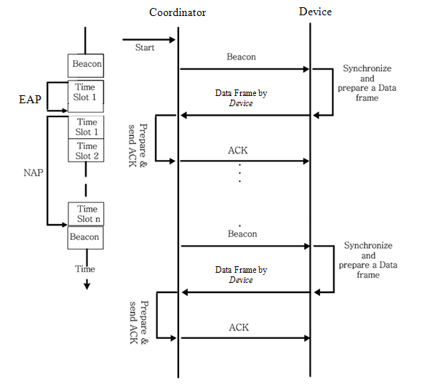
MAC Protocol Description: Flow Diagram

Slide 13
MAC Protocol Description: Timing Diagram
Superframe (n)
Superframe (n+1)
B
1
2
3
15
31
B
1
2
3
15
31
B
Coordinator
B
DC
Node -1
B
DC
Node -2
.
.
.
B
DC
Node -k
B
Beacon
DC
Data communication
* In the above Superframe, it has 32 slots
1
Superframe slot

Slide 14
MAC Protocol Description: Operations
Two way communication takes place: between the coordinator and the devices.
The MAC operations are as follows:
  The coordinator sends beacon on regular intervals. The beacon contains synchronization and slots information.
  Each device wakeups when an event of interest happens, and listens for the beacon.
  When it gets the beacon, it synchronizes to the superframe
  It randomly choose a slot in the current superframe for communication.
  It sends a packet using the framed slotted ALOHA in the beginning of the chosen slot with probability one.
  After successful transmission it goes to sleep state.
  If collision happens, the device tries in the next superframe using the same procedure.
  For Reliable Data communication we propose to use immediate acknowledgement (iAck)

Slide 15
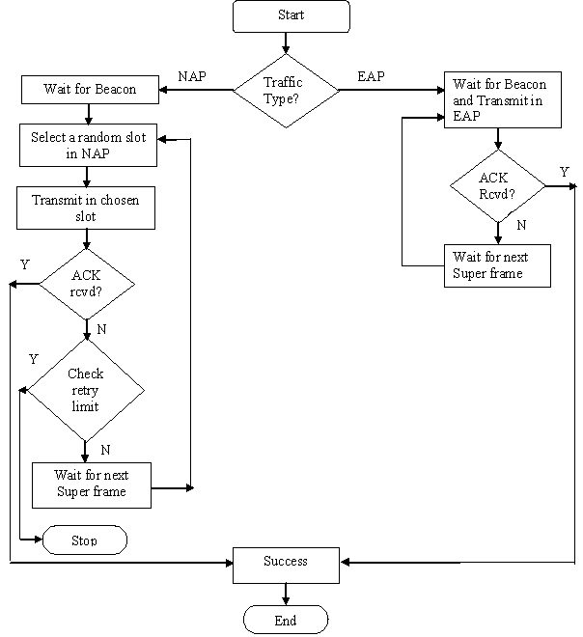
MAC Protocol Description: Flow Chart
Retry
<
maxLimit
?

Slide 16
MAC Frame Structure
The MAC frame is as shown below.
  The address field is long to accommodate large number of end devices.
Preamble
PHY
MAC
13
variable
2
Octet
MAC Header
Payload
FCS [CRC]
MAC Frame length: 13+ 2 + payload
Notes:
16
16

Slide 17
Performance Evaluation
The assumptions are as follows:
  There are N devices in the network
  All the devices are in star topology and within range of the coordinator
  Packets are generated by Poisson with avg. arrival rate λ
  Throughput and Utilization factor are investigated
  Maximum network sizes are estimated upon given frame size
  Each device has one packet to transmit in one superframe.

Slide 18
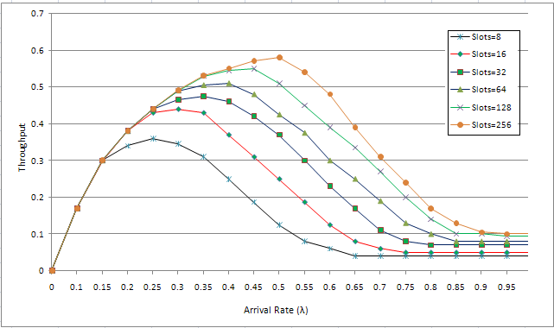
Throughput Analysis

Slide 19
Estimated Network Size
Frame Size | Max Throughput | Individual Traffic Intensity | Max network size | Utilization Factor (%)
8 | 0.36 | 0.00036 | 1000 | 0.0360
 |  | 0.00024 | 1500 | 0.0240
 |  | 0.00018 | 2000 | 0.0180
 |  | 0.000144 | 2500 | 0.0144
 |  | 0.00012 | 3000 | 0.0120
 |  | 0.000072 | 5000 | 0.0072
 |  | 0.000036 | 10000 | 0.0036
16 | 0.44 | 0.00044 | 1000 | 0.0440
 |  | 0.000293 | 1500 | 0.0293
 |  | 0.00022 | 2000 | 0.0220
 |  | 0.000176 | 2500 | 0.0176
 |  | 0.000147 | 3000 | 0.0147
 |  | 0.000088 | 5000 | 0.0088
 |  | 0.000044 | 10000 | 0.0044
32 | 0.475 | 0.000475 | 1000 | 0.0475
 |  | 0.000317 | 1500 | 0.0317
 |  | 0.000238 | 2000 | 0.0238
 |  | 0.00019 | 2500 | 0.0190
 |  | 0.000158 | 3000 | 0.0158
 |  | 0.000095 | 5000 | 0.0095
 |  | 0.0000475 | 10000 | 0.0048
Frame Size | Max Throughput | Individual Traffic Intensity | Max network size | Utilization Factor (%)
64 | 0.51 | 0.00051 | 1000 | 0.0510
 |  | 0.00034 | 1500 | 0.0340
 |  | 0.000255 | 2000 | 0.0255
 |  | 0.000204 | 2500 | 0.0204
 |  | 0.00017 | 3000 | 0.0170
 |  | 0.000102 | 5000 | 0.0102
 |  | 0.000051 | 10000 | 0.0051
128 | 0.55 | 0.00055 | 1000 | 0.0550
 |  | 0.000367 | 1500 | 0.0367
 |  | 0.000275 | 2000 | 0.0275
 |  | 0.00022 | 2500 | 0.0220
 |  | 0.000183 | 3000 | 0.0183
 |  | 0.00011 | 5000 | 0.0110
 |  | 0.000055 | 10000 | 0.0055
256 | 0.58 | 0.00058 | 1000 | 0.0580
 |  | 0.000387 | 1500 | 0.0387
 |  | 0.00029 | 2000 | 0.0290
 |  | 0.000232 | 2500 | 0.0232
 |  | 0.000193 | 3000 | 0.0193
 |  | 0.000116 | 5000 | 0.0116
 |  | 0.000058 | 10000 | 0.0058

Slide 20
Conclusion
The IEEE TG4k is formed to address the Low Energy Critical Infrastructure monitoring (LECIM).
We propose a dynamic framed ALOHA MAC for LECIM.
A beacon enabled superframe is used with EAP and NAP periods.
We analyzed throughput for different frame sizes and found optimum network size and utilization factor.
Proposed protocol is simple to implement and flexible in terms of network size.
We will extend the proposal to a full MAC and present in next meeting.

Slide 21
The End
Thank You

