Slide 1
Project: IEEE P802.15 Working Group for Wireless Personal Area Networks (WPANs)
Submission Title: [TG4e Overview]
Date Submitted: [18 Jan 2014]
Source: [Patrick Kinney] Company [Kinney Consulting LLC]
Address [Chicago area, IL, USA]
Voice:[+1.847.960.3715], E-Mail:[pat.kinney@ieee.org]
Re: [Information on TG4e for Jan 2014 Session]
Abstract: [Information on TG4e for Jan 2014 Session]
Purpose: [To assist in the understanding of TG4e]
Notice: This document has been prepared to assist the IEEE P802.15. It is offered as a basis for discussion and is not binding on the contributing individual(s) or organization(s). The material in this document is subject to change in form and content after further study. The contributor(s) reserve(s) the right to add, amend or withdraw material contained herein.
Release: The contributor acknowledges and accepts that this contribution becomes the property of IEEE and may be made publicly available by P802.15.

Slide 2
TG4e
First MAC amendment to 802.15.4
Originally intended to amend 802.15.4-2006 but changed to amend 802.15.4-2011 to:
  better support the industrial markets, and
  permit compatibility with modifications proposed within the Chinese WPAN
  Changes to address TG4f
  Changes to address TG4g

Slide 3
TG4e major changes
Deterministic & Synchronous Multi-channel Extension mode (DSME)
Time Slotted Channel Hopping mode (TSCH)
Low Latency Deterministic Network mode (LLDN)
Additional Frame Formats
Low Energy mode (CSL, RIT)
Enhanced Beacon behavior
Information Elements (IE)
Miscellaneous

Slide 4
Deterministic & Synchronous Multichannel Extension (DSME)
Support of industrial applications and commercial applications which need deterministic latency and higher link reliability
Operation
  DSME-enabled network runs on beacon-enabled PAN. All devices synchronize multi-superframe via beacon frame.
  Multi-superframe enhances GTS operation in 802.15.4-2006 by grouping multiple superframes, and also extends single channel operation during CFP to multi-channel operation either by adapting (switching) channels or by hopping channels.
  A pair of peer devices wakes up at a reserved GTS slot(s) to exchange a data frame and an ACK frame.

Slide 5
Time Slotted Channel Hopping (TSCH)
Process Automation applications with a particular focus on equipment and process monitoring
IETF 6TiSCH is built upon and extending TSCH operation to higher layers
Operation
  All devices in the same network synchronize slotframes
  All timeslots are contained within a slotframe cycle
  Timeslots repeat in time: the slotframe period
  Device-to-device communication within a timeslot includes packet Tx/Rx & ACK Tx/Rx

Slide 6
Time Slotted Channel Hopping (TSCH)
Typical segments of the application domain of TSCH are process automation facilities for the following:
Oil and gas industry
Food and beverage products
Chemical products
Pharmaceutical products
Water/waste water treatments
TSCH allows devices to sleep when no active links are set up to allow significant energy savings, allowing TSCH routers to be battery or energy harvested powered

Slide 7
Time Slotted Channel Hopping (TSCH)
TSCH mode overview
The TSCH mode uses time synchronized communication and channel hopping to provide network robustness through spectral and temporal redundancy. Time slotted communication links increase potential throughput by minimizing unwanted collisions that can lead to catastrophic failure and provides deterministic yet flexible bandwidth for a wide variety of applications. Channel hopping extends the effective range of communications by mitigating the effects of multipath fading and interference. TSCH is also topology independent; it can be used to form any topology from a star to a full mesh. TSCH MAC primitives can be used with higher layer networking protocols to form the basis of reliable, scalable, and flexible networks.

Slide 8
Time Slotted Channel Hopping (TSCH)
MAC behaviors unique to TSCH
The TSCH mode introduces no unique commands specific for this mode; however, IEs are used extensively.
TSCH uses EBs containing the TSCH Synchronization payload IE, TSCH-Slotframe and Link payload IE, TSCH Timeslot payload IE, and Channel Hopping payload IE to advertise the presence of a TSCH PAN and allow new devices to synchronize to it. Devices maintain synchronization by exchanging acknowledged frames within defined Timeslot windows and providing timing corrections in the acknowledgment via the ACK/NACK Time Correction IE. Communication resources are broken up into timeslots that are organized into repeating slotframes

Slide 9
Time Slotted Channel Hopping (TSCH)
TSCH areas within the 802.15.4e amendment
TheTSCH-Slotframe structure behavior is cited in 5.1.1.5, synchronization is stated in 5.1.1.4, the IEs are described in 5.2.4.11, 5.2.4.13, 5.2.4.14, 5.2.4.15, and the primitives are declared in 6.2.19.
TSCH link example
Figure on next slide shows how nodes may communicate in a very simple three-timeslot slotframe.

Slide 10
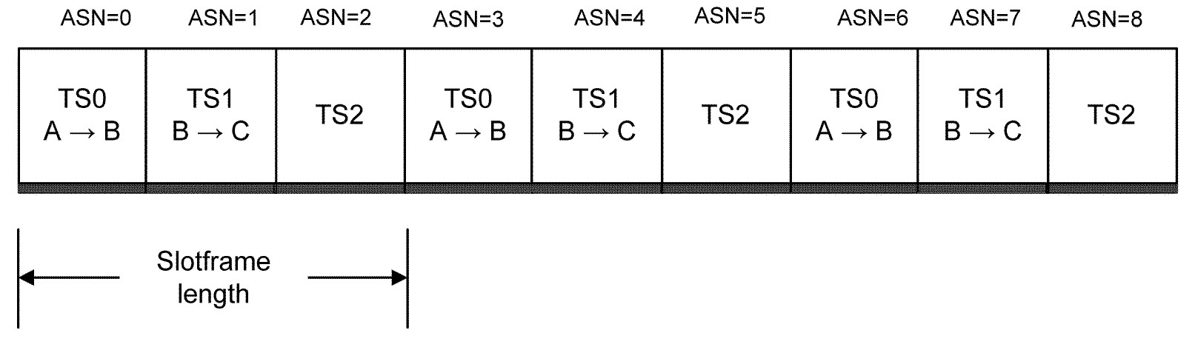
Time Slotted Channel Hopping (TSCH)
Nodes A and B communicate during timeslot 0, nodes B and C communicate during timeslot 1, and timeslot 2 is not being used. Every three timeslots, the schedule repeats, but note that ASN increments continuously. The pairwise assignment of a directed communication between devices in a given timeslot on a given channelOffset is a link.

Slide 11
Time Slotted Channel Hopping (TSCH)
Physical channel, CH, in a link is made according to the following formula:
  CH = macHoppingSequenceList [(macASN + channelOffset) % macHoppingSequenceLength]
Use of a channelOffset allows for different channels to be used at a given macASN for a given macHoppingSequenceList. There are macNumberOfChannels channelOffsets that will result in a unique channel for that combination of macASN and macHoppingSequenceList.

Slide 12
Low Latency Deterministic Network (LLDN)
Support of factory automation and process automation e.g. automotive robots/suspension tracks, machine tools milling/turning/robot revolver
Uses beacon and assigned time slots to provide determinism
Designed for small networks and small frames
Substantial reduction in MAC overhead to allow very small superframes, hence reduced device latencies
Includes a Group ACK function to reduce bandwidth needs

Slide 13
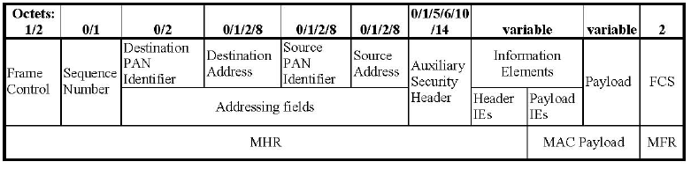
Additional Frame Formats
New frame type to accommodate LLDN networks
  Reduced overhead
Added multipurpose frame that:
  Accommodates TG4f (Tx only devices), Low Energy mode, etc.
  Reduce overhead, e.g. MAC overhead for an TG4f type frame can be as low as 4 octets (MAC overhead was 11 octets with the previous frame type)
  Provides configurability and extensibility

Slide 14
Low Energy
IP-centric Sensor Networks
  Creates illusion of Always On, Low Latency, Multicast Capable, Synchronous Acks
Coordinated Sampled Listening (CSL)
  Receiver periodically performs channel sampling for radio traffic
    Every macCSLPeriod (ms)
  Sender transmits wakeup frame sequence prior to payload frame
    Full wakeup sequence (macCSLMaxPeriod) if unsynchronized with receiver, i.e., first time to send to the receiver
    Short wakeup sequence for guard time if synchronized with receiver
  Tradeoff between latency and energy consumption
Receiver Initiated Transmission (RIT)
  Receiver periodically broadcasts datareq frames and listen for a short amount of time (macRitDataWaitPeriod) for incoming transmissions every macRitPeriod
  Sender waits until receiving datareq frame from receiver then immediately transmit payload frame
  Works better when higher latency can be tolerated and works with regulations which limit continuous transmission duration (e.g., Japan)

Slide 15
Enhanced Beacon & Enhanced Beacon Requests
Enhanced beacon includes ability to carry additional information in beacons (IEs).
Enhanced beacon request includes respondent filters and generalized information query capability

Slide 16
Information Elements (IEs)
Simple, extensible, flexible information container
Allows adding information to existing frame format without adding new frame type
Managed ID spaces allows flexibility
  ID numbers are assigned by 802.15 ANA
Already being utilized by SUN PHY and RFID

Slide 17
Miscellaneous
Fast Association
  This mode allows a device to send and association response in direct communication eliminating a delay in the current indirect communication association response command
Network Metrics
  Added attributes macRetryCount, macMultipleRetryCount, macTXFailCount, macTXSuccessCount relate to data frame transmission
  Added attributes macFCSErrorCount, macSecurityFailure, macDuplicateFrameCount, macRXSuccessCount relate to data frame reception
Channel Diversity
  Provides support for Channel Hopping via Hopping Sequence PIB and a default hopping sequence

Slide 18
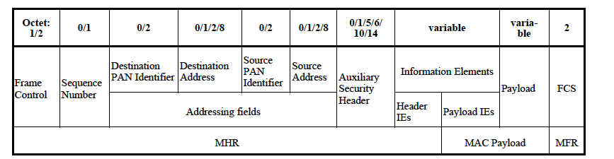
Miscellaneous - Enhanced Acknowledgement Frames
  Allow ACKs be secured, include payloads, and a configurable delay to allow devices sufficient time to decrypt, etc

Slide 19
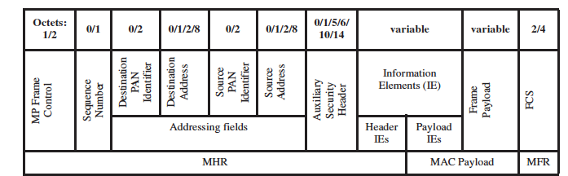
Miscellaneous - Multipurpose Frame
The Multipurpose (MP) frame type provides a flexible format that may used for a variety of purposes. The format supports a short and long form of the Frame Control field, and allows for all the fields in the MHR to be present or elided as specified
The minimum overhead for the multipurpose frame is 3 octets
The first uses of the MP Frame were for low energy and RFID

Slide 20
Summary
Substantial additions to enable “managed” networks (such as DSME, TSCH, LLDN) to exhibit deterministic behavior, accommodate a large number of devices, better manage network behaviors
Additional protocol behaviors that can facilitate longer battery life, faster response times, etc

