Slide 1
Project: IEEE P802.15 Working Group for Wireless Personal Area Networks (WPANs)
Submission Title:[Preliminary Fragmentation Proposal for TG4k]
Date Submitted: [July 14, 2011]
Source:[Benjamin Rolfe]
Company [Blind Creek Associates]
Address []
Voice: [+1.408.395.7207], FAX: [None], E-Mail: [ben @ blindcreek.com]
Re:[Follow-on to discussion in doc 11-0395 from MAY 2011 meeting]
Abstract:[Fragmentation Ideas collected together for group consideration ]
Purpose:[Initial proposal]
Notice: This document has been prepared to assist the IEEE P802.15. It is offered as a basis for discussion and is not binding on the contributing individual(s) or organization(s). The material in this document is subject to change in form and content after further study. The contributor(s) reserve(s) the right to add, amend or withdraw material contained herein.
Release: The contributor acknowledges and accepts that this contribution becomes the property of IEEE and may be made publicly available by P802.15.

Slide 2
Introduction
Combination of inputs
  Ideas shared in May 2011 meeting
  Teleconference call discussions
  Email received via reflector and directly
Reference documents:
  P802.15-11-0395-00
  P802.15-11-0348-00

Slide 3
Goals for Fragmentation
Adapt LECIM PHYs to operate with existing MAC transparently
Improve apparent reliability of the medium
Fit expected channel conditions, data rates and other PHY characteristics for LECIM
Reduce on the air overhead
Coexistence: reduce interference footprint and improve interference tolerance
Consider generalizations to make useful beyond LECIM PHYs and applications

Slide 4
PHY proposals drive specifics
General concepts for fragmentation derived from requirements, channel model, and discussions of PHY characteristics discussed so far needed to meet those requirements
Will Refine and adjust as PHY proposals presented, considered and converged
  May be more essential for some proposals for others (ex: shared spectrum vs licensed bands)

Slide 5
What we know
Application requirements => very low bit rates (< 40kbps) => Expected PHY rates of 1 to 40 kbps
Provisioned, asymmetrical end-points => Star topology likely
Channel characteristics:
  Use of shared spectrum likely => interference mitigation and coexistence important
  Short term channel conditions change over the duration of 15.4 MAC frame at LECIM data rates (channel coherence time)
Must be compatible with existing MAC
  Compatible with higher layer protocols typically used with 15.4 is a good thing too!
  May have fragmentation/compression being used above the MAC (i.e. 6loWPAN like protocols)

Slide 6
Packet Duration Examples
Example | Maximum packet Duration (ms) | Reference packet * duration (ms)
802.15.4 DSSS @ 250kbps | 4.25 ms | 4.12 ms
802.15.4 FSK @ 100kbps | 10.64ms | 10.32ms
Ethernet @ 10Mbps | 1.22 ms | 0.012 ms
802.11 @ 54Mbps | 0.6 ms | 0.04 ms
802.11 @ 2Mbps | 16.4 ms | 1.02 ms
802.16 @ | Fixed DL duration 0.2 to 2ms
*Reference packet =
100 octets payload + average overhead bits (PHY and MAC)

Slide 7
PHY packet size for LECIM?
Typical packet duration “real world” ranges from < 1ms to ~16ms
LECIM data rates < 40kbps (may be much lower)
20 octet packet =>
  4 ms @ 40kbps
  8 ms @ 20kbps
  16 ms @ 10kbps
Packet size <= 20 octets seems likely
  Aligns well with channel model (coherence time)
  Might need to be << 20 in some situations

Slide 8
MSDU -> multiple MPDUs
MAC Frame Overhead
802.15.4 MAC frame example
  802.15.4 2006 frame: 23 octets + payload
802.15.4e frame: 20 octets + payload
Fragmenting MPDU makes sense
2 | 1 | 8 | 8 | 2 | Variable | 2
FCF | DSN | SRC Addr | Dest Addr | PANID | MSDU | FCS
2 | 8 | 8 | Variable | 2
FCF | SRC Addr | Dest Addr | MSDU | FCS

Slide 9
Overview of Fragmentation
MPDU constructed in the normal 15.4 process
Fragment 15.4 MPDU into multiple PHY packets (Compress/suppress repetition MHR fields)
Fragment carries minimal overhead
Each fragment validated, acknowledged
Retransmission of failed fragments only
Example: fixed PPDU size =20 octets

Slide 10
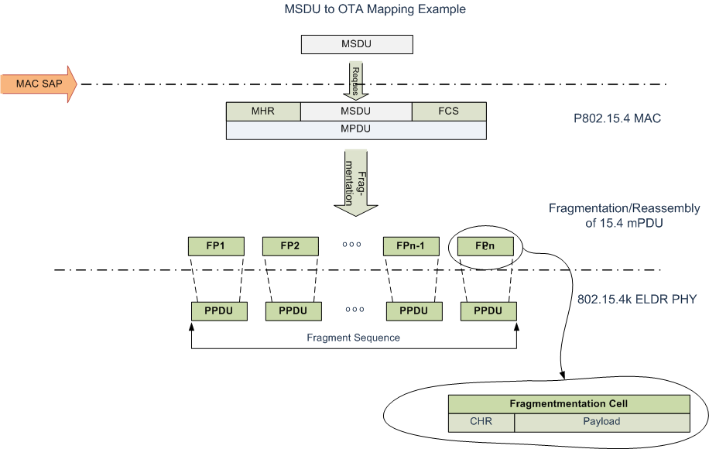

Slide 11
State information associated with MSDU
Destination address
MSDU ID
Transfer type:
  Acknowledged or not acknowledged
PHY specific transmit parameters
  TX power/SF/bits per symbol/, FEC, etc depending on PHY

Slide 12

MPDU Construction and Fragmentation
MPDU constructed by existing 802.15.4 MAC process
Fragmented into a sequence of fragmentation cells [FP1,…FPn] that each fit into a PPDU
MAC overhead (MHR, Security header, MPDU FCS) sent only once

Slide 13
Fragmentation Cell Construction
Fragment Sequence ID | Fragment Number | AR | More/end | PHY info | MPDU Data Fragment
Fragment Sequence ID identifies this collection of fragments
  Determined by MSDU ID, Destination address; MSDU ID associated with destination address once at start of sequence (Link context)
Fragment number (which fragmentation cell is this in sequence)
Per-fragment acknowledgment request
More fragments/end of fragment sequence
PHY info
  Medium quality/status measurement (LQI)
  Other PHY specific info appropriate?
Fragment Error Detection
  Need to retransmit individual fragments
  CRC, block code, FEC??

Slide 14
Link Adaptation
Channel conditions change during MPDU duration == need to support PHY parameter adjustment between fragments
Provide medium quality indication in each fragment and response (‘the last time I heard you…’)
PHY defines what can be adjusted
Medium quality (LQI) method PHY specific

Slide 15
MPDU Reassembly
Reassemble MPDU using fragment sequence ID and fragment number
Identify missing and/or invalid fragments
Request retransmission of missing fragments
Pass reassembled MPDU on for further MAC processing

Slide 16
Fragment and MPDU Validation
levels of validation
  Per fragment validation and retransmission
  Validation of reassembled MPDU using MFR FCS
  Message integrity/authentication?
Fragment Retransmission alternatives
  Progressive acknowledgement and retransmission of individual Fragments
  Aggregated acknowledgement followed by retransmission of missed fragments
  Parameterized progressing (Hybrid) acknowledgment (incremental aggregation)
MPDU validation and retransmission
  Using existing MAC validation and acknowledge procedures

Slide 17
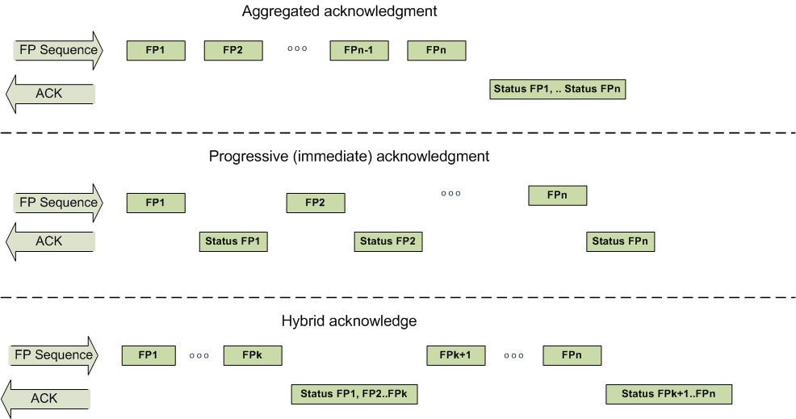

Slide 18
Conclusion
  Leverages the existing 802.15.4 MAC frame structures and capabilities
  Fits MAC frame structures into smaller chunks appropriate to LECIM PHY characteristics to contain PPDU duration
  Incremental effort improves MPDU delivery reliability, and reduces OTR overheads
  Adaptable to a variety of PHYs and data rates
  May be generalized for other PHYs

Slide 19
Next Steps
Revise/Refine concept as LECIM PHY(s) develop
Areas (I know of) that need more analysis
  Fragment context: need to know how many fragments to expect and when to give up on the sequence?
  Parameterized hybrid ACK scheme to support upper layer adaptation
  Need to validate each FP in such a way as to detect spoof'd fragments?

Slide 20

Thanks for your Attention!

