Slide 1
Project: IEEE P802.15 Working Group for Wireless Personal Area Networks (WPANs)
Submission Title: Usage Models for Personal Space Communications
Date Submitted: May 12, 2011
Source: Yongsuk Kim [Samsung Electronics], Jinkyeong Kim, and Sunggeun Jin [ETRI]
Address: yongsuk@samsung.com
Re:
Abstract: We present usage models suitable for personal space communications.
Purpose: To inform 802.15 members on progress
Notice: This document has been prepared to assist the IEEE P802.15. It is offered as a basis for discussion and is not binding on the contributing individual(s) or organization(s). The material in this document is subject to change in form and content after further study. The contributor(s) reserve(s) the right to add, amend or withdraw material contained herein.
Release: The contributor acknowledges and accepts that this contribution becomes the property of IEEE and may be made publicly available by P802.15.
Slide 1

Slide 2
Contents
PAR Comments
PSC characteristics
  Concurrent group communication
  Fast association and synchronization
services
  Local advertisement/information
  Mobile P2P
Supportable services by PSC

Slide 3
PAR Comments
Slide 2

Slide 4
PAR Comments
Data Rate
  5.2 Scope: This standard defines the PHY and MAC specifications optimized for personal space communications, providing dynamic scalability of link rates from 100 kbps to 50 Mbps (50Mbps ~ 500Mbps) in the globally available unlicensed bands including 2.4 GHz and 60 GHz bands, principally operating in short range. It supports features including group communication, high precision ranging, QoS (reliability and latency), low power consumption, fast association and synchronization, enhanced security, handover for devices, and coverage extension. (More information regarding this project is provided in Section 8.1.)

Slide 5
PSC characteristics
Slide 2

Slide 6
PSC Characteristics
Main distinct identities
  Concurrent group communication
  Fast association and synchronization
  High precision ranging & location service
  Dynamic service range control
Implementation
  One standard/PHY/MAC/chip solution to support above features
  Not combination of existing technologies into a combo chip
  Physical layer to enable multiple data rates
  MAC layer to operate in distributed ways
  Optimization to support PSC features

Slide 7
Dynamic Scalability of Broad Range of Link Rates
Different QoS requirements in personal space
  Heterogeneous services requiring different type of resource to support its own QoS
  Data file, Mobile video/audio, sensing/control data
  High data rate, low latency, energy efficiency
  Dynamic link rate adaptation for different features of services
Link rates change and flexible frame structure
  From low to high link rate: 50Mbps ~ 500 Mbps
  Adaptive resource allocation for different services
  New frame structure to accommodate services with different QoS
  Periodic, on-demand, temporal resource allocation

Slide 8
Dynamic Scalability of Broad Range of Link Rates
Technology for high data rate
  WiFi: ~ 72.2 Mbps (11n with 20MHz)
  MB-OFDM based Ultra wide band (UWB): 53Mbps ~ 480 Mbps
  60 GHz millimeter wave: ~ 2 Gbps
Operating bands
  2.4/5 GHz ISM band: available, but too crowded
  3 – 10 GHZ UWB band: limitation of power emission
  57 – 64 GHZ band: coexisting with other microwave systems

Slide 9
Concurrent Group Communication
Grouping of devices
  Accomplished in distributed ways without central coordinator
  Dynamic grouping of devices without service interruption
  Based on fast association and synchronization
Resource allocation for group communication
  More resource where it is more needed
  Some devices/ personal spaces require more resource than others
  Different requirement of a device/personal space
  High data rate for file transfer, low latency for real-time service
  Dynamic and adaptive resource allocation to support different needs
  Resource allocation to support concurrent transmissions
  Interference avoidance between devices/personal spaces

Slide 10
Fast Association & Synchronization
Instantaneous connection establishment
  Seamless mobility without service interruption
  Fast neighbor devices discovery
  Dynamic and automatic connection/disconnection
Association and synchronization
  Fast synchronization between devices and PSC terminal
  Proper PHY preamble structure for fast synch
  Dynamic and rapid association between devices and PSC terminal
  Continuous/seamless service for mobile users

Slide 11
Examples of services
Slide 2

Slide 12
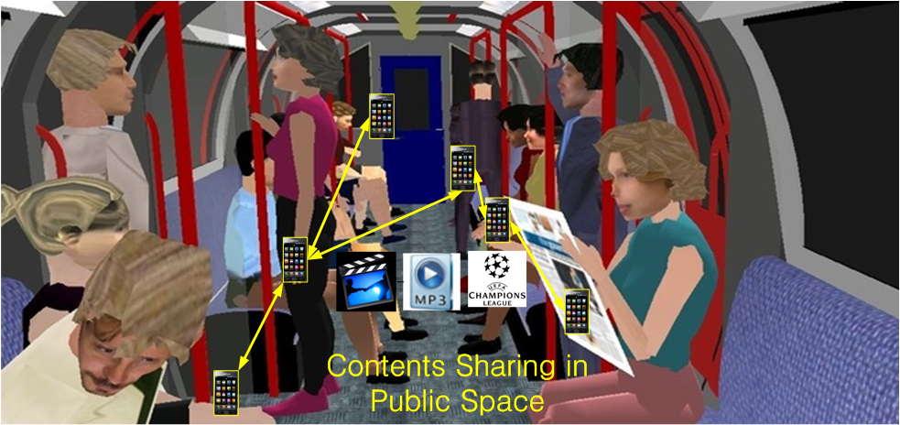
Mobile P2P Application

Slide 13
Technical Requirements
Distributed network structure
  Peer-to-peer communication
  Fast neighboring devices detection /association
  Group communication among multiple devices
High-data rate for multi-media content delivery
  Large size multi-media contents distribution
  Personal area multi-media streaming service
Flexible radio resource management
  Considering mutual interference of adjacent transmitters
  Traffic priority based resource allocation

Slide 14
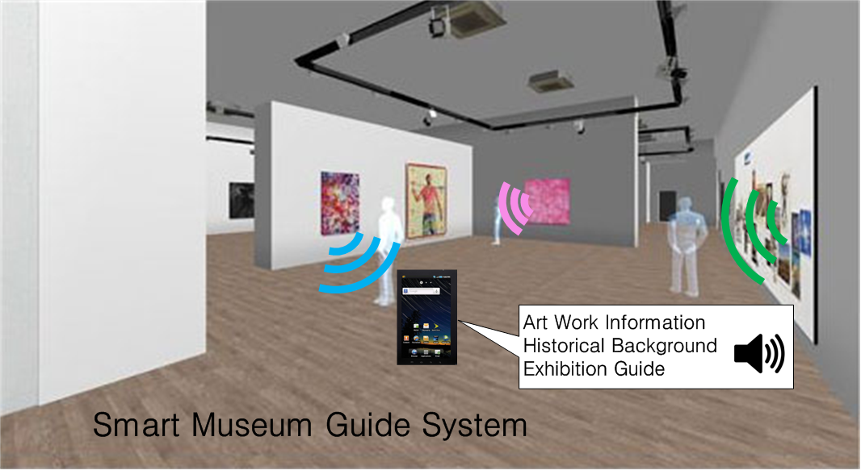
Museum Guide
Notes:
http://trendland.net/2011/01/03/phillips-de-pury-virtual-gallery-tour/#

Slide 15
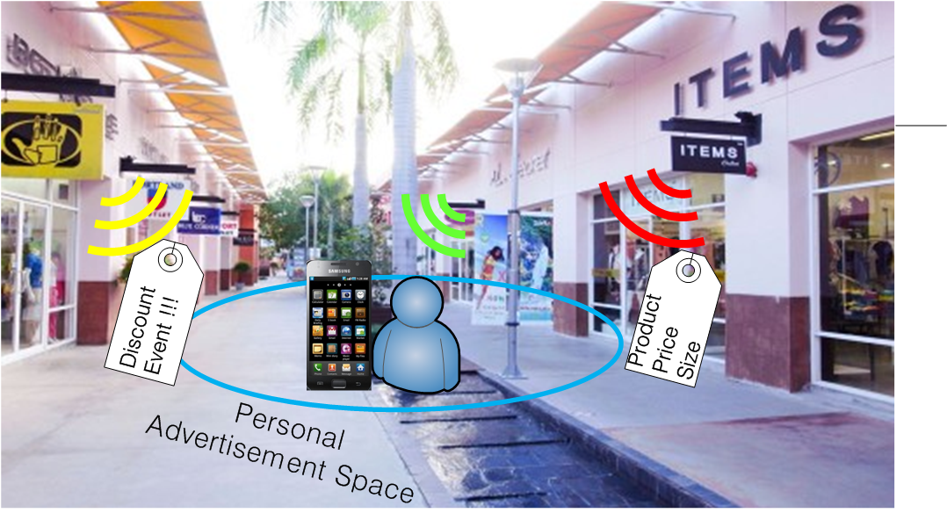
Local Advertisements

Slide 16
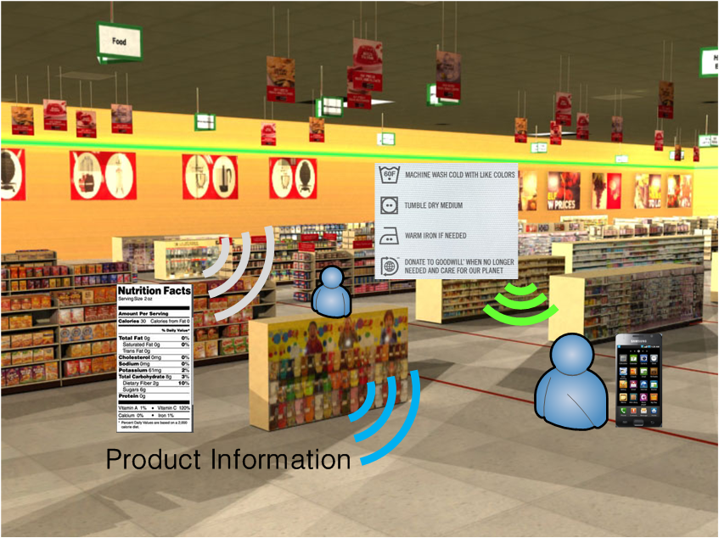
Local Product Information

Slide 17
Technical Requirements
Group communication
  Concurrent information transmission for audiences/shoppers
  Multi-lingual contents broadcast
Dynamic network configuration
  Fast association for nomadic visitors/shoppers
  Association delay < 20ms
High data rate
  HD video/audio contents/ads delivery
  Multi-media guiding service

