Slide 1
Project: IEEE P802.15 Working Group for Wireless Personal Area Networks (WPANs)
Submission Title:[Fragmentation Ideas for Discussion]
Date Submitted: [May 11, 2011]
Source:[Ben Rolfe]
Company [BCA]
Address []
Voice: [+4.408.395.7207], FAX: [None], E-Mail: [ben @ blindcreek.com]
Re:[]
Abstract:[Fragmentation Ideas for group discussion ]
Purpose:[Stimulate thought in the task group]
Notice: This document has been prepared to assist the IEEE P802.15. It is offered as a basis for discussion and is not binding on the contributing individual(s) or organization(s). The material in this document is subject to change in form and content after further study. The contributor(s) reserve(s) the right to add, amend or withdraw material contained herein.
Release: The contributor acknowledges and accepts that this contribution becomes the property of IEEE and may be made publicly available by P802.15.

Slide 2
Summary
Why Fragment
MSDU to multiple MSDU overhead examples
Ideas for optimization

Slide 3
Why Fragment?
Inspired by 15-11-0348
Burst packet: Fragmentation and reassembly with fragment level retry
Substantial improvement in real world reliability
Reduction in use of air time
Smaller chunk less vulnerable to interference and changing channel conditions
Retransmit smaller increments = less retry overhead
Reduce interference foot print (we breath between chunks in a burst)

Slide 4
Why Fragment? (Restatement of the Obvious)
When over the air data rate goes down, time on the air goes up
Longer transmission time -> more time for things to go wrong
Longer transmission time blocks other channel uses longer

Slide 5
Why Fragment? (Restatement of the Obvious)
Examples:
Example | PSDU, Octets | Time @ 1kbps
802.15.4 thru 2010 | 127 | 1016ms
Ethernet MTU | 1518 | 12144
802.15.4g | 2047 | 16376
802.11 | 4095 | 32760

Slide 6
MSDU -> multiple MPDUs MAC Frame Overhead
802.15.4 (pre 802.15.4e) (some examples):
Min: FCTL[2] + Seq#[1] + MinAddr[2] +FCS[2] = 7
Nominal: Min + Long Src [4] + Long Dest [4] = 15
Secure: Nominal + 14 = 29 octets
14 fragments * 14 overhead = 196 = 14%

Slide 7
MSDU -> multiple MPDUs MAC Frame Overhead
802.15.4e
Min: FCTL[2] + FCS[2] = 4
Nominal: Min + Short Address [2] = 6
13 fragments * 6 overhead = 78= 6%

Slide 8
What if…
Can compress MHR?
Addressing map to short address (2)
Control information suppression
State vs Stateless?
Explicit stateless: everything in every packet
Stateful: keep track of all things
Inferred state: known rules or characteristics that make state known

Slide 9
Conceptual Example
Leverage existing MAC features
Lots of implementations
Flexible
Adaptable to multiple PHYs already
Even Lower Data Rate (ELDR) PHY
OTA packet resolution < 20ms @ 1kbps (< 200 bits)

Slide 10
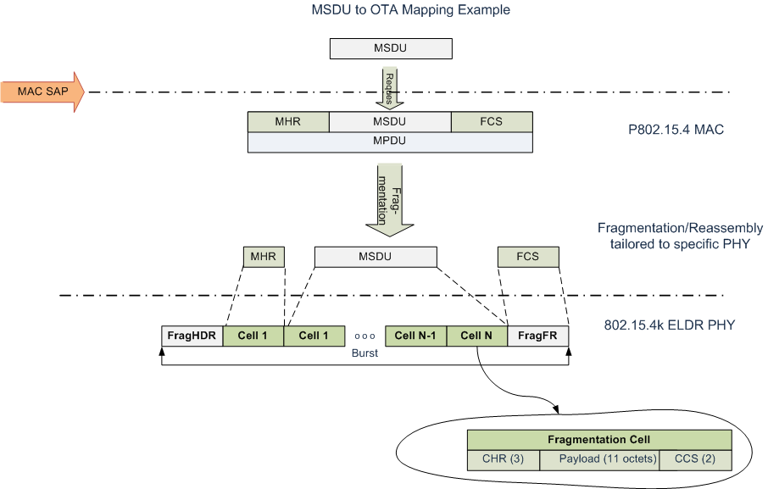

Slide 11
Closing
Fragmentation is a good thing for ELDR PHYs
Think about fragmentation in the MAC
Optimized for the ELDR PHY(s)
Compatible with existing MAC concepts

Slide 12
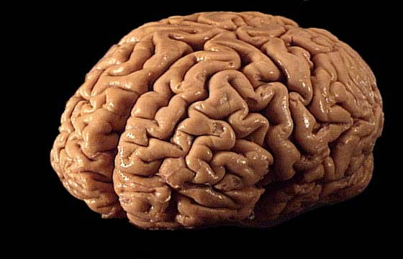
Thanks for your Attention!

