Slide 1
Project: IEEE P802.15 Working Group for Wireless Personal Area Networks (WPANs)
Submission Title: [802.15.4k Link Budget Considerations]
Date Submitted: [May 2011]
Source: [Roberto Aiello, Sourav Dey], Company [Independent, On-Ramp Wireless]
Address [Bend, OR, San Diego, CA]
Voice:[], FAX:], E-Mail:[aiello@ieee.org, sourav.dey@onrampwireless.com]
Abstract: [Considerations on link budget for 15.4k]
Purpose: [Technical contribution]
Notice: This document has been prepared to assist the IEEE P802.15. It is offered as a basis for discussion and is not binding on the contributing individual(s) or organization(s). The material in this document is subject to change in form and content after further study. The contributor(s) reserve(s) the right to add, amend or withdraw material contained herein.
Release: The contributor acknowledges and accepts that this contribution becomes the property of IEEE and may be made publicly available by P802.15.

Slide 2
802.15.4k Link Budget Considerations
5/9/2011

Slide 3
Outline
Need for Link Budget
Methods to get Link Budget
Consequences of Link Budget

Slide 4
Link Budget
Link budget measures the ability of a wireless system to overcome obstacles to close a link.
Balance sheet of gains and losses, accounting for the effect of all the processes throughout the link, including transmit power, noise sources, and signal attenuators.
It determines how much “money” we have to spend in closing the link by overcoming interference, shadowing, fading, and propagation losses.

Slide 5
Link Budget Overcomes
Interference
Due to other local transmitters (co-channel or adjacent channel)
Due to system self interference
Shadowing
Due to terrain, foliage, buildings, underground vaults, etc.
Fading
Due to dynamic multipath from changing RF environment
Propagation Losses
Due to distance

Slide 6
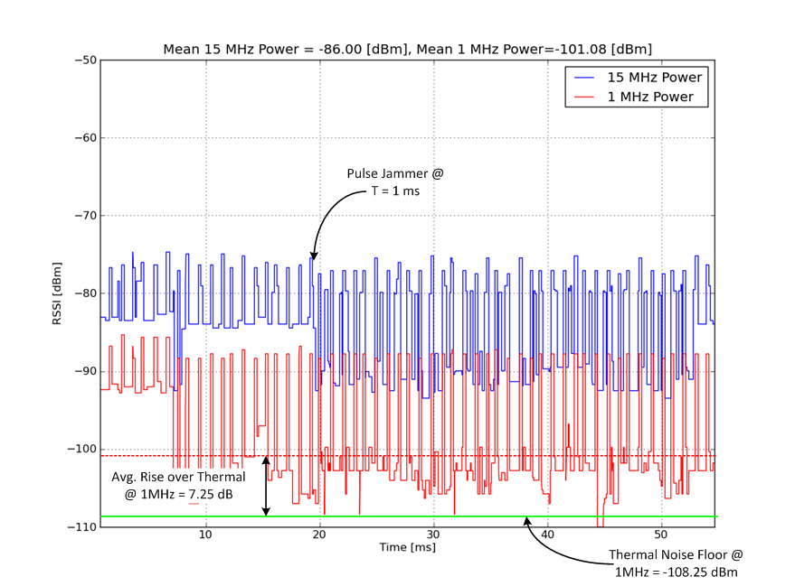
Interference
Interference at advantaged locations anywhere from 7-15 dB over Thermal Noise in 1MHZ@2.4GHz band
Reference: DCN 15-11-0074-01-004k by Dey

Slide 7
Shadowing
RF Modeling Software used to predict shadowing
Accounts for terrain blockage
Accounts for clutter loss as a function of land use type
Example RF Modeling Software Packages
EDX Signal
CelPlan
Typical Clutter Shadowing
Mountaintop Antenna:
Residential Clutter Loss = -14 dB, Commercial Clutter Loss = -16 dB
Utility Pole Antenna:
Residential Clutter Loss = -39 dB, Commercial Clutter Loss = -38 dB

Slide 8
Shadowing and Fading Variance
Even with good software, clutter shadowing is highly variable and hard to predict
Even though monitored devices are static the channel is dynamic and changing because of multipath fading
Reference: CelPlan Manual Section 9.1.2.4
In units of dBm assuming lognormal distribution of shadowing

Slide 9
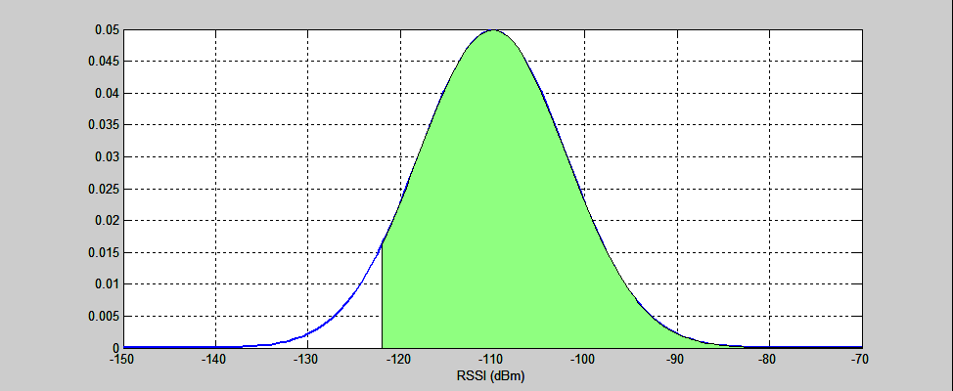
Probability of Coverage
Common model is lognormal distribution of RSSI around prediction, p, due to clutter and fading.
Assume reception threshold is T. Probability of coverage is event that RSSI is > T. It can be expressed as:
If want decent probability of coverage need margin ~2σ = 12-20 dB
T = -122 dBm
p = -110 dBm
σ = 8 dBm

Slide 10
Example: Mountaintop Coverage
Assumptions
7 dB rise over thermal interference
16 dB average shadowing loss
8 dB of std. deviation in prediction due to shadowing and fading
Lognormal shadowing and fading distribution
Legend
Green: >95% probability of coverage
Yellow: >75% probability of coverage
Red: > 50% probability of coverage
No Color: < 50% probability of coverage

Slide 11
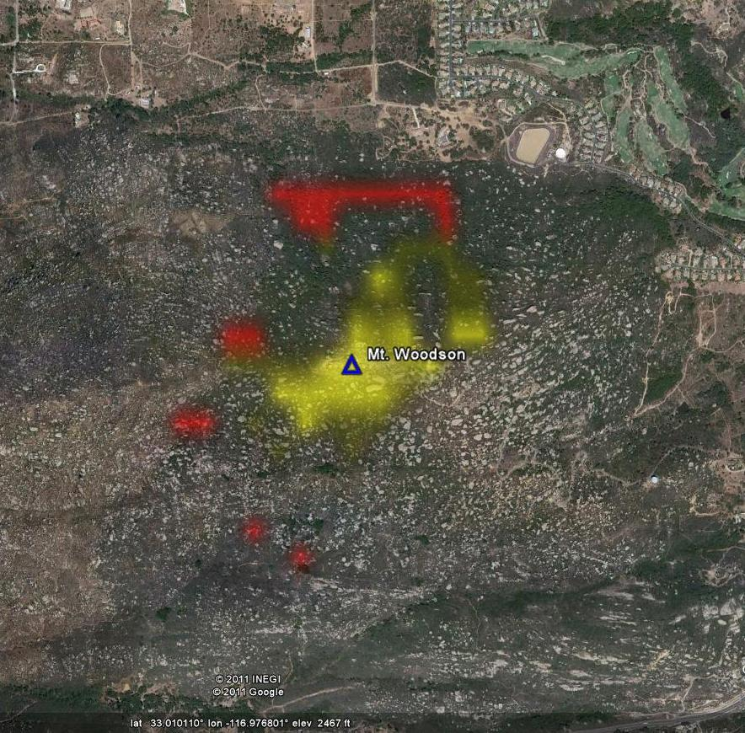
Mountaintop Coverage with 120 dB LB
~0.5 km
Coverage maps made with EDX Signal post-processed in Python

Slide 12
Mountaintop Coverage with 150 dB LB
~4 km
Coverage maps made with EDX Signal post-processed in Python

Slide 13
Mountaintop Coverage with 170 dB LB
~16 km
Coverage maps made with EDX Signal post-processed in Python

Slide 14
Outline
Need for Link Budget
Methods to get Link Budget
Consequences of Link Budget

Slide 15
Link Budget Drivers
Link Budget = Transmit Power + Antenna Gain – Receiver Sensitivity
EiRP Limits (2.4GHz band )
FCC limits the EiRP to 36 dBm (4W) for digital modulation
ETSI limits the EiRP to 10mW/MHz up to a maximum of 100mW
EiRP limits transmit power and antenna gain
Receiver sensitivity is the differentiator
Modulation Technique
Coding
Spread Spectrum
Receiver Noise Figure
Adjacent Channel Rejection

Slide 16
How to get better Receiver Sensitivity?
Narrow Bandwidth Modulation
Reduces the amount of thermal noise floor
Reduces wideband interference
Processing Gain
Spread Spectrum with high spreading factors
Much higher than SF32 (15 dB).
Greater than or equal to SF512 (27 dB)?

Slide 17
Outline
Need for Link Budget
Methods to get Link Budget
Consequences of Link Budget

Slide 18
Long On-Air Time
Both methods to increase link budget lead to extremely long packet on air times
Maximum size 802.15.4-2006 packet is 127 octets
Maximum size 802.15.4g packet is 2047 octets
Packet Size | Payload Transmit Time Uncoded BPSK SF512 @ 1Mcps | Payload Transmit Time Rate ½ Coded BPSK SF512 @ 1Mcps
127 Octets | 0.52 sec | 1.04 sec
2047 Octets | 8.38 sec | 16.77 sec
* Payload transmit time does not include overhead of preamble

Slide 19
Packet Error Rate
Channel is varying must faster than the packet
Coherence time of channel power can be quite short
Extremely long transmission times will lead to high PER and an unreliable PHY

Slide 20
Coexistence
Extremely long transmission time is bad for coexistence
Would be terrible for CSMA/CA with other radios in unlicensed bands

Slide 21
Potential Solution
Fragment large 802.15.4 MAC packets into smaller PHY packets
Smaller packets also help with power consumption, as only the missing fragments need to be replaced, not the whole packet
Need low robust data rates with a limited on air time!
Packet Size | Payload Transmit Time Uncoded BPSK SF512 @ 1Mcps | Payload Transmit Time Rate ½ Coded BPSK SF512 @ 1Mcps
127 Octets | 0.52 sec | 1.04 sec
2047 Octets | 8.38 sec | 16.77 sec
16 Octets | 0.0655 sec | 0.131 sec
* Payload transmit time does not include overhead of preamble

