Slide 1
Project: IEEE P802.15 Working Group for Wireless Personal Area Networks (WPANs)
Submission Title: [comment CID 12 and proposed resolution]
Date Submitted: [April 21 2011]
Source: [Taehan Bae, Jaeseung Son] Company [Samsung Electronics Co.,LTD]
Address [Dong Suwon P.O. Box 105, 416 Maetan-3dong, Yeongtong-gu, Suwon-si, Gyeonggi-do, 443-742 Korea]
Voice:[82-31-279-7293], FAX: [82-31-279-5130], E-Mail:[taehan.bae@samsung.com]
Re: []
Abstract: [Proposed resolution about comment CID 12 ]
Purpose: [Contribution to IEEE 802.15.7 TG-VLC]
Notice: This document has been prepared to assist the IEEE P802.15. It is offered as a basis for discussion and is not binding on the contributing individual(s) or organization(s). The material in this document is subject to change in form and content after further study. The contributor(s) reserve(s) the right to add, amend or withdraw material contained herein.
Release: The contributor acknowledges and accepts that this contribution becomes the property of IEEE and may be made publicly available by P802.15.

Slide 2
Comment CID 12
Comment 12
About the same philosophy of both Blinking notification and color-function support
Agree and Principle and Instruction to Editor in next page
Comment # | Name | Page | Subclause | Line | Comment | Proposed Change
12 | Lim, Sang-Kyu | 61 | 5.1.10.2 | 16 | There is no any description for Table 4 in 5.1.10.2. 2. "Bit: 5" is not clear whether it says 5th bit or the number of bit is 5. | Add the description for Table 4 to the text body. 3. Change "Bit :5" in Table 4 to "Bit : b0, b1, b2, b3, b4".

Slide 3
Instruction to Editor for CID 12
Delete the text, figure and table about “hopping” in the draft.
Pleaser refer following instruction
Delete following sentence at line 47 page viii
5.1.10.2Band hopping for interference avoidance...........................................................60
Delete following sentence at line 35 page 3
HPhopping pattern
Delete following sentence at line 23 page 23
and band hopping
Delete subclause 5.1.10.2 at line 50 page 60
5.1.10.2 Band hopping for interference avoidance
A single coordinator can service multiple cells.
If interference is being experienced from an adjacent light then hopping can be used to mitigate the interference. When spatial reuse due to direction optics is not present, and when the VLC communications system uses the same time slot between the adjacent light sources or cells with multiple band communication, and when multiple bands are supported by the PHY, band hopping can be used. In order to avoid interference and increase system capacity, pre-assigned hopping patterns should be adopted.
The hopping pattern should be assigned to the device and then the device should operate and hop based on the assigned hopping pattern.
If the VLC system does not use multiple bands (Src_multi_info is set to code '0000000'), then the hopping function is not supported. The hopping patterns shall be structured so as not to change the visual perception of the light. For example, the patterns could hop between RGB in the proper time averaged portion so as to appear white.

Slide 4
Instruction to Editor for CID 12
Pleaser refer following instruction
Delete following sentence at line 53 page 86
Delete following sentence at line 22 page 275

Slide 5
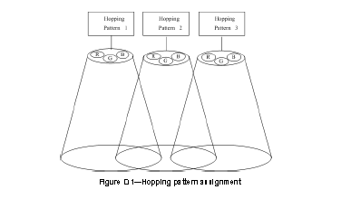
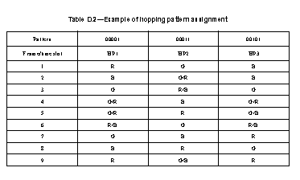
Instruction to Editor for CID 12
Pleaser refer following instruction
Delete figure Figure D.1—Hopping pattern assignment and Table D.2—Example of hopping pattern assignment at line 21 page 276

Slide 6
Comment CID 12
Comment 12
About the same philosophy of both Blinking notification and color-function support
Agree and Principle and Instruction to Editor in next page
Comment # | Name | Page | Subclause | Line | Comment | Proposed Change
12 | Lim, Sang-Kyu | 61 | 5.1.10.2 | 16 | There is no any description for Table 4 in 5.1.10.2. 2. "Bit: 5" is not clear whether it says 5th bit or the number of bit is 5. | Add the description for Table 4 to the text body. 3. Change "Bit :5" in Table 4 to "Bit : b0, b1, b2, b3, b4".

Slide 7
Instruction to Editor for CID 12
Add the following sentence at page 61, line 8 in subclause 5.1.10.2
Black: original text in D7 / Black: text deleted from D7 / Red: new text
The hopping pattern should be assigned to the device and then the device should operate and hop based on the assigned hopping pattern. The coordinator shall transmit the 'H_pattern' in MAC command frame payload which is defined in Table 4 to the device.
Change “5” into “b0, b1, b2, b3, b5” in table 4 like below.
Black: original text in D7 / Black: text deleted from D7 / Red: new text
MAC command frame payload | Bit | Usage/Description | Down/Up Link
H_pattern | 5 b0, b1, b2, b3, b5 | Band hopping information | D/L

