Slide 1
Project: IEEE P802.15 Working Group for Wireless Personal Area Networks (WPANs)
Submission Title: Overview of PSC Concepts and key technical issues
Date Submitted: March 2011
Source: Soo-Young Chang, CSUS, and Peter Murray, Self Employed
Address:
Contact Information: 530 574 2741 [sychang@ecs.csus.edu, petermurr@mac.com]
Re:
Abstract: This contribution is prepared for the tutorial in Mar. 2011 to introduce overview of PSC concepts and key technical issues for the PSC standard and PSC implementation.
Purpose:
Notice: This document has been prepared to assist the IEEE P802.15. It is offered as a basis for discussion and is not binding on the contributing individual(s) or organization(s). The material in this document is subject to change in form and content after further study. The contributor(s) reserve(s) the right to add, amend or withdraw material contained herein.
Release: The contributor acknowledges and accepts that this contribution becomes the property of IEEE and may be made publicly available by P802.15.
Slide 1

Slide 2
Introduction
Slide 2

Slide 3
INTRODUCTION
  This presentation is prepared to introduce
    Overview of PSC concepts and its uniqueness and
    Some key technical issues to show the necessity of and technical feasibility for the PSC standard.
  The following issues are addressed:
    Introduction of new spaces –public space and personal space
    Definition of PSC
    Brief list of use cases identified so far and introduction of new use cases
    Technical requirements identified from these use cases
    Review of some key technical issues for the standard and
    Comparison with similar technologies.
Slide 3

Slide 4
Definition of Personal Space Communications (PSC)
Slide 4

Slide 5
PERSONALIZATION OF A SPACE (1)
Personalization *
  “Personalization involves using technologies to accommodate the differences among individuals” and among groups formed based on corresponding individuals.
Personalization implies:
  The changes based on implicit data of each individual or each group,
  Elimination of repetitive tasks, recognition of personal information including habits and routine works/things to reflect this personal information to set surrounding environment with minimal human intervention,
  Provision of more specific information that is increasingly relevant to an individual’s interests; replacement of “average” information with information specific to that person’s environment, and
  Accommodation of unique personal preferences.
* “personalization” on wikipeida.org
Slide 5

Slide 6
PERSONALIZATION OF A SPACE (2)
Space Identity (or Place Identity)
  A “sub-structure of the self-identity of a person consisting of broadly conceived cognitions about the physical world in which the individual lives” *
    These cognitions define the daily experiences of every human being.
  Through one’s attitudes, feelings, ideas, memories, personal values and preferences toward the range and type of physical settings, he/she can then understand the environment they live in and their overall experience.
  A cognitive "database“: implicit information of the individual
Implicit personalization and explicit personalization
  Implicit personalization: the personalization is performed by the information stored based on the individual’s or the group’s preferences, past activities, etc.
  Explicit personalization: the environment (or information stored) is changed by the individual using the features provided by the system: customization.
* Proshansky, H.M. (1987). "The field of environmental psychology: securing its future." 'Handbook of environmental psychology. D. Stokols and I. Altman. New York, John Wiley & Sons.
Slide 6

Slide 7
PERSONAL SPACE AND PUBLIC SPACE (1)
Personal space
  Logical (virtual) space which contains devices associated to an individual
  Exchanging implicit data without human intervention and/or explicit control between a human being and a device or among devices in this space of an individual
  Profile/group based, behavior based, and collaboration based
Public space containing personal space(s)
  Physical space where an individual can reach such as each room of a building
  Exchanging explicit control among devices in the public space, only for support of communications in the public space or with other public spaces
Personalization of a space
  To make devices in a public space react differently corresponding to each individual based on implicit data stored or explicit control inputted by the individual
  To feel the space within reach of any limb of an individual.
Slide 7

Slide 8
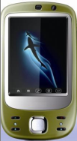


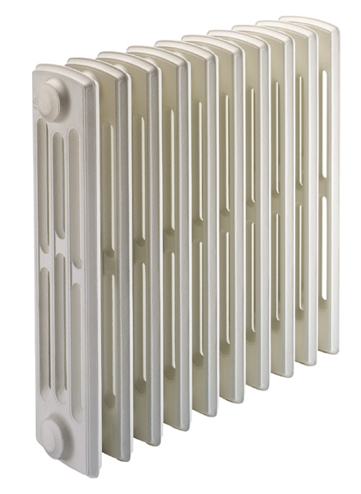

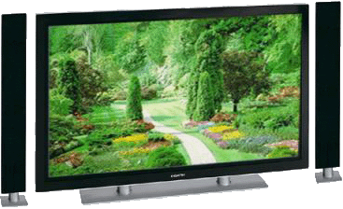
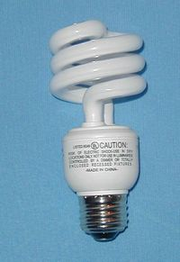


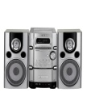
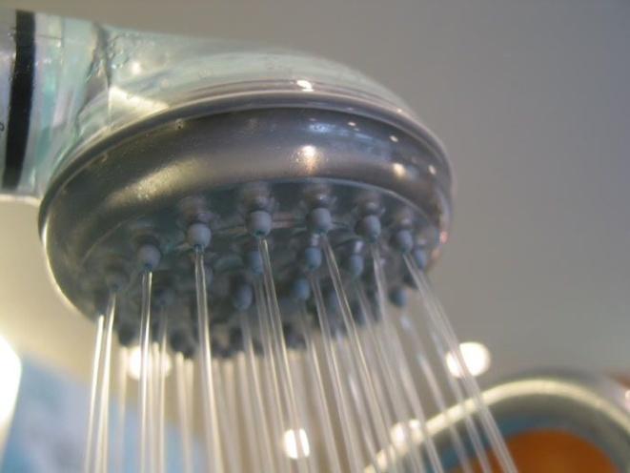
PERSONAL SPACE AND PUBLIC SPACE (2)
A device is registered as a member of one personal space or more in a public space. It knows which personal space(s) and public space(s) it belongs to.
Definition
Public space: space separated and isolated physically where one individual or more share machines/devices. A device in this space may be controlled by more than one individual.
Personal space: logical (virtual) space associated with one individual in a public space (or throughout multiple public spaces for a few special cases). All machines/devices in this space can be controlled by implicit information and explicit control relevant to this individual. This space is controlled by a PSC terminal of the individual.
Personal space A
Public space
Personal space B
°C
°C
Personal space C
PSC terminal
Slide 8

Slide 9

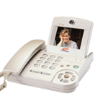
PERSONAL SPACE AND PUBLIC SPACE (3)
°C
°C
°C
Public space
After more individuals entered into this public space
Public space with one personal space
Public space with more than one personal space (In this figure, three personal spaces)
Slide 9

Slide 10
PERSONAL SPACE AND PUBLIC SPACE (4)
Grouping devices in a personal space:
  There can be multiple device groups commonly controlled by the PSC terminal of a personal space.
  The PSC terminal may assign different communication resource to each group adaptively and dynamically according to its technical requirements: each group may need different data rate and information delivery structure.
  → The PSC terminal communicates with all user groups simultaneously.
Public space
°C
Device group 3
°C
°C
Device group 1
Device group 2
Personal space A
Slide 10

Slide 11
REQUIREMENTS FOR PERSONAL SPACES
PSC terminal of a personal space
  A personal space is initiated by one PSC terminal which belongs to an individual, but this terminal can invite other PSC terminals which are associated to other individuals as members of this space. For this case, each of these PSC terminals behaves as a member of this space, not as a PSC terminal, while this terminal has its own personal space with different communication channels (for example, different frequency hopping sequences).
Requirements of communications for personal spaces
  Group based communications in a personal space
    Group based communications in a public space: multiple personal spaces possible overlapping each other in a public space
    Group based communications throughout multiple public spaces: devices in a personal space are possibly spread throughout more than one public space .
  Number of communications in a public space will increase dramatically as the number of personal spaces and machines involved increases.
  Need to guarantee various qualities of service (QoS) simultaneously
    Various types of contents delivered among devices simultaneously: need to accommodate a broad range of dynamically scalable data rates and fast and easy association with low latency.
Slide 11

Slide 12
TYPES OF PERSONAL SPACES (1) *
Autonomous personal space: basic and typical space
  Personal space where devices exchange information data to each other to collaborate without use of information from outside of the public space
  Communications performed only within a public space
Personal space with remote devices
  Personal space which includes device(s) located in other remote public space(s) in a different region.
  Information for collaboration needs to be exchanged with outside of its public space.
  Communications with device(s) in the outside of its public space are needed through outside communication networks.
Personal space with mobile PSC terminals (or with mobility to multiple public spaces)
  Personal space which overlaps throughout multiple public spaces to follow an individual who moves to other adjacent public spaces
  Hand-over is needed between two adjacent public spaces.
  Communications between adjacent public spaces are needed for hand-over and exchange of information including implicit information regarding the individual
  This type of personal space is also utilized for range extension (or coverage expansion) using relays between two adjacent public spaces.
* Prepared based on Ref. [10]
Slide 12

Slide 13
TYPES OF PERSONAL SPACES (2)
Region: A region is defined as an area where a PSC device can communicate with another PSC device only using PSC networks without using outside networks.
Personal space A
Public space
Personal space B
°C
°C
Personal space C
Region 1
Autonomous Personal Spaces
PSC terminal
Slide 13

Slide 14

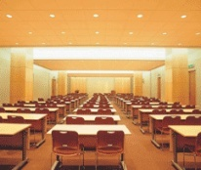
TYPES OF PERSONAL SPACES (3)
°C
°C
Region 1
Region 2
Public space 1
Public space 2
Outside network
Personal Space with Remote Devices
PSC terminal
Slide 14

Slide 15
TYPES OF PERSONAL SPACES (4)
Personal Space with Mobile PSC Terminal
Region 1
°C
°C
°C
Public space 1
Public space 2
Public space 3
Hand-over
Hand-over
PSC terminal
Slide 15

Slide 16
SOME FACTS FOR PERSONAL SPACES [10]
Radius of public space which contains a personal space or more
  Sphere with 50 feet of radius
Number of communicators (devices or machines) involving collaboration for a personal space
  Gradually increasing from 3~4 to 60~80, or even more
Communication types
  peer-to-peer, 1-n, n-1
  n-m group-cast (group-chat)
  Transmit only, receive only, two way
Traffic characteristics
  Delay tolerant data, real-time control, low latency audio/video stream
More than one individual can exist in a public space.
  In a public space, there may be more than one personal space overlapping each other. A device may be associated with only one personal space while another may belong to more than one personal space.
Slide 16

Slide 17
DEFINITION OF PSC (1)
  Necessity of emergence of PSC: New paradigm shift: Provider oriented → User oriented
  Power shift
18th century
Manufacturer
20th century
Distributer
21th century
Final user
    Users made selection among products from mass production provided by manufacturers.
Manufacturers need to diversify their products to satisfy a broad range of user requirements and preferences.
New paradigm for manufacturers to provide various small volume products fitted exactly to each individual
  Change of meanings of users
    Consumer: consumes products provided by manufacturers
Customer: recognized by distributers, not by manufacturers
User: customize his/her own products which fit best to the user
  Service providers provide short range connectivity to make their service be selected by users by approaching closer to the users
  → Users select services among services provided in their vicinity.
Slide 17

Slide 18
DEFINITION OF PSC (2)
  Necessity of emergence of PSC: (continued)
  New paradigm shift: Provider oriented → User oriented
  Personal space moves as the user moves.
    In a user centered space, the user selects a service among services available from the providers: user oriented selection/customization.
    Service providers should do their best to come closer to the users with the interface that fits the user space.
    Service providers provide services broadcasting in a space so that the user select their services.
  Service providers provide short range connectivity to approach closer to the users.
    Short range connectivity becomes more important.
    In a space, broadcasting is more important to be selected by users.
    This short range connectivity can be integrated with 5G to provide connectivity to the core networks.
Slide 18

Slide 19
DEFINITION OF PSC (3)
  Ubiquity
    Mobility friendly to increase user convenience
    Base instrument common for ubiquitous services
    Ubiquitous connection to identify appropriate devices, control environment, and communicate among devices
    With more centralized intelligence
    Automatically with pre-stored (implicit) information and/or explicit control from human being
    Self-configuring network of fixed or mobile devices connected by wireless links
  Using various communication methods
    In indoor/home environment: short range dedicated PSC wireless network
    To/from remote sources (or devices): through existing outside networks including WPAN, WLAN, MAN, cellular networks, and landline networks
Slide 19

Slide 20

DEFINITION OF PSC (4)
  User-oriented mobile space
    User-oriented, not provider-oriented [2]
  Providers should translate their services to user interface specifications within user mobile personal space.
Mobile
Broad-
casting
IPTV
Femto
WSD
WiMAX
Various types of outside networks can be connected to a personal space to communicate with outside world.
Internet
LTE
IPTV
User
Personal
Home
Appliance
User Personal
Space
WSD
Mobile
VoIP
Mobile
VoIP
RFID
USN
WLAN
Space
Wired
DMB
Mobile
Phone
Slide 20

Slide 21
DEFINITION OF PSC (5)
Machine-to-machine (MTM): definition from ITU-R
  Machine-to-machine communication is a type of service which exchanges data without human interaction, such as remote sensor, remote bio-monitoring and personal environment service. This type of communication is an important part of PSC applications and services.
Personal environment service (PES)
  The integrated service platform of open architecture for the customized and intelligent living environment services with the convergence of mobile phone, equipments, and service server [1]
  The electric, electronic, and mechanical machines surrounding users can be automatically configured according to the pre-defined and/or self-growing user preference. [5]
  “The living environment follows when a person moves.” [5]
Relationship between PES and PSC defined
  PES: higher, more conceptual and broader level of service platform for the customized and intelligent living environment services
  PSC: PHY and MAC layer communication technology to realize PES. This PSC may transfer a small size of data traffic in a large number of sessions or a large amount of real time video streaming among multiple devices/machines.
Slide 21

Slide 22
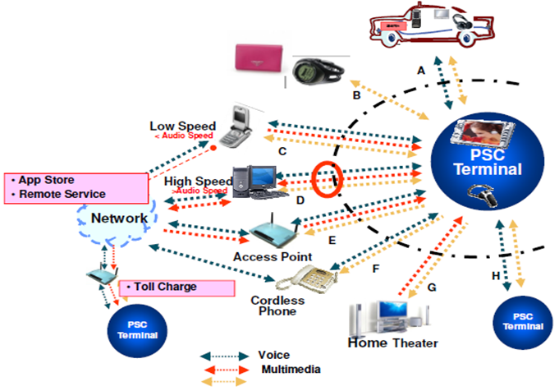
TYPES OF PSC APPLICATIONS [2]
  Communication
  Broadcasting
    Broadcasting among devices
  Education
  Entertainment
    Multi peer group game
Various content formats in a user’s personal space
[9]
Data
Personal space
Slide 22

Slide 23
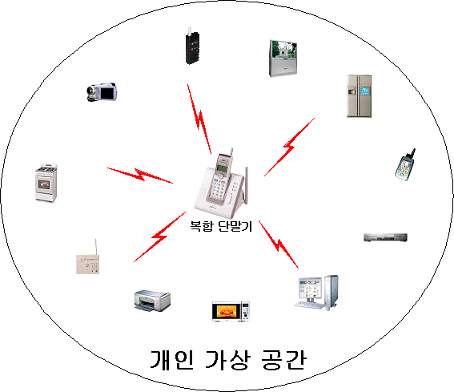
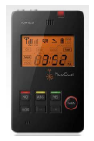

PSC OPERATION SCENARIO (1) [9]
PSC personal space
Cell Phone
WiMAX
Cable
PBX
HSDPA
LTE
etc.
PSC personal space
PSC personal space
PSC personal space
Slide 23

Slide 24
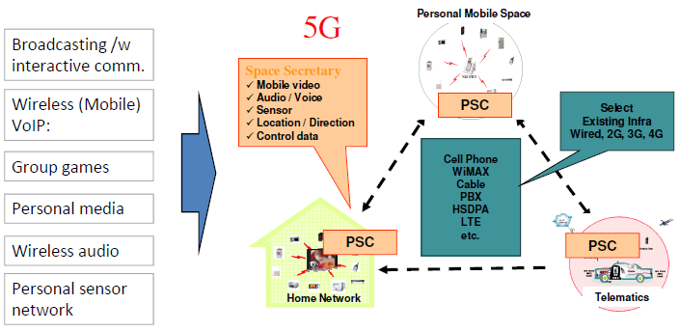
PSC OPERATION SCENARIO (2) [9]
In the future, the user will be the center of the services and the Personal Space Communications will be the common interface to the environments the user moves into.
PSC personal space
PSC personal space
PSC personal space
Slide 24

Slide 25
USE CASES, HOME/INDOOR ENVIRONMENT (1)
  Sensors: favorite group selection
    Automatic doors [1]
    Automatic air conditioning [1]
    Home appliances control including TV, music, and other home appliances
  Automatic telephone forwarding [1]
  Customized computer setting [1, 2]
    Auto configuration of computer
  Local advertisement/information system [2]
Automatic recognition: attendance check, entrance control, automatic PC lock/unlock [1]
Private assistant: pulling conference material from user’s computer to the meeting place, personal gateway [1]
Location identification: indoor location identification, automatic destination guide from the display at the entrance or corridor, elevator control, LBS [1]
Amusement park [9]
Slide 25

Slide 26
USE CASES, HOME/INDOOR ENVIRONMENT (2)
  Mobile VOIP or wireless VOIP [2]: refer to following slides
  Two way graphic remote control [2]: refer to following slides
  Two way Conferencing and one way seminar[2]: refer to following slides
Multi Lingual Interpretation System: refer to following slides
  Microphone [2]: secured
  Stereo ear set [2]
  TV/game headset [2]
  Smarter Phone which support Group game
  Mobile video [2]
  x.1 channel audio [2]
  Medical applications
    Hospital environment and Doctor’s office
  Customer management: restaurant, store, theater, and etc. [1]
  Public place broadcasting [2]
Slide 26

Slide 27
USE CASES, HOME/INDOOR ENVIRONMENT (3)
  Data transfer to picture frame
  Food selection and cooking method are configured automatically and properly
  Broadcasting with interactive communications [9]
  Personal media [9]
  M2M (Sensor network) [9]
Group games [9]:
  Latency: < 16ms, Wired Voice quality, Channel capacity: Concurrent active channels
Wireless audio [9]: Cordless microphones, headset, wireless speakers, distributed speakers
  Latency: < 16ms, Data rate: < 2M bps, Channel capacity: Concurrent active channels
Slide 27

Slide 28
USE CASES, VEHICULAR ENVIRONMENT
Automatic air conditioning: temperature, ventilation for each passenger [1]
Automatic driving mode control: seat position, handle position, mirror angle, pedal sensitivity, maximum speed alarm [1]
Favorite music or broadcasting station selection [1]
In-vehicle navigator configuration: menu configuration, favorite geography information, geography information update and Telematics services through the mobile phone and WLAN [1]
  Hands free set [2]
Slide 28

Slide 29
USE CASES, OUTDOOR APPLICATIONS
  Obtaining information from outside screens/monitors/roadside units
  Stadium game broadcast
Travel and location information service [1]
  When user stands in front of the electric display guide, it shows the information about destination, geography, transportation, and shopping in user’s language.
Automatic street lamp control [1]
Electronic payment [1]
  Mobile communication provider could participate in E-Commerce business, and provide personalized marketing considering time and location information of users, using mobile communications network.
Slide 29

Slide 30
USE CASES, PUBLIC SECTOR
Energy & CO₂ saving
  Light off in the place where no one exists, and optimal control for air conditioner, heater, TV, PC, etc. [1]
Safety service
  Acquisition of information about people passing by a check point, like caretaker, bus stop, lobby, etc., using PSC manager equipped at the post, for checking pedestrians to protect from criminals, and provisioning of alarm information to them [1]
Traffic information gathering
  Gathering traffic information from the mobile PSC devices of drivers and passengers and PSC modules equipped at roadside [1]
Slide 30

Slide 31
COMMUNICATIONS FOR PERSONAL SPACES (1)
    PSC manager of a public space
      Device or function of a device whose main roles are
        to provide sync signals to devices in a public space
        to maintain sync with all other public spaces in the same region
        to communicate with other PSC managers of adjacent public spaces for hand-over and exchange of data/information and for data relay among public spaces
      Only one device among devices including PSC terminals in a public space can be a PSC manager.
Types of communications for a personal space
  Communications among devices (or machines) in a public space
  Communications between PSC managers of adjacent public spaces for hand-over and exchange of implicit information regarding the individual and for data relay between public spaces in a region
  Communications between a device in a public space and a device (or machine) in a remote outside world
Slide 31

Slide 32
COMMUNICATIONS FOR PERSONAL SPACES (2)
1. Communication within a public space: intra public space communications
  1-1, 1-n, and n-m group-cast possible
  Max. 100 feet range
  10kbps ~ 55Mbps throughput
  Less than 20 ms latency
2. Inter-public space communication: inter public space communications through PSC managers
  Interconnection between two physically adjacent public spaces
  10kbps ~ 55Mbps throughput
  Less than 20 ms latency
  Needs hand-over between two adjacent public spaces for mobile individuals and range extension
  Managed on MAC layer
3. Remote area access communication: inter public space communications through outside network.
  Access to database or exchange of information data through a core (outside) network
  Wide area wired or wireless network: cable network, telephone network, WLAN, cellular network, etc.
Slide 32

Slide 33
COMMUNICATIONS FOR PERSONAL SPACES (3)
Public space 2
  PSC needs three types of connections.
    Communication inside a public space
    Communication between two adjacent public spaces
    Connection to outside world
PSC device
Phone
Home appliances
TV
Public space 1
Game
Environment control
PSC device
Phone
computer
WLAN
audio
Home appliances
TV
Cable network
Game
Environment control
2. Communication between two adjacent PSC public spaces
MAN
computer
audio
WAN
3. Communication through wide area networks for
connection to
outside world
Mobile network
1. Communication
inside a PSC public space
Slide 33

Slide 34
COMMUNICATIONS FOR PERSONAL SPACE (4)
1. Communications among devices in a public space
Sync broadcast to all devices in a public space
Public space 1
Personal space A
Comm. between a device in a personal space and PSC manager
Personal space B
PSC manager
Personal space C
Comm. among devices in a personal space
Slide 34

Slide 35
COMMUNICATIONS FOR PERSONAL SPACE (5)
2. Communications between two PSC managers in a region
Personal space A’
Personal space A
Public space 2
Public space 1
Sync broadcast to PSC managers
PSC manager
Personal space B
Comm. Between PSC managers
PSC manager
Personal space B’
Personal space C’
Personal space C
Region 1
Slide 35

Slide 36
COMMUNICATIONS FOR PERSONAL SPACE (6)
3. Communications between a device in a public space and an outside device (1)
Only devices in a public space which have capability to communicate with outside remote devices can have this type of communications, e.g. WLAN AP and computer with WiFi.
Personal space A
Public space 1
PSC manager
Personal space B
Comm. between a device in a public space and an outside device through a core network
Personal space C
(extended)
Remote devices are also members of the personal space, but do not maintain sync with other devices in the personal space of another region. A remote device only sets up a link through a designated channel to a device in another region.
Remote device
Personal space C
Region 2
Region 1
Slide 36

Slide 37
COMMUNICATIONS FOR PERSONAL SPACE (7)
3. Communications between a device in a public space and an outside device (2)
Outside networks
Comm. channels
PSC personal space
PSTN
WLAN
Phone
PSC manager
Other PSC terminal
Wired LAN
Agriculture control
LAN
Wired PSTN
Home appliances
Environment control
High speed optical
TV
Mobile networks
Game
Mobile phone
User
PSC
terminal
xDSL
Public broadcast
computer
Audio/video
WPAN
Internal radio
WLAN router /other modem
Mobile channel
Internet
Broadcast, public
Medical control
Slide 37

Slide 38
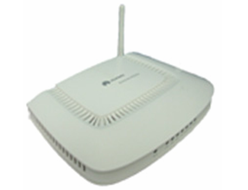
COMMUNICATIONS FOR PERSONAL SPACE (8)
3. Communications between a device in a public space and an outside device (3)
Two-way remote control/monitoring of a device (or machine) at a remote location
1. A device in a remote personal space
Cell Phone
WiMAX
Cable
PBX
HSDPA
LTE
etc.
Remote PSC personal space
(extended)
PSC personal space
2. A device in a remote non PSC space
Remote association is needed for remote devices to be members of this personal space. → remote association: association to a remote personal space
Remote Non-PSC space
Slide38

Slide 39
FREQUENCIES AND DURATIONS OF USE CASES [1]
Function | Freq. (Duration) | Function | Freq. (Duration)
Configure indoor equipment | 3/1hr (3sec) | PC security for departing | 1/3hrs (2sec)
Configure vehicle equipment | 1/24hrs (3sec) | Customer management | 1/12hrs (5sec)
Configure road equipment | 1/12hrs (2sec) | Customized marketing | 1/12hrs (5sec)
Electric frame data Tx | 3*1MB/day (33sec) | Menu guidance | 1/2days (3sec)
Location finding in office/home | 1/4hrs (2sec) | Pedestrian check | 1/2hrs (2sec)
Elevator floor selection | 1/6hrs (2sec) | TV, audio play | 1/2days (1hr)
Travel information | 1/12hrs (5sec) | TV game play | 1/2days (30mins)
Public transportation getting on/off notification | 1/day (2sec) | Messaging | 1/3hrs (2sec)
Facility guidance | 1/6hrs (3sec) | Business card exchanging | 1/2days (2sec)
Data retrieving | 1*1MB/6hrs (11sec) | Paging CUG/friends | 1/12hrs (2sec)
Traffic information gathering | 1/hr (2sec) | Caring child/pet | 1/day (2sec)
Toll collection | 1/2days (3sec) | Gateway service | 2*2/day (20mins)
Electric payment | 1/8hrs (3sec) | Equipment manage | 1*10/week (10sec)
Entrance control | 1/3hrs (2sec) | Health care | 1/2hrs (3sec)
Slide 39

Slide 40
REQUIRED FEATURES FOR SUGGESTED USE CASES (1)
  One PHY and MAC solution for integrated service platform of open architecture for the customized and intelligent living environment services [1]
    Easily adaptive to each environment/situation
Intelligent and flexible configuration adaptive to each environment/situation
Low power consumption for mobile/portable devices [2]
Dynamically scalable link rates: from 100K to 55M
Multiple topologies supported: 1-1, 1-n, n-m, star, two-way broadcasting,
Synchronized relay for communication between two public spaces in the same region
High level security between nodes
Medium range: 0.3 m to 30 m with range-extension capability
Low latency for audio and video synch
Slide 40

Slide 41
REQUIRED FEATURES FOR SUGGESTED USE CASES (2)
Fast synch: ready for easy and fast association
  Easy, simple and fast association of devices to PSC terminal by requesting association
  Well-tailored preamble for fast synch
Accommodation of numerous receive-only devices: No ARQ [2]
  more than 16 concurrent transmissions within a personal space and unlimited receive only receivers
High QoS for real time streaming data
  Various diversity techniques considered for high QoS including macrodiversity
Seamless authentication for mobile association
  Authentication requires that a (mobile) device establish its identity before sending frames.
Location / Direction finding [1]
    accuracy : max. ~ 50cm, rec. ~10cm
Roaming/Soft Hand-over
  Seamless roaming between two adjacent public spaces, not nomadic roaming, for mobile audio/video streaming: "make before break,“ and soft handover.
Slide 41

Slide 42
REQUIRED FEATURES FOR SUGGESTED USE CASES (3)
Avoidance of mutual interference: co-channel and adjacent channel interference
  Dynamic and Adaptive Resource Allocation (DARA)
  Interference mitigation/avoidance structure/mechanism for simultaneous multiple transmissions from multiple transmitters at the same time in a confined area
  Avoid or mitigate interference from adjacent transmitters in same or different channels
Frame structure independent of content types
  Delivery of various types of contents in the same frame structure: data, audio, and mobile video simultaneously
Broadcasting with interactive communication and cell expansion
  Synchronous system among personal spaces and public spaces
→ Single (PHY+MAC) for various types of services with various types of contents exchanged.
Slide 42

Slide 43
PSC System Definition
Slide 43

Slide 44
DEFINITION OF PSC TERMINAL
  PSC featured devices (or PSC machines) can be categorized as following:
  PSC terminal: associated to one individual (or user). An individual (or user) has a PSC terminal.
  Two types of PSC terminals
    PSC/cell phone device
      PSC functions integrated into and embedded in a cell phone
    Stand alone PSC terminal
  Other PSC devices (or machines): having built-in PSC functions in them.
Contents delivered/exchanged
  Mobile video
  Audio/voice
  Sensor data
  Location/direction information
  Control data
Slide 44

Slide 45
TYPES OF PSC DEVICES (1)
  Categories according to forms of installation
    On body device or stand-alone device
    Device attached to an electronic machine
    Device built in a machine such as a computer, a LAN access point, etc.
    Device built in a cell phone
  Categories according to functions
    PSC terminal: can be a two-way master device
    Two-way PSC device: two-way PSC featured device
    Listen only PSC device
  Types of communications performed
    Point-to-point two-way communication: 1:1
    Point-to-multi-point two-way communication: 1:n
    Multi-point-to-multi-point two-way communication: n:m
    Broadcast transmit only / receive only
Slide 45

Slide 46
TYPES OF PSC DEVICES (2)
  Categories according to data rates and amount of information delivered
    Low rate one way (including broadcast) only < 500 Kbps
    Medium rate one way (including broadcast) only ~ 4 Mbps
    High rate one way (including broadcast) only ~ 55 Mbps
    Two way balanced low rate < 500 Kbps
    Two way balanced medium rate ~ 4 Mbps
    Two way balanced high rate ~ 55 Mbps
    Two way unbalanced low rate < 500 Kbps
    Two way unbalanced medium rate ~ 4 Mbps
    Two way unbalanced high rate ~ 55 Mbps
Slide 46

Slide 47
LEVEL OF DEVICES (1)
  Levels of devices for broad range of use cases and required features
    Level 1 device: integrated into a machine
      simplest device with low data rate and least features. Low power consumption
      Simple control data exchanges
      500 Kcps fixed clock rate
    Level 2 device: integrated into a machine
      most complicated device with high data rate and full functions. Low power consumption
      Audio/video stream/control data
      Up to 55 Mbps scalable data rate
      PSC manager function included
    User stand-alone device (PSC terminal):
      most complicated device with high data rate and full functions. Low power consumption
      Audio/video stream/control data
      Large graphic display/speaker/microphone
      Up to 55 Mbps scalable data rate
      PSC manager function included
      PSC featured cell phones belong to this level.
  Common features to all levels
    Listen only mode, transmit only mode, tx/rx mode
Slide 47

Slide 48
LEVEL OF DEVICES (2)
    PSC manager
      Device or function in a device whose main roles are
        to provide sync signals to devices in a public space,
        to maintain sync with other public spaces in the same region,
        to communicate with PSC managers of adjacent public spaces for synchronous relay, and
        to provide radio resource allocation information to each personal space with cooperation of other public spaces so as to allocate radio resources to each personal space to minimize the interference with other personal spaces and public spaces.
      Only one device among Level 2 devices and PSC terminals in a public space can be a PSC manager.
Common sync in Public space
Personal space A
PSC manager
°C
°C
Personal space B
Personal space C
Slide 48

Slide 49
KEY REQUIREMENTS FOR PSC
  Dynamically Scalable link rates/data rates
    Data rates are scaled dynamically depending on types of applications.
    Spectral and temporal radio resource is flexibly and dynamically assigned to each device to meet its needs.
  Fast synch for easy and simple association and high throughput <500 us
    Dynamic association
  Low latency <16 ms
    Periodically every less than 16 ms, a segment of information can be transmitted.
  Avoidance of mutual interference from adjacent transmitters
    Adjacent transmitters interfere with other devices with co-channel and spurious signals from these transmitters. A mitigation method should be applied. Frequency hopping is one strong scheme to mitigate this interference.
  Synchronized relay between public spaces
    To form an ad hoc mesh network for the case that a user device moves to another public space and for range extension.
  Localization/locating/positioning
    An important feature for some of PSC applications – LBS system and services
Slide 49

Slide 50
PERSONAL SPACE AND PUBLIC SPACE
Definition
Public space: space separated and isolated physically where one individual or more share various machines. A machine in this space may be controlled by more than one individual. In a public space, there may be more than one personal space overlapping each other.
Personal space: logical (virtual) space associated with one individual. All machines in this space can be controlled by implicit information and explicit control relevant to this individual. This space is controlled by a PSC terminal of the individual.
Some machines are associated with only one personal space while some of other machines are associated with more than one personal space.
A machine is registered as a member of one personal space or more in a public space. It knows which personal space(s) and public space it belongs to.
Personal space A
Public space
°C
°C
Personal space B
Personal space C
PSC terminal
Slide 50

Slide 51
GROUPING DEVICES IN A PERSONAL SPACE
Groups of devices in a personal space:
  There can be multiple device groups commonly controlled by the personal terminal of a personal space.
  The PSC terminal assigns different communication resource to each group flexibly and dynamically according to its required needs: each group may have different data rate and information delivery structure. For example, a unique FH sequence can be assigned to each group.
  → The PSC terminal communicates with all user groups simultaneously.
Public space
°C
Device group 3
°C
°C
Device group 1
Device group 2
Personal space A
Slide 51

Slide 52
DYNAMINC AND ADAPTIVE RESOURCE ALLOCATION (DARA) (1)
Two situations that need different amounts of information to be delivered with different data rates/link rates
In a personal space, some devices need more resources than other devices due to more information to be delivered and/or their required higher data rates.
Among personal spaces in a public space, a personal space needs more resource than other personal spaces due to its operational characteristics (or needs).
→ The amount of channel resource for a device or a personal space needs to be adjusted dynamically and adaptively to its needs.
These concepts are very important for PSC to use spectral resources more dynamically, more adaptively and more efficiently to various types of contents and communications. → These concepts should be developed more in detail. Need to develop how these requirements and concepts can be implemented.
Types of resources:
Frequency (or spectrum) → spectrum size assigned
Time → time (or frame size or payload size in a frame) assigned
Processing power → modulation complexity to deliver more information for each symbol
Slide 52

Slide 53
DYNAMINC AND ADAPTIVE RESOURCE ALLOCATION (DARA) (2)
For two situations
Channel resource needs to be assigned to a device dynamically and adaptively to its needs.
In a personal space, some devices need more resources than other devices due to more information to be delivered and their required higher data rates.
→ dynamic resource assignment (DRA) dynamically and adaptively to its operation
Among personal spaces in a public space, a personal space needs more resource than other personal spaces due to its overall operational characteristics/needs.
→ adaptive resource assignment (ARA) adaptively to its operation
Three types of resource manipulation methods
In the frequency domain:
(1) spectrum management: more spectrum assigned to higher information exchange demand and/or higher data rates
In the time domain:
(2) time management: more time assigned to higher information exchange demand for fixed data rates
(3) adaptive modulation scheme: more constellation points assigned for higher data rates
Slide 53

Slide 54
DYNAMINC AND ADAPTIVE RESOURCE ALLOCATION (DARA) (3)
Dynamic resource assignment (DRA):
  Communication channels/resources assigned dynamically and adaptively to a device due to its needs for its data rate, amount of information delivered, type of contents delivered, etc. in a personal space
Adaptive resource assignment (ARA):
  Communication channels/resources assigned adaptively assigned to a personal space due to its needs for type of applications, total amount of information delivered, type of contents delivered, etc. in a public space
Adaptive and dynamic resource allocation (DARA):
  Communication channels/resources assigned dynamically and adaptively to a personal space in a public space and to a device in a personal space due to their needs for data rates, amounts of information delivered, types of contents delivered, types of applications, etc. in a public space
  Each personal space needs different capability/capacity in a public space. At the same time, each device in a personal space requires different capability/capacity due to its missions or roles.
Slide54

Slide 55
DYNAMINC AND ADAPTIVE RESOURCE ALLOCATION (DARA) (4)
Two types of resources to be manipulated in the frequency domain:
(1) more spectrum to a personal space of higher information exchange demand and/or higher data rate
(2) more spectrum to a device of higher information exchange demand and/or higher data rate
For Personal space 1
For Personal space 2
For Personal space 3
For Personal space 4
For Personal space 5
f
Whole frequency band available: 5 frequency bins for 5 personal spaces
For Device 1
For Device 2
For Device 3
For Device 4
For Device 16
f
Frequency band for one personal space: 16 frequency bins for 16 devices in a personal space
Slide 55

Slide 56
DYNAMINC AND ADAPTIVE RESOURCE ALLOCATION (DARA) (5)
Two types of resources to be manipulated in the time domain:
(1) more time to higher information exchange demand for a fixed data rate
(2) adaptive modulation scheme: more constellation points for higher data rates applied to each symbol
This concept may be applied in a frame structure.
FCH
sync
Payload segment 0
sync
Payload segment 1
sync
Payload segment 15
Device 0
Device 0
All short data devices
FCH
sync
Payload segment 0
sync
Payload segment 1
sync
Payload segment 15
Device 0
256 QAM
Device 1
QPSK
Device 15
BPSK
Slide 56

Slide 57
CHANNEL RESOURCE MANAGEMENT/ALLOCATION (1)
Assumptions for resource distribution/management (an example)
  Distribution among personal spaces
  There are up to five personal spaces which share the whole radio resource: in the frequency domain only. → frequency bandwidth allocation to personal spaces
    If less than five, zero is assigned for not-existing or inactive spaces.
  The whole radio resource is divided into five dynamically-variable-amount resource sets: each of sets is assigned to a personal space.
  Distribution in a personal space to accommodate multiple simultaneous transmissions
  In a personal space, up to 16 simultaneous transmissions are allowed by sharing a resource set: 16 variable amounts of transmitted information : in both the frequency and time domains. → frequency bandwidth allocation and time slot allocation to transmitters.
  By combining some of these transmission shares, one device can transmit more information than others. One device can use all of 16 transmission shares while achieving “the total data rate”.
  Grouping in a personal space by assigning a part of resource to a group
  These transmission shares can be grouped to form some groups among devices for group communications. Each group may have a different data rate: each group does not necessarily have the same data rate.
Slide 57

Slide 58
CHANNEL RESOURCE MANAGEMENT/ALLOCATION (2)
Five basic techniques for spreading and multiple access considered
  FDM/FDMA
  TDM/TDMA
  Frequency hopping (FH)
  Direct sequence spreading (DS)
  OFDM/OFDMA
By combining two of the above techniques, the available communication resource can be used in a more efficient manner.
    one for resource management among personal spaces and
    the other for resource management among devices in a personal space for multiple simultaneous transmissions and grouping.
Slide 58

Slide 59
CHANNEL RESOURCE MANAGEMENT/ALLOCATION (3)
Spreading
FH
  Spreading gain can be achieved as symbol frequency hops for every symbol.
  → BW of a frequency bin << BW of the whole band → spreading gain = no. of frequency bins
DS
  Spreading gain can be achieved as a symbol is represented by multiple binary chips.
  → BW required for a symbol << BW of the whole band → spreading gain = no. of chips
OFDM
  Multiple symbols are assigned to equal number of subcarriers for spreading.
  Interleaving can be applied if multiple subcarriers are assigned to one user (or device) to mitigate near-far problem.
  The OFDM modulation is a strong candidate because of its ability to combat the frequency selective fading and inter-symbol interference (ISI) due to multipath propagation, without the need of complex equalization.
Slide 59

Slide 60
CHANNEL RESOURCE MANAGEMENT/ALLOCATION (4)
Multiple access
among personal spaces in a public space and
among devices in a personal space
FH
  Using a different hopping pattern for each space or device
DS
  Using a different PN sequence for each space or device
OFDMA
  Using a different set of subcarriers for each space or device
Frequency diversity
For all above cases, frequency diversity in the whole band can be applied.
  Multiple frequency carriers or subcarriers can be used at the same time for a symbol.
Time division in a frame with multiple payloads
A frame structure has multiple payloads (or slots) each of which can be assigned to different device: a kind of Time Division Multiplex (TDM). Each of these payloads can be assigned to different devices.
Slide 60

Slide 61
CHANNEL RESOURCE MANAGEMENT/ALLOCATION (5)
 | No. of subbands in whole band | 5 personal spaces in a public space (with or without ARA*) | 16 simultaneous transmissions in a personal space (with or without DRA**)
FH in FDM | 80 with 1 MHz each | FDM: 5 sets of 16 hopping sequence segments | FH: 16 different hopping sequences in a set
FH in FH | 80 with 1 MHz each | FH: 5 sets of 16 hopping sequence segments | FH: 16 different hopping sequences in a set
FH in OFDMA | 80 subcarriers with 1 MHz each | OFDMA: 5 sets of 16 hopping sequence subcarriers | FH: 16 different hopping sequences in a set
DS in FDM | 5 with 16 MHz each | FDM: 5 subbands | DS: 16 PN codes in a subband
DS in FH | 5 with 16 MHz each | FH: 5 sets of hopping sequences with 5 subbands | DS: 16 PN codes in a subband
DS in OFDMA | 80 subcarriers with 1 MHz each | OFDMA: 5 sets of 16 hopping sequence subcarriers | DS: 16 PN codes applied to a set
Slide 61

Slide 62
CHANNEL RESOURCE MANAGEMENT/ALLOCATION (6)
 | No of subbands in whole band | 5 personal spaces in a public space (with or without ARA*) | 16 simultaneous transmissions in a personal space (with or without DRA**)
OFDMA in FDM | 5 with 16 MHz each | FDM: 5 subbands | OFDMA or OFDMA/FH
OFDMA in FH | 5 with 16 MHz each | FH: 5 sets of hopping sequence subcarriers | OFDMA with or OFDMA/FH
No DARA case with 5 sets and 16 hopping sequences. DARA can be applied which needs some modifications in the table.
* ARA: adaptive resource assignment
** DRA: dynamic resource assignment
*** DARA: dynamic and adaptive resource allocation
Slide 62

Slide 63
ONE EXAMPLE, FREQUENCY HOPPING IN A PERSONAL SPACE
80 subchannels are grouped into 5 sets each of which has 16 subchannels.
FH in FH: Frequency hopping in a personal space
A set of 16 frequency subchannels
A set of 5 hopping sets among personal spaces
User i in Personal space 1
Set 4 Freq. ch 3
Set 2 Freq. ch 1
Set 1 Freq. ch 15
Set 3 Freq. ch 2
Set 5 Freq. ch 14
Set 4 Freq. ch 13
User j in Personal space 2
Set 2 Freq. ch 14
Set 5 Freq. ch 2
Set 4 Freq. ch 1
Set 1 Freq. ch 13
Set 3 Freq. ch 5
Set 2 Freq. ch 4
User k in Personal space 3
Set 1 Freq. ch 1
Set 3 Freq. ch 15
Set 2 Freq. ch 2
Set 5 Freq. ch 4
Set 4 Freq. ch 3
Set 1 Freq. ch 11
User l in Personal space 4
Set 5 Freq. ch 4
Set 4 Freq. ch 7
Set 3 Freq. ch 12
Set 2 Freq. ch 5
Set 1 Freq. ch 3
Set 5 Freq. ch 9
User m in Personal space 5
Set 3 Freq. ch 12
Set 1 Freq. ch 4
Set 5 Freq. ch 6
Set 4 Freq. ch 10
Set 2 Freq. ch 8
Set 5 Freq. ch 7
Slide 63

Slide 64
ONE EXAMPLE, DIRECT SEQUENCE (DS) SPREADING IN A PERSONAL SPACE
DS in FH: Hybrid DS in FH spreading
The whole band is divided into 5 subbands.
A set of 16 PN codewords
A set of 5 hopping subbands among personal space
User i in Personal space 1
Subband 4 PN code 3
Subband 2 PN code 1
Subband 1 PN code 15
Subband 3 PN code 2
Subband 5 PN code 14
Subband 4 PN code 13
User j in Personal space 2
Subband 2 PN code 14
Subband 5 PN code 2
Subband 4 PN code 1
Subband 1 PN code 13
Subband 3 PN code 5
Subband 2 PN code 4
User k in Personal space 3
Subband 1 PN code 1
Subband 3 PN code 15
Subband 2 PN code 2
Subband 5 PN code 4
Subband 4 PN code 7
Subband 1 PN code 11
User l in Personal space 4
Subband 5 PN code 4
Subband 4 PN code 7
Subband 3 PN code 12
Subband 2 PN code 5
Subband 1 PN code 3
Subband 5 PN code 9
User m in Personal space 5
Subband 3 PN code 12
Subband 1 PN code 4
Subband 5 PN code 6
Subband 4 PN code 10
Subband 2 PN code 8
Subband 5 PN code 7
Slide 64

Slide 65
ONE EXAMPLE, OFDMA IN A PERSONAL SPACE
OFDMA in FH: Hybrid OFDM in FH spreading
Hybrid OFDM in FH spreading
  FH: (mitigation of near-far effect + spreading) + OFDM: for severe channel conditions
The whole frequency band is divided into 5 subbands. Each subband is assigned to a personal space. → ACA can be applied.
For each subband, OFDMA is applied for multiple links. A part of OFDM subcarriers are assigned to a link in the personal space. → DCA can be applied.
Each color for a different personal space
One FH sequence
OFDM symbol time
Subband 1
OFDM 5
OFDM 1
OFDM 2
OFDM 3
OFDM 4
OFDM 5
OFDM 1
Subband 2
OFDM 5
OFDM 1
OFDM 2
OFDM 3
OFDM 4
OFDM 5
OFDM 1
Subband 3
OFDM 5
OFDM 1
OFDM 2
OFDM 3
OFDM 4
OFDM 5
OFDM 1
Subband 4
OFDM 5
OFDM 1
OFDM 2
OFDM 3
OFDM 4
OFDM 5
OFDM 1
Subband 5
OFDM 5
OFDM 1
OFDM 2
OFDM 3
OFDM 4
OFDM 5
OFDM 1
Slide 65

Slide 66
COMPARISON OF FREQUENCY SPREADING/MULTIPLE ACCESS METHODS
Multiple access for grouping (multiple access for personal spaces : FDM) | FDMA | TDMA | FH | DSSS |  | DS in FH | OFDM in FH | FH in OFDM FFT=16 | FH in OFDM FFT=32
Multiple access in a group | TDMA | TDMA | TDMA | DS | TD | DS | OFDMA | FH | FH
Symbol length (us) ← ISI resistance | 1/3 | 1/16 | 1 | 1 |  | 1 | 18 | 1.125 | 2.25
Chip length (us) |  |  |  | 1/16 |  | 1/16
Total BW of a personal space (MHz) | 16 | 16 | 16 | 16 |  | 16 | 16 | 16 | 16
BW per user group (MHz) | 3 | 16 | 1 | 16 | 16 | 1 | 1 | 1 | 0.5
Max. No. device groups | 5 | 5 | 16 | 8 | 64 | 16 | 16 | 16 | 16
No. concurrent transmitters per group | 16 | 16 | 1 | 8 | 1 | 64 | 1 | 16 | 16
Total symbol rate per group (Msps) | 3 | 3.2 | 1 | 16 |  | 1 | 0.89 | 14.2 | 7.1
chip rate (Mcps) |  |  |  | 256 |  | 16
freq synthesizer change period (us) ← resistance to RF spill | No change | No change | 1, flex | No change |  | 1,flex | 18 | No change | No change
Hoping rate (Mhops/sec) |  |  | 1 |  |  | 1 | 0.89 | 14.2 | 7.1
Slide 66

Slide 67
RANGE EXTENSION AND SOFT HANDOVER (1)
Dynamic single frequency network (DSFN) (1)
Conditions of DSFN
  One way with DSFN: downlink only: simulcast
    Uplink can be implemented through communications with the PSC manager.
  Need a central system controller for scheduling
    PSC manager can be a system controller.
DSFN concept can be applied for range extension and hand-over
  Multi language interpretation system
  Personal media
  Wireless (mobile) VoIP
Slide 67

Slide 68
RANGE EXTENSION AND SOFT HANDOVER (2)
Dynamic single frequency network (DSFN) (2)
Dynamic Single Frequency Networks (DSFN) is a transmitter macrodiversity technique for OFDM based networks. Digital wireless communication systems based on the OFDM modulation scheme are well-suited to DSFN operation, since OFDM in combination with some forward error correction scheme can eliminate intersymbol interference and fading caused by multipath propagation without the use of complex equalization.
However, other modulation scheme can be considered if the above problems can be overcome.
→ DSFN can be considered as a combination of packet scheduling, macro-diversity and dynamic resource allocation (DRA).
→ DSFN concept can be applied for range extension and hand-over.
Slide 68

Slide 69
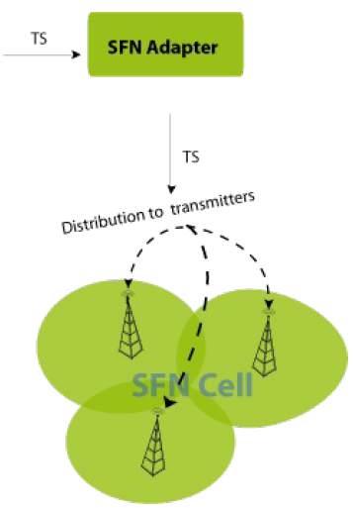
RANGE EXTENSION AND SOFT HANDOVER (3)
Dynamic single frequency network (DSFN) (3)
Transmission parameters:
Guard interval, bandwidth, FFT mode etc.
Synchronization information:
Temporal sync: Time stamp and time budget (max. network delay, etc.)
Frequency Sync: using a fixed frequency clock signal
→ DSFN concept can be applied for range extension and hand-over.
A simple SFN network:
Providing synchronization and all transmission information to transmitters
Slide 69

Slide 70
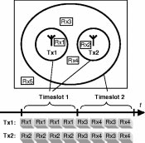
RANGE EXTENSION AND SOFT HANDOVER (4)
Dynamic single frequency network (DSFN) (4) [14]
DSFN enables soft handover, meaning that when a receiver terminal moves from one base station transmitter toward another, both transmitters send to the receiver awhile instead of abruptly switching from the first to the second transmitter. Soft handover is robust toward sudden shadow fading of one of the transmitters.
→ DSFN can be applied for coverage extension and relay using soft handover.
A simple example of dynamic single frequency networks. Top: Coverage map. Below: Data packet schedule, stating the packet destinations.
Slide 70

Slide 71
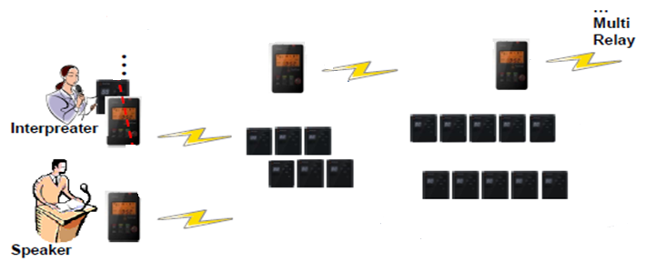
RANGE EXTENSION AND SOFT HANDOVER (5)
Use Case 1: Multi Lingual Interpretation System [4] with Range Extension
Need relay among public spaces: some listeners move to other public spaces.
Two-way communication should be better if consider Q&A sessions.
PSC manager
PSC manager
PSC manager: range extender: Synchronous system with robust sync
How to communicate between two PSC managers? → using a set of or a part of frequency band as a channel
Listeners
Listeners
Public space 1
Area 1: 0-30 m
Public space 2
Area 2: 30-60 m
Slide 71

Slide 72
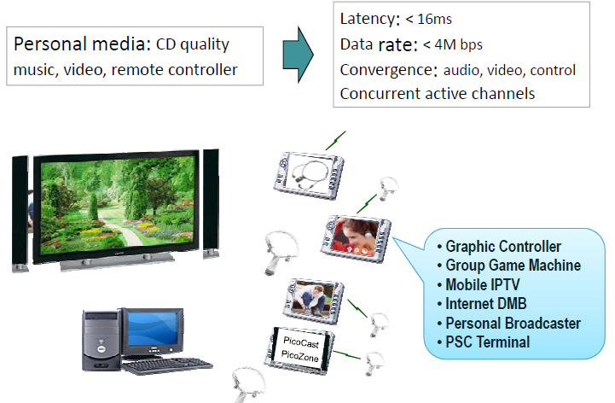

RANGE EXTENSION AND SOFT HANDOVER (6)
Use Case 2: Personal Media [9]
Need relay among public spaces: for ex., one mobile device can access a media source in another room.
Slide 72

Slide 73

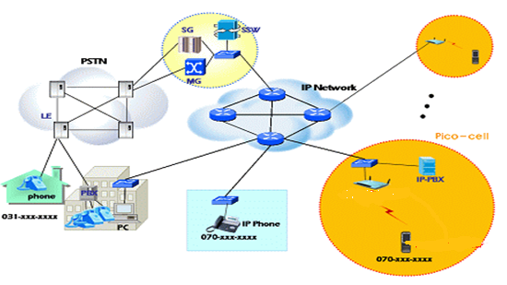
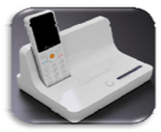
RANGE EXTENSION AND SOFT HANDOVER (7)
Use Case 3: Wireless (Mobile) VoIP [9]
Channel capacity
: concurrent active channels
Soft handover
Privacy
Repeater – cell extender
Wireless Mobile VoIP:
Mobile VoIP, Wireless PBX
Need relay among public spaces: for ex., a mobile VOIP device accesses the access point in another room via the PSC manager.
PSC VoIP terminal
Slide 73

Slide 74
RANGE EXTENSION AND SOFT HANDOVER (8)
PSC manager transmissions for range extension and soft handover
CASE 1: one example
The PSC manager can transmit a packet using public space control group and receive another packet using another group simultaneously in a payload segment.
All frequency subcarriers are divided into 5 groups: Group 1, Group 2, …, Group 5.
  Each group has 16 subcarriers.
  Group 1 is assigned as the public space control channel: this group provides a channel for communication among PSC managers.
  Other groups are used for in-space communications.
A device in a public space sends a packet twice in two consecutive payload segments using another group assigned for in-space communication only for the case of necessity of relay.
Problems to be solved
PSC manager: range extender: Synchronous system with robust sync
Need to clarify how to communicate between two PSC managers? → through Group 1
In a frame structure of 15 segments, how can this scheme be continued to the next frame? → continue in the next frame.
How can a device transmit and receive at the same time? Still problem with different groups for TX and RX. → only FDD can be applied. OFDM can be applied by assigning different groups.
Slide 74

Slide 75
RANGE EXTENSION AND SOFT HANDOVER (9)
Down: through PSC managers for range extension and soft handover (1)
Device i in Public space 1: for transfer to PSC manager 1
RX: Groups a TX: Groups a
FCH
sync
Packet 1
sync
Packet 1
sync
Packet 2
sync
Packet 2
sync
Public space 1 PSC manager: for transfer to PSC manager 2
RX: Groups a TX: Group 1
FCH
sync
Packet 1
sync
Packet 1
Packet 1
sync
Packet 2
Packet 1
sync
Packet 2
Packet 2
sync
Public space 2 PSC manager
RX: Groups 1 TX: Group 1
FCH
sync
sync
Packet 1
sync
Packet 1
Packet 1
sync
Packet 2
Packet 1
sync
macrodiversity
This might be the problem because of TX and RX with the same group. One possible way is to use directional antennas: can be solved using DSFN concept, even the case of OFDM.
Payload segment 0
Payload segment 1
Payload segment 2
Payload segment 3
Payload segment 15
Slide 75

Slide 76
RANGE EXTENSION AND SOFT HANDOVER (10)
Down: through PSC managers for range extension and soft handover (2)
In Public space 1,
  Device i sends Packet 1 in Payload segments 0 and 1 using Group a.
  PSC manager 1 sends Packet 1 in Payload segments 1 and 2 using Group 1.
  Devices in Public space 1 receive Packet 1 twice in Payload segments 0 and 1 using Group a and twice in Payload segments 1 and 2 using Group 1.
Public space 1 PSC manager
RX: Groups a TX: Group 1
FCH
sync
Packet 1
sync
Packet 1
Packet 1
sync
Packet 2
Packet 1
sync
Packet 2
Packet 2
sync
Payload segment 0
Payload segment 1
Payload segment 2
Payload segment 3
Payload segment 15
Slide 76

Slide 77
RANGE EXTENSION AND SOFT HANDOVER (11)
Down: through PSC managers for range extension and soft handover (3)
In Public space 2,
  PSC manager 2 sends Packet 1 in Payload segments 2 and 3 using Group 1.
  Devices in Public space 2 receive Packet 1 twice in Payload segments 2 and 3 using Group 1. If needed, PSC manager 2 sends packets using another group.
Every other payload segment a device can have soft handover by receiving a packet from two adjacent PSC managers, for ex., a device receives Packet 1 in Payload segment 2 from both PSC managers 1 and 2: instantaneous handover.
Delay due to this relay/handover is two payload segment periods: 1/2 throughput.
Public space 2 PSC manager
RX: Groups 1 TX: Group 1
FCH
sync
sync
Packet 1
sync
Packet 1
Packet 1
sync
Packet 2
Packet 1
sync
Payload segment 0
Payload segment 1
Payload segment 2
Payload segment 3
Payload segment 15
Slide 77

Slide 78
RANGE EXTENSION AND SOFT HANDOVER (12)
Up: through PSC managers for range extension and soft handover
Device j in Public space 2: for transfer to PSC manager 2
RX: Groups b TX: Groups b
FCH
sync
Packet 1
sync
Packet 1
sync
Packet 2
sync
Packet 2
sync
Public space 2 PSC manager: for transfer to PSC manager 1
RX: Groups b TX: Group 1
FCH
sync
Packet 1
sync
Packet 1
Packet 1
sync
Packet 2
Packet 1
sync
Packet 2
Packet 2
sync
Public space 1 PSC manager
RX: Groups 1 TX: Group 1
FCH
sync
sync
Packet 1
sync
Packet 1
Packet 1
sync
Packet 2
Packet 1
sync
macrodiversity
This might be the problem because of TX and RX with the same group. One possible way is to use directional antennas : can be solved using DSFN concept, even the case of OFDM.
Payload segment 0
Payload segment 1
Payload segment 2
Payload segment 3
Payload segment 15
Slide 78

Slide 79
EXAMPLE NUMBERS FOR KEY ISSUES FOR FRAME STRUCTURE DESIGN
  Fast synch <500 us
    A PSC manager device provides sync periodically.
    Every 1ms, 4 octet preamble is sent: 32 us for 500 Kbps with QPSK: sync information every 1 ms
  Low latency <16 ms
    16 ms frame
    In this frame, all contents are included.
    At least, a content is repeated every 16 ms.
  Avoidance of mutual interference
    How many transmissions impacted by mutual interference can be minimized by segmenting information and assigning channels randomly to these segments.
30 m diameter = max. 0.1 us propagation time difference, max
between two devices for in space communication
and
100 m distance = max. 0.33 us propagation time difference, max
between two PSC managers for inter space communications
Slide 79

Slide 80
EXAMPLE NUMBERS FOR KEY ISSUES FOR FREQUENCY PLAN DESIGN
  Dynamically scalable link rates/data rates
    20K, 200K, 1M, 4M, 16M, and 55M
    Data rate = symbol rate x no. subcarrier x log₂(no. signal levels) for OFDM case
    55M <= 1M x 16 x 4
  ISI (inter symbol interference)
    Depends on frequency spacing:
    1MHz spacing = 1us symbol duration
    Longer ISI is more immune to multipath fading
  Avoidance of mutual interference
    FHSS is applied inside of a group among subcarriers.
    Some subcarriers are eliminated to avoid interference from other transmitters.
OFDM/OFDMA
30 m diameter = max. 0.1 us propagation time difference, max
=
Cyclic prefix for guard interval for OFDM = 0.1 us
Slide 80

Slide 81
PAYLOAD ASSIGNMENT FOR TEMPORAL RESOURCE MANAGEMENT (1)
  16 payload segments
    Each user occupies one or more payload segments.
    Short data users utilize the last segment all together.
    Each personal space (or each user) has its own FH sequence or subchannels which applies to payload segments for a FH case.
16 ms fixed, frame
1 ms fixed
FCH
sync
Payload segment 0
sync
Payload segment 1
sync
Payload segment 15
User 0
User 1
Short data users
968 us, DBPSK,
484 bits=60 bytes
Slide 81

Slide 82
PAYLOAD ASSIGNMENT FOR TEMPORAL RESOURCE MANAGEMENT (2)
  For lowest rate information sources
  For highest rate information sources
16 ms fixed, frame
1 ms fixed
FCH
sync
Payload segment 0
sync
Payload segment 1
sync
Payload segment 15
source 0
source 1
Short data sources
968 us, DBPSK,
484 bits=60 bytes
FCH
sync
Payload segment 0
sync
Payload segment 1
sync
Payload segment 15
source 0
source 0
source 0
Slide 82

Slide 83
SYNCHRONIZED RELAYS AMONG PUBLIC SPACES (1)
  Two types of synchronized relays among public spaces
    Chased relay network: chased personal space for a self-configuring network for a moving device connected by wireless links
    A personal space follows an individual who moves to another public space.
    Communication between adjacent public spaces needed
    Relay for space expansion (or coverage expansion or range extension)
      Ad-hoc network formed between public spaces
      Hand-over needed for moving from one public space to another
: Common sync
: Data exchange between PSC managers
S
S
S
S
S
M
S
M
S
M
S
M
S
S
S
S
S
M: PSC manager
S: non-manager device
Slide 83

Slide 84
SYNCHRONIZED RELAYS AMONG PUBLIC SPACES (2)
  Chased relay network (personal space with mobile PSC terminals)
  An individual (or user) moves to another public space while it communicates with a machine in the old public space.
  This individual expands his/her personal space in the new public space.
  Some of machines in the old public space need to communicate with the moving device: communications between two public spaces needed.
  Registration process is needed for a public space and the personal space.
  Soft hand-over between two adjacent public spaces
Old public space
New public space
: Common sync
: Data exchange between PSC managers
S
S
S
S
S
M
S
M
S
M
S
M
S
S
S
S
S
M: PSC manager
S: non-manager device
Slide 84

Slide 85
SYNCHRONIZED RELAYS AMONG PUBLIC SPACES (3)
  Relay for space expansion (or range extension)
    Ad-hoc network formed throughout multiple public spaces.
    Hand-over is necessary when a device moves from one personal space to another.
    Communication among public spaces in a region to form an ad-hoc network throughout multiple public spaces
Personal space (Ad hoc network)
: Common sync
: Data exchange between PSC managers
S
S
S
S
S
M
S
M
S
M
S
M
S
S
S
S
S
M: PSC manager
S: non-manager device
M: PSC manager
S: non-manager device
Slide 85

Slide 86
SYNCHRONIZED RELAYS AMONG PUBLIC SPACES (4)
  Synchronized relay between two adjacent public spaces:
    This type of sync relay can be done through PSC managers of two adjacent public spaces.
    A device in a public space asks the PSC manager to establish a comm. link using the same communication channel: this PSC manager will become a member of the same personal space.
    This PSC manager has a link with PSC manager of the next adjacent public space using a fixed set of frequencies and/or sequences: communications among PSC managers of adjacent public spaces. MAC level association needed
    The PSC manager of the new public space has a link to the destination device with the same channel that this device is currently using to become a member of this personal space.
: Common sync
: Data exchange between PSC managers
S
S
S
S
S
M
S
M
S
M
S
M
S
M: PSC manager
S: non-manager device
Old public space
S
S
S
S
New public space
Slide 86

Slide 87
SYNCHRONIZED COMMUNICATION THROUGHOUT A REGION (1)
Frequency set and/or sequence for sync channel for a public space in the same region
  The fixed set and/or sequence of frequencies assigned to the first personal space formed in a public space: always fixed for all public spaces.
    The PSC manager of a public space monitors sync signals for all sets of subchannels or sequences. If it detects any signal, it selects and uses a sequence or subchannels for its sync.
    Thus all public spaces in a region maintain the same sync.
    FCH is sent using the same sequence or subchannels.
Public space 1
Public space N
: Common sync
: Data exchange between PSC managers
S
S
S
S
S
M
S
M
S
M
S
M
S
M: PSC manager
S: non-manager device
Region
S
S
S
S
M: PSC manager
S: non-manager device
Slide 87

Slide 88
SYNCHRONIZED COMMUNICATION THROUGHOUT A REGION (2)
  Synchronized communications among public spaces:
    This type of sync communications are needed to exchange information (synchronized or non synchronized) among devices in a region: this type of communications can be done through relays among PSC managers of adjacent public spaces in a region.
      A device in a public space talks with the PSC manager.
      PSC managers communicate with other PSC managers using a fixed set of subchannels and/or sequences to form a network among PSC managers.
    Through the above two links, a device can communicate with another device in a different public space in a region.
Public space 1
Public space N
: Common sync
: Data exchange between PSC managers
S
S
S
S
S
M
S
M
S
M
S
M
S
M: PSC manager
S: non-manager device
Region
S
S
S
S
M: PSC manager
S: non-manager device
Slide 88

Slide 89
Summary and Conclusions
Slide 89

Slide 90
SUMMARY AND CONCLUSIONS
SUMMARY
  Overview of PSC is presented.
  Some unique features for PSC are emphasized.
    To identify issues on why PSC is unique and distinctive.
  Some technologies which may be applied for this PSC are analyzed for showing technical feasibility of PSC.
    To show which technologies can be considered at this moment.
CONCLUSIONS
  Some unique features are identified for PSC.
    Dynamic scalability of link rates/data rates
    Fast, easy and simple association
    Concurrent broadcasting of multiple various rate multimedia streams
    Multi-peer group communication with low latency
  These features will be implemented with one technology (one MAC+PHY).
    Not combining multiple technologies into a combo chip
Slide 90

Slide 91
REFERENCES
15-10-0169-01, Overview and Requirements of Personal Environment Service, Jongtaek Oh, et al., Mar. 2010
15-10-0156-03, Personal Space Communication with WPAN Broadcasting, S. M. Ryu, et al., Mar. 2010
15-10-0295-00, Telecom Services and Personal Space Communication, Liang Li, et al., May 2010
15-10-0349-00, Personal Broadcasting for Personal Space Communication, S. M. Ryu, et al., May 2010
RECOMMENDATION ITU-R M.1822 Framework for services supported by IMT
15-10-0635-00-0psc-sg-psc-draft-par
15-10-0636-00-0psc-sg-psc-draft-5c
15-10-0350-00-0psc-regarding-psc-definition
15-10-0594-00-0psc-psc-use-cases-and-technical-requirements
15-10-0595-00-0psc-scope-of-communications-for-the-personalized-space
15-10-0608-01-0psc-mobile-terminal-relay-and-psc
http://www.palowireless.com/bluearticles/packets.asp
http://grouper.ieee.org/groups/802/15/pub/2003/Jan03/03036r0P802-15_WG-802-15-4-TG4-Tutorial.ppt
Dynamic Single Frequency Networks, Magnus Eriksson, IEEE JOURNAL ON SELECTED AREAS IN COMMUNICATIONS, VOL. 19, NO. 10, OCTOBER 2001.
Slide 91

