Slide 1
Project: IEEE P802.15 Working Group for Wireless Personal Area Networks (WPANs)
Submission Title: [Home monitoring applications]
Date Submitted: [6 Mar, 2011]
Source: [Shoichi Kitazawa, Kazuto Yano, Kohji Ohshima, Narihiro Nakamoto, Masahiro Uno and Masazumi Ueba] Company [ATR]
Address [2-2-2, Hikaridai Seika, Kyoto, 619-0288, JAPAN]
Voice:[+81 774951511], FAX: [+81 774951508], E-Mail:[kitazawa@atr.jp]
Abstract: [This presentation describes a potential application for DSA system.]
Purpose: [To discuss issues with applications of DSA system.]
Notice: This document has been prepared to assist the IEEE P802.15. It is offered as a basis for discussion and is not binding on the contributing individual(s) or organization(s). The material in this document is subject to change in form and content after further study. The contributor(s) reserve(s) the right to add, amend or withdraw material contained herein.
Release: The contributor acknowledges and accepts that this contribution becomes the property of IEEE and may be made publicly available by P802.15.

Slide 2
Home monitoring applications
Shoichi Kitazawa
Kazuto Yano
Kohji Ohshima
Narihiro Nakamoto
Masahiro Uno
Masazumi Ueba
(ATR)

Slide 3
Abstract
We proposes home monitoring application for DSA system.
  Problem
  Features
  Requirement
  Scenario

Slide 4
Problem in Home Environment
Various 2.4GHz wireless systems are operated in Home environment.
Interference is generated from in house and neighbor houses.
Unused fragment spectrum still remains even though high traffic-load situation.
DSA system will be suitable for such situation.

Slide 5
Home monitoring
DSA system collect the information in home environment.
Intercommunication system
  Visitor
  Between rooms
Security
  Motion detectors
  Window/Door
  Fire alarm
Health care
  Blood pressure
  Heartbeat
  Motion

Slide 6
Features
Rise priority of its own traffic according to the importance of contents.
Increases priority when home monitoring system catches some event.
DSA System Throughput
Request from application
Throughput
Time
Reference: IEEE 802.15-11-0161-00-0sru System concept of DSA

Slide 7
Requirements
Purpose | Type of information | Data rate | Delay
Intercommunication system | Voice Video | ～ Several Mbps | msec
Motion | accelerated velocity Angular velocity | Several kbps | Several msec
Security | ON/OFF Video monitoring | Several kbps ～ Several Mbps | sec
Health care | Blood pressure Motion | ～ Several Mbps | msec

Slide 8
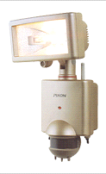

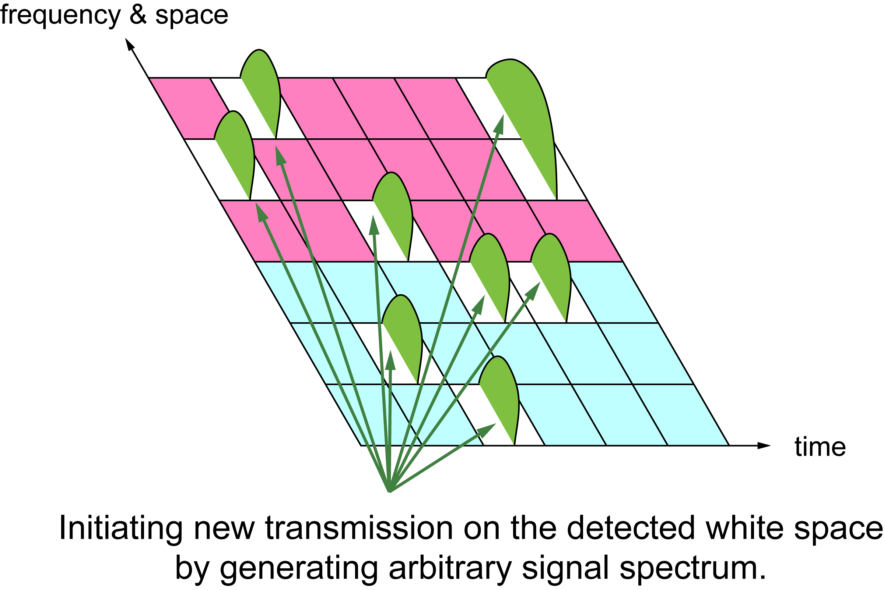
Scenario
Normal mode
  DSA policy :Modest
  Low CS threshold
Emergency mode
  DSA policy :Greedy
  High CS threshold
Throughput
Other system
DSA
Time

Slide 9
Conclusions
We propose Home monitoring applications as an application of the DSA system.
The DSA system will be suitable in home environment where various wireless systems coexist.
Acknowledgment
This work is supported by the Ministry of Internal Affairs and Communications under a grant “Research and development on radio resource control technologies among multiple radio systems on same frequency band.”

