Slide 1
Project: IEEE P802.15 Working Group for Wireless Personal Area Networks (WPANs)
Submission Title: [Comment Resolution of CID 521]
Date Submitted: [January 2011]
Source: [Steve Shearer] Company [Silver Spring Networks]
Address [Redwood City, CA]
Voice:[(925) 997 0576] FAX: [ ], E-Mail:[sshearer @ silverspringnet.com]
Re: [Comment Resolution]
Abstract: [Comment Resolution of CID 521]
Purpose: [Comment Resolution of CID 521]
Notice: This document has been prepared to assist the IEEE P802.15. It is offered as a basis for discussion and is not binding on the contributing individual(s) or organization(s). The material in this document is subject to change in form and content after further study. The contributor(s) reserve(s) the right to add, amend or withdraw material contained herein.
Release: The contributor acknowledges and accepts that this contribution becomes the property of IEEE and may be made publicly available by P802.15.

Slide 2
Comment Resolution of CID 521
Steve Shearer January 2011

Slide 3
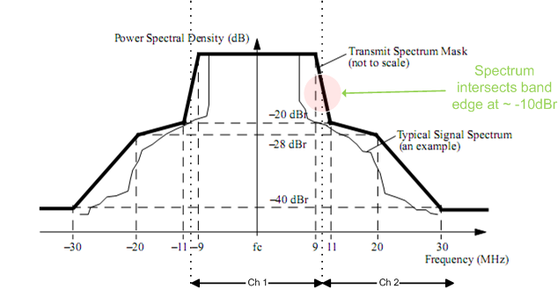
802.11a Channel Spacing
In 802.11a adjacent spectra intersect at the band edge at approximately the -10dBr level.
This leads to acceptable system operation

Slide 4
Mode 1 Channel Spacing at 1200kHz
Adjacent channel intersect at ~ -21dB

Slide 5
Mode 2 Channel Spacing @ 600kHz
Adjacent channel intersect at ~ -18dB

Slide 6
Mode 3 Channel Spacing @ 400kHz
Adjacent channel intersect at ~ -23dB

Slide 7
Mode 4 Channel Spacing @ 200kHz
Adjacent channel intersect at ~ -18dB

Slide 8
Summary and Conclusion
All Options exceed the band edge attenuation of -10dB used by 802.11
  Option 3 is the least stringent with a transition region of nearly 60 kHz and an intersect of -23dB
  Option 4 is the most stringent with a transition region of 22kHz and an intersect of -18dB
  600kHz channel spacing for Option 2 is neither the best, nor the worst
Option 2 channel spacing of 600kHz is acceptable.
 | Channel Spacing (kHz) | Nominal b/w (kHz) | b/w -6dB (kHz) | b/w -20dB (kHz) | Transition region. Nominal to band edge (kHz) | Band Edge intersect (dB)
Opt 4 | 200 | 156 | 156 | 207 | 22 | -18
Opt 3 | 400 | 281 | 281 | 346 | 59.5 | -23
Opt 2 | 600 | 552 | 553 | 627 | 24 | -18
Opt 1 | 1200 | 1094 | 1093 | 1166 | 53 | -21

