Slide 1
Project: IEEE P802.15 Working Group for Wireless Personal Area Networks (WPANs)
Submission Title: Overview of PSC Concepts
Date Submitted: January 2011
Source: Soo-Young Chang, CSUS
Address:
Contact Information: 530 574 2741 [sychang@ecs.csus.edu]
Re:
Abstract: This contribution is prepared to introduce overview of PSC concepts and some design ideas on PSC.
Purpose:
Notice: This document has been prepared to assist the IEEE P802.15. It is offered as a basis for discussion and is not binding on the contributing individual(s) or organization(s). The material in this document is subject to change in form and content after further study. The contributor(s) reserve(s) the right to add, amend or withdraw material contained herein.
Release: The contributor acknowledges and accepts that this contribution becomes the property of IEEE and may be made publicly available by P802.15.
Slide 1

Slide 2
Overview of PSC Concepts
Soo-Young Chang, CSUS
Slide 2

Slide 3
Introduction
Slide 3

Slide 4
INTRODUCTION
  This contribution is prepared to introduce
    Overview of PSC concepts and
    Some design ideas to show technical feasibility for the PSC standard.
  The following issues are addressed:
    Definition of PSC
    Introduction of new spaces –public space and personal space
    Review of use cases identified so far and introduction of new use cases
    Technical requirements identified from these use cases
    Review of some design ideas and similar technologies
Slide 4

Slide 5
Definition of Personal Space Communications (PSC)
Slide 5

Slide 6
PERSONALIZATION FOR PERSONAL SPACE (1)
Personalization *
  “Personalization involves using technologies to accommodate the differences among individuals” and among groups formed based on corresponding individuals.
Personalization implies:
  The changes based on implicit data of each individual or each group,
  Elimination of repetitive tasks, recognition of personal information including habits and routine works/things to reflect this personal information to set surrounding environment with minimal human intervention,
  Provision of more specific information that is increasingly relevant to an individual’s interests; replacement of “average” information with information specific to that person’s environment, and
  Accommodation of unique personal preferences.
* “personalization” on wikipeida.org
Slide 6

Slide 7
PERSONALIZATION FOR PERSONAL SPACE (2)
Space Identity (or Place Identity)
  A “sub-structure of the self-identity of a person consisting of broadly conceived cognitions about the physical world in which the individual lives” *
    These cognitions define the daily experiences of every human being.
  Through one’s attitudes, feelings, ideas, memories, personal values and preferences toward the range and type of physical settings, he/she can then understand the environment they live in and their overall experience.
  A cognitive "database“: implicit information of the individual
Implicit personalization and explicit personalization
  Implicit personalization: the personalization is performed by the information stored based on the individual’s or the group’s preferences, past activities, etc.
  Explicit personalization: the environment (or information stored) is changed by the individual using the features provided by the system: customization.
* Proshansky, H.M. (1987). "The field of environmental psychology: securing its future." 'Handbook of environmental psychology. D. Stokols and I. Altman. New York, John Wiley & Sons.
Slide 7

Slide 8
PERSONAL SPACE AND PUBLIC SPACE (1)
Personal space
  Logical (virtual) space which contains devices associated to an individual
  To exchange implicit data without human intervention and/or explicit control between a human being and a device or among devices in this space of an individual
  Profile/group based, behavior based, and collaboration based
Public space containing personal space(s)
  Physical space where an individual can reach such as each room of a building
  To exchange explicit control among devices in the public space, only for support of communications in the public space or with other public spaces
Personalization of a space *
  To make devices in a public space react differently corresponding to each individual based on implicit data stored or explicit control inputted by the individual
  To feel the space within reach of any limb of an individual.
* “personalization” on wikipeida.org
Slide 8

Slide 9
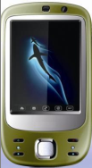


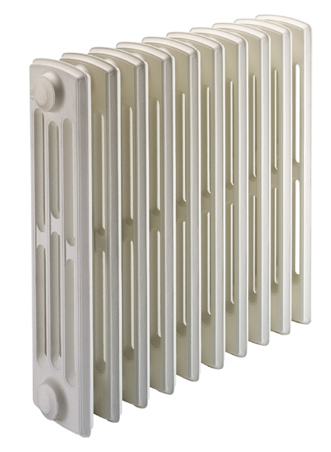

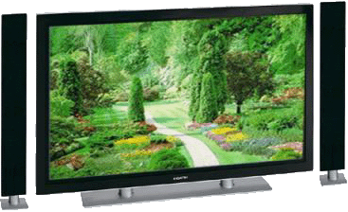
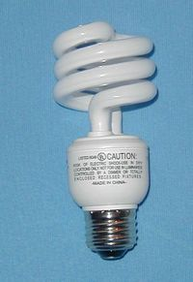


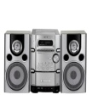
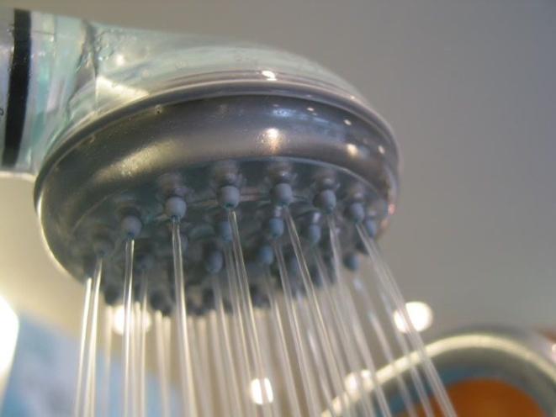
PERSONAL SPACE AND PUBLIC SPACE (2)
A device is registered as a member of one personal space or more in a public space. It knows which personal space(s) and public space(s) it belongs to.
Definition
Public space: space separated and isolated physically where one individual or more share machines/devices. A device in this space may be controlled by more than one individual.
Personal space: logical (virtual) space associated with one individual in a public space (or throughout multiple public spaces for a few special cases). All machines/devices in this space can be controlled by implicit information and explicit control relevant to this individual. This space is controlled by a PSC terminal of the individual.
Personal space A
Public space
Personal space B
°C
°C
Personal space C
PSC terminal
Slide 9

Slide 10

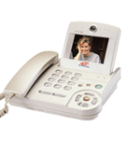
PERSONAL SPACE AND PUBLIC SPACE (3)
°C
°C
°C
Public space
After more individuals entered into this public space
Public space with one personal space
Public space with more than one personal space (In this figure, three personal spaces)
Slide 10

Slide 11
GROUPING DEVICES IN A PERSONAL SPACE
Groups of devices in a personal space:
  There can be multiple device groups commonly controlled by the PSC terminal of a personal space.
  The PSC terminal may assign different communication resource to each group adaptively and dynamically according to its technical requirements: each group may need different data rate and information delivery structure.
  → The PSC terminal communicates with all user groups simultaneously.
Public space
°C
Device group 3
°C
°C
Device group 1
Device group 2
Personal space A
Slide 11

Slide 12
REQUIREMENTS FOR PERSONAL SPACE
PSC terminal of a personal space
  A personal space is initiated by one PSC terminal which belongs to an individual, but this terminal can invite other PSC terminals which are associated to other individuals as members of this space. For this case, each of these PSC terminals behaves as a member of this space, not as a PSC terminal, while this terminal has its own personal space with different communication channels (for example, different frequency hopping sequences).
Requirements of communications for personal spaces
  Group based communications in a personal space
    Group based communications in a public space: multiple personal spaces possible overlapping each other in a public space
    Group based communications throughout multiple public spaces: devices in a personal space are possibly spread throughout more than one public space .
  Number of communications in a public space will increase dramatically as the number of personal spaces and machines involved increases.
  Need to guarantee various qualities of service (QoS) simultaneously
    Various types of contents delivered among devices simultaneously: need to accommodate a broad range of dynamically scalable data rates and fast and easy association with low latency.
Slide 12

Slide 13
TYPES OF PERSONAL SPACES (1) *
Autonomous personal space: basic and typical space
  Personal space where devices exchange information data to each other to collaborate without use of information from outside of the public space
  Communications performed only within a public space
Personal space with remote devices
  Personal space which includes device(s) located in other remote public space(s) in a different region.
  Information for collaboration needs to be exchanged with outside of its public space.
  Communications with device(s) in the outside of its public space is needed through outside communication networks
Personal space with mobile PSC terminals (or with mobility to multiple public spaces)
  Personal space which overlaps throughout multiple public spaces to follow an individual who moves to other adjacent public spaces
  Hand-over is needed between two adjacent public spaces.
  Communications between adjacent public spaces for hand-over and exchange of information including implicit information regarding the individual
  This type of personal space is also utilized for range extension (or coverage expansion) using relays between two adjacent public spaces.
* Prepared based on Ref. [10]
Slide 13

Slide 14
TYPES OF PERSONAL SPACES (2)
Region: A region is defined as an area where a PSC device can communicate with another PSC device only using PSC networks without using outside networks.
Personal space A
Public space
Personal space B
°C
°C
Personal space C
Region 1
Three Autonomous Personal Spaces
PSC terminal
Slide 14

Slide 15

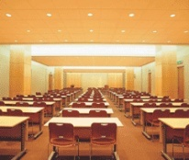
TYPES OF PERSONAL SPACES (3)
°C
°C
Region 1
Region 2
Public space 1
Public space 2
Outside network
Personal Space with Remote Devices
PSC terminal
Slide 15

Slide 16
TYPES OF PERSONAL SPACES (4)
Personal Space with Mobile PSC Terminal
Region 1
°C
°C
°C
Public space 1
Public space 2
Public space 3
Hand-over
Hand-over
PSC terminal
Slide 16

Slide 17
SOME FACTS FOR PERSONAL SPACES [10]
Radius of public space which contains a personal space or more
  Sphere with 50 feet of radius
Number of communicators (devices or machines) involving collaboration for a personal space
  Gradually increasing from 3~4 to 60~80, or even more ?
Communication types
  peer-to-peer, 1-n, n-1
  n-m group-cast (group-chat)
  Transmit only, receive only, two way
Traffic characteristics
  Delay tolerant data, real-time control, low latency audio/video stream
More than one individual can exist in a public space.
  In a public space, there may be more than one personal space overlapping each other. A device may be associated with only one personal space while another may be associated with more than one personal space.
Slide 17

Slide 18
DEFINITION OF PSC (1)
  Ubiquity
    Mobility friendly to increase user convenience
    Base instrument common for ubiquitous services
    Ubiquitous connection to identify appropriate devices, control environment, and communicate among devices
    With more centralized intelligence
    Automatically with pre-stored (implicit) information and/or explicit control from human being
    Self-configuring network of fixed or mobile devices connected by wireless links
  Using various communication methods
    In indoor/home environment: short range dedicated PSC wireless network
    To/from remote sources (or devices): through existing outside networks including WPAN, WLAN, MAN, cellular networks, and landline networks
Slide 18

Slide 19

DEFINITION OF PSC (2)
  User-oriented mobile space
    User-oriented, not provider-oriented [2]
  Providers should translate their services to user interface specifications within user mobile personal space.
Mobile
Broad-
casting
IPTV
Femto
WSD
WiMAX
Various types of outside networks can be connected to a personal space to communicate with outside world.
Internet
LTE
IPTV
User
Personal
Home
Appliance
User Personal
Space
WSD
Mobile
VoIP
Mobile
VoIP
RFID
USN
WLAN
Space
Wired
DMB
Mobile
Phone
Slide 19

Slide 20
DEFINITION OF PSC (3)
Machine-to-machine (MTM): definition from ITU-R
  Machine-to-machine communication is a type of service which exchanges data without human interaction, such as remote sensor, remote bio-monitoring and personal environment service. This type of communication is an important part of PSC applications and services.
Personal environment service (PES)
  The integrated service platform of open architecture for the customized and intelligent living environment services with the convergence of mobile phone, equipments, and service server [1]
  The electric, electronic, and mechanical machines surrounding users can be automatically configured according to the pre-defined and/or self-growing user preference. [5]
  “The living environment follows when a person moves.” [5]
Relationship between PES and PSC defined in this document
  PES: higher, more conceptual and broader level of service platform for the customized and intelligent living environment services
  PSC: PHY and MAC layer communication technology to realize PES. This PSC may transfer a small size of data traffic in a large number of sessions or a large amount of real time video streaming among multiple devices/machines.
Slide 20

Slide 21
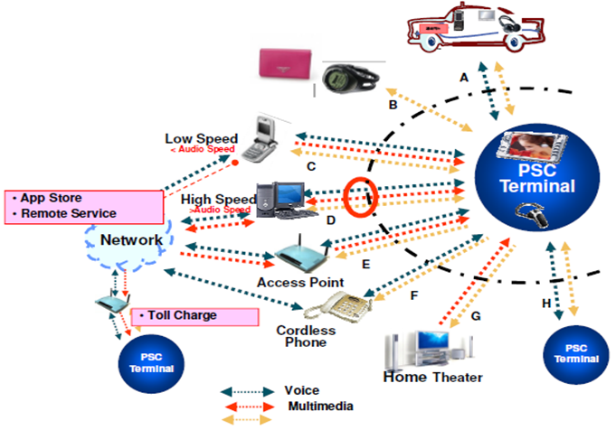
TYPES OF PSC APPLICATIONS [2]
  Communication
  Broadcasting
    Broadcasting among devices
  Education
  Entertainment
    Multi peer group game
Various content formats in a user’s personal space
[9]
Data
Personal space
Slide 21

Slide 22
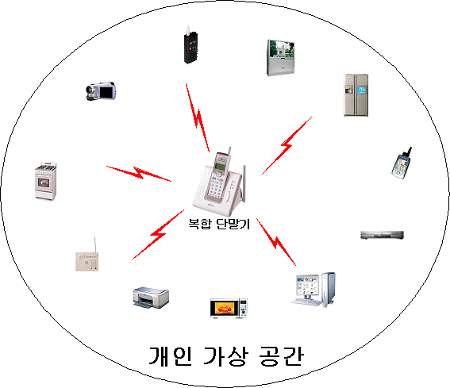
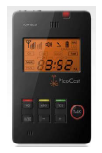

PSC OPERATION SCENARIO (1) [9]
PSC personal space
Cell Phone
WiMAX
Cable
PBX
HSDPA
LTE
etc.
PSC personal space
PSC personal space
PSC personal space
Slide 22

Slide 23
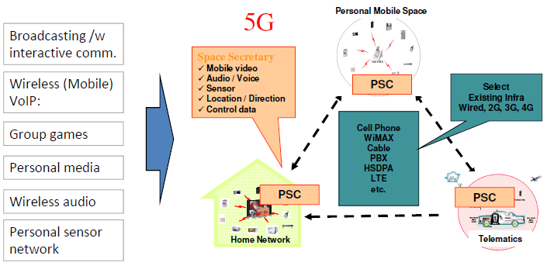
PSC OPERATION SCENARIO (2) [9]
In the future, the user will be the center of the services and the Personal Space Communications will be the common interface to the environments the user moves into.
PSC personal space
PSC personal space
PSC personal space
Slide 23

Slide 24
USE CASES, HOME/INDOOR ENVIRONMENT (1)
  Sensors: favorite group selection
    Automatic doors [1]
    Automatic air conditioning [1]
    Home appliances control including TV, music, and other home appliances
  Automatic telephone forwarding [1]
  Customized computer setting [1, 2]
    Auto configuration of computer
  Local advertisement/information system [2]
Automatic recognition: attendance check, entrance control, automatic PC lock/unlock [1]
Private assistant: pulling conference material from user’s computer to the meeting place, personal gateway [1]
Location identification: indoor location identification, automatic destination guide from the display at the entrance or corridor, elevator control, LBS [1]
Amusement park [9]
Slide 24

Slide 25
USE CASES, HOME/INDOOR ENVIRONMENT (2)
  Mobile VOIP or wireless VOIP [2]: refer to following slides
  Two way graphic remote control [2]: refer to following slides
  Two way Conferencing and one way seminar[2]: refer to following slides
Multi Lingual Interpretation System: refer to following slides
  Microphone [2]: secured
  Stereo ear set [2]
  TV/game headset [2]
  Smarter Phone which support Group game
  Mobile video [2]
  x.1 channel audio [2]
  Medical applications
    Hospital environment and Doctor’s office
  Customer management: restaurant, store, theater, and etc. [1]
  Public place broadcasting [2]
Slide 25

Slide 26
USE CASES, HOME/INDOOR ENVIRONMENT (3)
  Data transfer to picture frame
  Food selection and cooking method are configured automatically and properly
  Broadcasting with interactive communications [9]
  Personal media [9]
  M2M (Sensor network) [9]
Group games [9]:
  Latency: < 16ms, Wired Voice quality, Channel capacity: Concurrent active channels
Wireless audio [9]: Cordless microphones, headset, wireless speakers, distributed speakers
  Latency: < 16ms, Data rate: < 2M bps, Channel capacity: Concurrent active channels
Slide 26

Slide 27
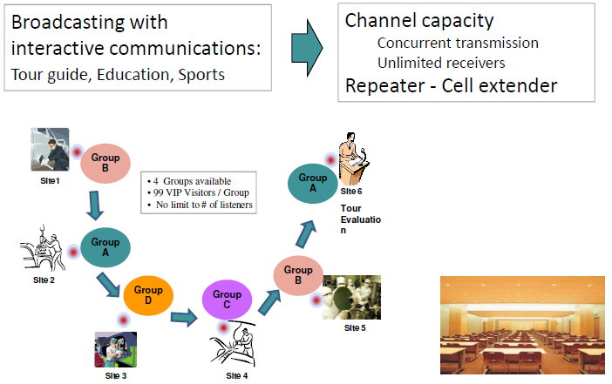
USE CASES, HOME/INDOOR ENVIRONMENT (4)
  Broadcasting with interactive communications [9]
Slide 27

Slide 28
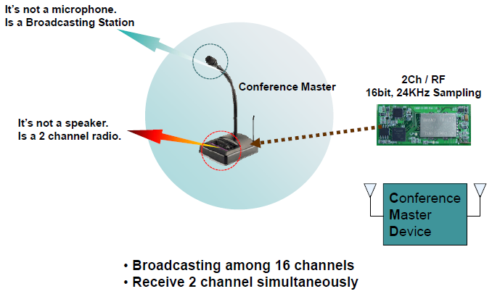
USE CASES, HOME/INDOOR ENVIRONMENT (5)
Wireless Conferencing System [4]
: for bilingual translation or separation of voice and data
Slide 28

Slide 29
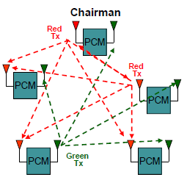
USE CASES, HOME/INDOOR ENVIRONMENT (6)
Portable Conference Master [4]
Features: simultaneous two channel broadcast & two channel receive
- Wireless Conference
- 2 Talkers Simultaneously
- Electric Voting (99 persons)
- Talking time limit: Quit the Talking Device
• Red & Green Ch Broadcasting
• Every PCM receives Red & Green Ch together.
• Chairman broadcast Red Ch.
• Every PCM share Green Ch for Tx.
• If chairman quit Red Ch, other PCM shares Red Ch too.
Closed group talking/broadcasting optional
Slide 29

Slide 30
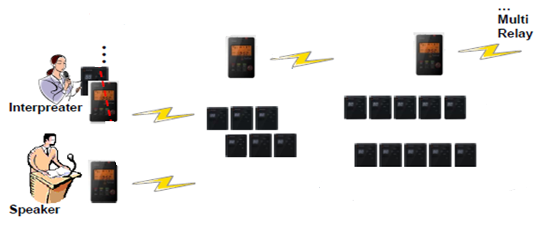
USE CASES, HOME/INDOOR ENVIRONMENT (7)
Multi Lingual Interpretation System [4] with range extension [9]
PSC manager
PSC manager
PSC manager: range extender: Synchronous system with robust sync [9]
Listeners
Listeners
Two-way communication should be better if consider Q&A sessions.
Public space 1
Area 1: 0-30 m
Public space 2
Area 2: 30-60 m
Slide 30

Slide 31

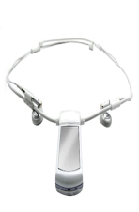
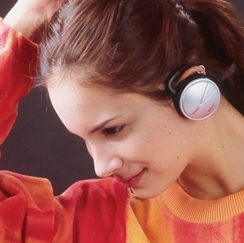
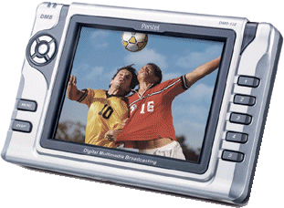




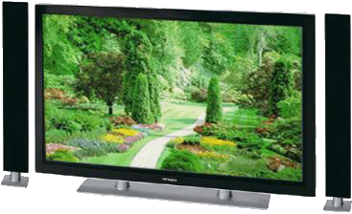

USE CASES, HOME/INDOOR ENVIRONMENT (8)
2-way graphic remote controller [2]
Local 2-way
Advertisement
  
Graphic Remocon =
Internet DMB =
Mobile IPTV =
Mobile VoIP =
Local Broadcasting =
Mobile Search
  
Broadcasting
Service Provider
  
  
Searching
Service Provider
Communication
Service Provider
Slide 31

Slide 32
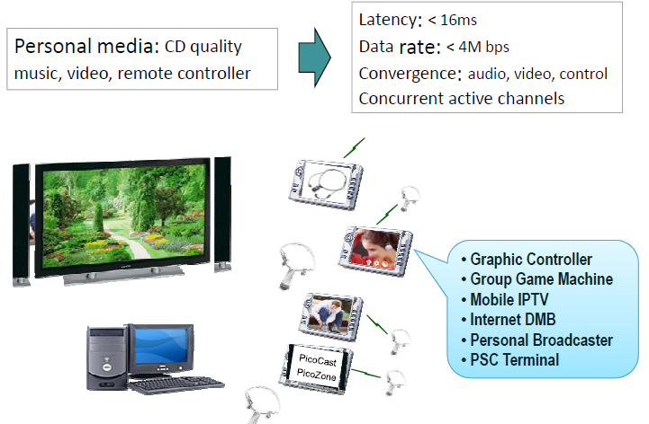
USE CASES, HOME/INDOOR ENVIRONMENT (9)
Personal media [9]
Need relay among public spaces: for ex., one device can access a media source in another room.
Slide 32

Slide 33
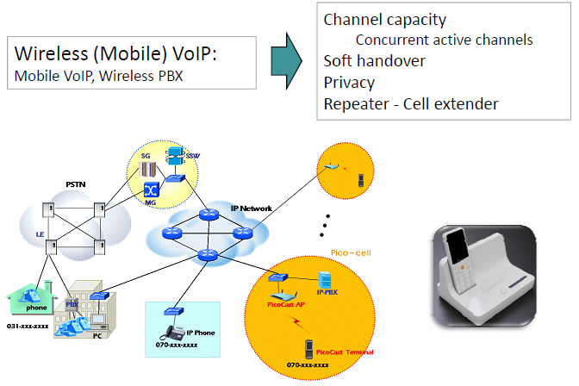
USE CASES, HOME/INDOOR ENVIRONMENT (10)
Wireless (Mobile) VoIP [9]
Need relay among public spaces: for ex., a VOIP device accesses the access point in another room via through PSC managers.
Slide 33

Slide 34
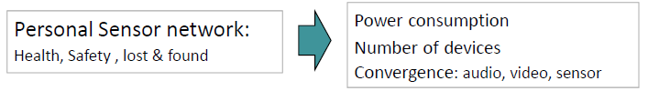
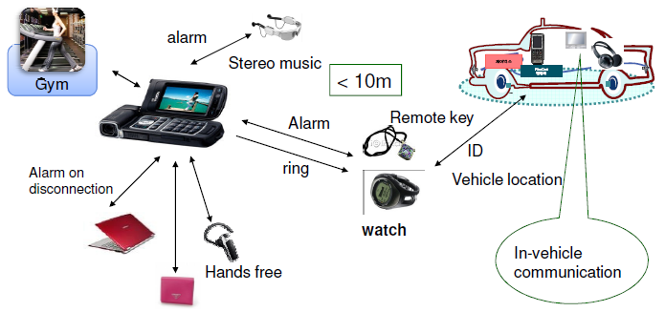
USE CASES, HOME/INDOOR ENVIRONMENT (11)
Personal Sensor Network [9]
Slide 34

Slide 35

USE CASES, HOME/INDOOR ENVIRONMENT (12)
Access to computers available to public
No need to carry a computer if computers are available to the public.
Personal computer setting information and stored data
Data/document/file retrieval from remote server
Remote server
Places open to the public
Meeting/conference room
Computer lab
Hotel business center, etc.
Computers provided to the public
Slide 35

Slide 36
USE CASES, VEHICULAR ENVIRONMENT
Automatic air conditioning: temperature, ventilation for each passenger [1]
Automatic driving mode control: seat position, handle position, mirror angle, pedal sensitivity, maximum speed alarm [1]
Favorite music or broadcasting station selection [1]
In-vehicle navigator configuration: menu configuration, favorite geography information, geography information update and Telematics services through the mobile phone and WLAN [1]
  Hands free set [2]
Slide 36

Slide 37
USE CASES, OUTDOOR APPLICATIONS
  Obtaining information from outside screens/monitors/roadside units
  Stadium game broadcast
Travel and location information service [1]
  When user stands in front of the electric display guide, it shows the information about destination, geography, transportation, and shopping in user’s language.
Automatic street lamp control [1]
Electronic payment [1]
  Mobile communication provider could participate in E-Commerce business, and provide personalized marketing considering time and location information of users, using mobile communications network.
Slide 37

Slide 38
USE CASES, PUBLIC SECTOR
Energy & CO₂ saving
  Light off in the place where no one exists, and optimal control for air conditioner, heater, TV, PC, etc. [1]
Safety service
  Acquisition of information about people passing by a check point, like caretaker, bus stop, lobby, etc., using PSC manager equipped at the post, for checking pedestrians to protect from criminals, and provisioning of alarm information to them [1]
Traffic information gathering
  Gathering traffic information from the mobile PSC devices of drivers and passengers and PSC modules equipped at roadside [1]
Slide 38

Slide 39
USE CASES, MOBILE PHONE APPLICATIONS (1) [3]
Mobile social network global market more than $28 billion by 2012
More than 400 million mobile ticketing users by 2013*
Mobile location based services and location enabled apps global market over $12.7 billion by 2014**
……
However, current cellular networks cannot accommodate every app and satisfy user’s experience well by itself.
Mobile phone applications
  Indoor location-based service
  Information delivery service
  M-ticketing & M-payment
  M-advertising & M-couponing
  Mobile office
  Multi-player services: mobile gaming
  Multi-chatting & social networks
Need to add PSC feature to cell phones to accommodate mobile phone applications to connect to both cellular networks and PSC networks: It is an important benefit for cell phone manufacturers and service providers. It is similar to Bluetooth feature in a cell phone.
Two types of PSC devices: (1) cell phone with PSC feature and (2) PSC device
Slide 39

Slide 40
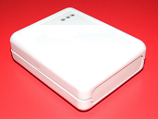
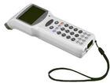
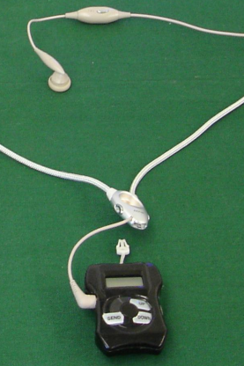
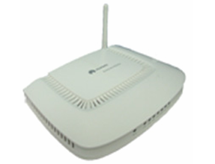
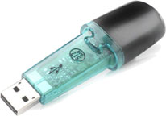

USE CASES, MOBILE PHONE APPLICATIONS (2) [3]
PSC solution: PSC + Telecom Services (1)
: this service can be performed with PSC concepts and devices
Smart Card Reader
Information Node
SIM Card
Point of Sale
Mobile Terminal
Headset & Speaker
Access Point
Flash Card
Slide 40

Slide 41
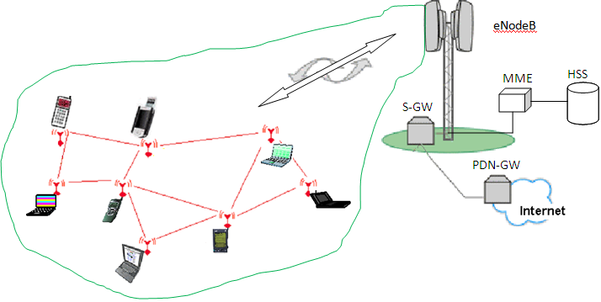
USE CASES, MOBILE TERMINAL RELAY [11]
PSC solution proposed by China Mobile
Terminal relay for
  Coverage extension
  New telecom services
No additional deployment
  No cost for carrier
Most effective when most needed
  Usually the demand is high when users are dense
  In terms of both capacity improvement and coverage extension
Benefits of PDCP Tunneling Method
Security and security are enforced at the same level
  No additional trust issue involved
Leverage existing QoS provisioning at air interface L1/L2
Limited update to RAN, low complexity
  No change to the core network
Control and configured by carrier network
  Different from the gateway relay architecture
Slide 41

Slide 42
COMMUNICATIONS FOR PERSONAL SPACES (1)
    PSC manager of a public space
      Device or function of a device whose main roles are
        to provide sync signals to devices in a public space
        to maintain sync with all other public spaces in the same region
        to communicate with other PSC managers of adjacent public spaces for hand-over and exchange of data/information and for data relay among public spaces
      Only one device among devices including PSC terminals in a public space can be a PSC manager.
Types of communications for a personal space
  Communications among devices (or machines) in a public space
  Communications between PSC managers of adjacent public spaces for hand-over and exchange of implicit information regarding the individual and for data relay between public spaces in a region
  Communications between a device in a public space and a device (or machine) in a remote outside world
Slide 42

Slide 43
COMMUNICATIONS FOR PERSONAL SPACES (2)
Communication within a public space: intra public space communications
  1-1, 1-n, and n-m group-cast possible
  Max. 100 feet range
  10kbps ~ 54Mbps throughput
  Less than 20 ms latency
Inter-public space communication: inter public space communications through PSC managers
  Interconnection between two physically adjacent public spaces
  10kbps ~ 54Mbps throughput
  Less than 20 ms latency
  Needs hand-over between two adjacent public spaces for mobile individuals and range extension
  Managed on MAC layer
Remote area access communication: inter public space communications through outside network.
  Access to database or exchange of information data through a core (outside) network
  Wide area wired or wireless network: cable network, telephone network, WLAN, cellular network, etc.
Slide 43

Slide 44
COMMUNICATIONS FOR PERSONAL SPACES (3)
Public space 2
  PSC needs three types of connections.
    Communication inside a public space
    Communication between two adjacent public spaces
    Connection to outside world
PSC device
Phone
Home appliances
TV
Public space 1
Game
Environment control
PSC device
Phone
computer
WLAN
audio
Home appliances
TV
Cable network
Game
Environment control
2. Communication between two adjacent PSC public spaces
MAN
computer
audio
WAN
3. Communication through wide area networks for
connection to
outside world
Mobile network
1. Communication
inside a PSC public space
Slide 44

Slide 45
COMMUNICATIONS FOR PERSONAL SPACE (4)
Communications among devices in a public space
Sync broadcast to all devices in a public space
Public space 1
Personal space A
Comm. between a device in a personal space and PSC manager
Personal space B
PSC manager
Personal space C
Comm. among devices in a personal space
Slide 45

Slide 46
COMMUNICATIONS FOR PERSONAL SPACE (5)
Communications between two PSC managers in a region
Personal space A’
Personal space A
Public space 2
Public space 1
Sync broadcast to PSC managers
PSC manager
Personal space B
Comm. Between PSC managers
PSC manager
Personal space B’
Personal space C’
Personal space C
Region 1
Slide 46

Slide 47
COMMUNICATIONS FOR PERSONAL SPACE (6)
Communications between a device in a public space and an outside device (1)
Only devices in a public space which have capability to communicate with outside remote devices can have this type of communications, e.g. WLAN AP and computer with WiFi.
Personal space A
Public space 1
PSC manager
Personal space B
Comm. between a device in a public space and an outside device through a core network
Personal space C
(extended)
Remote devices are also members of the personal space, but do not maintain sync with other devices in the personal space of another region. A remote device only sets up a link through a designated channel to a device in another region.
Remote device
Personal space C
Region 2
Region 1
Slide 47

Slide 48
COMMUNICATIONS FOR PERSONAL SPACE (7)
Communications between a device in a public space and an outside device (2)
Outside networks
Comm. channels
PSC personal space
PSTN
WLAN
Phone
PSC manager
Other PSC terminal
Wired LAN
Agriculture control
LAN
Wired PSTN
Home appliances
Environment control
High speed optical
TV
Mobile networks
Game
Mobile phone
User
PSC
terminal
xDSL
Public broadcast
computer
Audio/video
WPAN
Internal radio
WLAN router /other modem
Mobile channel
Internet
Broadcast, public
Medical control
Slide 48

Slide 49
FREQUENCIES AND DURATIONS OF USE CASES [1]
Function | Freq. (Duration) | Function | Freq. (Duration)
Configure indoor equipment | 3/1hr (3sec) | PC security for departing | 1/3hrs (2sec)
Configure vehicle equipment | 1/24hrs (3sec) | Customer management | 1/12hrs (5sec)
Configure road equipment | 1/12hrs (2sec) | Customized marketing | 1/12hrs (5sec)
Electric frame data Tx | 3*1MB/day (33sec) | Menu guidance | 1/2days (3sec)
Location finding in office/home | 1/4hrs (2sec) | Pedestrian check | 1/2hrs (2sec)
Elevator floor selection | 1/6hrs (2sec) | TV, audio play | 1/2days (1hr)
Travel information | 1/12hrs (5sec) | TV game play | 1/2days (30mins)
Public transportation getting on/off notification | 1/day (2sec) | Messaging | 1/3hrs (2sec)
Facility guidance | 1/6hrs (3sec) | Business card exchanging | 1/2days (2sec)
Data retrieving | 1*1MB/6hrs (11sec) | Paging CUG/friends | 1/12hrs (2sec)
Traffic information gathering | 1/hr (2sec) | Caring child/pet | 1/day (2sec)
Toll collection | 1/2days (3sec) | Gateway service | 2*2/day (20mins)
Electric payment | 1/8hrs (3sec) | Equipment manage | 1*10/week (10sec)
Entrance control | 1/3hrs (2sec) | Health care | 1/2hrs (3sec)
Slide 49

Slide 50
CATEGORIES OF INFORMATION EXCHANGES (1)
One-way user information from PSC terminal to other devices
  Audio/video device control information : DVD player, TV set, stereo system
  Home appliance control information
  Home environment control information: curtain, aircon/heater
  Computer control: user data restoration, user friendly setting, auxiliary optional storage
  Agricultural control: temperature, moisture/humidity, water, nutrient
  Automatic recognition: attendance check, entrance control, automatic PC lock/unlock [1]
  Private assistant: pulling conference material from user’s computer to the meeting place, personal gateway [1]
  Remote controller
  Location identification: indoor location identification, elevator control, LBS, [1] automatic door
Slide 50

Slide 51
CATEGORIES OF INFORMATION EXCHANGES (2)
One-way transfer from other devices to PSC terminal
  Audio transfer: CD player, stereo system for public radio listening, internet audio broadcasting through computer, internet audio broadcasting through WLAN router, audio from other PSC device
  Video transfer: DVD player, TV set, IPTV through computer, IPTV through WLAN router, video from other PSC device
  Data transfer from Home appliance
  Data transfer from Home environment control: curtain, aircon, heater
  Data transfer from Computer: auxiliary optional storage
  Data transfer from Agricultural control: temperature, moisture/humidity, water, nutrient
  Local advertisement/information system [2]
  Automatic destination guide from the display at the entrance or corridor [1]
Slide 51

Slide 52
CATEGORIES OF INFORMATION EXCHANGES (3)
Two-way synchronized low latency between PSC terminal and another device
  Voice exchange: home radio, intercom, VOIP through mobile network, VOIP through computer (LAN)
  Video exchange: video conference, video transfer
  Data exchange: data transfer
  Automatic telephone forwarding [1]
Two-way synchronized between non-PSC terminal devices
  Control data exchange: home/office environment control, automatic setting and control
Slide 52

Slide 53
CATEGORIES OF INFORMATION EXCHANGES (4)
Two-way synchronized low latency broadcasting among PSC terminals
  Audio conferencing/group chatting
  Video conferencing
  Group game
  Multi language interpretation system
Localization/location/positioning should be an important feature for some of PSC applications – LBS system and services.
Slide 53

Slide 54
CATEGORIES OF INFORMATION EXCHANGES (5)
Two-way remote control/monitoring of a device (or machine) at remote location (1)
  Home appliances/environment control/monitoring: communications between PSC terminal and a device (or machine) of the remote site
  Agriculture control/monitoring: communications between PSC terminal and a device (or machine) of the remote site
  Medical control/monitoring: communications between PSC terminal and a device (or machine) of the remote site
Remote association is needed for remote devices to be members of this personal space.
Remote association: association to a remote personal space
Two types of remote associations
1. for a device in a remote personal space where a PSC manager exist.
2. for a device in a remote non PSC space where no PSC manager exist.
Slide 54

Slide 55
CATEGORIES OF INFORMATION EXCHANGES (6)
Two-way remote control/monitoring of a device (or machine) at remote location (2)
1. A device in a remote personal space
Cell Phone
WiMAX
Cable
PBX
HSDPA
LTE
etc.
Remote PSC personal space
(extended)
PSC personal space
2. A device in a remote non PSC space
Remote association is needed for remote devices to be members of this personal space. → remote association: association to a remote personal space
Remote Non-PSC space
Slide 55

Slide 56
REQUIRED FEATURES FOR SUGGESTED USE CASES (1)
  Integrated service platform of open architecture with one PHY and MAC solution for the customized and intelligent living environment services [1]
    Easily adaptive to each environment/situation
Intelligent and flexible configuration adaptive to each environment/situation
Low power consumption for mobile/portable devices [2]
Dynamically scalable speed: 10K, 100K, 500K, 1M, 2M, 4M, 8M, 16M, 32M, and 54M
Multiple topologies supported: 1-1, 1-n, n-m, star, two-way broadcasting, synchronized relay for communication between two public spaces in the same region
Avoidance of mutual interference: co-channel and adjacent channel interference
  Dynamic and Adaptive Resource Allocation (DARA)
High level security between nodes
Medium range: 0.3 m to 30 m with range-extension capability
Low latency for audio and video synch
Slide 56

Slide 57
REQUIRED FEATURES FOR SUGGESTED USE CASES (2)
Fast synch: ready for easy and fast association
  Easy, simple and fast association of devices to PSC terminal by requesting association
Accommodation of numerous receive-only devices: No ARQ [2]
High QoS for real time streaming data
Seamless authentication for mobile association
  Authentication requires that a (mobile) device establish its identity before sending frames.
Location / Direction finding [1]
    accuracy : max. ~ 50cm, rec. ~10cm
Roaming/Hand-over
  Seamless roaming between two adjacent public spaces, not nomadic roaming, for mobile audio/video streaming: "make before break,“ and soft handover.
→ Single (PHY+MAC) for various types of services with various types of contents exchanged.
Slide 57

Slide 58
TECHNICAL REQUIREMENTS IDENTIFIED (1)
Fast synch (lock time less than 500 us) and no ARQ for accommodating numerous (or unlimited number of) receivers [2]
Low latency for real time broadcast [2]
  Mono: <7msec, Stereo: <16msec
Frame structure independent of content types
  Delivery of various types of contents in the same frame structure: data, audio, and mobile video simultaneously
Various diversity techniques considered for high QoS
  FEC is an option for high QoS.
  Macrodiversity
Well-tailored preamble for fast synch
  Dynamically scalable data rates:
    10 Kbps to 54 Mbps
Interference mitigation/avoidance structure/mechanism for simultaneous multiple transmissions from multiple transmitters at the same time in a confined area
  Avoid or mitigate interference from adjacent transmitters in same or different channels
Slide 58

Slide 59
TECHNICAL REQUIREMENTS IDENTIFIED (2)
Types of interference considered in PSC
  : In telecommunication and electronics, anything which alters, modifies, or disrupts a message as it travels along a channel between a source and a receiver. Typically the term refers to the addition of an unwanted signal to the useful signal.
  Co-channel interference (CCI), also known as crosstalk
    from two different radio transmitters using the same frequency
    Two examples: Frequency reuse of cellular mobile networks and overly-crowded radio spectrum
    Defined by CIR or CNIR (or C/(N+I)) where I is co-channel interference
  Adjacent-channel interference (ACI)
    caused by inadequate filtering, poor frequency control, etc
    Two factors: Adjacent Channel Leakage from outside transmitters and Adjacent Channel Selectivity of own receiver
  Inter symbol interference (ISI)
    One symbol interferes with subsequent symbols in the time domain.
    caused by multipath propagation or the inherent non-linear frequency response of a channel causing successive symbols to "blur" together.
    Two major measures: adaptive equalization and error correcting codes
  Inter-carrier interference (ICI), caused by Doppler shift in OFDM modulation (multitone modulation)
Slide 59

Slide 60
TECHNICAL REQUIREMENTS IDENTIFIED (3)
Co-channel interference among transmitters in a personal space
Far area
Tx : 0dbm
Near area
I₂
I₁
O₁
Strong signal: RX:-60dbm
Tx : 0dbm
M
O₂
Weak signal: Rx : -80dbm
I₃
M cannot receive O₂ signal while adjacent PHY I₂ is transmitting.
Near-far problem for mainly CDMA or OFDMA: only the case for co-channel
- A condition in which a strong signal captures a receiver making it impossible for the receiver to detect a weaker signal, particularly difficult in CDMA systems where transmitters share transmission frequencies and transmission time.
- In contrast, FDMA and TDMA systems are less vulnerable.
Need power control to overcome this problem
: dynamic output power adjustment of the transmitters
: dynamic output power control
Slide 60

Slide 61
TECHNICAL REQUIREMENTS IDENTIFIED (4)
Adjacent channel interference among transmitters in a personal space [2]
Tx : 0dbm
Rx : -80dbm
Search Frequency
Near area
I₂
I₁
Spurious:-60dbm
O₁
Rx : -80dbm
Far area
Tx : 0dbm
M
I₃
O₂
M cannot receive O₂ signal while adjacent PHY I₂ is transmitting.
40dB
60dB
80dB
UWB
f_{I2}
f_{O2}
frequency
Slide 61

Slide 62
TECHNICAL REQUIREMENTS IDENTIFIED (5)
Broadcasting with interactive communication and cell expansion → Synchronous system among personal spaces and public spaces
Soft Handover
CD quality audio, wireline quality voice, SVGA video → data rate up to 54M bps, FER < 10⁻⁶ with effective diversity measures
Channel capacity → more than 16 concurrent transmissions within a personal space and unlimited receive only receivers
Low power consumption → similar to Bluetooth
Personal portable/cordless → price similar to Bluetooth with reasonable complexity
Slide 62

Slide 63
PSC System Definition
Slide 63

Slide 64
DEFINITION OF PSC TERMINAL
  PSC featured devices (or PSC machines) can be categorized as following:
  PSC terminal: associated to one individual (or user). An individual (or user) has a PSC terminal.
  Two types of PSC terminals
    PSC/cell phone device
      PSC functions integrated into and embedded in a cell phone
    Stand alone PSC terminal
  Other PSC devices (or machines): having built-in PSC functions in them.
Contents delivered/exchanged
  Mobile video
  Audio/voice
  Sensor data
  Location/direction information
  Control data
Slide 64

Slide 65
TYPES OF PSC DEVICES (1)
  Categories according to forms of installation
    On body device or stand-alone device
    Device attached to an electronic machine
    Device built in a machine such as a computer, a LAN access point, etc.
    Device built in a cell phone
  Categories according to functions
    PSC terminal: can be a two-way master device
    Two-way PSC device: two-way PSC featured device
    Listen only PSC device
  Types of communications performed
    Point-to-point two-way communication: 1:1
    Point-to-multi-point two-way communication: 1:n
    Multi-point-to-multi-point two-way communication: n:m
    Broadcast transmit only / receive only
Slide 65

Slide 66
TYPES OF PSC DEVICES (2)
  Categories according to data rates and amount of information delivered
    Low rate one way (including broadcast) only < 500 Kbps
    Medium rate one way (including broadcast) only ~ 4 Mbps
    High rate one way (including broadcast) only ~ 54 Mbps
    Two way balanced low rate < 500 Kbps
    Two way balanced medium rate ~ 4 Mbps
    Two way balanced high rate ~ 54 Mbps
    Two way unbalanced low rate < 500 Kbps
    Two way unbalanced medium rate ~ 4 Mbps
    Two way unbalanced high rate ~ 54 Mbps
Slide 66

Slide 67
LEVEL OF DEVICES (1)
  A couple of levels of devices for broad range of use cases and required features
    Level 1 device: integrated into a machine
      simplest device with low data rate and least features. Low power consumption
      Simple control data exchanges
      500 Kcps fixed clock rate
    Level 2 device: integrated into a machine
      most complicated device with high data rate and full functions. Low power consumption
      Audio/video stream/control data
      Up to 54 Mbps scalable data rate
      PSC manager function included
    User stand-alone device (PSC terminal):
      most complicated device with high data rate and full functions. Low power consumption
      Audio/video stream/control data
      Large graphic display/speaker/microphone
      Up to 54 Mbps scalable data rate
      PSC manager function included
      PSC featured cell phones belong to this level.
  Common features to all levels
    Listen only mode, transmit only mode, tx/rx mode
Slide 67

Slide 68
LEVEL OF DEVICES (2)
    PSC manager
      Device or function in a device whose main roles are
        to provide sync signals to devices in a public space,
        to maintain sync with other public spaces in the same region,
        to communicate with PSC managers of adjacent public spaces for synchronous relay, and
        to provide radio resource allocation information to each personal space with cooperation of other public spaces so as to allocate radio resources to each personal space to minimize the interference with other personal spaces and public spaces.
      Only one device among Level 2 devices and PSC terminals in a public space can be a PSC manager.
Common sync in Public space
Personal space A
PSC manager
°C
°C
Personal space B
Personal space C
Slide 68

Slide 69
KEY REQUIREMENTS FOR PSC
  Fast synch for fast association and high throughput <500 us
  Low latency <16 ms
    Periodically every less than 16 ms, a segment of information can be transmitted.
  Avoidance of mutual interference from adjacent transmitters
    Adjacent transmitters interfere with other devices with co-channel and spurious signals from these transmitters. A mitigation method should be applied. Frequency hopping is one strong scheme to mitigate this interference.
  Dynamically Scalable data rates
    Data rates are scaled dynamically depending on types of applications.
    Spectral and temporal radio resource is flexibly and dynamically assigned to each device to meet its needs.
  Synchronized relay between public spaces
    To form an ad hoc mesh network for the case that a user device moves to another public space and for range extension.
  Localization/locating/positioning
    An important feature for some of PSC applications – LBS system and services
Slide 69

Slide 70
PERSONALIZED SPACE AND PUBLIC SPACE
A machine is registered as a member of one personal space or more in a public space. It knows which personal space(s) and public space it belongs to.
Definition
Public space: space separated and isolated physically where one individual or more share various machines. A machine in this space may be controlled by more than one individual. In a public space, there may be more than one personal space overlapping each other.
Personal space: logical (virtual) space associated with one individual. All machines in this space can be controlled by implicit information and explicit control relevant to this individual. This space is controlled by a PSC terminal of the individual.
Some machines are associated with only one personal space while some of other machines are associated with more than one personal space.
If a machine is associated to more than one personal space in a public space, it is controlled by the first space initiated.
Personal space A
Public space
°C
°C
Personal space B
Personal space C
PSC terminal
Slide 70

Slide 71
GROUPING DEVICES IN A PERSONAL SPACE
Groups of devices in a personal space:
  There can be multiple device groups commonly controlled by the personal terminal of a personal space.
  The PSC terminal assigns different communication resource to each group flexibly and dynamically according to its required needs: each group may have different data rate and information delivery structure. For example, a unique FH sequence can be assigned to each group.
  → The PSC terminal communicates with all user groups simultaneously.
Public space
°C
Device group 3
°C
°C
Device group 1
Device group 2
Personal space A
Slide 71

Slide 72
DYNAMINC AND ADAPTIVE RESOURCE ALLOCATION (DARA) (1)
Two situations that need different amounts of information to be delivered with different data rates
In a personal space, some devices need more resources than other devices due to more information to be delivered and/or their required higher data rates.
Among personal spaces in a public space, a personal space needs more resource than other personal spaces due to its operational characteristics (or needs).
→ The amount of channel resource for a device or a personal space needs to be adjusted dynamically and adaptively to its needs.
These concepts are very important for PSC to use spectral resources more dynamically, more adaptively and more efficiently to various types of contents and communications. → These concepts should be developed more in detail. Need to develop how these requirements and concepts can be implemented.
Types of resources:
frequency (or spectrum) → spectrum size assigned
time → time (or frame size or payload size in a frame) assigned
processing power → modulation complexity to deliver more information for each symbol
Slide 72

Slide 73
DYNAMINC AND ADAPTIVE RESOURCE ALLOCATION (DARA) (2)
For two situations
Channel resource needs to be assigned to a device dynamically and adaptively to its needs.
In a personal space, some devices need more resources than other devices due to more information to be delivered and their required higher data rates.
→ dynamic resource assignment (DRA) dynamically and adaptively to its operation
Among personal spaces in a public space, a personal space needs more resource than other personal spaces due to its overall operational characteristics/needs.
→ adaptive resource assignment (ARA) adaptively to its operation
Three types of resource manipulation methods
In the frequency domain:
(1) spectrum management: more spectrum assigned to higher information exchange demand and/or higher data rates
In the time domain:
(2) time management: more time assigned to higher information exchange demand for fixed data rates
(3) adaptive modulation scheme: more constellation points assigned for higher data rates
Slide 73

Slide 74
DYNAMINC AND ADAPTIVE RESOURCE ALLOCATION (DARA) (3)
Dynamic resource assignment (DRA):
  Communication channels/resources assigned dynamically and adaptively to a device due to its needs for its data rate, amount of information delivered, type of contents delivered, etc. in a personal space
Adaptive resource assignment (ARA):
  Communication channels/resources assigned adaptively assigned to a personal space due to its needs for type of applications, total amount of information delivered, type of contents delivered, etc. in a public space
Adaptive and dynamic resource allocation (DARA):
  Communication channels/resources assigned dynamically and adaptively to a personal space in a public space and to a device in a personal space due to their needs for data rates, amounts of information delivered, types of contents delivered, types of applications, etc. in a public space
  Each personal space needs different capability/capacity in a public space. At the same time, each device in a personal space requires different capability/capacity due to its missions or roles.
Slide74

Slide 75
DYNAMINC AND ADAPTIVE RESOURCE ALLOCATION (DARA) (4)
Two types of resources to be manipulated in the frequency domain:
(1) more spectrum to a personal space of higher information exchange demand and/or higher data rate
(2) more spectrum to a device of higher information exchange demand and/or higher data rate
For Personal space 1
For Personal space 2
For Personal space 3
For Personal space 4
For Personal space 5
f
Whole frequency band available: 5 frequency bins for 5 personal spaces
For Device 1
For Device 2
For Device 3
For Device 4
For Device 16
f
Frequency band for one personal space: 16 frequency bins for 16 devices in a personal space
Slide 75

Slide 76
DYNAMINC AND ADAPTIVE RESOURCE ALLOCATION (DARA) (5)
Two types of resources to be manipulated in the time domain:
(1) more time to higher information exchange demand for a fixed data rate
(2) adaptive modulation scheme: more constellation points for higher data rates applied to each symbol
This concept may be applied in a frame structure.
FCH
sync
Payload segment 0
sync
Payload segment 1
sync
Payload segment 15
Device 0
Device 0
All short data devices
FCH
sync
Payload segment 0
sync
Payload segment 1
sync
Payload segment 15
Device 0
256 QAM
Device 1
QPSK
Device 15
BPSK
Slide 76

Slide 77
CHANNEL RESOURCE MANAGEMENT/ALLOCATION (1)
Assumptions for resource distribution/management
  Distribution among personal spaces
  There are up to five personal spaces which share the whole radio resource: in the frequency domain only. → frequency bandwidth allocation to personal spaces
    If less than five, zero is assigned for not-existing or inactive spaces.
  The whole radio resource is divided into five dynamically-variable-amount resource sets: each of sets is assigned to a personal space.
  Distribution in a personal space to accommodate multiple simultaneous transmissions
  In a personal space, up to 16 simultaneous transmissions are allowed by sharing a resource set: 16 variable amounts of transmitted information : in both the frequency and time domains. → frequency bandwidth allocation and time slot allocation to transmitters.
  By combining some of these transmission shares, one device can transmit more information than others. One device can use all of 16 transmission shares while achieving “the total data rate”.
  Grouping in a personal space by assigning a part of resource to a group
  These transmission shares can be grouped to form some groups among devices for group communications. Each group may have a different data rate: each group does not necessarily have the same data rate.
Slide 77

Slide 78
CHANNEL RESOURCE MANAGEMENT/ALLOCATION (2)
Five basic techniques for spreading and multiple access considered
  FDM/FDMA
  TDM/TDMA
  Frequency hopping (FH)
  Direct sequence spreading (DS)
  OFDM/OFDMA
By combining two of the above techniques, the available communication resource can be used in a more efficient manner.
    one for resource management among personal spaces and
    the other for resource management among devices in a personal space for multiple simultaneous transmissions and grouping.
Slide 78

Slide 79
CHANNEL RESOURCE MANAGEMENT/ALLOCATION (3)
Spreading
FH
  Spreading gain can be achieved as symbol frequency hops for every symbol.
  → BW of a frequency bin << BW of the whole band → spreading gain = no. of frequency bins
DS
  Spreading gain can be achieved as a symbol is represented by multiple binary chips.
  → BW required for a symbol << BW of the whole band → spreading gain = no. of chips
OFDM
  Multiple symbols are assigned to equal number of subcarriers for spreading.
  Interleaving can be applied if multiple subcarriers are assigned to one user (or device) to mitigate near-far problem.
  The OFDM modulation is chosen because of its ability to combat the frequency selective fading and intersymbol interference (ISI) due to multipath propagation, without the need of complex equalization.
Slide 79

Slide 80
CHANNEL RESOURCE MANAGEMENT/ALLOCATION (4)
Multiple access
among personal spaces in a public space and
among devices in a personal space
FH
  Using a different hopping pattern for each space or device
DS
  Using a different PN sequence for each space or device
OFDMA
  Using a different set of subcarriers for each space or device
Frequency diversity
For all above cases, frequency diversity in the whole band can be applied.
  Multiple frequency carriers or subcarriers can be used at the same time for a symbol.
Time division in a frame with multiple payloads
A frame structure has multiple payloads (or slots) each of which can be assigned to different device: a kind of Time Division Multiplex (TDM). Each of these payloads can be assigned to different devices.
Slide 80

Slide 81
CHANNEL RESOURCE MANAGEMENT/ALLOCATION (5)
* ARA: adaptive resource assignment
** DRA: dynamic resource assignment
*** DARA: dynamic and adaptive resource allocation
 | No. of subbands in whole band | 5 personal spaces in a public space (with or without ARA*) | 16 simultaneous transmissions in a personal space (with or without DRA**)
FH in FDM | 80 with 1 MHz each | FDM: 5 sets of 16 hopping sequence segments | FH: 16 different hopping sequences in a set
FH in FH | 80 with 1 MHz each | FH: 5 sets of 16 hopping sequence segments | FH: 16 different hopping sequences in a set
FH in OFDMA | 80 subcarriers with 1 MHz each | OFDMA: 5 sets of 16 hopping sequence subcarriers | FH: 16 different hopping sequences in a set
DS in FDM | 5 with 16 MHz each | FDM: 5 subbands | DS: 16 PN codes in a subband
DS in FH | 5 with 16 MHz each | FH: 5 sets of hopping sequences with 5 subbands | DS: 16 PN codes in a subband
DS in OFDMA | 80 subcarriers with 1 MHz each | OFDMA: 5 sets of 16 hopping sequence subcarriers | DS: 16 PN codes applied to a set
No DARA case with 5 sets and 16 hopping sequences. DARA can be applied which needs some modifications in the table.
Slide 81

Slide 82
CHANNEL RESOURCE MANAGEMENT/ALLOCATION (6)
 | No of subbands in whole band | 5 personal spaces in a public space (with or without ARA*) | 16 simultaneous transmissions in a personal space (with or without DRA**)
OFDMA in FDM | 5 with 16 MHz each | FDM: 5 subbands | OFDMA or OFDMA/FH
OFDMA in FH | 5 with 16 MHz each | FH: 5 sets of hopping sequence subcarriers | OFDMA with or OFDMA/FH
No DARA case with 5 sets and 16 hopping sequences. DARA can be applied which needs some modifications in the table.
* ARA: adaptive resource assignment
** DRA: dynamic resource assignment
*** DARA: dynamic and adaptive resource allocation
Slide 82

Slide 83
FREQUENCY HOPPING IN A PERSONAL SPACE (1)
FH in FDM: Frequency hopping in a personal space
A set of 16 frequency subchannels
User i in Personal space 1
Set 4 Freq. ch 3
Set 4 Freq. ch 1
Set 4 Freq. ch 15
Set 4 Freq. ch 2
Set 4 Freq. ch 13
Set 4 Freq. ch 3
User j in Personal space 2
Set 2 Freq. ch 14
Set 2 Freq. ch 2
Set 2 Freq. ch 1
Set 2 Freq. ch 13
Set 2 Freq. ch 4
Set 2 Freq. ch 14
User k in Personal space 3
Set 1 Freq. ch 1
Set 1 Freq. ch 15
Set 1 Freq. ch 2
Set 1 Freq. ch 4
Set 1 Freq. ch 11
Set 1 Freq. ch 1
User l in Personal space 4
Set 5 Freq. ch 4
Set 5 Freq. ch 7
Set 5 Freq. ch 12
Set 5 Freq. ch 5
Set 5 Freq. ch 9
Set 5 Freq. ch 4
User m in Personal space 5
Set 3 Freq. ch 12
Set 3 Freq. ch 4
Set 3 Freq. ch 6
Set 3 Freq. ch 10
Set 3 Freq. ch 7
Set 3 Freq. ch 12
Slide 83

Slide 84
FREQUENCY HOPPING IN A PERSONAL SPACE (2)
FH in FH: Frequency hopping in a personal space
A set of 16 frequency subchannels
A set of 5 hopping sets among personal spaces
User i in Personal space 1
Set 4 Freq. ch 3
Set 2 Freq. ch 1
Set 1 Freq. ch 15
Set 3 Freq. ch 2
Set 5 Freq. ch 14
Set 4 Freq. ch 13
User j in Personal space 2
Set 2 Freq. ch 14
Set 5 Freq. ch 2
Set 4 Freq. ch 1
Set 1 Freq. ch 13
Set 3 Freq. ch 5
Set 2 Freq. ch 4
User k in Personal space 3
Set 1 Freq. ch 1
Set 3 Freq. ch 15
Set 2 Freq. ch 2
Set 5 Freq. ch 4
Set 4 Freq. ch 3
Set 1 Freq. ch 11
User l in Personal space 4
Set 5 Freq. ch 4
Set 4 Freq. ch 7
Set 3 Freq. ch 12
Set 2 Freq. ch 5
Set 1 Freq. ch 3
Set 5 Freq. ch 9
User m in Personal space 5
Set 3 Freq. ch 12
Set 1 Freq. ch 4
Set 5 Freq. ch 6
Set 4 Freq. ch 10
Set 2 Freq. ch 8
Set 5 Freq. ch 7
Slide 84

Slide 85
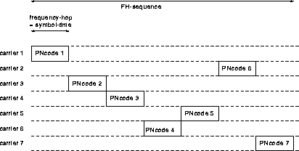
FREQUENCY HOPPING IN A PERSONAL SPACE (3)
FH in OFDMA: Hybrid FH in OFDMA spreading
Hybrid FH in OFDM spreading
  FH: (mitigation of near-far effect + spreading) + OFDM: for severe channel conditions
The whole subcarriers of an OFDM symbol are divided into 5 subbands (or groups).
  Each subband (or group) is assigned to a personal space. → DARA can be applied.
For an example with 7 FH subcarriers for a personal space
= OFDM symbol time
Subcarrier 1
OFDM1
OFDM2
OFDM3
OFDM4
OFDM5
OFDM6
OFDM7
symbol1
A part of 7 OFDM subcarriers assigned to a personal space
Subcarrier 5
symbol6
Subcarrier 13
symbol2
Subcarrier 14
symbol3
Subcarrier 25
symbol5
Subcarrier 62
symbol4
Subcarrier 79
symbol7
Slide 85

Slide 86
DIRECT SEQUENCE (DS) SPREADING IN A PERSONAL SPACE (1)
DS in FDM: Hybrid DS in FDM spreading
A set of 16 PN codewords for 16 symbol times
User i in Personal space 1
Subband 4 PN code 3
Subband 4 PN code 1
Subband 4 PN code 15
Subband 4 PN code 2
Subband 4 PN code 13
Subband 4 PN code 3
User j in Personal space 2
Subband 2 PN code 14
Subband 2 PN code 2
Subband 2 PN code 1
Subband 2 PN code 13
Subband 2 PN code 4
Subband 2 PN code 14
User k in Personal space 3
Subband 1 PN code 1
Subband 1 PN code 15
Subband 1 PN code 2
Subband 1 PN code 4
Subband 1 PN code 11
Subband 1 PN code 1
User l in Personal space 4
Subband 5 PN code 4
Subband 5 PN code 7
Subband 5 PN code 12
Subband 5 PN code 5
Subband 5 PN code 9
Subband 5 PN code 4
User m in Personal space 5
Subband 3 PN code 12
Subband 3 PN code 4
Subband 3 PN code 6
Subband 3 PN code 10
Subband 3 PN code 7
Subband 3 PN code 12
Slide 86

Slide 87
DIRECT SEQUENCE (DS) SPREADING IN A PERSONAL SPACE (2)
DS in FH: Hybrid DS in FH spreading
A set of 16 PN codewords
A set of 5 hopping subbands among personal space
User i in Personal space 1
Subband 4 PN code 3
Subband 2 PN code 1
Subband 1 PN code 15
Subband 3 PN code 2
Subband 5 PN code 14
Subband 4 PN code 13
User j in Personal space 2
Subband 2 PN code 14
Subband 5 PN code 2
Subband 4 PN code 1
Subband 1 PN code 13
Subband 3 PN code 5
Subband 2 PN code 4
User k in Personal space 3
Subband 1 PN code 1
Subband 3 PN code 15
Subband 2 PN code 2
Subband 5 PN code 4
Subband 4 PN code 7
Subband 1 PN code 11
User l in Personal space 4
Subband 5 PN code 4
Subband 4 PN code 7
Subband 3 PN code 12
Subband 2 PN code 5
Subband 1 PN code 3
Subband 5 PN code 9
User m in Personal space 5
Subband 3 PN code 12
Subband 1 PN code 4
Subband 5 PN code 6
Subband 4 PN code 10
Subband 2 PN code 8
Subband 5 PN code 7
Slide 87

Slide 88
DIRECT SEQUENCE (DS) SPREADING IN A PERSONAL SPACE (3)
DS in OFDMA: Hybrid DS in OFDMA spreading
Hybrid DS in OFDMA spreading
  DS: spreading gain + OFDM: for severe channel conditions
The whole subcarriers of an OFDM symbol are divided into 5 subbands (or groups) each of which has 16 subcarriers.
  Each subband (or group) is assigned to a personal space. → ACA can be applied.
For each subband (or group), a PN code is applied for a link in a personal space.
OFDM symbol time
For an example with 7 subcarriers for a personal space, PN code i is assigned to the ith link.
Subcarrier 1
PN code i
PN code i
PN code i
PN code i
PN code i
PN code i
PN code i
A part of OFDM subcarriers assigned to a personal space
Subcarrier 12
Subcarrier 17
Subcarrier 32
Subcarrier 58
Subcarrier 62
Subcarrier 79
Slide 88

Slide 89
OFDMA IN A PERSONAL SPACE (1)
OFDMA in FDM: Hybrid OFDM in FDM spreading
Hybrid OFDM in FDM
  OFDM: for severe channel conditions
The whole frequency band is divided into 5 subbands. Each subband is assigned to a personal space. → ACA can be applied.
For each subband, OFDMA is applied. A part of OFDM subcarriers are assigned to a link in the personal space. → DCA can be applied.
OFDM symbol time
Subband 1 for PS 1
OFDM 1
OFDM 2
OFDM 3
OFDM 4
OFDM 5
OFDM 6
Subband 2 for PS 2
OFDM 1
OFDM 2
OFDM 3
OFDM 4
OFDM 5
OFDM 6
Subband 3 for PS 3
OFDM 1
OFDM 2
OFDM 3
OFDM 4
OFDM 5
OFDM 6
Subband 4 for PS 4
OFDM 1
OFDM 2
OFDM 3
OFDM 4
OFDM 5
OFDM 6
Subband 5 for PS 5
OFDM 1
OFDM 2
OFDM 3
OFDM 4
OFDM 5
OFDM 6
Slide 89

Slide 90
OFDMA IN A PERSONAL SPACE (2)
OFDMA in FH: Hybrid OFDM in FH spreading
Hybrid OFDM in FH spreading
  FH: (mitigation of near-far effect + spreading) + OFDM: for severe channel conditions
The whole frequency band is divided into 5 subbands. Each subband is assigned to a personal space. → ACA can be applied.
For each subband, OFDMA is applied for multiple links. A part of OFDM subcarriers are assigned to a link in the personal space. → DCA can be applied.
Each color for a different personal space
One FH sequence
OFDM symbol time
Subband 1
OFDM 5
OFDM 1
OFDM 2
OFDM 3
OFDM 4
OFDM 5
OFDM 1
Subband 2
OFDM 5
OFDM 1
OFDM 2
OFDM 3
OFDM 4
OFDM 5
OFDM 1
Subband 3
OFDM 5
OFDM 1
OFDM 2
OFDM 3
OFDM 4
OFDM 5
OFDM 1
Subband 4
OFDM 5
OFDM 1
OFDM 2
OFDM 3
OFDM 4
OFDM 5
OFDM 1
Subband 5
OFDM 5
OFDM 1
OFDM 2
OFDM 3
OFDM 4
OFDM 5
OFDM 1
Slide 90

Slide 91
OFDMA IN A PERSONAL SPACE (3)
Multiple access with Hybrid FH/OFDMA
Hybrid OFDMA in FH
  Multiple access among personal spaces
    by changing a subband for each OFDM symbol according to a hopping pattern
  Multiple access among links in a personal space
    by assigning a different group of OFDM subcarriers to a link
Hybrid FH in OFDMA
  Multiple access among personal spaces
    by assigning a fixed group of OFDM subcarriers to a personal space
  Multiple access among links in a personal space
    by assigning a different subcarrier for a symbol in each OFDM symbol period according to a hopping pattern
Slide 91

Slide 92
DYNAMIC SINGLE FREQUENCY NETWORK (1)
Dynamic single frequency network (DSFN)
Conditions of DSFN
  One way with DSFN: downlink only: simulcast
    Uplink can be implemented through communications with the PSC manager.
  Need a central system controller for scheduling
    PSC manager can be a system controller.
DSFN concept can be applied for range extension and hand-off
  Multi language interpretation system
  Personal media
  Wireless (mobile) VoIP
Slide 92

Slide 93
DYNAMIC SINGLE FREQUENCY NETWORK (2)
Dynamic single frequency network (DSFN)
How can PSC managers in multiple public spaces receive signals simultaneously?
  Is there a time difference between receptions by the first PSC manager and the second because the first sends the signal to the second and the second will send it again.
  OFDM can overcome this problem because it has relatively longer symbol period.
How can a receiver eliminate weaker signals among multiple received signals?
  Pick up the stronger signal among received signals
  There are some ways to process (and combine) received signals constructively rather than to select the strongest.
→ Combining – In combining, all antennas maintain established connections at all times. The signals are then combined and presented to the receiver. Depending on the sophistication of the system, the signals can be added directly (equal gain combining) or weighted and added coherently (maximal-ratio combining). Such a system provides the greatest resistance to fading but since all the receive paths must remain energized, it also consumes the most power.
Slide 93

Slide 94
USE CASES REQUIRING DSFN (1)
Multi Lingual Interpretation System [4] with Range Extension [9]
Need relay among public spaces: some listeners move to other public spaces.
PSC manager
PSC manager
PSC manager: range extender: Synchronous system with robust sync
Listeners
Listeners
Two-way communication should be better if consider Q&A sessions.
Public space 1
Area 1: 0-30 m
Public space 2
Area 2: 30-60 m
Slide 94

Slide 95
USE CASES REQUIRING DSFN (2)
Personal Media [9]
Need relay among public spaces: for ex., one mobile device can access a media source in another room.
Slide 95

Slide 96

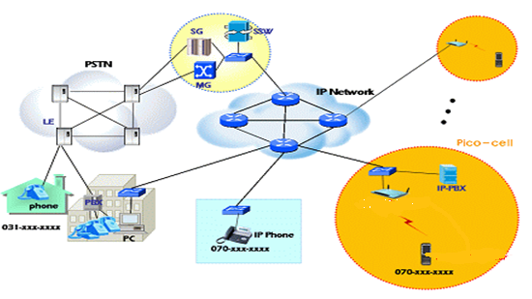
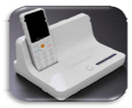
USE CASES REQUIRING DSFN (3)
Wireless (Mobile) VoIP [9]
Channel capacity
: concurrent active channels
Soft handover
Privacy
Repeater – cell extender
Wireless Mobile VoIP:
Mobile VoIP, Wireless PBX
Need relay among public spaces: for ex., a mobile VOIP device accesses the access point in another room via the PSC manager.
PSC VoIP terminal
Slide 96

Slide 97
DYNAMIC SINGLE FREQUENCY NETWORK (3)
Dynamic single frequency network (DSFN)
Dynamic Single Frequency Networks (DSFN) is a transmitter macrodiversity technique for OFDM based networks. Digital wireless communication systems based on the OFDM modulation scheme are well-suited to SFN operation, since OFDM in combination with some forward error correction scheme can eliminate intersymbol interference and fading caused by multipath propagation without the use of complex equalization.
→ DSFN can be considered as a combination of packet scheduling, macro-diversity and dynamic channel allocation (DCA).
→ DSFN concept can be applied for range extension and hand-off
Slide 97

Slide 98
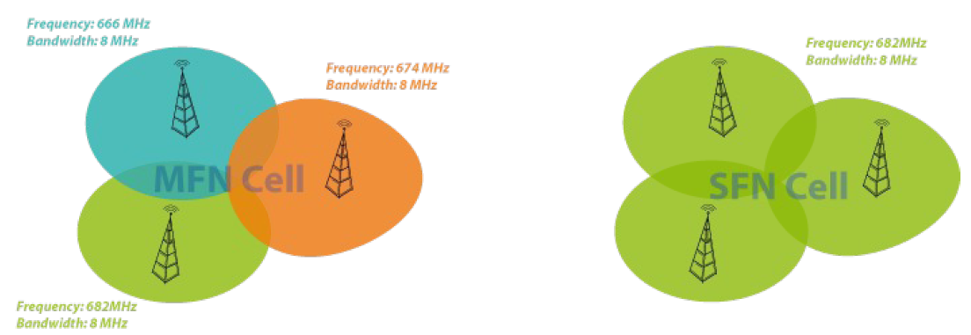
DYNAMIC SINGLE FREQUENCY NETWORK (4)
Dynaic single frequency network (DSFN)
Comparison between MFN and SFN topology
Slide 98

Slide 99
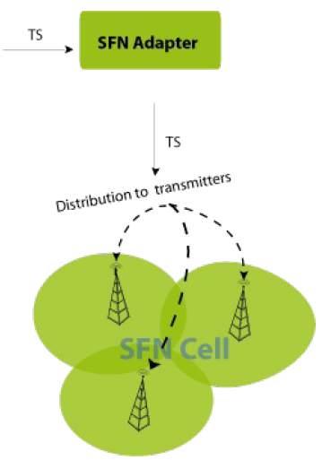
DYNAMIC SINGLE FREQUENCY NETWORK (5)
Dynamic single frequency network (DSFN)
Transmission parameters:
guard interval, bandwidth, FFT mode etc.
Synchronization information:
Temporal sync: Time stamp and time budget (max. network delay, etc.)
Frequency Sync: using 10MHz clock signal
→ DSFN concept can be applied for range extension and hand-off
A simple SFN network:
Providing synchronization and all transmission information to transmitters
Slide 99

Slide 100
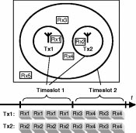
DYNAMIC SINGLE FREQUENCY NETWORK (6)
Dynamic single frequency network (DSFN) [14]
DSFN enables soft handover, meaning that when a receiver terminal moves from one base station transmitter toward another, both transmitters send to the receiver awhile instead of abruptly switching from the first to the second transmitter. Soft handover is robust toward sudden shadow fading of one of the transmitters.
→ DSFN can be applied for coverage extension and relay using soft handover.
A simple example of dynamic single frequency networks. Top: Coverage map. Below: Data packet schedule, stating the packet destinations.
Slide 100

Slide 101
RANGE EXTENSION AND SOFT HANDOVER (1)
Multi Lingual Interpretation System [4] with Range Extension
Need relay among public spaces: some listeners move to other public spaces.
PSC manager
PSC manager
PSC manager: range extender: Synchronous system with robust sync
How to communicate between two PSC managers? → using a set of or a part of frequency band as a channel
Listeners
Listeners
Public space 1
Area 1: 0-30 m
Public space 2
Area 2: 30-60 m
Slide 101

Slide 102
RANGE EXTENSION AND SOFT HANDOVER (2)
PSC manager transmissions for range extension and soft handover
CASE 1: one example
The PSC manager can transmit a packet using public space control group and receive another packet using another group simultaneously in a payload segment.
All frequency subcarriers are divided into 5 groups: Group 1, Group 2, …, Group 5.
  Each group has 16 subcarriers.
  Group 1 is assigned as the public space control channel: this group provides a channel for communication among PSC managers.
  Other groups are used for in-space communications.
A device in a public space sends a packet twice in two consecutive payload segments using another group assigned for in-space communication only for the case of necessity of relay.
Problems to be solved
PSC manager: range extender: Synchronous system with robust sync
Need to clarify how to communicate between two PSC managers? → through Group 1
In a frame structure of 15 segments, how can this scheme be continued to the next frame? → continue in the next frame.
How can a device transmit and receive at the same time? Still problem with different groups for TX and RX. → only FDD can be applied. OFDM can be applied by assigning different groups.
Slide 102

Slide 103
RANGE EXTENSION AND SOFT HANDOVER (3)
Down: through PSC managers for range extension and soft handover
Device i in Public space 1: for transfer to PSC manager 1
RX: Groups a TX: Groups a
FCH
sync
Packet 1
sync
Packet 1
sync
Packet 2
sync
Packet 2
sync
Public space 1 PSC manager: for transfer to PSC manager 2
RX: Groups a TX: Group 1
FCH
sync
Packet 1
sync
Packet 1
Packet 1
sync
Packet 2
Packet 1
sync
Packet 2
Packet 2
sync
Public space 2 PSC manager
RX: Groups 1 TX: Group 1
FCH
sync
sync
Packet 1
sync
Packet 1
Packet 1
sync
Packet 2
Packet 1
sync
macrodiversity
This might be the problem because of TX and RX with the same group. One possible way is to use directional antennas: can be solved using DSFN concept, even the case of OFDM.
Payload segment 0
Payload segment 1
Payload segment 2
Payload segment 3
Payload segment 15
Slide 103

Slide 104
RANGE EXTENSION AND SOFT HANDOVER (4)
Down: through PSC managers for range extension and soft handover
In Public space 1,
  Device i sends Packet 1 in Payload segments 0 and 1 using Group a.
  PSC manager 1 sends Packet 1 in Payload segments 1 and 2 using Group 1.
  Devices in Public space 1 receive Packet 1 twice in Payload segments 0 and 1 using Group a and twice in Payload segments 1 and 2 using Group 1.
Public space 1 PSC manager
RX: Groups a TX: Group 1
FCH
sync
Packet 1
sync
Packet 1
Packet 1
sync
Packet 2
Packet 1
sync
Packet 2
Packet 2
sync
Payload segment 0
Payload segment 1
Payload segment 2
Payload segment 3
Payload segment 15
Slide 104

Slide 105
RANGE EXTENSION AND SOFT HANDOVER (5)
Down: through PSC managers for range extension and soft handover
In Public space 2,
  PSC manager 2 sends Packet 1 in Payload segments 2 and 3 using Group 1.
  Devices in Public space 2 receive Packet 1 twice in Payload segments 2 and 3 using Group 1. If needed, PSC manager 2 sends packets using another group.
Every other payload segment a device can have soft handover by receiving a packet from two adjacent PSC managers, for ex., a device receives Packet 1 in Payload segment 2 from both PSC managers 1 and 2: instantaneous handover.
Delay due to this relay/handover is two payload segment periods: 1/2 throughput.
Public space 2 PSC manager
RX: Groups 1 TX: Group 1
FCH
sync
sync
Packet 1
sync
Packet 1
Packet 1
sync
Packet 2
Packet 1
sync
Payload segment 0
Payload segment 1
Payload segment 2
Payload segment 3
Payload segment 15
Slide 105

Slide 106
RANGE EXTENSION AND SOFT HANDOVER (6)
Up: through PSC managers for range extension and soft handover
Device j in Public space 2: for transfer to PSC manager 2
RX: Groups b TX: Groups b
FCH
sync
Packet 1
sync
Packet 1
sync
Packet 2
sync
Packet 2
sync
Public space 2 PSC manager: for transfer to PSC manager 1
RX: Groups b TX: Group 1
FCH
sync
Packet 1
sync
Packet 1
Packet 1
sync
Packet 2
Packet 1
sync
Packet 2
Packet 2
sync
Public space 1 PSC manager
RX: Groups 1 TX: Group 1
FCH
sync
sync
Packet 1
sync
Packet 1
Packet 1
sync
Packet 2
Packet 1
sync
macrodiversity
This might be the problem because of TX and RX with the same group. One possible way is to use directional antennas : can be solved using DSFN concept, even the case of OFDM.
Payload segment 0
Payload segment 1
Payload segment 2
Payload segment 3
Payload segment 15
Slide 106

Slide 107
KEY ISSUES FOR FRAME STRUCTURE DESIGN
  Fast synch <500 us
    A PSC manager device provides sync periodically.
    Every 1ms, 4 octet preamble is sent: 32 us for 500 Kbps with QPSK: sync information every 1 ms
  Low latency <16 ms
    16 ms frame
    In this frame, all contents are included.
    At least, a content is repeated every 16 ms.
  Avoidance of mutual interference
    FHSS is applied.
    Number of transmissions impacted by mutual interference can be minimized by segmenting information and assigning channels randomly to these segments.
30 m diameter = max. 0.1 us propagation time difference, max
between two devices for in space communication
and
100 m distance = max. 0.33 us propagation time difference, max
between two PSC managers for inter space communications
Slide 107

Slide 108
KEY ISSUES FOR FREQUENCY PLAN DESIGN
  Dynamically scalable data rates
    20K, 200K, 1M, 4M, 16M, and 54M
    Data rate = symbol rate x no. subcarrier x log₂(no. signal levels) for OFDM case
    54M <= 1M x 16 x 4
  ISI (inter symbol interference)
    Depends on frequency spacing:
    1MHz spacing = 1us symbol duration
    Longer ISI is more immune to multipath fading
  Avoidance of mutual interference
    FHSS is applied inside of a group among subcarriers.
    Some subcarriers are eliminated to avoid interference from other transmitters.
OFDM/OFDMA
30 m diameter = max. 0.1 us propagation time difference, max
=
Cyclic prefix for guard interval for OFDM = 0.1 us
Slide 108

Slide 109
TWO FREQUENCY BANDS CONSIDERED
2.4 GHz
  physical environment where, due to the longer wavelength, LOS is not necessary and multipath may be significant
    The ability to support near-LOS and non-LOS (NLOS) scenarios requires additional PHY functionality, such as the support of advanced power management techniques, interference mitigation/coexistence, and multiple antennas.
  license-exempt: need mechanisms to facilitate the detection and avoidance of interference and the prevention of harmful interference into other users including specific spectrum users identified by regulation: dynamic frequency selection (DFS).
60 GHz
  physical environment where, due to the short wavelength, line-of-sight (LOS) is required and multipath is negligible
  Typical channel bandwidths of 25 MHz or 28 MHz
  well suited for point-to multipoint (PMP) access serving applications from small office/home office (SOHO) through medium to large office applications
Slide 109

Slide 110
SYMBOL/DATA RATES, FDM/FDMA AND FDM/TDMA
Assumptions:
  BPSK or any other more efficient modulation can be applied: up to 16QAM (=4bits/symbol).
  Total bandwidth for a personal space is 16MHz: FDM for five personal spaces in a public space.
  For each personal space, total data rate is 54Mbps
  Up to five user groups in a personal space.
FDMA among groups
  Five user groups in a personal space with BW of 3MHz for each group
  For a group, Symbol length = 1/3 us and BW of a carrier = 3MHz
  Symbol rate for a group = 3Msps
  Max. Data rate for a group = 3Msps x max no. bits per symbol = 3Msps x 4 bits/symbol = 12 Mbps → total max data rate = 60Mbps
TDMA
  Time division for five groups in a frame, payload by payload
  Symbol length = 1/16 us and BW of a carrier = 16 MHz with time division
  Total symbol rate for each personal space = 16Msps for five groups
  Total data rate for each personal space = 16Msps x max no. bits per symbol = 16Msps x 4 bits/symbol = 54 Mbps with overhead: max data rate for a group if this group uses all payloads.
Slide 110

Slide 111
SYMBOL/DATA RATES, FDM/FH
Assumptions:
  BPSK or any other higher efficient modulation can be applied: up to 16QAM (=4bits/symbol).
  Total bandwidth for a personal space is 16MHz: FDM for five personal spaces in a public space.
  For each personal space, total data rate is 54Mbps.
  A unique FH sequence is assigned to each device group: hopping rate is one hop per symbol.
  Symbol length = 1us and BW of a carrier = 1MHz
  Symbol rate = 1Msps
  Max. Data rate = 1Msps x max no. bits per symbol = 1Msps x 4 bits/symbol = 4Mbps for each group
  For each group, only 4Mbps can be achieved. This may be a problem for FDM/FH systems .
Slide 111

Slide 112
SYMBOL/DATA RATES, FDM/DS
Assumptions:
  BPSK or any other higher efficient modulation can be applied: up to 16QAM (=4bits/symbol).
  Total bandwidth for a personal space is 16MHz: FDM for five personal spaces in a public space.
  For each personal space, total data rate is 54 Mbps.
  16 chips per symbol and 64 16 bit orthogonal codewords for the PN code: two 8bit orthogonal codewords concatenated to construct 64 16 bit codewords
First half of the code for device grouping and second half for multiple access in a group
  Up to 8 groups for each personal space, up to 8 devices for each group
  Symbol length = 1us and BW of a carrier = 16MHz
  → chip length = 1/16 = 0.0625 us → chip rate = 16Mcps
  Symbol rate = 1Msps
  Max. Data rate = 1Msps x max no. bits per symbol = 1Msps x 4 bits/symbol = 4Mbps for each device for the case that less groups is better with multiple simultaneous transmissions
16 bit code for device grouping and TDMA for multiple access in a group
  Symbol length = 1us and BW of a carrier = 16 MHz
  → chip length = 1/16 = 0.0625us → chip rate = 16Mcps
  Symbol rate = 1Msps
  Max. Data rate = 1Msps x max no. bits per symbol = 1Msps x 4 bits/symbol = 4Mbps for each group for the case that more groups is better with one transmission
Slide 112

Slide 113
SYMBOL/DATA RATES, FDM/DS IN FH
Assumptions:
  BPSK or any other higher efficient modulation can be applied: up to 16QAM (=4bits/symbol).
  Total bandwidth for a personal space is 16MHz : FDM for five personal spaces in a public space, FH for 16 groups in a personal space, DS for 64 devices in a group.
  For each personal space, total data rate is 54Mbps.
  16 chips per symbol and 64 16 bit orthogonal code for PN code : two 8bit orthogonal codewords concatenated to construct 64 16 bit codewords.
  A unique FH sequence is assigned to each user group: hopping rate is one hop per symbol.
  Symbol length = 1us and BW of a FH carrier = 1MHz
  → chip length = 1/16 us → chip rate = 16Mcps
  Symbol rate = 1Msps x 16 FH carriers = 16Msps per personal space
  Max. Data rate = 16Msps x max no. bits per symbol = 16Msps x 4 bits/symbol = 54Mbps
Slide 113

Slide 114
OFDM SYMBOL/DATA RATES, FDM/OFDM IN FH
Assumptions:
  BPSK or any other higher efficient modulation can be applied: up to 16QAM (=4bits/symbol).
  Total bandwidth for a personal space is 16MHz: FDM for five personal spaces in a public space, FH for 16 groups in a personal space, ODFM(A) for up to 16 devices in a group.
  For each personal space, total data rate is 54Mbps
  16 chips per symbol and 64 (=8x8) 16 bit orthogonal codewords for PN code
  A guard interval of 1/8 of the symbol length is inserted between each symbol.
  A unique FH sequence is assigned to each user group: hopping rate is one hop per symbol.
  Cyclic prefix of a guard interval = 2 us
  Symbol length = 16 us → BW of a OFDM subcarrier = 1/16 MHz
  Total symbol length = (16+2) us = 18 us
  OFDM symbol rate = 1/18Msps = 0.056Msps
  Symbol rate = 0.056Msps x 16 subcarriers = 0.89Msps per group
  Max. Data rate = 0.89Msps x max no. bits per symbol = 0.89Msps x 4 bits/symbol = 3.56 Mbps for each group
Slide 114

Slide 115
OFDM SYMBOL/DATA RATES, FDM/FH IN OFDM, FFT=16
Assumptions:
  BPSK or any other higher efficient modulation can be applied: up to 16QAM (=4bits/symbol).
  Total bandwidth for a personal space is 16MHz: FDM for five personal spaces in a public space, OFDMA for up to 16 groups in a personal space, FH for up to 16 devices in a group.
  For each personal space, total data rate is 54 Mbps
  A guard interval of 1/8 of the symbol length is inserted between each symbol.
  A unique FH sequence is assigned to each user group: hopping rate is one hop per symbol.
  Cyclic prefix of a guard interval = 0.125 us
  Symbol length = 1 us → BW of a subcarrier = 1 MHz
  Total symbol length = (1+0.125) us = 1.125 us
  OFDM symbol rate = 1/1.125Msps = 0.89Msps
  Symbol rate = 0.89Msps x 16 subcarriers = 14.2Msps
  Max. Data rate = 14.2Msps x max no. bits per symbol = 14.2 Msps x 4 bits/symbol = 56.8 Mbps for each personal space
Slide 115

Slide 116
OFDM SYMBOL/DATA RATES, FDM/FH IN OFDM, FFT=32
Assumptions:
  BPSK or any other higher efficient modulation can be applied: up to 256QAM (=4bits/symbol).
  Total bandwidth for a personal space is 16MHz: FDM for five personal spaces in a public space, OFDMA for up to 16 groups in a personal space, FH for up to 16 devices in a group.
  For each personal space, total data rate is 54 Mbps
  A guard interval of 1/8 of the symbol length is inserted between each symbol.
  A unique FH sequence is assigned to each user group: hopping rate is one hop per symbol.
  One half of FFT inputs (=16) are assigned to input data elements for use of better channels: No. of non-silent subcarriers = 16.
  Cyclic prefix of a guard interval = 0.25 us
  Symbol length = 2 us → BW of a subcarrier = 0.5 MHz
  Total symbol length = (2+0.25) us = 2.25 us
  OFDM symbol rate = 1/2.25 Msps = 0.45 Msps
  Symbol rate = 0.45 Msps x 16 subcarriers = 7.1 Msps
  Max. Data rate = 7.1 Msps x max no. bits per symbol = 7.1 Msps x 8 bits/symbol = 56.8 Mbps
Slide 116

Slide 117
COMPARISON OF FREQUENCY SPREADING/MULTIPLE ACCESS METHODS
Multiple access for grouping (multiple access for personal spaces : FDM) | FDMA | TDMA | FH | DSSS |  | DS in FH | OFDM in FH | FH in OFDM FFT=16 | FH in OFDM FFT=32
Multiple access in a group | TDMA | TDMA | TDMA | DS | TD | DS | OFDMA | FH | FH
Symbol length (us) ← ISI resistance | 1/3 | 1/16 | 1 | 1 |  | 1 | 18 | 1.125 | 2.25
Chip length (us) |  |  |  | 1/16 |  | 1/16
Total BW of a personal space (MHz) | 16 | 16 | 16 | 16 |  | 16 | 16 | 16 | 16
BW per user group (MHz) | 3 | 16 | 1 | 16 | 16 | 1 | 1 | 1 | 0.5
Max. No. device groups | 5 | 5 | 16 | 8 | 64 | 16 | 16 | 16 | 16
No. concurrent transmitters per group | 16 | 16 | 1 | 8 | 1 | 64 | 1 | 16 | 16
Total symbol rate per group (Msps) | 3 | 3.2 | 1 | 16 |  | 1 | 0.89 | 14.2 | 7.1
chip rate (Mcps) |  |  |  | 256 |  | 16
freq synthesizer change period (us) ← resistance to RF spill | No change | No change | 1, flex | No change |  | 1,flex | 18 | No change | No change
Hoping rate (Mhops/sec) |  |  | 1 |  |  | 1 | 0.89 | 14.2 | 7.1
Slide 117

Slide 118
PAYLOAD ASSIGNMENT FOR TEMPORAL RESOURCE MANAGEMENT (1)
  16 payload segments
    Each user occupies one or more payload segments.
    Short data users utilize the last segment all together.
    Each personal space (or each user) has its own FH sequence or subchannels which applies to payload segments.
16 ms fixed, frame
1 ms fixed
FCH
sync
Payload segment 0
sync
Payload segment 1
sync
Payload segment 15
User 0
User 1
Short data users
968 us, DBPSK,
484 bits=60 bytes
Slide 118

Slide 119
PAYLOAD ASSIGNMENT FOR TEMPORAL RESOURCE MANAGEMENT (2)
  For lowest rate information sources
  For highest rate information sources
16 ms fixed, frame
1 ms fixed
FCH
sync
Payload segment 0
sync
Payload segment 1
sync
Payload segment 15
source 0
source 1
Short data sources
968 us, DBPSK,
484 bits=60 bytes
FCH
sync
Payload segment 0
sync
Payload segment 1
sync
Payload segment 15
source 0
source 0
source 0
Slide 119

Slide 120
SYNCHRONIZED RELAYS AMONG PUBLIC SPACES (1)
  Two types of synchronized relays among public spaces
    Chased relay network: chased personal space for a self-configuring network for a moving device connected by wireless links
    A personal space follows an individual who moves to another public space.
    Communication between adjacent public spaces needed
    Relay for space expansion (or coverage expansion or range extension)
      Ad-hoc network formed between public spaces
      Hand-over needed for moving from one public space to another
: Common sync
: Data exchange between PSC managers
S
S
S
S
S
M
S
M
S
M
S
M
S
S
S
S
S
M: PSC manager
S: non-manager device
Slide 120

Slide 121
SYNCHRONIZED RELAYS AMONG PUBLIC SPACES (2)
  Chased relay network (personal space with mobile PSC terminals)
  An individual (or user) moves to another public space while it communicates with a machine in the old public space.
  This individual expands his/her personal space in the new public space.
  Some of machines in the old public space need to communicate with the moving device: communications between two public spaces needed.
  Registration process is needed for a public space and the personal space.
  Soft hand-over between two adjacent public spaces
Old public space
New public space
: Common sync
: Data exchange between PSC managers
S
S
S
S
S
M
S
M
S
M
S
M
S
S
S
S
S
M: PSC manager
S: non-manager device
Slide 121

Slide 122
SYNCHRONIZED RELAYS AMONG PUBLIC SPACES (3)
  Relay for space expansion (or range extension)
    Ad-hoc network formed throughout multiple public spaces
    Hand-over is necessary when a device moves from one personal space to another.
    Communication among public spaces in a region to form an ad-hoc network throughout multiple public spaces
Personal space (Ad hoc network)
: Common sync
: Data exchange between PSC managers
S
S
S
S
S
M
S
M
S
M
S
M
S
S
S
S
S
M: PSC manager
S: non-manager device
M: PSC manager
S: non-manager device
Slide 122

Slide 123
SYNCHRONIZED RELAYS AMONG PUBLIC SPACES (4)
  Synchronized relay between two adjacent public spaces:
    This type of sync relay can be done through PSC managers of two adjacent public spaces.
    A device in a public space asks the PSC manager to establish a comm. link using the same communication channel: this PSC manager will become a member of the same personal space.
    This PSC manager has a link with PSC manager of the next adjacent public space using a fixed set of frequencies and/or sequences: communications among PSC managers of adjacent public spaces. MAC level association needed
    The PSC manager of the new public space has a link to the destination device with the same channel that this device is currently using to become a member of this personal space.
: Common sync
: Data exchange between PSC managers
S
S
S
S
S
M
S
M
S
M
S
M
S
M: PSC manager
S: non-manager device
Old public space
S
S
S
S
New public space
Slide 123

Slide 124
SYNCHRONIZATION THROUGHOUT A REGION
Frequency set and/or sequence for sync channel for a public space in the same region
  The fixed set and/or sequence of frequencies assigned to the first personal space formed in a public space: always fixed for all public spaces.
    The PSC manager of a public space monitors sync signals for all sets of subchannels or sequences. If it detects any signal, it selects and uses a sequence or subchannels for its sync.
    Thus all public spaces in a region maintain the same sync.
    FCH is sent using the same sequence or subchannels.
Public space 1
Public space N
: Common sync
: Data exchange between PSC managers
S
S
S
S
S
M
S
M
S
M
S
M
S
M: PSC manager
S: non-manager device
Region
S
S
S
S
M: PSC manager
S: non-manager device
Slide 124

Slide 125
SYNCHRONIZED COMMUNICATION THROUGHOUT A REGION
  Synchronized communications among public spaces:
    This type of sync communications are needed to exchange information (synchronized or non synchronized) among devices in a region: this type of communications can be done through relays among PSC managers of adjacent public spaces in a region.
      A device in a public space talks with the PSC manager.
      PSC managers communicate with other PSC managers using a fixed set of subchannels and/or sequences to form a network among PSC managers.
    Through the above two links, a device can communicate with another device in a different public space in a region.
Public space 1
Public space N
: Common sync
: Data exchange between PSC managers
S
S
S
S
S
M
S
M
S
M
S
M
S
M: PSC manager
S: non-manager device
Region
S
S
S
S
M: PSC manager
S: non-manager device
Slide 125

Slide 126
Summary and Conclusions
Slide 126

Slide 127
SUMMARY AND CONCLUSIONS
SUMMARY
  Overview of PSC is presented.
  Some unique features for PSC are emphasized.
    To suggest ideas on why PSC is unique and distinctive.
  Some technologies which may be applied for this PSC are analyzed for showing technical feasibility of PSC.
    To show which technologies can be considered at this moment.
CONCLUSIONS
  Some unique features are identified for PSC.
    Dynamic scalability of data rates
    Fast, easy and simple association
    Concurrent broadcasting of multiple various rate multimedia streams
    Multi-peer group communication with low latency
  These features will be implemented with one technology (one MAC+PHY).
    Not combining multiple technologies into a combo chip
Slide 127

Slide 128
REFERENCES
15-10-0169-01, Overview and Requirements of Personal Environment Service, Jongtaek Oh, et al., Mar. 2010
15-10-0156-03, Personal Space Communication with WPAN Broadcasting, S. M. Ryu, et al., Mar. 2010
15-10-0295-00, Telecom Services and Personal Space Communication, Liang Li, et al., May 2010
15-10-0349-00, Personal Broadcasting for Personal Space Communication, S. M. Ryu, et al., May 2010
RECOMMENDATION ITU-R M.1822 Framework for services supported by IMT
15-10-0635-00-0psc-sg-psc-draft-par
15-10-0636-00-0psc-sg-psc-draft-5c
15-10-0350-00-0psc-regarding-psc-definition
15-10-0594-00-0psc-psc-use-cases-and-technical-requirements
15-10-0595-00-0psc-scope-of-communications-for-the-personalized-space
15-10-0608-01-0psc-mobile-terminal-relay-and-psc
http://www.palowireless.com/bluearticles/packets.asp
http://grouper.ieee.org/groups/802/15/pub/2003/Jan03/03036r0P802-15_WG-802-15-4-TG4-Tutorial.ppt
Slide 128

Slide 129
REFERENCES
14. Dynamic Single Frequency Networks, Magnus Eriksson, IEEE JOURNAL ON SELECTED AREAS IN COMMUNICATIONS, VOL. 19, NO. 10, OCTOBER 2001.
Slide 129

