Slide 1
Project: IEEE P802.15 Working Group for Wireless Personal Area Networks (WPANs)
Submission Title: 802.15.4k Channel Interference Profiles
Date Submitted: 16, Jan 2011
Source: Sourav Dey Company (On-Ramp Wireless, Inc.)
Address 10920 Via Frontera, Suite 200, San Diego, CA 92127 USA
Voice:858-592-6008, FAX: 858-592-6009, E-Mail: sourav.dey@onrampwireless.com
Re: ISM 2.4GHz Channel Interference Profiles
Abstract: The presentation presents a number of channel interference profiles for 2.4 GHz unlicensed LECIM deployments. Key observations include the asymmetric nature of interference between potential endpoint and access point locations. Endpoint locations show minimal rise over thermal whereas access point locations show significant rise over thermal due to co-located transmitters and a high height. Also of note is the dynamic nature of the ISM band interference.
Purpose: Illustrate 2.4GHz ISM band interference profiles
Notice: This document has been prepared to assist the IEEE P802.15. It is offered as a basis for discussion and is not binding on the contributing individual(s) or organization(s). The material in this document is subject to change in form and content after further study. The contributor(s) reserve(s) the right to add, amend or withdraw material contained herein.
Release: The contributor acknowledges and accepts that this contribution becomes the property of IEEE and may be made publicly available by P802.15.

Slide 2
802.15.4k Channel Interference Profiles Sourav Dey On-Ramp Wireless
20/1/2010

Slide 3
Purpose
Illustrate 2.4 GHz ISM band interference profile
Endpoint locations which are located close to the ground
Undeveloped Land
Industrial Park Transformer Pad
Commercial Zone
Residential Area Transformers
Advantaged access point locations which are located high above the ground
Office Building Rooftop
Mt. Woodson Antenna Farm
Black Mt. Antenna Farm

Slide 4
Map of Measurement Locations

Slide 5
Measurement Methodology
Two measurements at each site
Sampled 15 MHz power after RF and ADC
Sampled 1 MHz power after RF, ADC, and digital filtering
Sampled over a 60-300 ms window of time
Measurement assumptions
5.6 dB receiver noise figure
Thermal noise at room temperature:
Rise over thermal noise due to ISM band interference
Bandwidth | Thermal Noise Floor | Noise Figure | Measured Noise Floor
15 MHz | -102.24 dBm | 5.6 dB | -96.64 dBm
1 MHz | -114.0 dBm | 5.6 dB | -108.4 dBm

Slide 6
Shield Box
Center Frequency = 2472 MHz
Mean 1 MHz Power = -108.13 dBm
Mean 15 MHz Power = -95.76 dBm
Close match with expected thermal noise measurement
1 MHz Thermal Noise Floor

Slide 7
Summary of Measurements
Location | Mean 1 MHz Power Measurement (dBm) | Mean 15 MHz Power Measurement (dBm)
Shield Box | -108.1 | -95.8
Undeveloped Land | -108.4 | -96.8
Light Industrial Pad Mount Transformer | -108.0 | -95.8
Commercial Zone | -107.2 | -94.0
Residential Underground Meter | -107.6 | -95.1
Residential Pad Mount Transformer | -107.0 | -93.5
Office Building Rooftop | -105.5 | -87.8
Mt. Woodson Antenna Farm | -101.1 | -86.0
Black Mt. Antenna Farm | -94.2 | -80.7

Slide 8
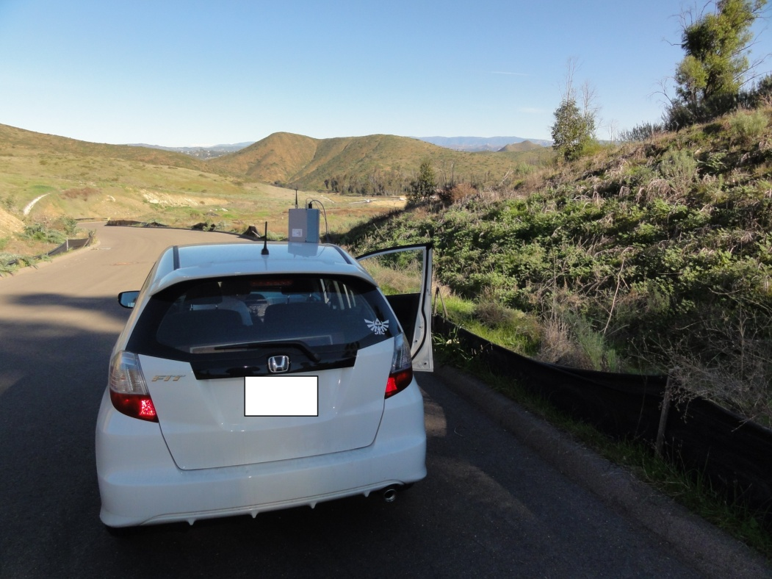
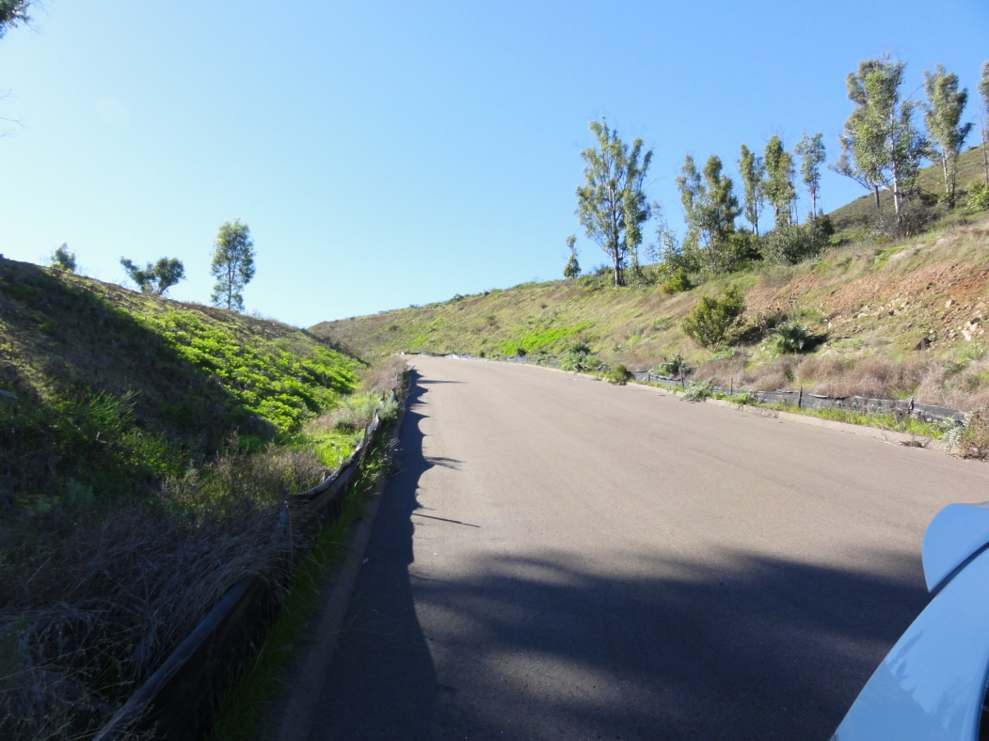
Undeveloped Land

Slide 9
Undeveloped Land
Center Frequency = 2426MHz
Mean 1 MHz Power = -108.41 dBm
Mean 15 MHz Power = -96.79 dBm
Close match with expected thermal noise measurement
1 MHz Thermal Noise Floor

Slide 10
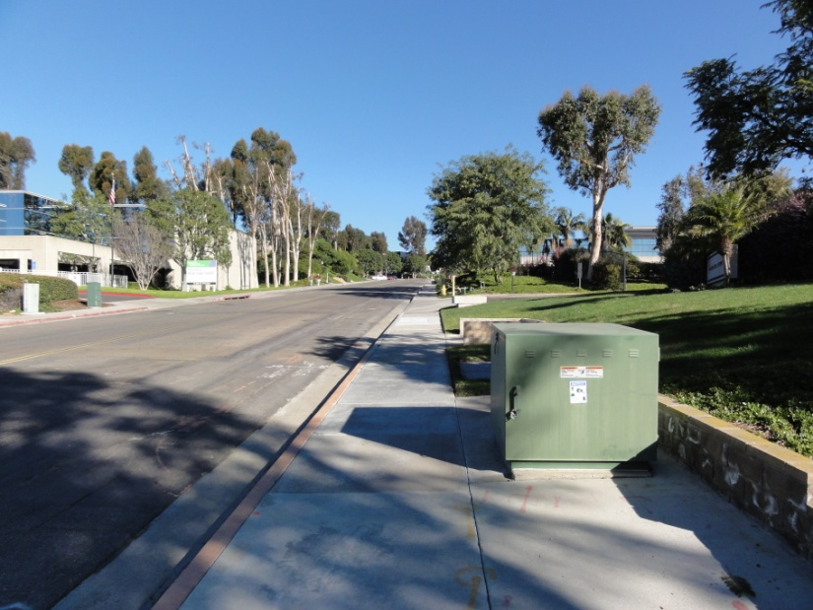
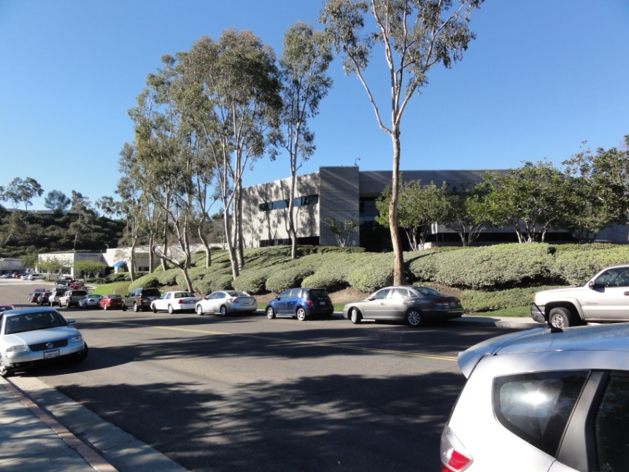
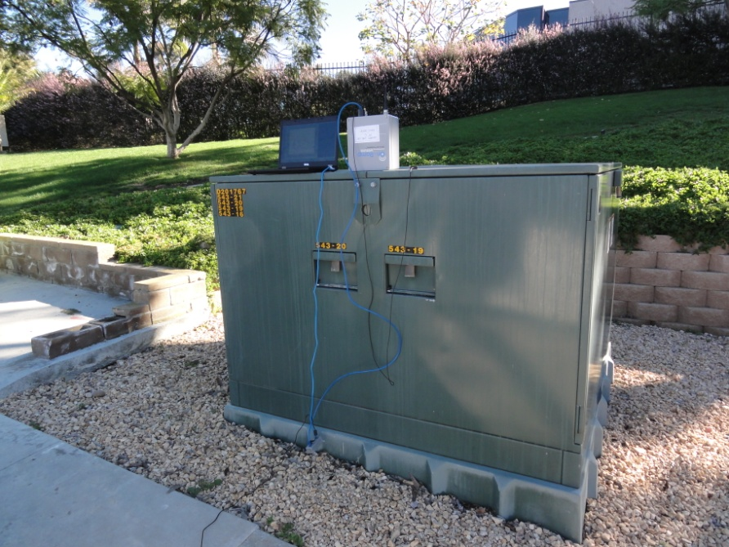
Light Industrial Pad Mount Transformer

Slide 11
Light Industrial Pad Mount Transformer
Center Frequency = 2426MHz
Mean 1 MHz Power = -107.98 dBm
Mean 15 MHz Power = -95.84 dBm
1 MHz Thermal Noise Floor

Slide 12
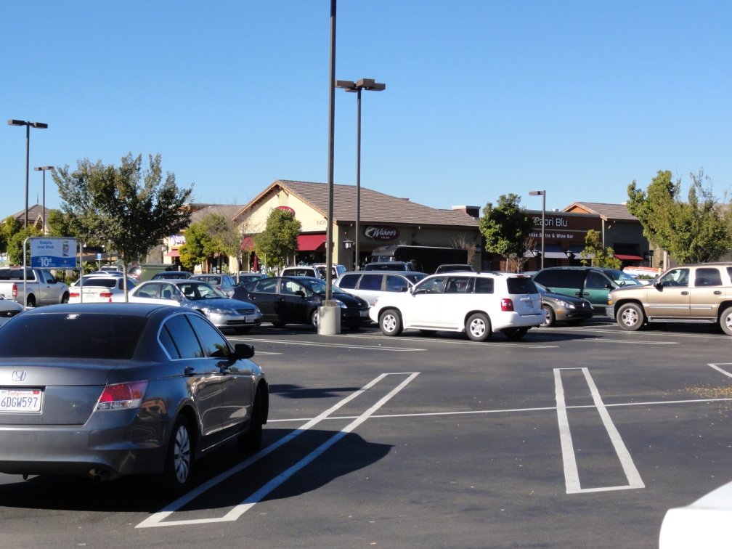
Commercial Zone

Slide 13
Commercial Zone
Center Frequency = 2426MHz
Mean 1 MHz Power = -107.24 dBm
Mean 15 MHz Power = -94.04 dBm
1 MHz Thermal Noise Floor

Slide 14
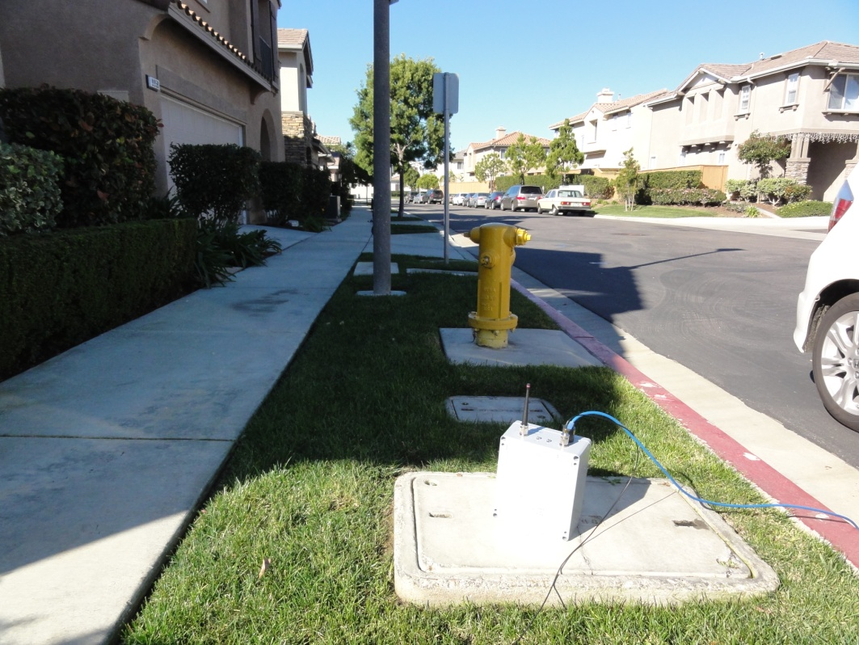
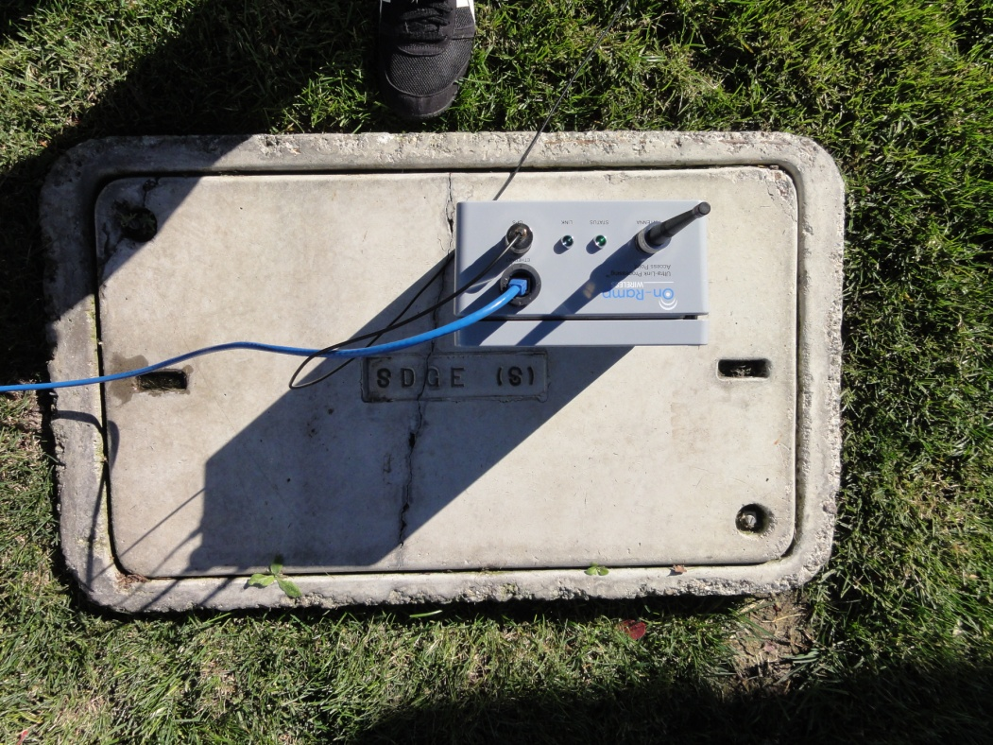
Residential Underground Meter

Slide 15
Residential Underground Meter
Center Frequency = 2426MHz
Mean 1 MHz Power = -107.64 dBm
Mean 15 MHz Power = -95.10 dBm
1 MHz Thermal Noise Floor

Slide 16
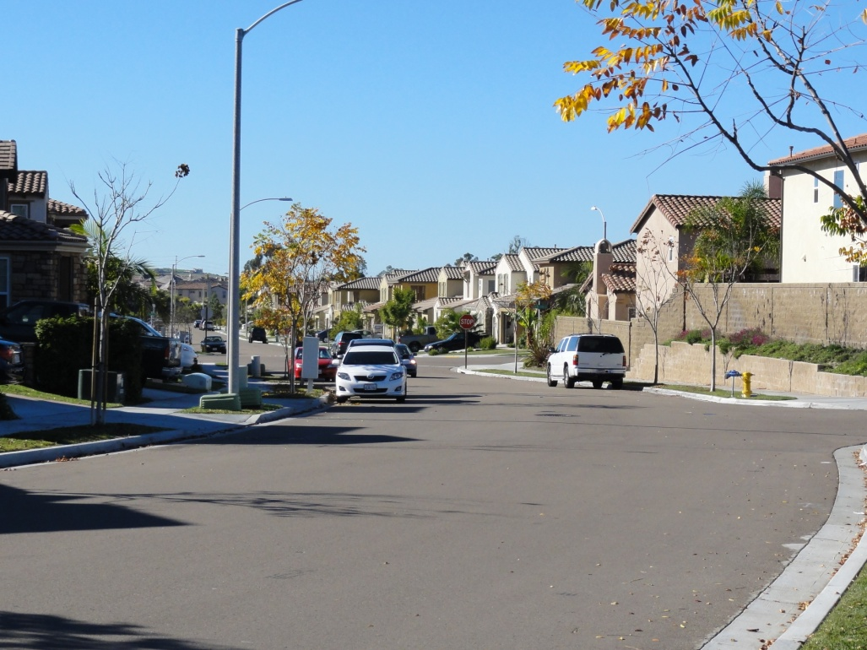
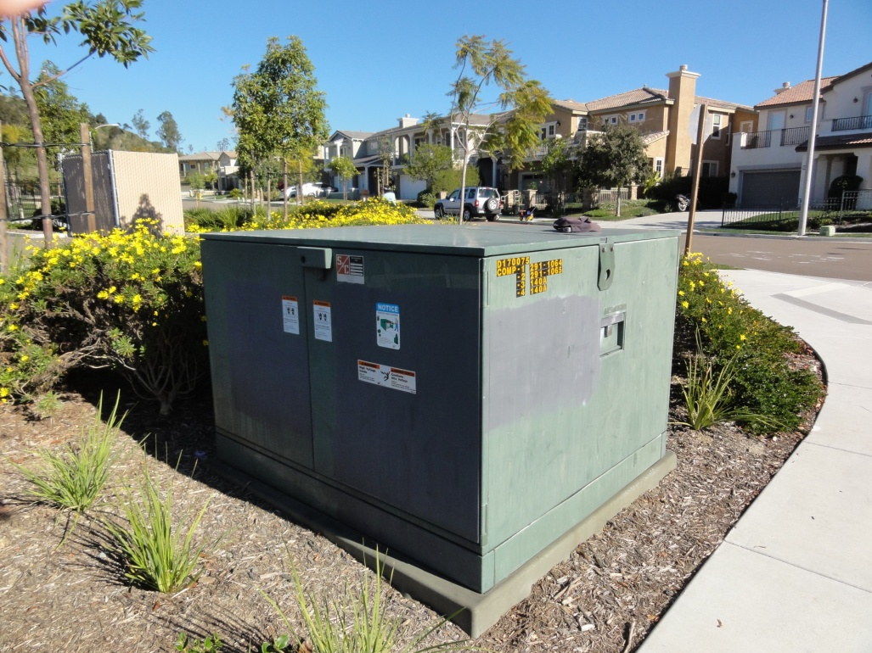
Residential Pad Mount Transformer

Slide 17
Residential Pad Mount Transformer
Center Frequency = 2426MHz
Mean 1 MHz Power = -107.03 dBm
Mean 15 MHz Power = -93.46 dBm
1 MHz Thermal Noise Floor

Slide 18
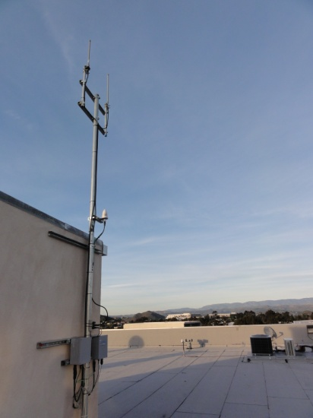
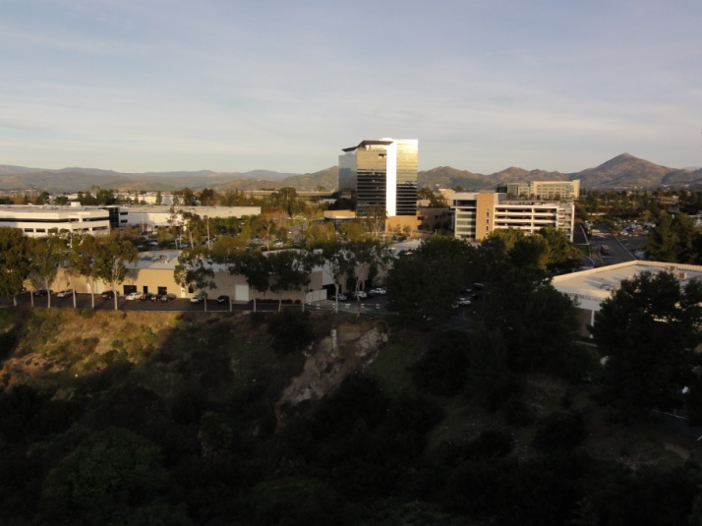
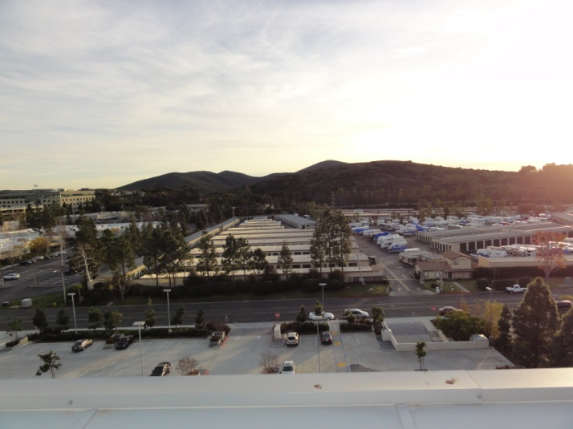
Office Building Rooftop

Slide 19
Office Building Rooftop
Center Frequency = 2472 MHz
Mean 1 MHz Power = -105.49 dBm
Mean 15 MHz Power = -87.80 dBm
1 MHz Thermal Noise Floor

Slide 20
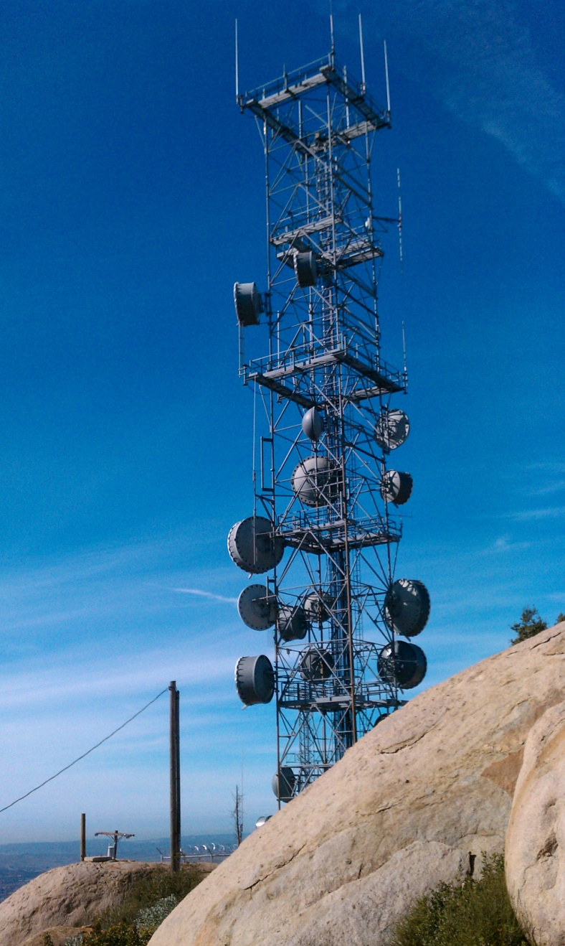
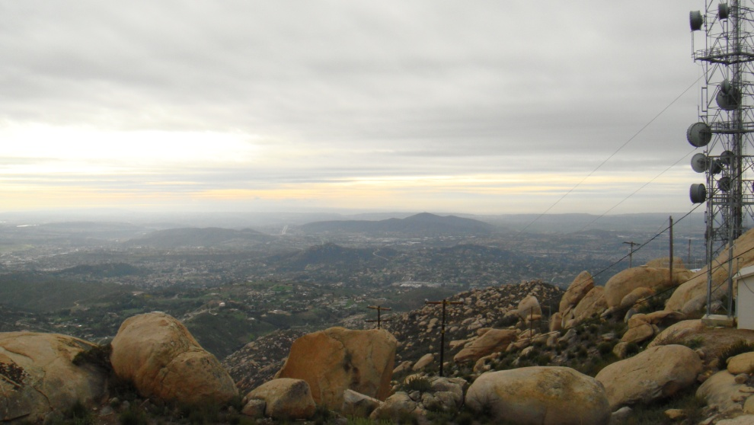
Mt. Woodson Antenna Farm

Slide 21
Mt. Woodson Antenna Farm
Center Frequency = 2428MHz
Mean 1 MHz Power = -101.08 dBm
Mean 15 MHz Power = -86.00 dBm
1 MHz Thermal Noise Floor

Slide 22
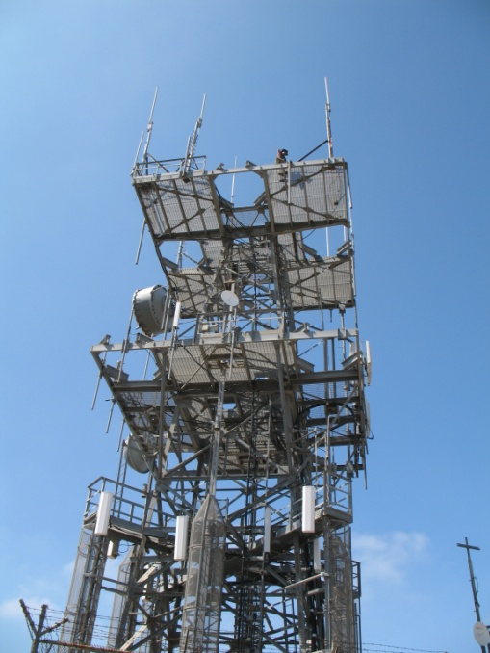
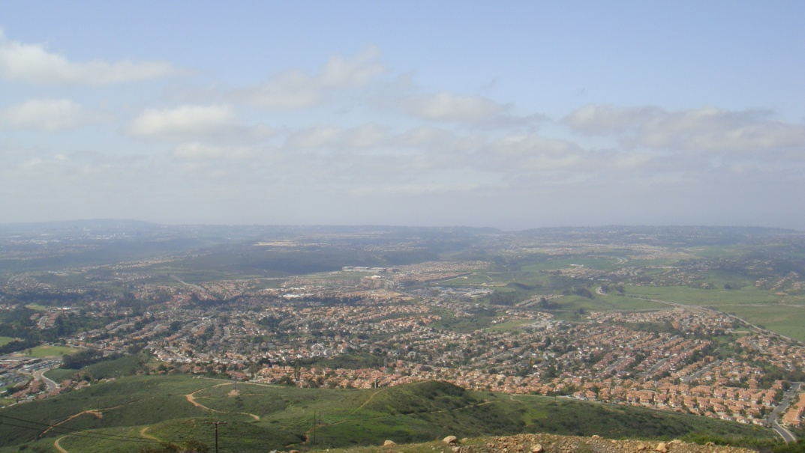
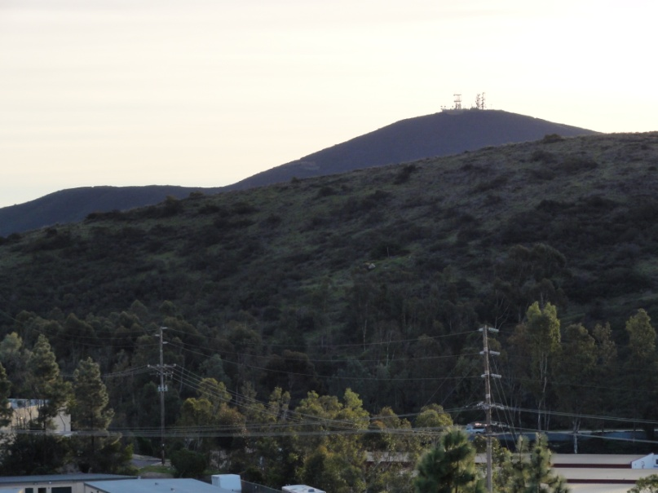
Black Mountain Antenna Farm

Slide 23
Black Mountain Antenna Farm
Center Frequency = 2428 MHz
Mean 1 MHz Power = -94.18 dBm
Mean 15 MHz Power = -80.72 dBm
1 MHz Thermal Noise Floor

Slide 24
Conclusions
Asymmetric interference between advantaged vs. non-advantaged sites
Not much rise over thermal at endpoint sites
Significant rise over thermal noise at advantaged sites
Dynamic and bursty interference due to other 2.4 GHz traffic

Slide 25
Backup slides

Slide 26
802.15.4k PAR
Operation in any of the regionally available licensed, license exempt, and special purpose frequency bands
Simultaneous operation for at least 8 co-located orthogonal networks
Application data rate of less than 40 kbits per second
Propagation path loss of at least 120 dB
>1000 endpoints per mains powered infrastructure
Asymmetric application data flow
Extreme difference in capabilities and performance between endpoint devices and coordinating devices (collectors)
coordinator may support all standardized modulations (MCS) and data rates
coordinator may be required to support antenna diversity or antenna beam steering
end point must be able to conserve energy
Reliable operation in dramatically changing environments (no control over environment)

