Slide 1
Project: IEEE P802.15 Working Group for Wireless Personal Area Networks (WPANs)
Submission Title: [Experimental results of High traffic-load situation]
Date Submitted: [9, November 2010]
Source: [Shoichi Kitazawa, Satoshi Tsukamoto, Tomohiro Miyasaka, Kazuto Yano, Masahiro Uno, Masazumi Ueba] Company [ATR]
Address [2-2-2, Hikaridai, Seika, Kyoto, 619-0288, JAPAN]
Voice:[+81 774951511], FAX: [+81 774951508], E-Mail:[kitazawa@atr.jp]
Re: []
Abstract: [Experimental result of coexistence of WLAN and Bluetooth]
Purpose: [Support document of 15-10-0739r1]
Notice: This document has been prepared to assist the IEEE P802.15. It is offered as a basis for discussion and is not binding on the contributing individual(s) or organization(s). The material in this document is subject to change in form and content after further study. The contributor(s) reserve(s) the right to add, amend or withdraw material contained herein.
Release: The contributor acknowledges and accepts that this contribution becomes the property of IEEE and may be made publicly available by P802.15.

Slide 2
Experimental results of High traffic-load situation
- Support document of 15-10-0739r1 -
Shoichi Kitazawa
Satoshi Tsukamoto
Tomohiro Miyasaka
Kazuto Yano
Masahiro Uno
Masazumi Ueba
(ATR)
{kitazawa, tsukamoto, miyasaka, kzyano,uno, ueba}@atr.jp

Slide 3
November, 2010
Measurement scenario
Four WLANs start their communications (FTP traffic) over different channels without spectrum overlap. (1ch, 5ch, 9ch, and 13ch)
Then, Bluetooth starts its communication (file transfer profile: FTP.)
Spectrum use is measured by a data-logger in anechoic chamber.
Shoichi Kitazawa, ATR

Slide 4
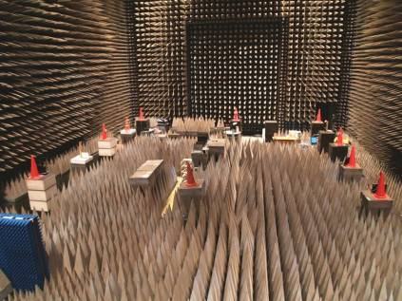
Measurement configuration
10m
Entrance
PC
AP
PC
ch1
BTTX
ch9
Measurement
equipments
ch5
10m
AP
AP
BTRX
ch13
PC
AP
PC
Notes:
4

Slide 5
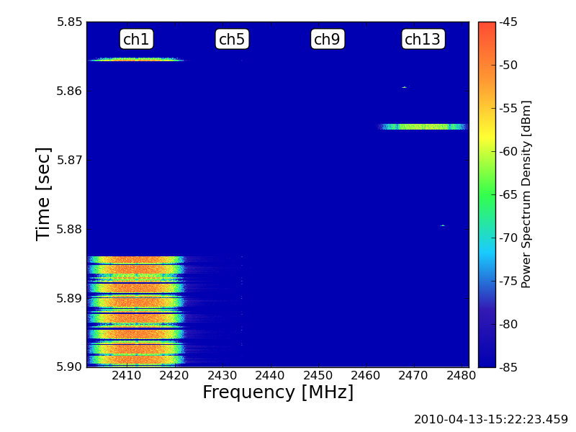
1st WLAN starts on ch1

Slide 6
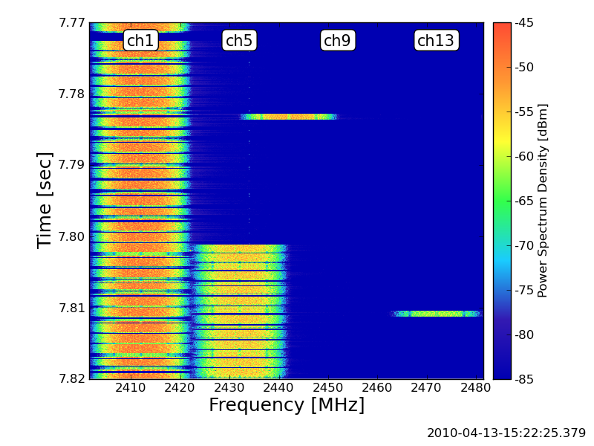
2nd WLAN starts on ch5

Slide 7
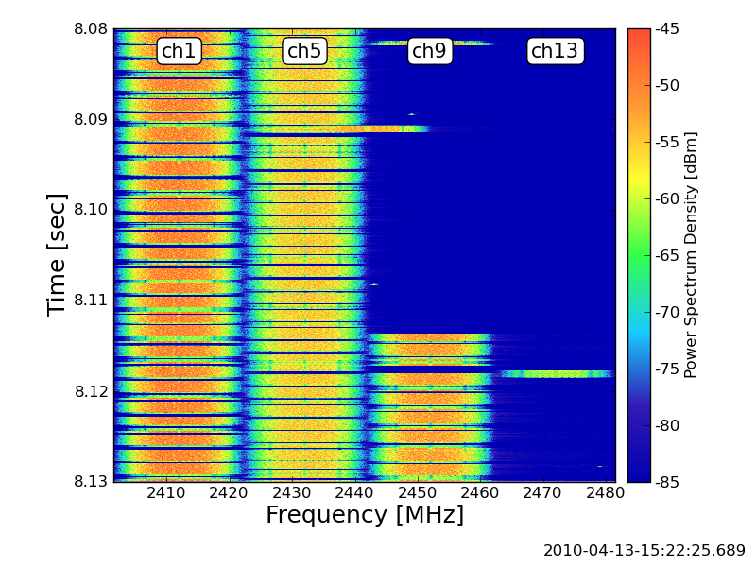
3rd WLAN starts on ch9

Slide 8
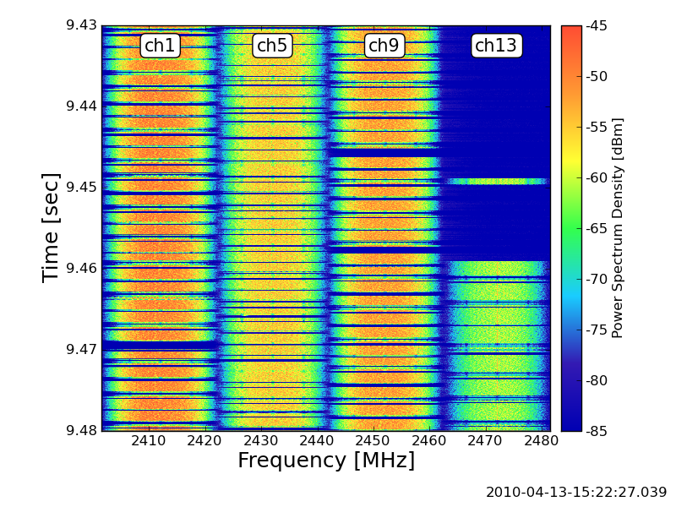
Last WLAN starts on ch13
Lower power than other channels

Slide 9
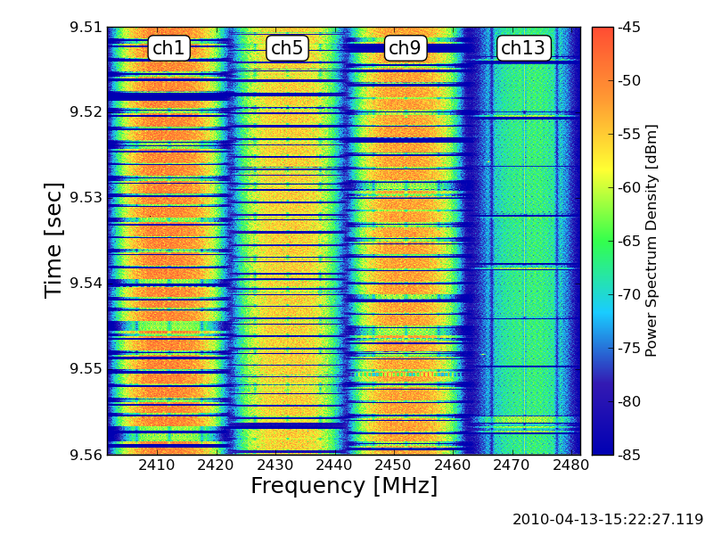
Four WLANs in the ISM band
This link becomes low data rate

Slide 10
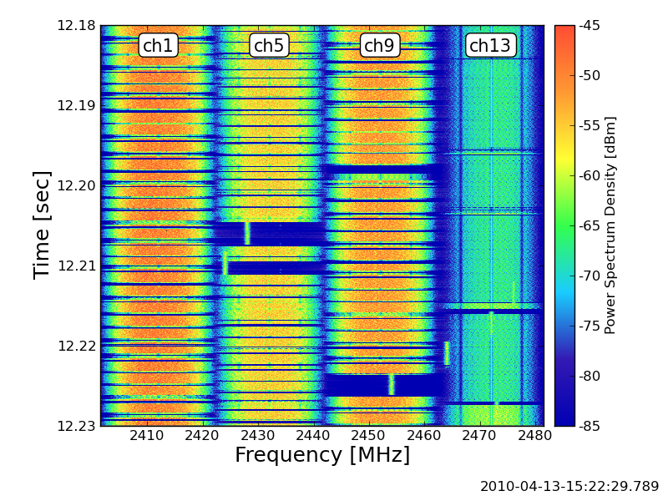
Bluetooth starts, and then interrupts WLANs

Slide 11
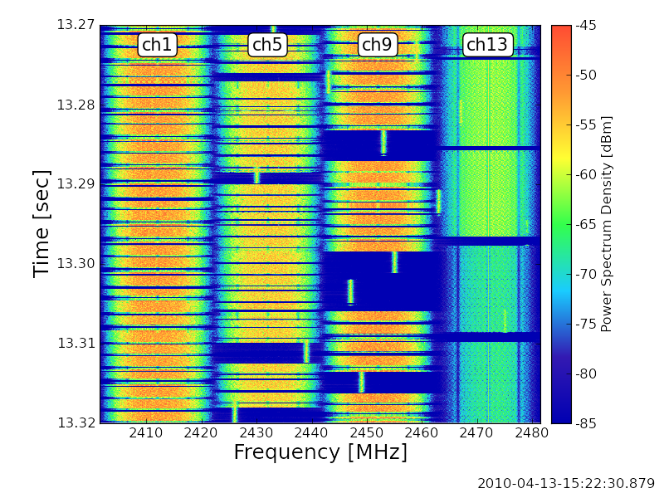
Coexistence of WLAN and Bluetooth
Notes:
11

Slide 12
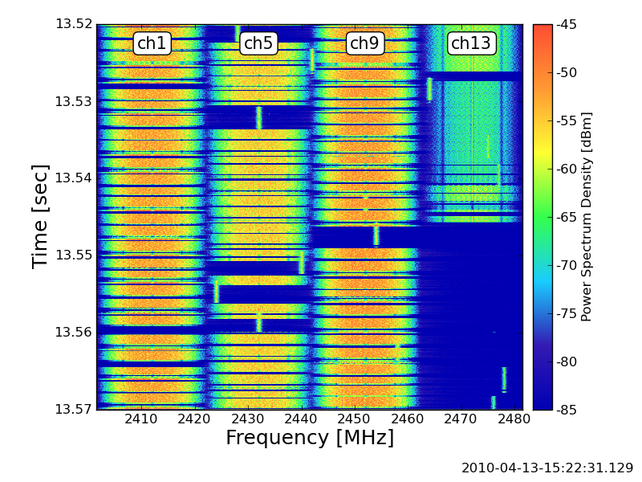
WLAN on ch13 is suspended by the Bluetooth

Slide 13
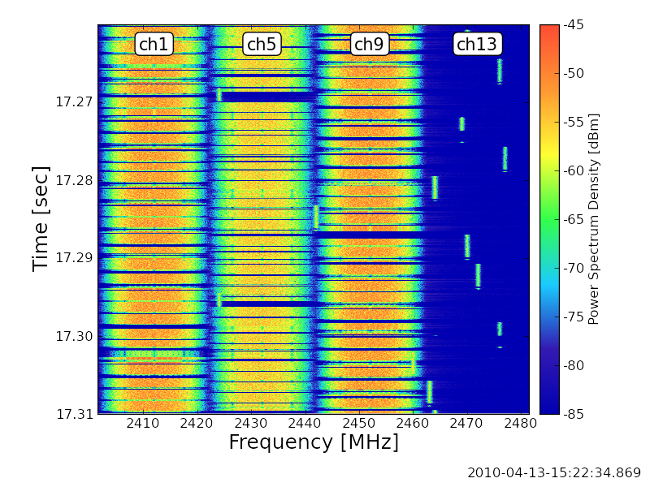
Ch13 is occupied by the Bluetooth

Slide 14
Conclusions
Coexistence with Four WLAN BSSs (1ch, 5ch, 9ch, and 13ch) and Bluetooth situation is shown.
High traffic-load situation in ISM band degrades the efficiency of the overall communications due to inter-system interference among co-existing wireless systems.
Unused spectrum still remains even though high traffic-load situation.
Acknowledgment
This work is supported by the Ministry of Internal Affairs and Communications under a grant “Research and development on radio resource control technologies among multiple radio systems on same frequency band.”

