Slide 1
Project: IEEE P802.15 Working Group for Wireless Personal Area Networks (WPANs)
Submission Title: [Cooperative Relay for Coverage Extension in LED-ID System]
Date Submitted: [20 Oct., 2010]
Source: [Jin young Kim, Yoon Hyun Kim, In Hwan Park, Muhammad Shahin Uddin*, Le Nam Tuan*,
Jaesang Cha**, Kyesan Lee***, and Yeong Min Jang*]
[Kwangwoon University, *Kookmin University, **Seoul National University of Science and Technology, ***Kyunghee University]
Address [Kwangwoon University, Seoul, Korea]
Voice:[82-10-5355-4825], FAX: [82-2-942-1697], E-Mail:[jinyoung@kw.ac.kr]
Abstract: [In this presentation, we introduced the LED-ID system and shadow region problem in LED-ID system. We proposed cooperative relay technique for coverage extension to overcome the shadow region problem in LED-ID system. ]
Purpose: [Introduces the concept of LED-ID system and coverage extension technique to overcome shadowing problem in LED-ID system.]
Notice: This document has been prepared to assist the IEEE P802.15. It is offered as a basis for discussion and is not binding on the contributing individual(s) or organization(s). The material in this document is subject to change in form and content after further study. The contributor(s) reserve(s) the right to add, amend or withdraw material contained herein.
Release: The contributor acknowledges and accepts that this contribution becomes the property of IEEE and may be made publicly available by P802.15.
Notes:
doc.: IEEE 802.15-09-0117-00-0007
<month year>

Slide 2
Contents
Nov. 2010
LED-ID Technique
Shadow Region Problem
Cooperative Relay
  Relay operation
  Relay channel model
Conclusion

Slide 3
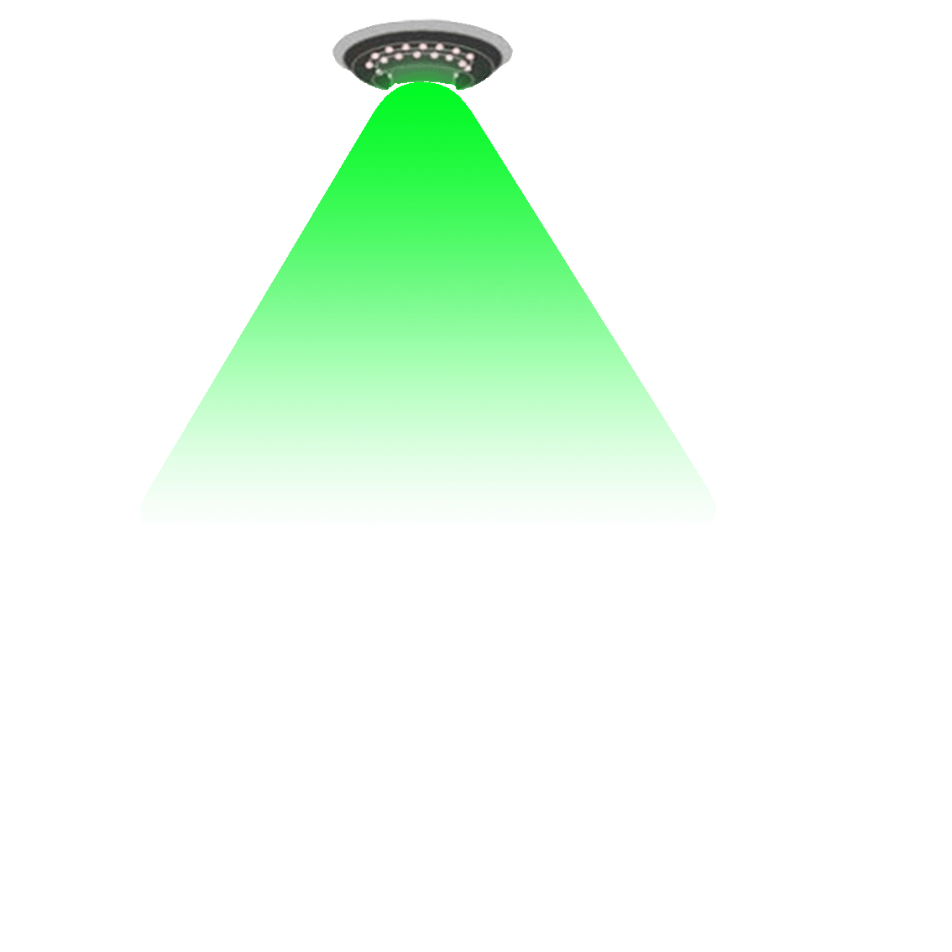
LED-ID Technique
Light Emitting Diode IDentification (LED-ID) is a technology that uses communication via light waves (especially visible light) to exchange voice/video/data among one Tag(Reader) to one or more identified Readers(Tags).
Protocol
  Identification phase (RFID technique)
  Communication phase (IEEE 802.15.7 standard)
Characteristic
  Various type of data
  High data rate
  Huge data transmission
  Reduce complexity of VLC protocol
Tag
Reader #3
Reader #2
Reader #1

Slide 4
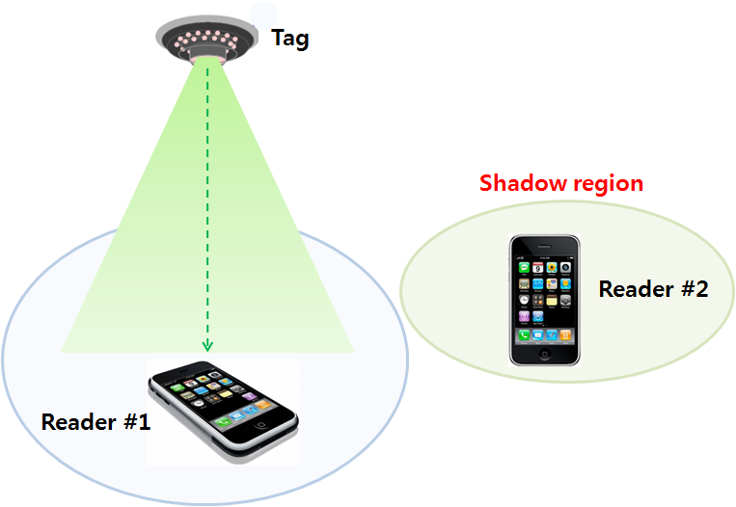
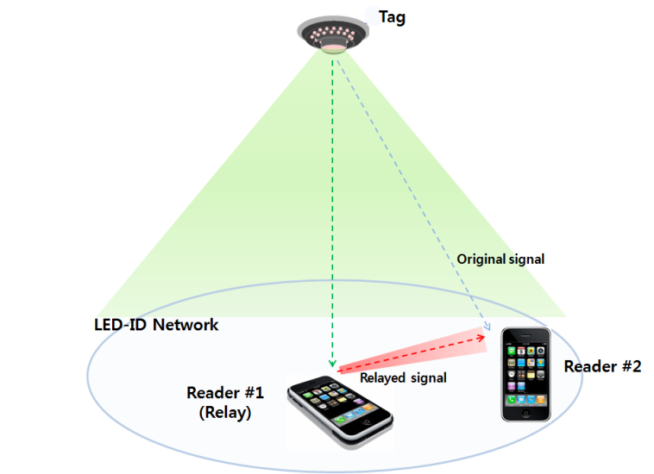
What is the Shadow Region Problem?
Shadow region problem.
Figure A
Figure B
Shadow region problem in LED-ID system occurs, and seriously affect the performance.
  Reader #2 can not detect tag’s signal (Figure A)
  Lower data rate (Figure B)
  Worse reliability (Figure B)

Slide 5
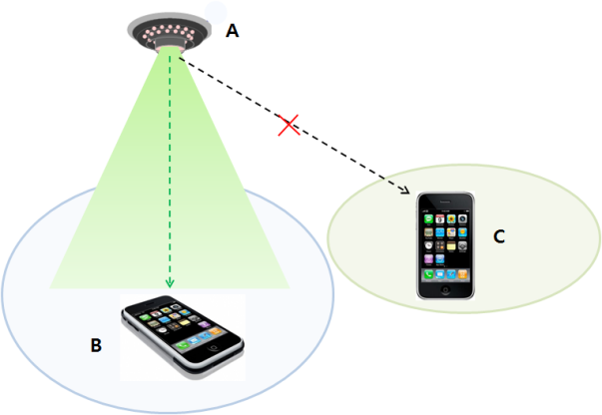
Why Shadow Region in LED-ID ?
LED-ID Characteristics
  Limitation of Field Of View (FOV)
  Limitation of Line Of Sight (LOS)
Tag
Reader
Reader
Reader C can’t sense Tag A’s signal

Slide 6
Discussion
Current draft VLC specification bases on IEEE 802.15.4
Current draft VLC specification may consider shadow region problem.
  Communication phase in LED-ID system based on VLC specification (IEEE 802.15.7 standard)

Slide 7
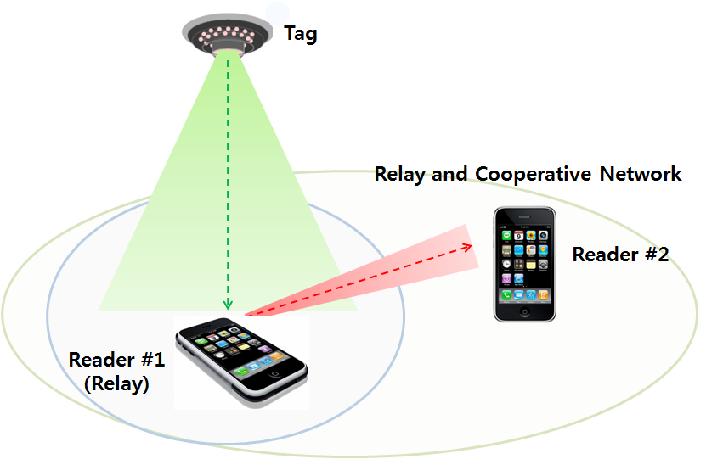
Cooperative Relay for LED-ID systems
“Better” reliability
“Higher” data rates
“Wider” range
High diversity gain
Expanding coverage

Slide 8
Cooperative Relay
Advantages
  Lower transmission power
  Extend coverage
  Increase capacity
Disadvantages
  Interference management scheme
  Mobility management scheme
  Routing protocol

Slide 9
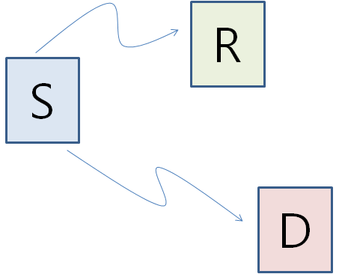
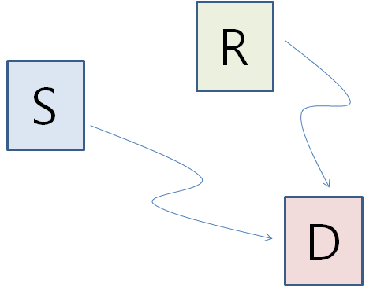

Relay Operation
Full Duplex
- Relay can receive and transmit same time and same frequency band
Half duplex
- Relay will not receive and transmit same time and same frequency band
Broadcast
Multiple Access
1st time slot
2nd time slot

Slide 10
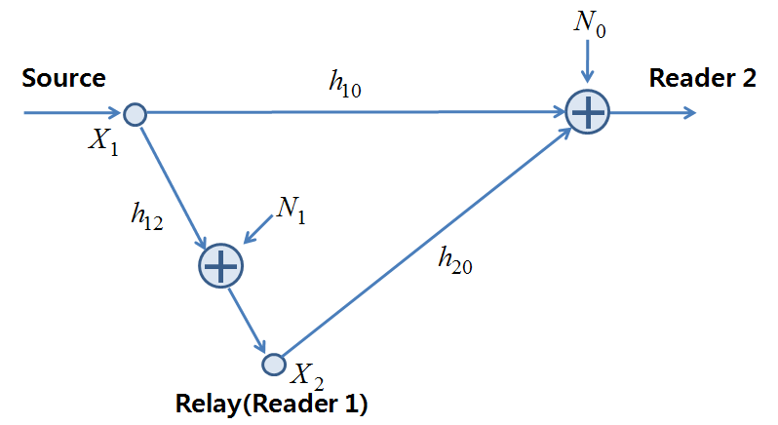
Cooperative Relay Model
The equivalent channel model for half duplex

Slide 11
Conclusion
Shadow region problem in LED-ID system
Proposed cooperative relay for LED-ID systems
- High diversity gain
- Expanded coverage

