Slide 1
10/687r0
Project: IEEE P802.15 Working Group for Wireless Personal Area Networks (WPANs)
Submission Title: Protocol stack models for clause 6.6.12
Date Submitted: September 2010
Source: Rick Roberts (Intel Labs)
Address
Voice:503-712-5012, E-Mail:richard.d.roberts@intel.com
Re:
Abstract:
Purpose:
Notice: This document has been prepared to assist the IEEE P802.15. It is offered as a basis for discussion and is not binding on the contributing individual(s) or organization(s). The material in this document is subject to change in form and content after further study. The contributor(s) reserve(s) the right to add, amend or withdraw material contained herein.
Release: The contributor acknowledges and accepts that this contribution becomes the property of IEEE and may be made publicly available by P802.15.

Slide 2
10/687r0
What is the model for the protocol stack in clause 6.6.12?

Slide 3
Model #1 – One MAC, One PHY, multiple photodetectors?
10/687r0
To Link Layer
MAC SAP
PDs and LEDs are connected in parallel and connect to one PHY
MAC
PHY SAP
PHY
Optical SAP
Optical SWITCH
Optical Node
(e.g. PD and LED)

Slide 4
Model #2 – One MAC, multiple PHYs?
10/687r0
Single MAC frames can be routed to/from any combination of PHYs
To Link Layer
MAC SAP
MAC
PHY SAP
PHY SWITCH
PHY
PHY
PHY
PHY
PHY
PHY
Optical Node
(e.g. PD and LED)
PHY
PHY
PHY

Slide 5
Model #3 –multiple MAC/PHYs?
10/687r0
Link Layer - or - Service-specific convergence sublayer
Each optical node is a 15.7 compliant device and all nodes can operate independently
MAC
MAC
MAC
PHY
PHY
PHY
MAC
MAC
MAC
PHY
PHY
PHY
Optical Node
(e.g. PD and LED)
MAC
MAC
MAC
PHY
PHY
PHY

Slide 6
10/687r0
How this relates to the text in clause 6.6.12

Slide 7
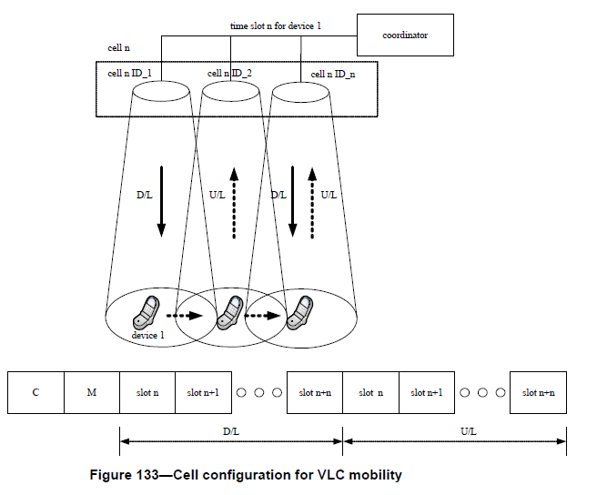
10/687r0
This figure shows that each optical node has a unique address that is addressed by the coordinator. It would be a natural for the node ID to be the VPANId, which would be consistent with model #3. Otherwise how is this addressing done?

Slide 8
When the device 1 moves into in cell 1 boundary, the coordinator can detect the device 1 uplink signal at cell j boundary. The coordinator should transmit boundary information, 'B_info' which is defined in table 85 to device 1 through boundary area optical sources like Cell j ID-4, 8 and 12. Then, optical sources of cell j boundary area assign time slot n+2 to the device 1 using S_info which is defined in Table 98. In boundary area, device 1 transmits and receives data and control through time slot n and n+2.
10/687r0
This text implies that each optical node has a unique address that is addressed by the coordinator, which would be consistent with model #3.

Slide 9
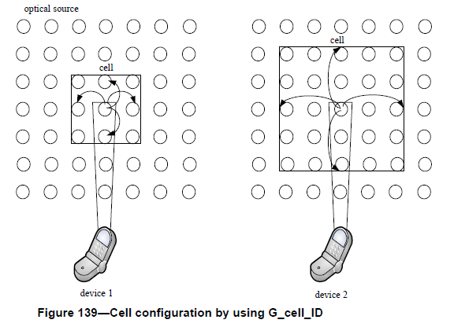
10/687r0
When the cell is defined as a group of light source, the dimension or size of the cell should be fixed or variable. When it is wanted to use variable size of cell, the group of light sources should be assigned granularly, called a granular cell configuration. A cell size should be configured by using G_cell_ID which is defined in Table 98. The G_cell_ID should be the specific number and the cell size is formed around the position of the device as the G_cell_ID number. Figure 139 show two examples of G_cell_ID, set as 00000 00001 and 00000 00010, respectively. If the G_cell_ID is set as 00000 00000, the granular cell configuration is not used.
Dynamic allocation of nodes to cells would be difficult at the Optical SAP level and PHY SAP level. It would be most practical at the MAC SAP level, which would be modle #3.

Slide 10
10/687r0
From 6.6.12.4
When the device 1 transmits initial access signal to the coordinator, the photo-detector of the coordinator should measure the power of the initial access signal from the device 1. As a result of the measured power, the coordinator should configure the cell based on the position of the measured optical signal power. In second method, the device 1 measure the signal power form the coordinator, for example a channel quality, and send that measured signal power to the coordinator. The coordinator should configure the cell based on the measured signal power received from the device 1.
From 5.9.4
The CQI measurement is a characterization of the strength and/or quality of a received frame. The measurement may be implemented using receiver energy detection (ED), a signal-to-noise ratio estimation, or a combination of these methods. The use of the CQI result by the network or application layers is not specified in this standard. The CQI measurement shall be performed for each received frame, and the result shall be reported to the MAC sublayer using the PD-DATA.indication, specified in 5.2.1.3, as an integer ranging from 0x00 to 0xff.
Continued on the next page

Slide 11
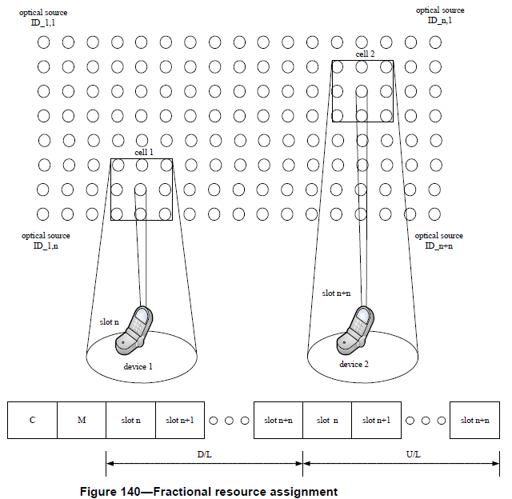
10/687r0
To do this dynamic grouping based on power received per optical node cluster would require at a minimum each node had a PHY layer (ref. 5.9.4). But if it was done via model #2 then how are these different PHYs addressed. It would seem model #3 would be a better fit.

Slide 12
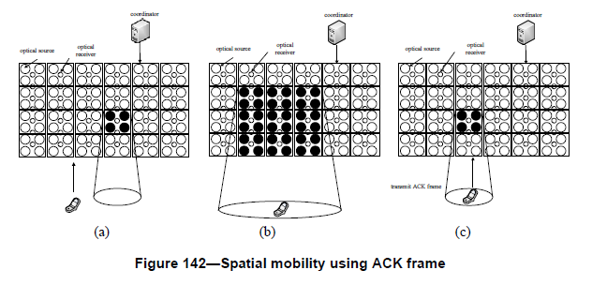
10/687r0
In this figure the reception of the ACK frame at an optical node is the metric for determining if this node is “in” or “out” of the cell; thus, it appears model #3 is appropriate.

Slide 13
10/687r0
Conclusions
Basically, it appears that the functionality described in clause 6.6.12 is best served by model #3, which is having a PHY/MAC at each optical node in a cell. The 15.7 standard is all about the PHY/MAC as per the 15.7 PAR.
It appears the cell management function is at a layer above the MAC. If so then it is out-of-scope of the standard. Perhaps it can be accommodated in the standard as a SSCS?
Overall the cell concept is interesting and would make a great informative annex to the document, but it is believed to be out-of-scope of the normative text.

