Slide 1
Project: IEEE P802.15 Working Group for Wireless Personal Area Networks (WPANs)
Submission Title: [Comment Resolution for CID 1420, 1422]
Date Submitted: [July 13, 2010]
Source: [Steve Shearer] Company [Silver Spring Networks]
Address [Redwood City, CA]
Voice:[(925) 997 0576 ] FAX: [Add FAX number], E-Mail:[Shearer_inc@yahoo.com]
Re: [OFDM Comment Resolution]
Abstract: [This document addresses some of the comments recorded in 15-10-0283-10-004g-lb51-comments.xls and proposes resolutions for the working group’s consideration.]
Purpose: [802.15.4g Comment Resolution for LB51.]
Notice: This document has been prepared to assist the IEEE P802.15. It is offered as a basis for discussion and is not binding on the contributing individual(s) or organization(s). The material in this document is subject to change in form and content after further study. The contributor(s) reserve(s) the right to add, amend or withdraw material contained herein.
Release: The contributor acknowledges and accepts that this contribution becomes the property of IEEE and may be made publicly available by P802.15.

Slide 2
Comment Resolution for
CID 1420, 1422
Steve Shearer July 2010

Slide 3
Pilot tones to Track the Channel
Pilot tones are used to sample the channel in time and frequency so that channel changes can be tracked
  Higher fading rate means that pilot symbols should be spaced closer in time
  Higher multipath means that pilot symbols should be spaced closer in frequency
2D interpolation across time and frequency provides a channel reference for the data tones
Demodulation of the data tones is highly dependent upon accurate channel estimation

Slide 4
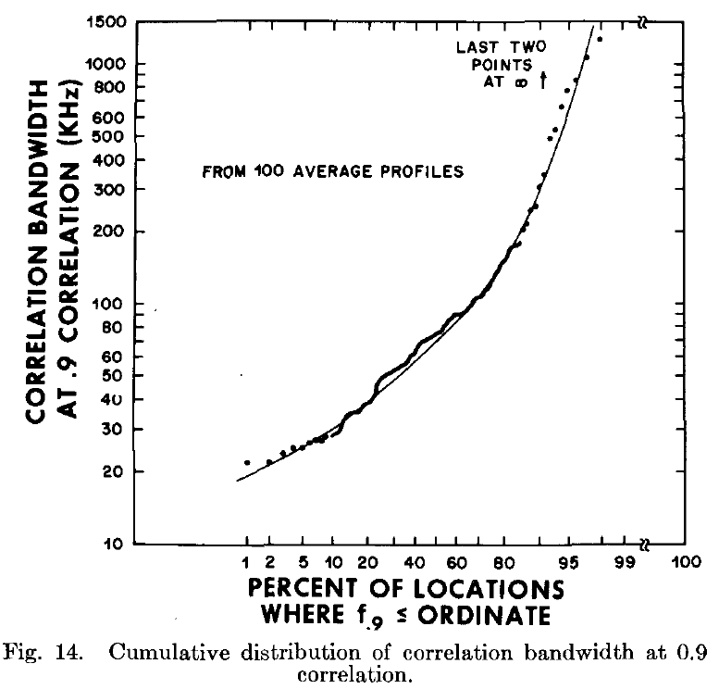
Channel Coherence Bandwidth
Real SUN channels contain multipath
Studies [1] have shown that phase changes caused by the channel are not correlated between tones
  50% of locations have a correlation b/w of less than 70kHz i.e. ~7 tones [2]
  10% of locations have a correlation b/w of less than 25kHz i.e. 2-3 tones
Interpolation between pilots
becomes more complicated
[1] IEEE TRANSACTIONSON COMMUNICATIONS, VOL.
COM-23, NO. 11, NOVEMBER 1975 "Correlation Bandwidth
and Delay Spread Multipath Propagation Statistics for
910-MHz Urban Mobile Radio Channels" Donald C. Cox,
Robert P. Leck
[2] Tone spacing in the 802.15.4g OFDM PHY is approx 10kHz

Slide 5
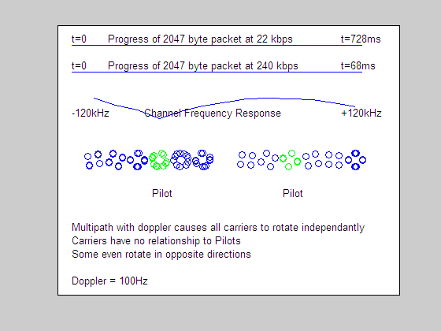
Animation in Multipath
This animation uses a simple two path channel with Multipath and Doppler
Illustrates how the
individual phases of the
data carriers move
during the length of a
burst
Shows how the phases
of the data tones are
de-correlated from
one-another
[1] Fade rate is chosen at 100Hz for visual effect,
but similar effects take place with lower dopplers

Slide 6
How Many Pilots are Needed to track a given channel?
The Negi&Ciotti paper [1] examines this question and concludes
  The length L of the Cyclic Prefix should be made 1 sample longer that the length of the multipath channel v. L=v+1
  If this condition is satisfied, then L pilots are needed to properly track the channel
Negi&Ciotti also use simulation results to conclude that
  for fading channels, continuous pilot tones at the same frequency are better than pilot symbols collected together in frequency periodically

Slide 7
Application to 15.4g OFDM
Consider channel length based upon:-
  Bad Urban (BU) – 5us,
  Hilly Terrain (HT) – 15us
  Cyclic Prefix of 24us
Pilot requirements for each Option listed in table below
  Undersampling ratio = Required # of pilots / Current # of pilots
Not possible to track the channel where the undersampling ratio >1 (red)
 | Option 1 | Option 2 | Option 3 | Option 4 | Option 5
FFT Size | 128 | 64 | 32 | 16 | 8
Chan length in samples BU / HT / CP | 6.4 / 19.2 / 32 | 3.3 / 9.6 / 16 | 1.6 / 4.8 / 8 | 0.8 / 2.4 / 4 | 0.4 / 1.2 / 2
Required # of pilots | 7 / 20 / 32 | 4 / 10 / 16 | 2 / 5 / 8 | 1 / 3 / 4 | 1 / 2 / 2
Current # of pilots | 8 | 4 | 2 | 2 | 2
Undersampling relative to “Channel Nyquist rate” | .87 / 2.5 / 8 | 1 / 2.5 / 4 | 1 / 2.5 / 4 | 0.5 / 1.5 / 4 | 0.5 / 1 / 1

Slide 8
Interim Conclusion
The currently proposed 15.4g OFDM pilot based channel tracking meets the Negi&Ciotti requirements for some scenarios
  But there are several scenarios where it is clear that
  channel tracking will fail
  The degree of failure will be exacerbated when considering 2x and 4x Frequency repetition because the pilots will be 3dB and 6dB less reliable than the data itself
Designing for the worst case would require significantly more pilots
  The overhead would be too burdensome
Rather, leave the existing number of pilots “as is” since they will accommodate most common channels
  Introduce a fall back mode to deal with the more difficult channels

Slide 9
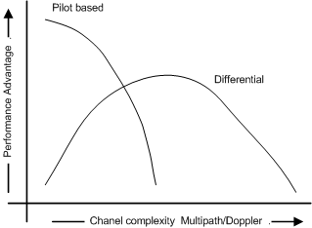
Performance Advantage Trends
Pilot based schemes offer a performance advantage for simple channels, but the advantage decreases as the channel becomes more complex
  Increased multipath
  Increased fading rate
A differential scheme has lesser
performance advantage for simple
channels, but this advantage
increases as the channel
becomes more complex
  Up to a limit of course ☺
A differential scheme excels when frequency repetition is used to gain data robustness

Slide 10
Proposal – Mixed Mode
Noting that the channel can be assumed to be stationary for a few symbols….
The PHY Header can always be reliably demodulated coherently based on the LTF training sequence
A bit in the Header signals whether the payload is Coherently or Differentially encoded
Demodulation of the payload is performed accordingly

Slide 11
Proposed Solution – Operation
The receiver acquires synchronization, decodes the training sequence and demodulates the PHY Header using coherent demodulation with pilot tones in place as defined in the current draft.
A bit in the header determines if the payload is coherently or differentially encoded and payload demodulation proceeds accordingly
To simplify the implementation the Pilots are always transmitted in the header and the payload regardless of the demod scheme
This approach preserves the requirements for coherent, and allows differential as an option without conflict or complication

Slide 12
Practical Considerations
Differential demodulation does not need pilots, and they could potentially be used for data….
  However this would significantly complicate the OFDM proposal
Leaving the pilot tones in place has several advantages
  The existing pilot scheme is unchanged
  The existing interleaving scheme is unchanged
  The existing coding scheme remains unchanged
  The existing MCS table remains unchanged
Most importantly, it keeps everything simple, and avoids much rework of the draft

Slide 13
Impact on the MCS table
The MCS table remains unchanged
  Grayed selections just become unavailable
  when differential is used
 | OFDM Option 1 | OFDM Option 2 | OFDM Option 3 | OFDM Option 4 | OFDM Option 5 | Unit
FFT Size | 128 | 64 | 32 | 16 | 8
Active Tones | 104 | 52 | 24 | 14 | 6
# Pilots tones | 8 | 4 | 2 | 2 | 2
# Data Tones | 96 | 48 | 24 | 12 | 4
MCS 0 - BPSK 1/2 rate,4xFDS | 100 | 50 |  |  |  | kbps
MCS 1 - BPSK 1/2 rate, 2xFDS | 200 | 100 | 50 |  |  | kbps
MCS 2 - QPSK 1/2 rate, 2xFDS | 400 | 200 | 100 | 50 |  | kbps
MCS 3 - DCM QPSK 1/2 rate | 800 | 400 | 200 | 100 |  | kbps
MCS 4 - QPSK 1/2 rate | 800 | 400 | 200 | 100 |  | kbps
MCS 5 - DCM-QPSK 3/4 rate |  | 600 | 300 | 150 | 50 | kbps
MCS 6 - QPSK 3/4 rate |  | 600 | 300 | 150 | 50 | kbps
MCS 8 - 16QAM 1/2 rate |  | 800 | 400 | 200 | 67 | kbps
MCS 9 - 16QAM 3/4 rate |  |  | 600 | 300 | 100 | kbps

Slide 14
Conclusion
The currently proposed 15.4g OFDM pilot based channel tracking meets the Negi&Ciotti requirements for number of pilots for some common SUN channels
  Such as AWGN, BU, and Rural Area
However the tracking system is marginal and will fail in more complex channels
  Anything worse than BU e.g. Hilly Terrain
  The degree of failure will be exacerbated when considering 2x and 4x Frequency repetition because the pilots will be 3dB and 6dB less reliable than the data itself
An optional fall-back mode has been presented that eliminates this risk in difficult conditions and has virtually no increase in complexity of the overall OFDM proposal

Slide 15
Proposed Resolution CID 1420, 1422
Adopt the mixed mode solution presented

