Slide 1
Project: IEEE P802.15 Working Group for Wireless Personal Area Networks (WPANs)
Submission Title: Hopping with 4g PHY: Alternatives for NHL control using 15.4 MAC capabilities
Date Submitted: 12 July 2010
Source:
Benjamin A. Rolfe Company: BCA
Wei Hong (Arch Rock Corp.)
Address Box 7 9 8 Los Gatos CA 9 5 0 3 1
Voice:[], FAX: [], E-Mail:[ben @ blindcreek.com]
Re: TG4g LB 51 and TG4e LB53 Comment Resolution
Abstract: Demonstrates an approach using existing MAC features and structures to meet requirements for frequency hopping with minimal changes to existing 15.4 MAC.
Purpose: Assist in comment resolution
Notice: This document has been prepared to assist the IEEE P802.15. It is offered as a basis for discussion and is not binding on the contributing individual(s) or organization(s). The material in this document is subject to change in form and content after further study. The contributor(s) reserve(s) the right to add, amend or withdraw material contained herein.
Release: The contributor acknowledges and accepts that this contribution becomes the property of IEEE and may be made publicly available by P802.15.

Slide 2
Channel Hopping for 4g PHYs
Alternatives for NHL control using 15.4 MAC capabilities

Slide 3
Objectives
Present plausible scenarios for hopping implementations
Using 15.4 PHYs where hopping will be required
Using minimal features of 802.15.4 MAC
Minimal changes to the MAC
An existence proof
Determine what we need in the MAC
Outcome
A recommendation to TG4g and TG4e

Slide 4
Intro
Why we hop
Hopping required to meet some regulations
902MHz, 2.4GHz in North America (FCC15.247)
Other regions may require hopping
Real-world performances
Works really well for a lot of SUN situations
This example:
Peer to Peer topology
Non-beacon PAN
Distributed control and timing (link relative sync)
Complimentary to DSME and TSCH: different approach for different situations

Slide 5
4e
DSME
Beacon enabled PAN assumed
Initially optimized for 15.4 2.4GHz DSSS (16 channels)
Work ongoing to apply to some 4g PHYs
TSCH
TDMA with global network synchronization
Initially optimized for 16 channels also
Work ongoing to apply to some 4g PHYs
4e scope does not require all features work with all PHYs
“may” not “must” accommodate needs of 4g
Neither optimized for SUN
Such as peer-to-peer mesh (as in this example)

Slide 6
Approach
Simple MAC, smarter NHL
Use basic features of the MAC
Minimal (or no?) changes to the MAC
802.15.4 PHY(s)+MAC tools can support various upper layer hopping strategies
Present an example of upper layer use of MAC
An existence proof
Tool to evaluate what is needed in the MAC
Smarts and Policy done by upper layers
Non-beacon, peer to peer, without global network synchronization

Slide 7
Review – How 15.4 is used today
Simplified: for a more complete story see 15-09-0633-00-004g (Beecher)

Slide 8
How 15.4 is typically used
MAC provides basic tools that ENABLE NHL to
Find peers
Find existing PANs
Associate with existing PAN
Form a new PAN
Manage PAN
Exchange data with other 15.4 devices
Networks are formed and managed by the higher layer(Network layer)
MAC does not DO discovery, association, assing PAN IDs or short addresses, etc…it supplies the tools for NHL to do what it needs when it needs to.
Simplified: for a more complete story see 15-09-0633-00-004g (Beecher)

Slide 9
Find and Join (15.4)
NHL determines what PHYs, bands, channels my local MAC/PHY implementation includes (MLME-GET).
NHL decides what PHY + Band to use
NHL initiates Scan for activity (MLME-Scan)
passive scan to find beaconing 15.4 deices/PANs
active scan to find non-beaconing 15.4 devices/PANs
Based on scan results, NHL decides what to associate with
Analyze received beacons
Determine what channel, PANID, etc
Associate via MLME-Associate primitives
Exchange other (higher layer) information via data frames.

Slide 10
Start a PAN
First two steps are the same – NHL decides what to try...then
NHL initiates a scan for activity a. ED scan to find a nice quiet place
NHL evaluates ED scan results, pick a channel
NHL will choose a PAN-ID (and maybe a short address)
NHL starts the PAN via MLME-START.request with channel page/channel to use, PAN-ID, and other PAN characteristics (beacons or not, etc).
NHL hangs out and handle associate requests as they happen

Slide 11
Extending for Hopping Example (implemented at higher layer)
Example Summary
Use a contact channel (+mode) for initial contact
Active devices listen at times when idle
Each device knows it’s own hopping sequence
Shared method to map Sequence ID to actual sequence (algorithmic, look-up, whatever)
When two peers have each other’s sequence they can communicate
Peer-wise pairing, not global to the network

Slide 12
Initial Contact Sequence
Send Query on designated contact channel (ISA100 like)
Listen for response
Response includes responding devices sequence ID
Response tells where in sequence (index)
Decide what to do based on response info
Which responding devices do I care about?
Can I support the mode(s) and channels?
Remember sequence ID and mode for devices I wish to link to
Initiate an association (if necessary)
Send association request on next channel in sequence for that destination (if you need it)
and so on…

Slide 13
Query and Response Initiated by NHL of ‘joining’ device
Use existing beacon request/beacon
Joiner sends beacon request (active scan of one channel) (always broadcast)
Anyone who hears it responds with a beacon
Beacon payload contains mode and sequence being used
May filter based on content of the request

Slide 14
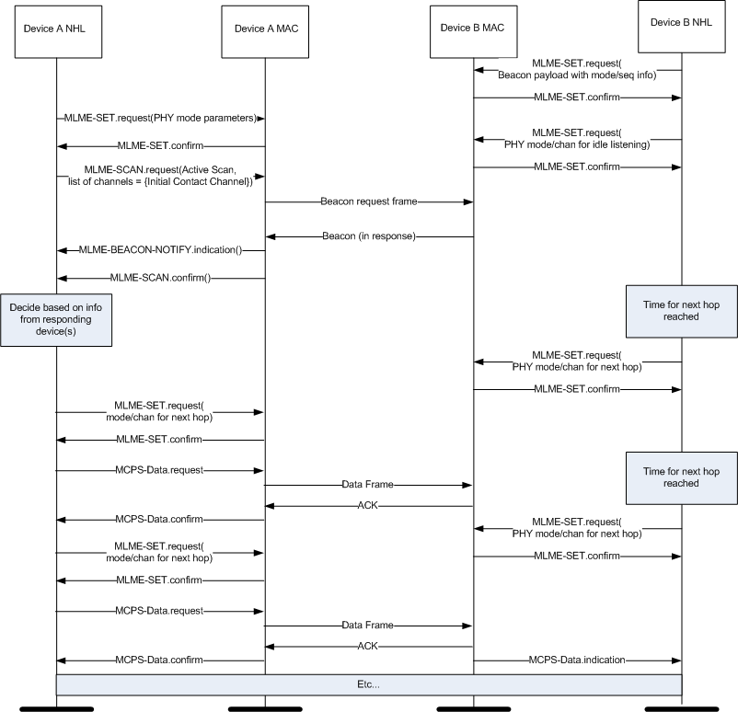
Query/Response MSC (beacon request)

Slide 15
Query/Response MSC (beacon request)
Beacon payload contains hopping information from responding device (sequence, sync info, etc)
MLME-set attribute macBeaconPayload
Joining device provides hopping information in subsequent data frame
Uses existing Services and MAC frames
No new primitives or frame definitions
Beacon and data frames can be secure

Slide 16
Variations
NHL layer determines when to listen/send
NHL can use multiple contact channels or other targeting schemes
NHL decides what to send when
Intelligence scaled to needs of application
Many variations supportable
Basic ‘building block’ MAC services is consistent with 802.15.4 philosophy
Less MAC == less restrictive == more flexible

Slide 17
Conclusion
Can do hopping without significant changes to the basic 15.4 MAC
802.15.4 is not the only standard in the world
802.15.4 is the bottom of the needed stack
Interoperability enabled by PHY/MAC, not assured
Upper layer standards to achieve system interoperability
Consistent with existing 15.4 MAC architecture, philosophy, and history (ISA, ZigBee, etc)
Contained scope == contained schedule
Huge value in SUN PHY standard now

Slide 18
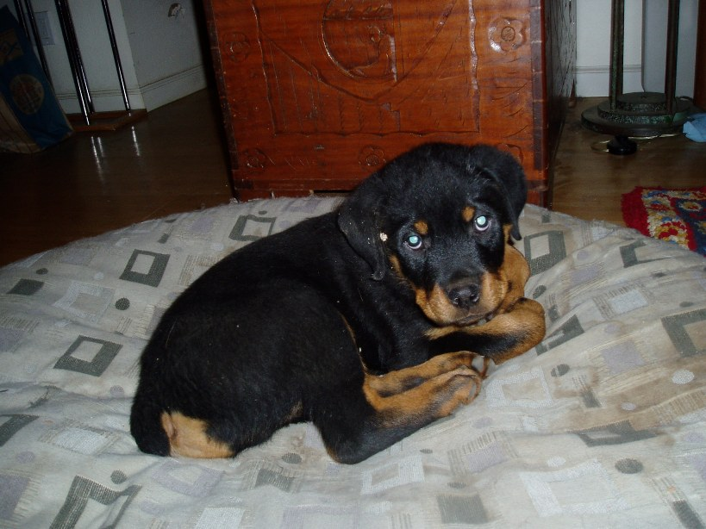
Thanks for Listening

