Slide 1
Project: IEEE P802.15 Working Group for Wireless Personal Area Networks (WPANs)
Submission Title: Proposed resolution of ESOR comments from LB53 (the easy ones)
Date Submitted: 13 July 2010
Source:
Benjamin A. Rolfe Company: BCA
Will San Filippo Company: SSN
Wei Hong Company: Arch Rock
Address Box 7 9 8 Los Gatos CA 9 5 0 3 1
Voice:[], FAX: [], E-Mail:[ben @ blindcreek.com]
Re: LB53 Comment Resolution
Abstract: Proposed resolutions for ESOR comments from LB53. Identifies the “low hanging fruit” with recommended resolutions, and suggests how other comments are being resolved w/proposed assignments.
Purpose: Assist in comment resolution
Notice: This document has been prepared to assist the IEEE P802.15. It is offered as a basis for discussion and is not binding on the contributing individual(s) or organization(s). The material in this document is subject to change in form and content after further study. The contributor(s) reserve(s) the right to add, amend or withdraw material contained herein.
Release: The contributor acknowledges and accepts that this contribution becomes the property of IEEE and may be made publicly available by P802.15.

Slide 2
ESOR Comment Summary
Ben Rolfe, Will San Filippo, Wei Hong
Et al.

Slide 3
Sub-groups
Grouped into three general sub-grouping:
Enhanced security: Punted to Rob C.
Frame format related: Addressed by proposal from Michael
Editorial: the error makes text technically incorrect but fix is obvious
Everything else

Slide 4
Not handled here
Security: Proposal expected (Rob C.)
Need technical input: 457 480 481 482 483 484 485 490 491 492 493 494 496 497 499 500 501 513 515 515 516 517 518 519
Proposal by MB for frames:
9 130 131 133 134 137 138 139 141 142 144 145 146 148 149 150 151 152 153 154 155 156 157 158 173 174 175 176 177 178 179 180 181 182 186 187 188 306 439 440 441 442 447 462 463 749 956 1038 1153 1155 1156 1175 1176 1178 1323 1324 1325 1326 1327 1344 1372 1375 1376 1392 1481 1552 1577 1582
LL assigned to MB:
461 464 465 477 478 479 747

Slide 5
Everything Else
Comments to accept as is:
132 135 140 143 184 438 443 444 445 446 448 449 450 451 452 453 454 456 458 466 467 468 469 470 471 472 473 474 475 476 480 486 495 498 502 503 504 514 1377
Accept in Principle, need input:
457 480 481 482 483 484 485 490 491 492 493 494 496 497 499 500 501 513 515 515 516 517 518 519

Slide 6
Others being worked on
Jonathan is working in TSCH:
455
MB proposal (partially – may need discussion):
487 488 489 1377

Slide 7
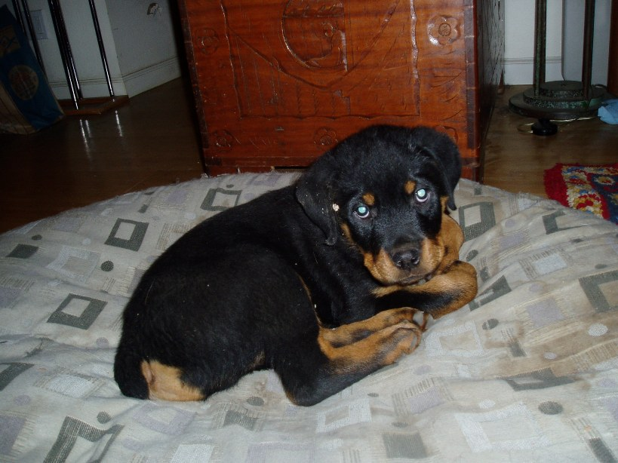
Thanks for Listening

