Slide 1
Project: IEEE P802.15 Working Group for Wireless Personal Area Networks (WPANs)
Submission Title: Proposed resolution of ESOR comments from LB53 (the easy ones)
Date Submitted: 13 July 2010
Source:
Benjamin A. Rolfe Company: BCA
Will San Filippo Company: SSN
Wei Hong Company: Arch Rock
Address Box 7 9 8 Los Gatos CA 9 5 0 3 1
Voice:[], FAX: [], E-Mail:[ben @ blindcreek.com]
Re: LB53 Comment Resolution
Abstract: Proposed resolutions for ESOR comments from LB53. Identifies the “low hanging fruit” with recommended resolutions, and suggests how other comments are being resolved w/proposed assignments.
Purpose: Assist in comment resolution
Notice: This document has been prepared to assist the IEEE P802.15. It is offered as a basis for discussion and is not binding on the contributing individual(s) or organization(s). The material in this document is subject to change in form and content after further study. The contributor(s) reserve(s) the right to add, amend or withdraw material contained herein.
Release: The contributor acknowledges and accepts that this contribution becomes the property of IEEE and may be made publicly available by P802.15.

Slide 2
ESOR Comment Summary
Ben Rolfe,
Will San Filippo,
Wei Hong
Et al.

Slide 3
Update
The text in red indicates comment resolutions to comments identified as still open or needing more inptut in 0-555r1 presented and accepted in SD.

Slide 4
Sub-groups
Grouped into three general sub-grouping:
Enhanced security: (see following slides)
Frame format related: Addressed by proposal from Michael
Editorial: the error makes text technically incorrect but fix is obvious
Everything else

Slide 5
Not handled here (0555r1)
Security: Proposal expected (Rob C.)
Need technical input: 457 480 481 482 483 484 485 490 491 492 493 494 496 497 499 500
(Not really security related; misidentified last time, all resolved now as shown in the following slide)
Proposal by 10-0532r1 for frames:
9 130 131 133 134 137 138 139 141 142 144 145 146 148 149 150 151 152 153 154 155 156 157 158 173 174 175 176 177 178 179 180 181 182 186 187 188 306 439 440 441 442 447 462 463 749 956 1038 1153 1155 1156 1175 1176 1178 1323 1324 1325 1326 1327 1344 1372 1375 1376 1392 1481 1552 1577 1582
LL assigned to MB:
461 464 465 477 478 479 747

Slide 6
Comments not really security
Misidentified comments (as security):
457 480 481 482 483 484 485 490 491 492 493 494 496 497 499 500
Not really security comments. All but 457 were resolved in SD per 10-0321r7

Slide 7
Comments not really security (details)
457: (no resolution in 0321r7)
Comment: The 4e draft reuses clause number 7.2.3 inconsistent with the base standard.
Recommended resolution: AIP, editor will number sub clauses appropriately (with input from WG TE as needed)

Slide 8
Remaining comments
Resolved in SD, assigned as DSME (resolution shown in 0321r7)
480, 481, 482, 483, 484, 485, 490, 491, 492, 493, 494, 496, 497, 499, 500
Others, with resolutions shown in 0321r7
513 Error in Figure, Accepted (in r7)
515 Resolved (AIP I r7)
516 A in r7
517 A in r7
518 A in r7
519 AIP in r7
Open form 0321r7 which have been resolved
501 Resolved with hopping changes

Slide 9
Accepted in SD
Comments to accept as is:
132 135 140 143 184 438 443 444 445 446 448 449 450 451 452 453 454 456 458 466 467 468 469 470 471 472 473 474 475 476 480 486 495 498 502 503 504 514 1377

Slide 10
Others being worked on
Jonathan is working in TSCH:
455 Resolved by JS with TSCH edits
Not lumped with 0532 but at least partially addressed there:
487 488 489 1377
Resolved with frame formats resolutions in Kona

Slide 11
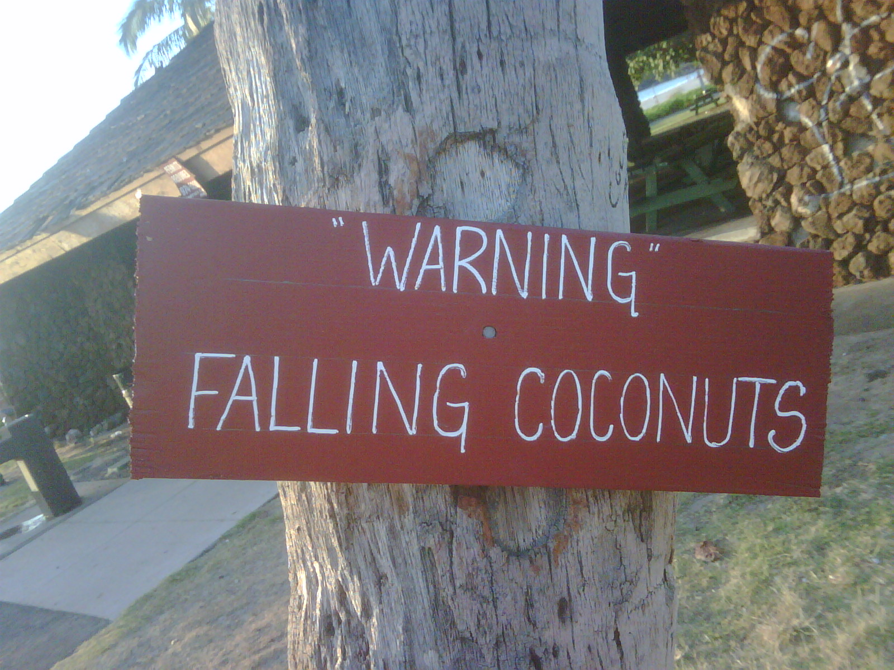
Thanks for Listening

