Slide 1
Project: IEEE P802.15 Working Group for Wireless Personal Area Networks (WPANs)
Submission Title: [LECIM Tutorial - Application Presentations]
Date Submitted: [July 2010]
Source: [Roberto Aiello] Company [Independent]
Address [San Diego, CA USA]
Voice:[], FAX:], E-Mail:[aiello@ieee.org]
Abstract: [This presentation summarizes application contributions for LECIM]
Purpose: [For information]
Notice: This document has been prepared to assist the IEEE P802.15. It is offered as a basis for discussion and is not binding on the contributing individual(s) or organization(s). The material in this document is subject to change in form and content after further study. The contributor(s) reserve(s) the right to add, amend or withdraw material contained herein.
Release: The contributor acknowledges and accepts that this contribution becomes the property of IEEE and may be made publicly available by P802.15.

Slide 2
LECIM Application Presentations
15-10-0053 – LECIM applications
Johan Becker - Amplex, Inc, Mike Calcagno - Sempra Energy, David Howard - On-Ramp Wireless, Inc.
15-10-0186 – Container tracking
Roberto Aiello - Independent
15-10-0291 – Wireless environment in agriculture
Liang Zhang, Bo Hu, Z.F. Zhao, Tao Xing, Haitao Liu, Betty Zhao - Vinno, SIMIT, China Mobile (BJ), BJ Agriculture Research Institute, Huawei
15-10-0297 – Remote monitoring
Nikica Mikulandra - KONČAR
15-10-0299 – Soil Monitoring
Peter Ellegaard - AquaSpy, Inc.
15-10-0307 – Applications in China
JF Luo, Y Yang, Y X Fu, J Shen, X Wang, X Tao, Haituo Liu, L Li - SIMIT, Vinno, Huawei

Slide 3
Critical Infrastructure Application Overview David Howard - On-Ramp Wireless, Inc.
Infrastructure Monitoring
Transportation & Asset tracking
Security & Life Safety
Water leak detection
Sewer monitoring
Bridge/structural integrity monitoring
Streetlight control systems
Fault Circuit Indicators
Soil monitoring
Oil & gas pipeline monitoring
Public transport tracking
Cargo container monitoring
Railroad condition monitoring
Traffic congestion monitoring
Gas/hazardous material detection
Perimeter security
Border surveillance
Medical alert for at-risk populations
First responder tracking
Small data packet, widely dispersed endpoints or hard to reach locations, high capacity, battery operated applications requiring a secure, reliable and cost effective wireless network

Slide 4
Water is an expensive scarce resource Johan Becker - Amplex Inc.
Water resources are often found far away from where it is being used
Water must be transported from supply to consumer
Fresh water produced at desalination plants
Global problem
California has put restrictions on water usage
Australia is transporting water by trucks to dry regions.
Within the European Union it is estimated that 11% of the population and 17% of the area has limited water resources
Mediterranean countries are highly dependant on rainfall (Cyprus needed to ship in water in 2008)

Slide 5
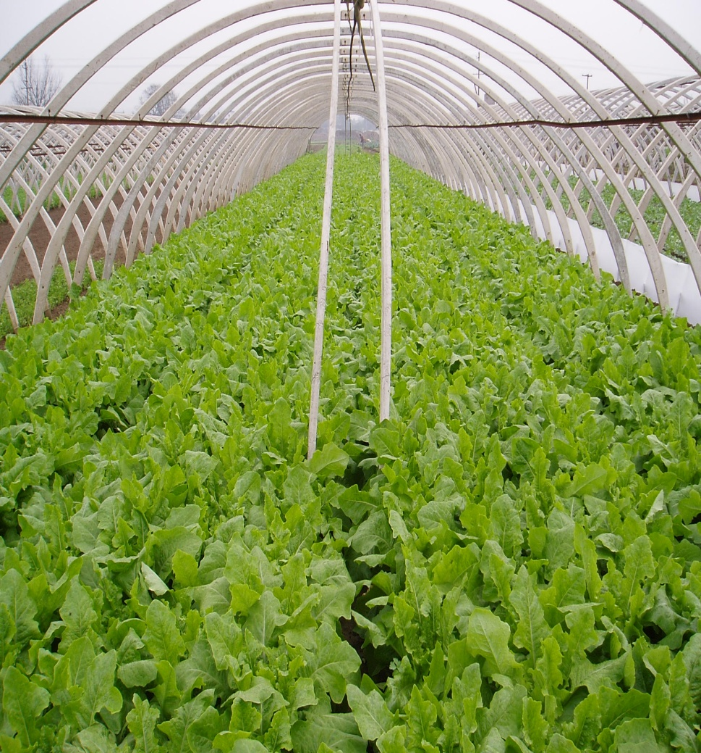
Sensors and Communication Networks Plays an important role in Green Houses Liang Zhang, Bo Hu, Z.F. Zhao, Tao Xing, Haitao Liu, Betty Zhao] Company [Vinno, SIMIT, China Mobile (BJ), BJ Agriculture Research Institute, Huawei
Sensors Collect the information in Green House as:
Temperature
Humunity
PH, CO2 and other soil factors.
Communication networks implement the remote monitor, real-time control and quick actions.
GPRS/GSM/3G
Internet
WPAN
The WPAN + 3G is an excellent applications
5

Slide 6
Smart Buoys Nikica Mikulandra - KONČAR
99,99% of mooring buoys are so far “manually” operated
Mooring with buoys VS “free” mooring
Organized mooring
Environmentally more friendly
Possibility of automation
No real-time monitoring of existing mooring buoys
Ad hoc tracking and inspection only at choke points (RFID)
Features
Ensure secure mooring
Ensure real time monitoring
Prevent loss of buoys
Ensure payment of service
Reduce cost
Improve customer service

Slide 7
Soil monitoring Peter Ellegaard - AquaSpy, Inc
Motivation
Ability to create low operational cost soil moisture sensors where low volume data is transmitted several times a day.
Objective
Reliable low energy, low data rate communication up to 20 miles
Fault tolerant communication that re-engages in case of a break-down
Ability to overcome bio-mass obstructions

Slide 8
Low Energy Critical Infrastructure Monitoring Application in China JF Luo, Y Yang, Y X Fu, J Shen, X Wang, X Tao, Haituo Liu, L Li] [SIMIT, Vinno, Huawei
Motivation
China has many applications which are suitable for the characteristics of low energy critical infrastructure monitoring (LECIM) system.
Objective
Describe the application situation in China
Smart Grid
Container monitoring
Pipeline monitoring
Provide application requirements for LECIM systems

Slide 9
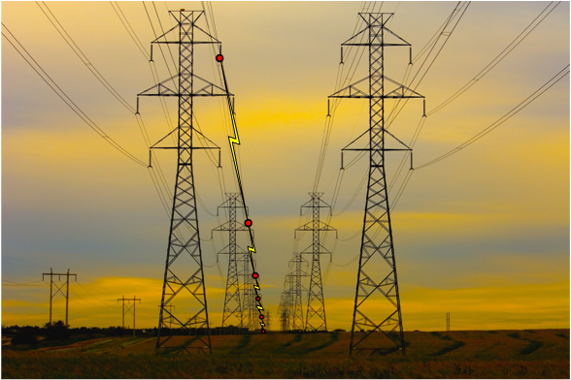
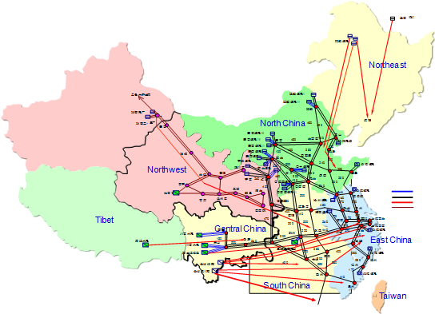
Electronic Equipment Monitoring
Monitoring electronic equipments
Find fault circuit quickly
Prevent from stolen or damage
……
Small data packet
Long distance transmission
High gain
Anti-Interference

Slide 10
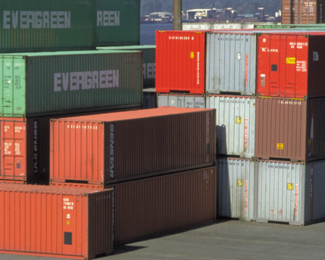
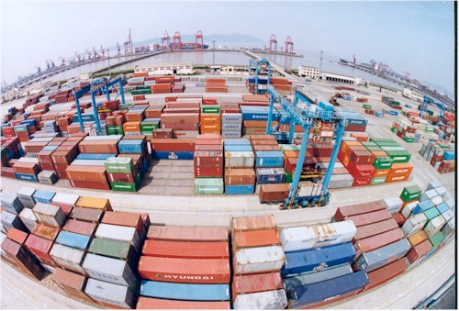
Container Monitoring
Real-time tracking of location of containers
Condition (temperature, humidity…) of containers monitoring
Throughput of containers from China is 1st in the world for these three years
Three of the world top 5 largest container throughput ports are in China

Slide 11
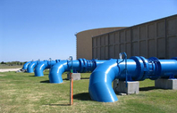
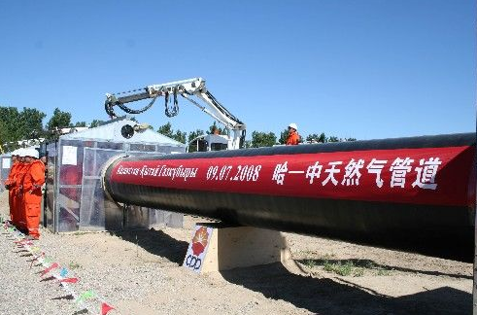
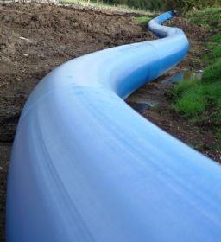
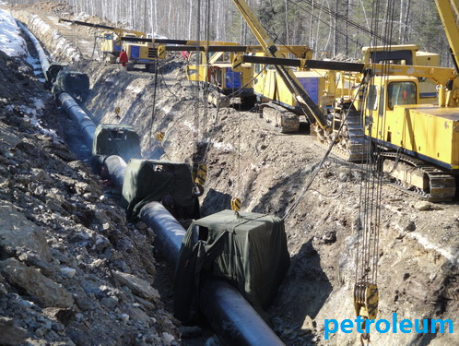
Pipeline Monitoring
Pipeline monitory
water pipeline
Total water pipe line is 236,000 km until 2008, from “National Bureau of Statistics of China”
oil-gas pipeline
60,000 km oil-gas pipeline in China at present, and will increase to100,000 km by the year of 2015

Slide 12
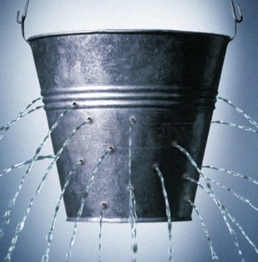
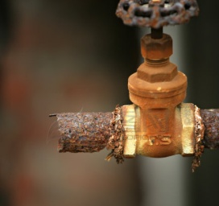
Water Pipeline Leak
Large population, but limited resources
Average percentage of water pipeline leak is 9.79% in 502 cities of China
Daily loss of water will be up to hundred million m
Water pipeline leak
Underground
Hard to detect
3

Slide 13
Conclusions
Summary applications
6 application presentations
10 author companies
15 applications described
Consensus on
Large opportunity
Technology gap
Not well addressed by other standards

