Slide 1
Project: IEEE P802.15 Working Group for Wireless Personal Area Networks (WPANs)
Submission Title: [Use Case: Distribution Grid and Substation Monitoring]
Date Submitted: [July 2010]
Source: [Mike Calcagno] Company: [Sempra Energy]
Address: [San Diego, CA USA]
Voice:[], FAX:[], E-Mail: [MCalcagno@semprautilities.com]
Abstract: [This presentation contains the material related to the IG LECIM tutorial]
Purpose: [For information]
Notice: This document has been prepared to assist the IEEE P802.15. It is offered as a basis for discussion and is not binding on the contributing individual(s) or organization(s). The material in this document is subject to change in form and content after further study. The contributor(s) reserve(s) the right to add, amend or withdraw material contained herein.
Release: The contributor acknowledges and accepts that this contribution becomes the property of IEEE and may be made publicly available by P802.15.

Slide 2
User Case Sempra Energy Mike Calcagno Distribution Grid Sensor/Fault Current Indicator Substation Monitoring

Slide 3
SDG&E Background
3,300,000 population in territory
700,000 gas meters
> 60 % underground infrastructure
1,400,000 electric meters
Significant IT programs
OpEx 20/20 – leveraging technology
VoIP
Wide-area network rebuild – TDM to IP/MPLS
LAN rebuild
Wireless wide area network rebuild

Slide 4
Sample of Wireless at SDG&E
System | Purpose | Frequency | Scope
SCADA | Distribution monitoring and control | 900 MHz MAS | 1500 RTUs
DataTac | Mobile Data | 800 MHz | 400 MDTs
Smartzone | PTT mobile voice | 900 MHz | 2000 units
Wirestring radio | Tactical field use | 450 MHz | 1000 units
Satellite links | Emergency comm | 12 GHz | 5 quick deployment
WiFi | LAN | 2.4 GHz | Offices
Commercial | Remote access | Various | 16,000

Slide 5
Gaps In Technology
Point to multi-thousands of point communications
Relatively small amount of data
Latency in seconds
Ability to operate without primary power
Minimal network complexity and number of active nodes
Standard network interface – IP
Standard device interface – Serial or IP
Available embedded through an OEM
Easily deployable
Able to communicate to underground assets
Addresses spectrum issues

Slide 6
Target Use Cases at SDG&E
Distribution Grid Sensor/ Fault Current Indicators
In the tens of thousands
Overhead and underground
Monitor state, possibly number of events
Distribution Transformers
In the hundreds of thousands
Voltage and current, power out
Monitoring Remote Terminal Units
Condition based monitoring
Improve outage resolution

Slide 7
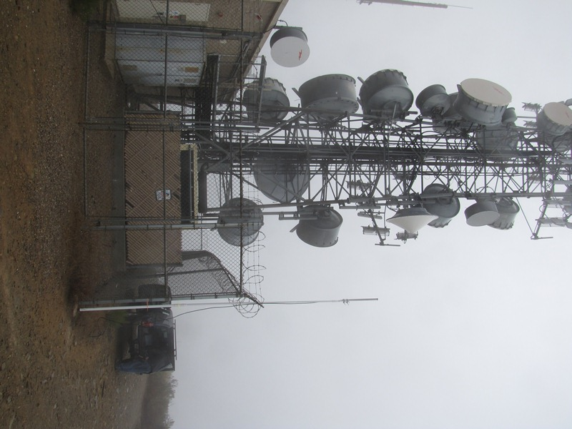
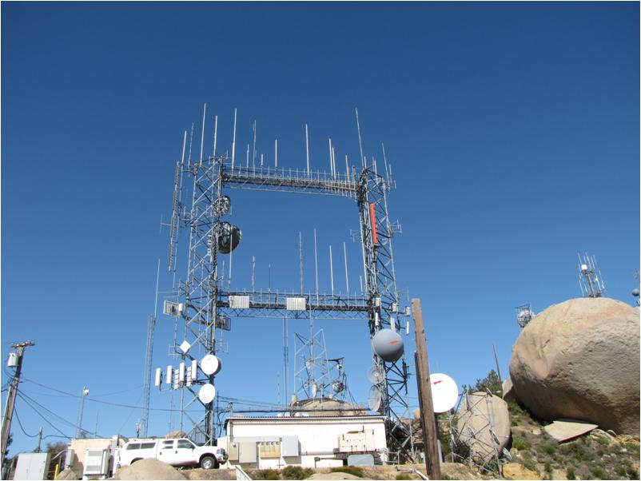
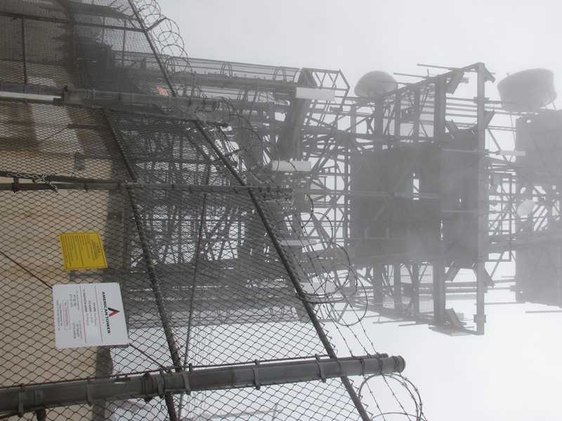
SDG&E Territory: Examples
Tower Shared Space / High Interference

Slide 8
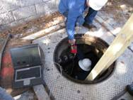
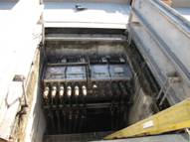
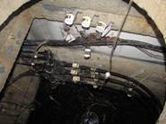
SDG&E Territory: Examples
FCI: Below Ground Deployment

Slide 9
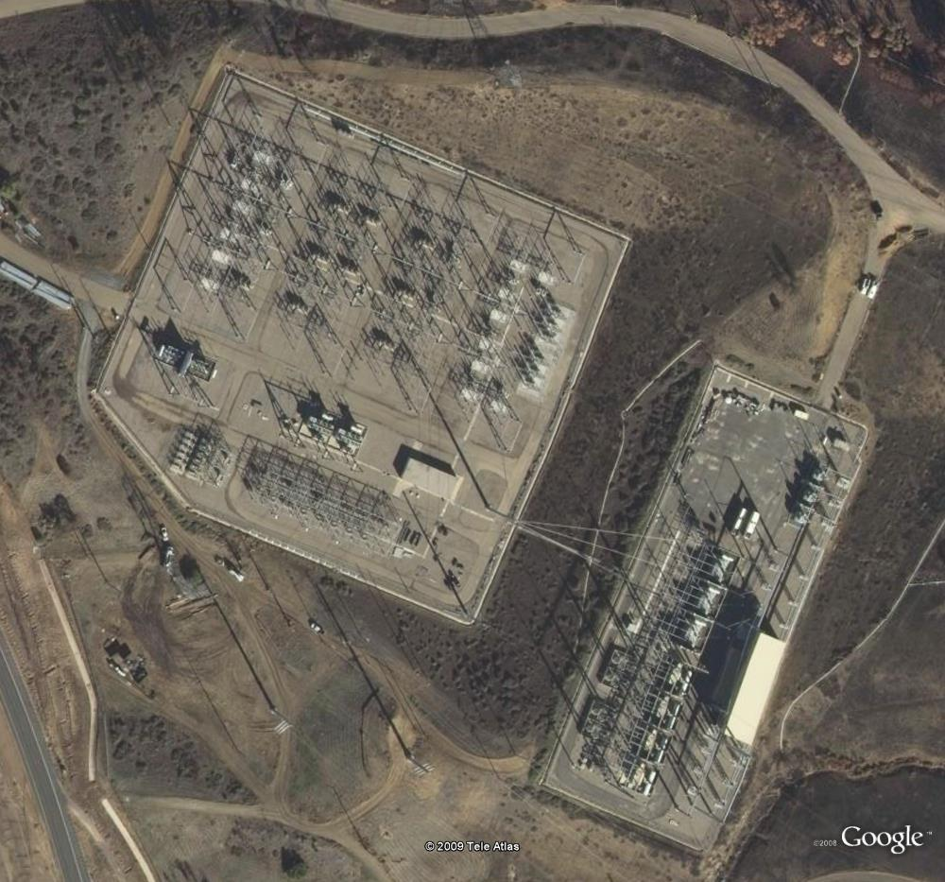
SDG&E Territory: Examples
Substation Monitoring: 500 KV / 230 KV

Slide 10
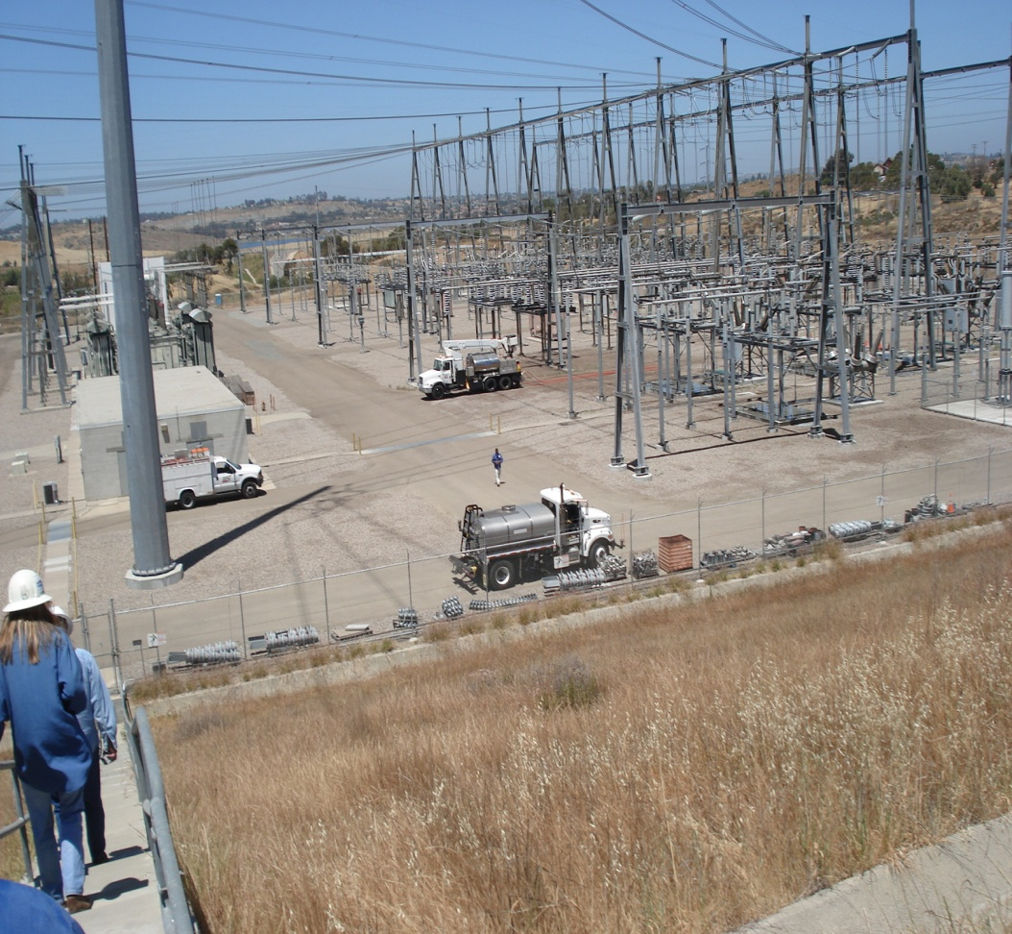
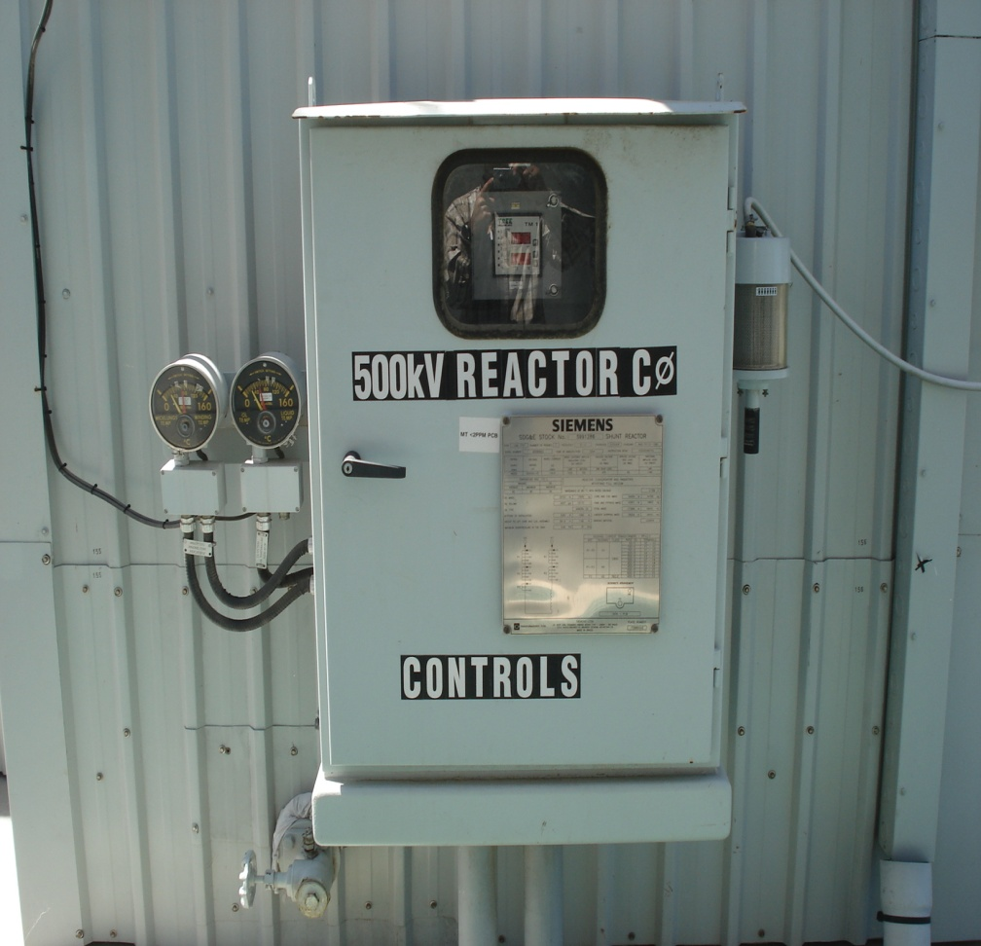
SDG&E Territory: Substation Monitoring
Harsh Environment
Inside Metal Cabinets

Slide 11
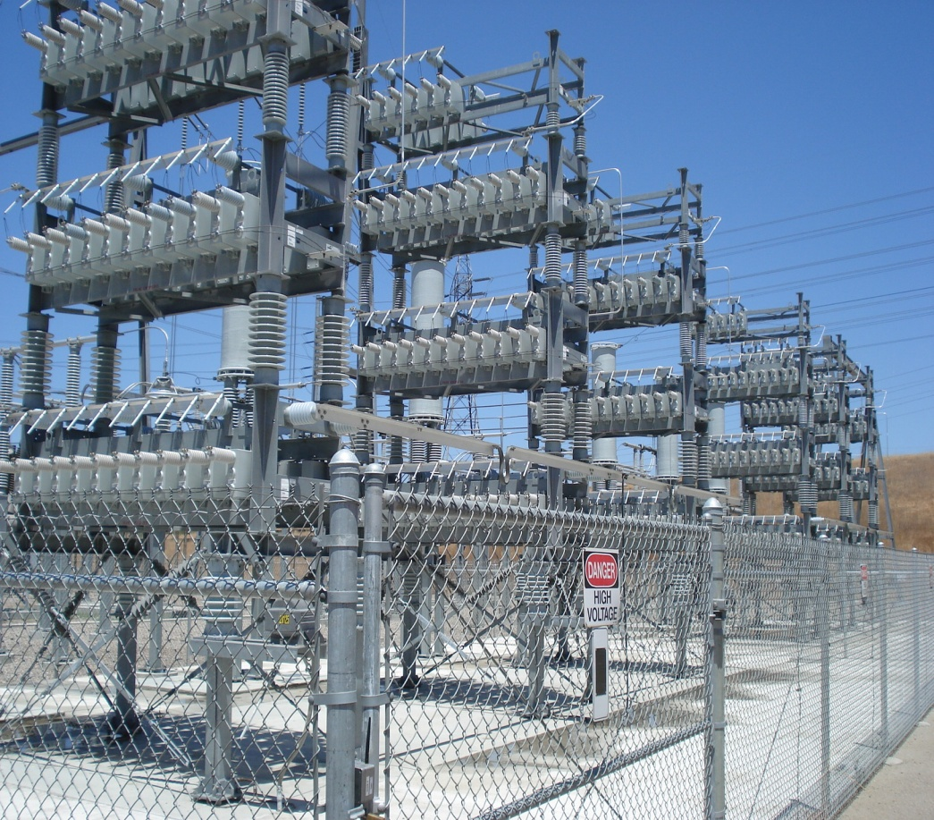
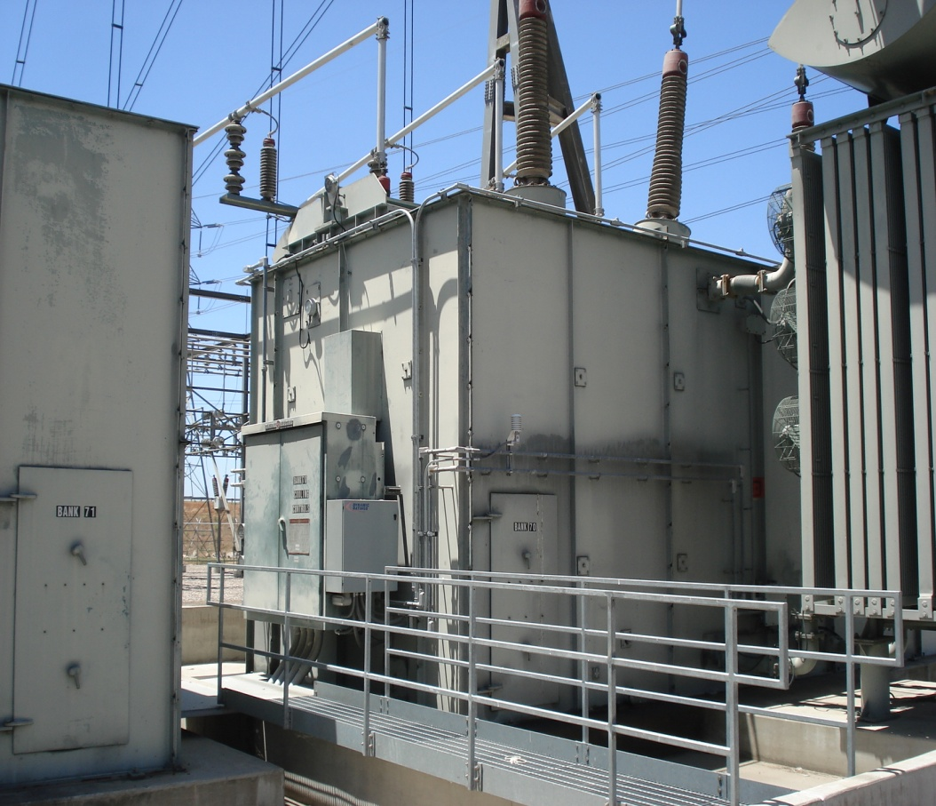
SDG&E Territory: Substation Monitoring
Harsh Environment: 230 KV

