Slide 1
IEEE 802.15-10-0347-00-004f
Project: IEEE P802.15 Working Group for Wireless Personal Area Networks (WPANs)
Submission Title: 802.15.4f Task Group Closing Report for Beijing, China
Date Submitted: May 20, 2010
Source: Tim Harrington, WhereNet / Zebra
Contact: Mike McInnis, The Boeing Company
Voice: E-Mail: michael.d.mcinnis@boeing.com
Re: 802.15.4f Active RFID Closing Report for the May 2010 Session
Abstract: Closing Report for the May 2010 Active RFID Session in Beijing, China.
Purpose: This amendment defines a Physical Layer (PHY), and those Medium Access Control Layer (MAC) modifications required to support it, for Active Radio Frequency Identification (RFID) readers and tags. It allows for efficient communications with active RFID tags and sensor applications in an autonomous manner in a promiscuous network, using very low energy consumption (low duty cycle), and low PHY transmitter power. The PHY parameters are flexible and configurable to provide optimized use in a variety of active RFID tag operations including simplex and duplex transmission (reader-to-tag and tag-to-readers), multicast (reader to a select group of tags), uni-cast as in reader to a single tag, tag-to-tag communication, and multi-hop capability.
Notice: This document has been prepared to assist the IEEE P802.15. It is offered as a basis for discussion and is not binding on the contributing individual(s) or organization(s). The material in this document is subject to change in form and content after further study. The contributor(s) reserve(s) the right to add, amend or withdraw material contained herein.
Release: The contributor acknowledges and accepts that this contribution becomes the property of IEEE and may be made publicly available by P802.15.

Slide 2
IEEE 802.15.4f Active RFID
Closing Report
9th Meeting as a Task Group
Beijing, China
May 20, 2010

Slide 3
802.15.4f PAR Purpose
Paragraph from 802.15.4f Project Authorization Request (PAR) document.
5.4 Purpose of Proposed Standard:
To provide a standard for low cost, ultra low energy consumption, flexible and highly reliable communication means and air interface protocol for Active RFID and sensor applications. The air interface should be able to support a wide range of needs for which active RFID systems can be useful and enable improved performance and flexibility for future mass deployments of active RFID systems around the world.

Slide 4
IEEE 802.15.4f Active RFID Meeting Overview
Chair: Mike McInnis
Vice-Chair: Tim Harrington
Secretary: George Cavage
Technical Editor: Tim Harrington
Eight each TG4f meeting time slots plus one joint TG4e/f/g meeting time slot assigned for this week. TG4f actual time slot use summary for the week was:
TG4f met during 8 TG4f meeting time slots.
TG4f participated in one joint TG4e/f/g meeting time slot.
TG4f participated in one joint 802.18 and TG4e/f/g meeting time slot.
3. Administrative Documents during this session:
15-10-0131-03 -Agenda-March-2010.xls
15-10-0167-01 -Opening-Introduction-March-2010.ppt
15-10-0222-00 -Active-RFID-Minutes-Orlando-March-2010.doc

Slide 5
This Slide Intentionally Blank
This slide and following slides should be disregarded until update
Blank until update

Slide 8
Active RFID Meeting Achievement summary
Discussed and approved proposals that resolved many of the ‘to be determined’ items listed in TG4f merged PHY document 15-09-0804-06 approved during the January 2010 meeting. Document 0804-06 was then updated to 0804-08 and approved early in the week then to 0804-11 and approved at the end of the week.
Some TBD items remain in the 0804-11 document and we will work on these during ad-hoc conference calls between the end of this meeting and the Bejing meeting.
Billy Verso completed draft text describing Blink Frame MAC Primitives and created document 15-10-0211-00-004e.
This document was reviewed and voted upon within TG4f and then submitted to TG4e.
TG4f requests that TG4e insert the draft text from document 0211-00 into their draft MAC standard document prior to letter ballot.

Slide 9
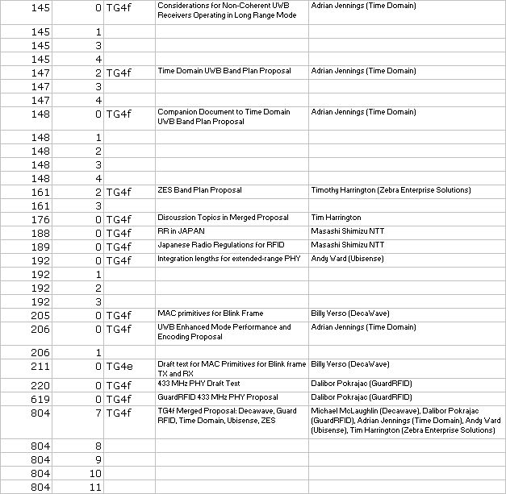
Documents presented and discussed during this TG4f meeting session.

Slide 10
TG4f Meeting Sessions This Week
Mtg | Monday | Tuesday | Wednesday | Thursday
AM1 0800-1000 |  | Draft TG4f PHY standard text writing, planning, and discussion | Draft TG4f PHY standard text writing, planning, and discussion | Draft TG4f PHY standard text writing, planning, and discussion
AM2 1030-1230 |  | Joint WG18/TG4e/f/g meeting | 802.15 WG Midweek MTG Wireless Next Gen (WNG) Tech Editor MTG? | Draft TG4f PHY standard text writing, planning, and discussion Prepare for May meeting in Bejing.
PM1 1330-1530 | Opening/Agenda / Objectives/Jan010 Minutes/ Timeline / PAR/ Review and discussion of TGe BLINK frame progress. |  | Draft TG4f PHY standard text writing, planning, and discussion
PM2 1600-1800 | Joint TGe/f/g Meeting |  | Draft TG4f PHY standard text writing, planning, and discussion

Slide 11
Next TG4f Meeting Goals and Agenda - May 2010 in Beijing
Discuss and resolve current UWB PHY and 2.4 GHz PHY ‘TBD’ items in the TG4f merged PHY document 0804-11.
Work on comments which may arise pertaining to the TG4f requested ‘BLINK’ frame and primitives in TG4e draft standard document following the 1st TG4e Letter Ballot cycle.
Review and discuss TG4f draft text presented for the UWB, 2.4 GHz, and 433 MHz PHYs during the week.
Discuss next steps and the July 2010 meeting in San Diego, California.

Slide 12
Project Meeting Dates and Locations http://grouper.ieee.org/groups/802/15/pub/Meeting_Plan.html
Meeting Date | Type | Location
Jan-09 | Interim | Los Angeles
Mar-09 | Plenary | Vancouver
May-09 | Interim | Montreal
Jul-09 | Plenary | San Francisco
Sep-09 | Interim | Kona, Hawaii
Nov-09 | Plenary | Atlanta, GA
Jan-10 | Interim | Los Angeles
Mar-10 | Plenary | Orlando, FLA
May-10 | Interim | Beijing, China
Jul-10 | Plenary | San Diego
Sep-10 | Interim | Kona, Hawaii
Nov-10 | Plenary | Dallas
Jan-11 | Interim | Los Angeles
Mar-11 | Plenary | Singapore

Slide 13
Draft 802.15.4f Timeline
March 2010 Plenary
1st Letter Ballot cycle
2nd Letter Ballot cycle
3rd Letter Ballot cycle
Sponsor Ballot cycles

Slide 14
TG4f Weekly Teleconference Call Schedule
Weekly, Thursdays, 8am Pacific Time (USA)
April 1, 2010
April 8, 2010
April 15, 2010
April 22, 2010
April 29 2010
May 6 2010
May 13, 2010
Teleconference call details will be distributed through the TG4f e-mail reflector:
STDS-802-15-4F@LISTSERV.IEEE.ORG

Slide 15
Sign up for 802.15.4f Active RFID e-mail reflector
Sign-up at: http://grouper.ieee.org/groups/802/15/pub/Subscribe.html
Email reflector address is: STDS-802-15-4f@listserv.ieee.org
Next Meeting
May 17-20, 2010 in Beijing, China
Register for the next meeting at:
https://ei.eventinfotech.com.au/ei/rs.esp?id=914&scriptid=REG

