Slide 1
Project: IEEE P802.15 Working Group for Wireless Personal Area Networks (WPANs)
Submission Title: Contribution for CSK Related Comments
Date Submitted: May 2010
Source: Soo-Young Chang, CSUS
Address:
Contact Information: 530 574 2741 [sychang@ecs.csus.edu]
Re:
Abstract: Remedies for CSK related comments, Comments 334, 500, 501, 515, 522, and 538 are suggested for the 15.7 standard.
Purpose:
Notice: This document has been prepared to assist the IEEE P802.15. It is offered as a basis for discussion and is not binding on the contributing individual(s) or organization(s). The material in this document is subject to change in form and content after further study. The contributor(s) reserve(s) the right to add, amend or withdraw material contained herein.
Release: The contributor acknowledges and accepts that this contribution becomes the property of IEEE and may be made publicly available by P802.15.
Slide 1

Slide 2
CSK RELATED COMMENTS AND REMEDIES
Soo-Young Chang
CSUS
Slide 2

Slide 3
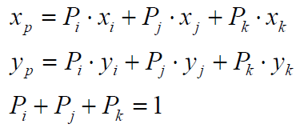
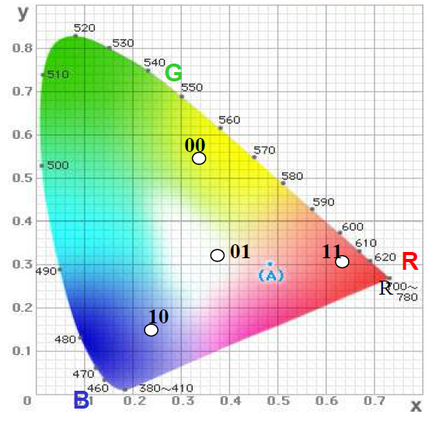
CURRENT CONSTELLATION IN D1
  A constellation diagram for quaternary cases (6.8.6)
Problem with this constellation
  Points of light sources should
  be outside of the constellation.
  Some light sources can be
  located inside the constellation.
  For this case, light signals for
  corresponding constellation
  points can not be generated.
  Constellation and formulae in the
  above should be modified.
Slide 3

Slide 4
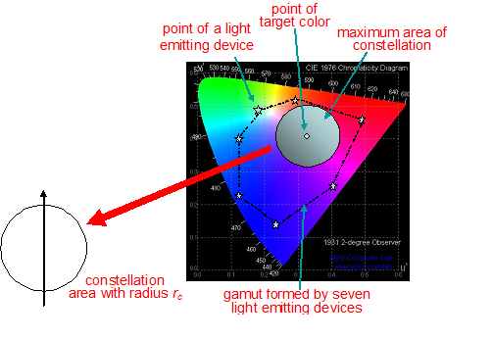
MODIFIED CONSTELLATION
  Formation of a maximum constellation area
    Light sources
    determine the gamut
    area.
    Depending on the
    target color
    A specific target
    color can be
    generated.
    Current constellation
    is one with white
    target color and three
    light sources.
    More flexibility
      Any target color
      Any number of light
      sources
an example with seven light emitting devices
Slide 4

Slide 5
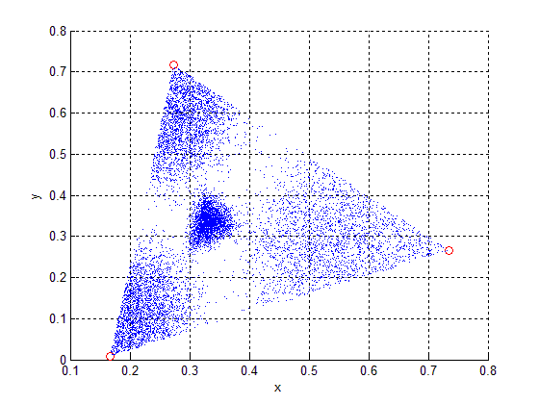
SYMBOL POINT DISPERSION (1)
Dispersion of received symbols for CSK due to added AWGN noise on CIE 1931 with current formulae
  Each symbol has a different
  dispersion area depending
  on the location of the point.
Slide 5

Slide 6
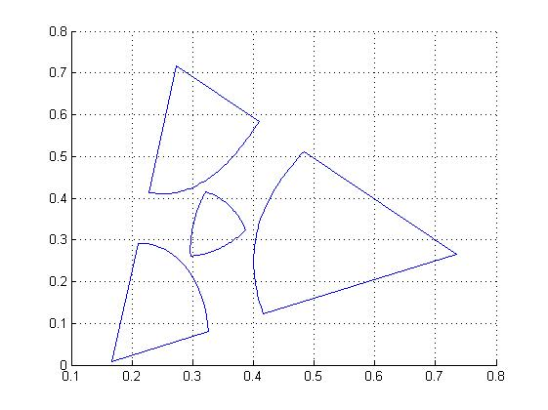
SYMBOL POINT DISPERSION (2)
Subareas each of which represents its own symbol due to added AWGN noise on CIE 1931 with current formulae
  Each symbol has a different
  dispersion area depending
  on the location of the point.
Slide 6

Slide 7
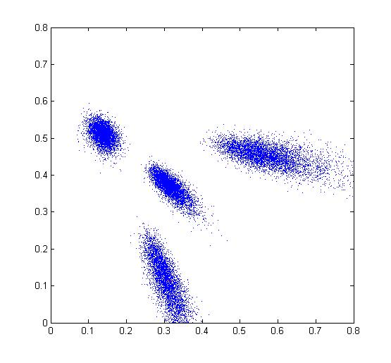
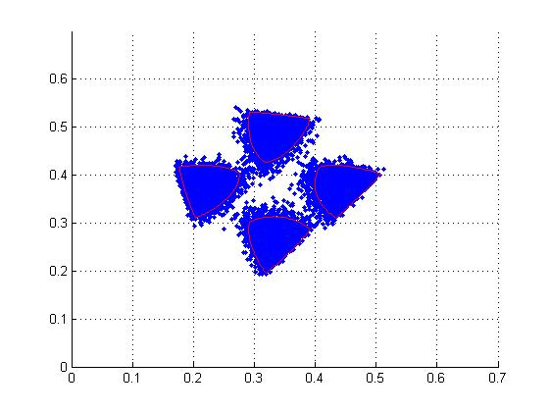
SYMBOL POINT DISPERSION (3)
Dispersion of received symbols for CSK which results in degradation of performance on CIE 1976
More dispersion
Less dispersion
Dispersion with current constellation and formulae
Dispersion with modified constellation and formulae
Slide 7

Slide 8
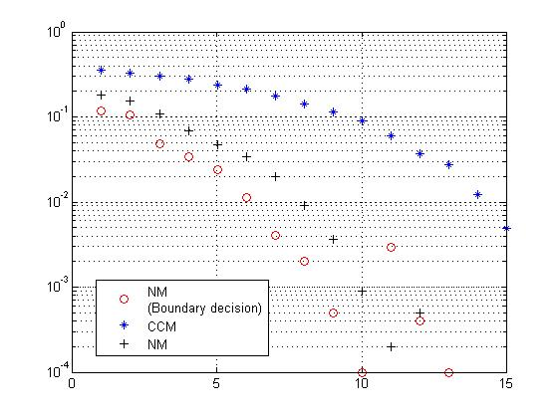
PERFORMANCE COMPARISON
BER performance comparison between current constellation and modified constellation
Modified constellation
(boundary decision)
Modified constellation
Current constellation
Slide 8

Slide 9
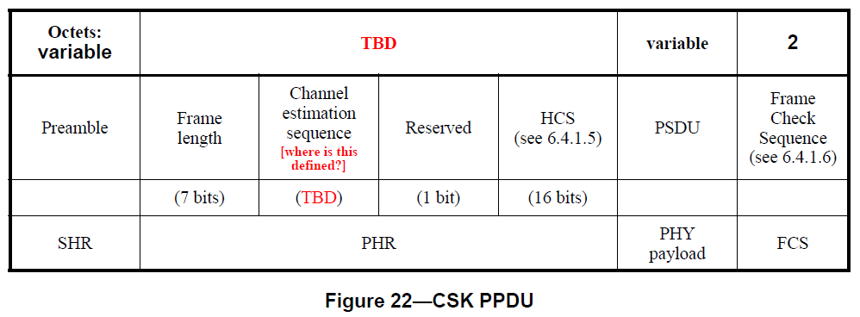
COMMENT 334
  Clause and Page: 6.4.1 Page 39 Line 21
Comment 334
  “In Figure 22, channel estimation sequence may not be needed if the receiver is able to compensate distortion from the channel.”
Suggested Remedy
  “A channel compensation algorithm can rearrange constellation points at receiver without channel estimation for better performance.”
Slide 9

Slide 10
REMEDY FOR COMMENT 334
Comment for the current 15.7 draft
  In the current draft, some information should be exchanged for channel estimation or calibration. It is not needed because the receiver can compensate the inference effect from channel.
Fact
  At the receiver, the constellation for data symbol points can easily be identified at the receiver by simply examining a fixed number of previous received points. From these points, the constellation can be re-established/calibrated at the receiver without any information from outside.
  Therefore channel estimation or calibration by exchanging information between transmitter and receiver is redundant and not needed.
Suggested Remedy
  “A channel compensation algorithm can rearrange constellation points at receiver without channel estimation for better performance.” Therefore , delete this estimation. No estimation or calibration is needed.
Slide 10

Slide 11
COMMENT 500
  Clause and Page: 6.8.4 Run Length Limiting Encoder
  All CSK modes use the 8B10B RLL code as defined in 6.7.3.2.
Comment 500: 6.8.4 Page 55 Line 17
  “CSK does not need RLL because it is a constant intensity modulation.”
  RLL is needed only for intensity (or power) balancing among symbol elements, which is not the case for CSK.
Suggested Remedy
  “Figure 36 needs to be modified and add explanations.”
Slide 11

Slide 12
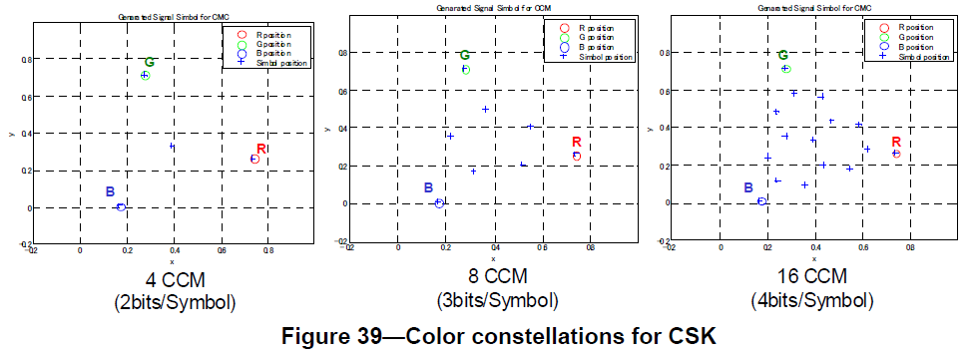
COMMENTS 501 & 538
Clause and Page: 6.8.5 CSK bit to symbol mapping & 6.8.6.1 CSK Calibration
  Comment 501: 6.8.5 Page 55 Line 21 & Comment 538: 6.8.6.2 Page 59 Line 22
  “CSK's constellation can be optimized with the characteristics light sources used. Therefore better constellation can be used for better performance for CSK.”
Suggested Remedy
  Better constellations depending on the symbol sizes should be used for better performance. Apply the modified constellation and corresponding mapping formulae described in one of previous slides.
Slide 12

Slide 13
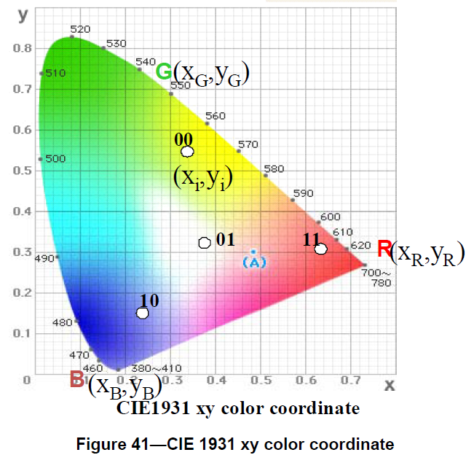
COMMENT 515
Clause and Page : 6.8.6 Symbol to Optical Mapping
  Comment 515: 6.8.6 Page 56 Line 25
  “Same issue as for Section 6.8.5. CSK's constellation can be optimized with the characteristics light sources used. Therefore better constellation can be applied for better performance for CSK.”
Suggested Remedy
  Better constellations depending on the symbol sizes should be used for better performance. Apply the modified constellation and corresponding mapping formulae described in one of previous slides.
Slide 13

Slide 14
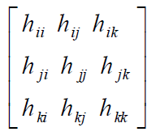
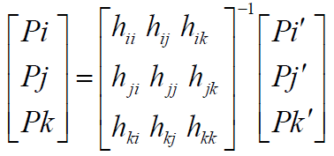
COMMENT 522
Clause and Page: 6.8.6.1 CSK Calibration
  Comment 522: 6.8.6.1 Page 57 Line 21
  “CSK does not need to have calibration. The receiver can calibrate by itself using received signals.”
  This calibration makes systems more complicated and becomes burdensome for link establishment.
Suggested Remedy
  “Constellations can be calibrated at the receiver without calibration signals from the transmitter.”
  No calibration is needed. So deletion of this clause is recommended.
Figure 42—channel propagation matrix
Figure 43—Propagation compensation
Slide 14

Slide 15
SUMMARY
This contribution is prepared to provide remedies for Comments 334, 500, 501, 515, 522, and 538.
CSK does not require information exchange between transmitters and receivers for any estimation and calibration.
  This exchange should be unnecessary burden for communication networks.
Modified constellation and corresponding formulae for determining intensities of light sources are suggested for better performance.
  Current constellation in D1 has a problem when light sources are located outside the constellation.
  Thus it needs to be modified and corresponding formulae for light source intensities.
  Modified constellation allows us to have freedom for realization of any target color with any number of light sources.
  Modified constellation has less dispersion and better BER performance that current constellation.
Slide 15

