Slide 1
Project: IEEE P802.15 Working Group for Wireless Personal Area Networks (WPANs)
Submission Title: A NEW BAND PLAN FOR 15.7
Date Submitted: May 2010
Source: Soo-Young Chang, CSUS
Address:
Contact Information: 530 574 2741 [sychang@ecs.csus.edu]
Re:
Abstract: A new band plan is suggested for the 15.7 standard.
Purpose:
Notice: This document has been prepared to assist the IEEE P802.15. It is offered as a basis for discussion and is not binding on the contributing individual(s) or organization(s). The material in this document is subject to change in form and content after further study. The contributor(s) reserve(s) the right to add, amend or withdraw material contained herein.
Release: The contributor acknowledges and accepts that this contribution becomes the property of IEEE and may be made publicly available by P802.15.
Slide 1

Slide 2
A NEW BAND PLAN FOR 15.7
Soo-Young Chang
CSUS
sychang@ecs.csus.edu
Slide 2

Slide 3
COMMENT 226
Clause and Page
  6.1.2 Page 22 Line 25
Comment
  “Band plan should be established using detector sensitivity rather than human eye sensitivity to have better performance. Therefore a new band plan can be introduced using photo detection device responsivities.”
Suggested Remedy
  “A new band plan is needed for better performance. Refer to a contribution document which will be posted later.”
Slide 3

Slide 4
INTRODUCTION
Recently visible light communications (VLC), wireless communications operating in the visible light range, were introduced as an alternative way to be used for short range and medium range communications.
Visible light signals have wavelengths that range from 380 nm to 780 nm [1]. This frequency (or wavelength) band can be divided into multiple communication channels or subbands.
Due to the increasing demand for wireless communications, a frequency band must be divided into channels in a manner that maximizes the efficiency of the band.
Light’s unique characteristics are considered in order to efficiently divide the visible light band.
Slide 4

Slide 5
MOTIVATIONS FOR NEW SCHEME
A method suggested for 15.7 divides the frequency channel based on human eye sensitivity [1].
  This method is not optimal for communication performance because the light signals for communications are not detected by human eyes, but by photo detection devices at receivers.
  Thus characteristics of photo detection devices should be considered for better communication performance.
Another motivation for the new scheme is to ensure power-fairness across the channels (i.e., equal received power for all channels).
  This fairness is very important in scenarios where wireless users have capability of accessing more than one channel.
  Having a constant received power, regardless of which channel the user operates on, enables users to have the same transmission range and thus makes the link more robust to failure. In contrast, having varied received power levels for the subbands increases potential for the link to fail.
Slide 5

Slide 6
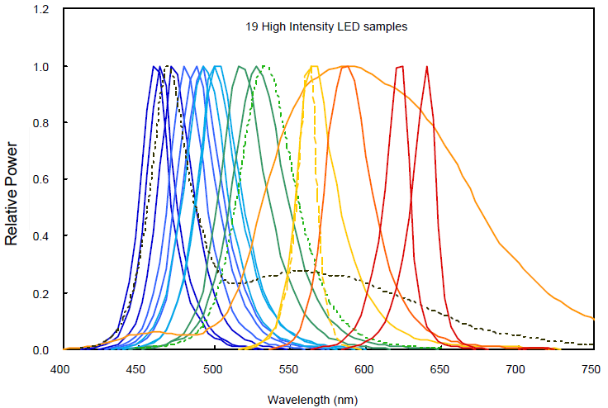
FACTORS TO BE CONSIDERED (1)
LED SPECTRAL DISTRIBUTION
LED Spectral Distribution
  Spectral distributions for various color LEDs [2]. Colored LEDs have narrower bands while white LEDs have broader bands.
Slide 6

Slide 7
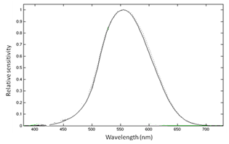
FACTORS TO BE CONSIDERED (2)
HUMAN EYE SENSITIVITY
Human Eye Sensitivity
  Human eye sensitivity - luminosity function, the luminance response of the human eye cone photoreceptors. Human eyes are more sensitive to light components in the central part of visible light band.
Slide 7

Slide 8
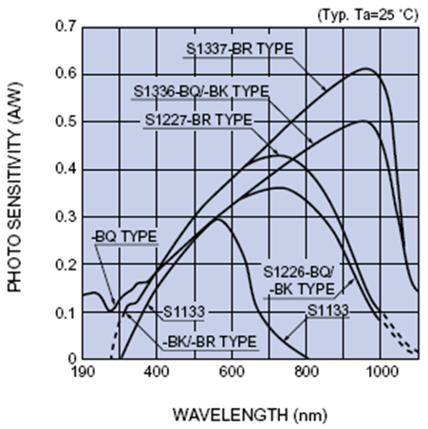
FACTORS TO BE CONSIDERED (3)
PHOTO DETECTION RESPONSIVITY
Photo Detector Responsivity
  Examples of responsivity curves for various photo detection devices [3]. In the visible light band, the responsivity increases approximately linearly with respect to wavelength.
Slide 8

Slide 9
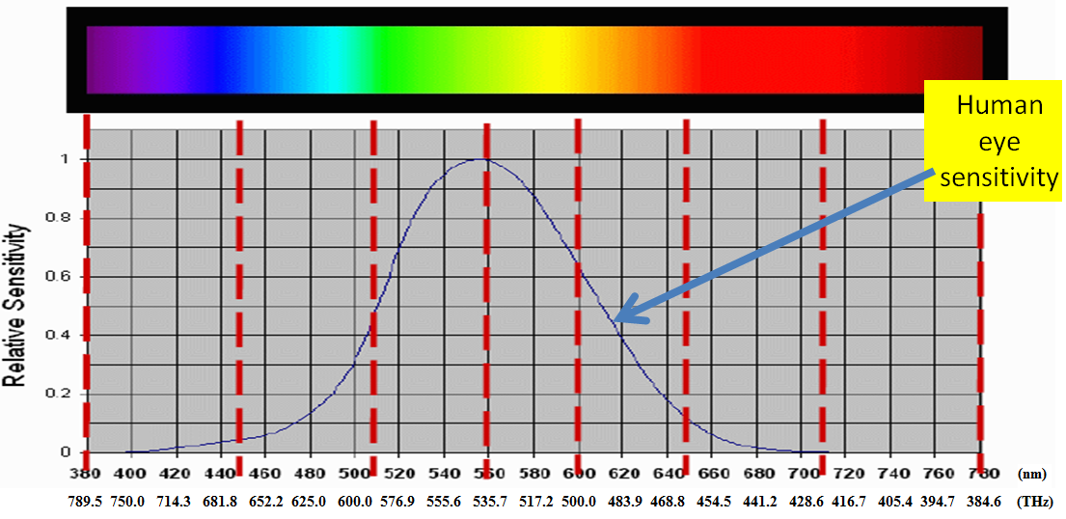
EXISTING FREQUENCY DIVISION METHOD
Based on human eye sensitivity:
  Band division of the entire visible light band based on human eye response to wavelength (an example for seven subbands case).
  This sensitivity is already considered in illumination systems design for appropriate visibility.
Slide 9

Slide 10
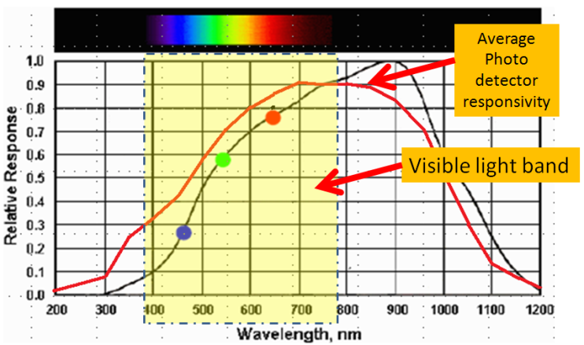
USE OF RESPONSIVITY OF PHOTO DETECTORS
Average Photo Detector Responsivity
  Average responsivity of photo detectors which is calculated by averaging responsivity values of various types of photo detection devices from multiple vendors, shown in red.
A specific
photo detector
responsivity
Slide 10

Slide 11
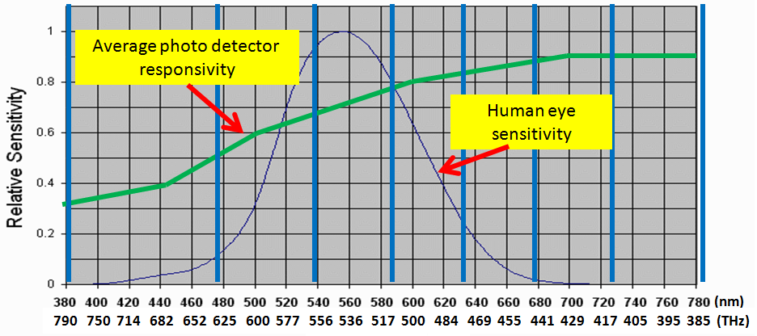
NEW BAND DIVISION METHOD USING RESPONSIVITIES (1)
Based on responsivities of photo detection devices, rather than human eye sensitivity
  In order to make a receiver have evenly distributed power for all subbands
  where s_{i} is the frequency range of the ith subband and R(f) is the average responsivity of photo detection devices as a function of frequency, f.
Slide 11

Slide 12
NEW BAND DIVISION METHOD USING RESPONSIVITIES (2)
Responsivities of photo detection devices, rather than human eye sensitivity applied for band division
Frequency Band |  |  |  | Bandwidth
(nm) |  | (THz) |  | (nm) | (THz)
380 | 478 | 628 | 790 | 98 | 162
478 | 540 | 556 | 628 | 62 | 72
540 | 588 | 510 | 556 | 48 | 46
588 | 633 | 474 | 510 | 45 | 36
633 | 679 | 442 | 474 | 46 | 32
679 | 726 | 413 | 442 | 47 | 29
726 | 780 | 385 | 413 | 54 | 28
Slide 12

Slide 13
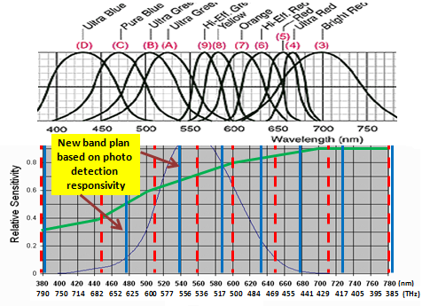
COMPARISON OF TWO METHODS
Comparison of band divisions vs. various LED spectral distributions. (dotted line: existing band division, solid line: new band division).
Slide 13

Slide 14
PERFORMANCE METRIC AND OPTIMALITY DEFINITION
To lower BER,
  Assuming additive white Gaussian noise at a receiver, for most modulation schemes,
  where Q is the Q-function of a normal distribution and a and c are arbitrary constants corresponding to the modulation scheme applied.
  Therefore, BER is a monotonically decreasing function with respect to E_{b}/N_{o}.
To maximize achievable spectral efficiency of overall network,
→ Performance metric : E_{b}/N₀
Slide 14

Slide 15

PERFORMANCE EVALUATION (1)
RELATIVE SIGNAL POWER
Relative signal power
: method using human eye sensitivity
by calculating total power in a subband
: method using photo detection responsivity
30
20
10
Sub-
band 1
Sub-
band 2
Sub-
band 3
Sub-
band 4
Sub-
band 5
Sub-
band 6
Sub-
band 7
Slide 15

Slide 16
PERFORMANCE EVALUATION (2)
RELATIVE CAPACITY
Relative capacity
: method using human eye sensitivity
Using spectral efficiency expression
: method using photo detection responsivity
5
4
3
2
1
Sub-
band 1
Sub-
band 2
Sub-
band 3
Sub-
band 4
Sub-
band 5
Sub-
band 6
Sub-
band 7
Slide 16

Slide 17
PERFORMANCE EVALUATION (3)
RELATIVE COMM. RANGE
Relative comm. range
: method using human eye sensitivity
path loss exponent=2
: method using photo detection responsivity
5
4
3
2
1
Sub-
band 1
Sub-
band 2
Sub-
band 3
Sub-
band 4
Sub-
band 5
Sub-
band 6
Sub-
band 7
Slide 17

Slide 18
PERFORMANCE EVALUATION (4)
SUMMARY
 | Human eye based method | Photo detector based method
Rate performance | Rate fluctuation by the uneven received power - Serious unbalanced network performance among subbands A significantly different communication capacity for each subband | - The same rate for all subband - 0.05dB rate spectral efficiency gain, or more than 1.1% rate spectral efficiency gain for E_{b}/N_{o} =24
Range | Switching to a channel that has lower received power may result in communication failure. The receiver has fallen outside of the transmitter’s transmission range, i.e., lower level of received SNR at the receiver. | - Improvement of reliability performance in a multi-channel environment (e.g., providing a basis to increase spectral efficiency by allowing dynamic spectrum access) A VLC transmitter can maintain a constant transmission range.
Slide 18

Slide 19
PERFORMANCE EVALUATION (4)
SUMMARY (CONT’D)
 | Human eye based method | Photo detector based method
Balance of received power: fairness | - The E_{b}/N_{o} performance varies with respect to the deployed subband (as much as 3.43dB, or more than 2.2 times, difference). | - This method yields equal performance for all the subbands.
Slide 19

Slide 20
CONCLUSION
The author can not see any persuasible reason to utilize human eye sensitivity for band division.
We propose a novel metric to be used for visible light band division, namely the photo detection responsivity. By using the photo detection responsivity of the receiver device rather than the currently existing metric of the third party (not participating in communication), i.e., human’s eye sensitivity, we achieve higher rate performance and more reliable communication, i.e., lower error rates.
The scheme divides the band so that all bands have equal E_{b}/N_{o} and thus results in fairness for all users. Furthermore, simulation shows the superiority of our scheme over the band division method using human eye sensitivity.
The new method improves reliability performance in a multi-channel environment since it enables a VLC transmitter to maintain a constant transmission range and make the communication link more robust.
Slide 20

Slide 21
REFERENCES
T. Bae, H. Kwon, J. Son, Y. Li, S. Rajagopal, and F. Khan, “Physical Layer proposal outline,” IEEE802.15-09-0550-01-0007, July 2009.
Y Ohno, “LED Photometric Standards,” ATP National Meeting, Photonics Manufacturing, San Jose, November 15-16, 1999 .
Photo Diode Technical Guide, Hamamatsu Photonics, K.K., http://sales.hamamatsu.com/assets/html/ssd/si-photodiode/index.htm .
L. Couch II, Digital and Analog Communication Systems, Fifth Edition, Prentice-Hall Inc., 1997.
Xiaoming Zhu and Joseph M. Kahn, “Performance Bounds for Coded Free-Space Optical Communications Through Atmospheric Turbulence Channels,” IEEE Trans. on Communications, vol. 51, no. 8, Aug. 2003.
F. P. Kelly, A. Maulloo, and D. Tan, “Rate Control in Communication Networks: Shadow Prices, Proportional Fairness and Stability,” Journal of the Operational Research Society, 49, 1998.
David Chandler, Introduction to Modern Statistical Mechanics. Oxford, 1987.
Slide 21

