Slide 1
Project: IEEE P802.15 Working Group for Wireless Personal Area Networks (WPANs)
Submission Title: [Low Energy Critical Infrastructure Monitoring Application in China]
Date Submitted: [May 2010]
Source: [JF Luo, Y Yang, Y X Fu, J Shen, X Wang, X Tao, Haituo Liu, L Li]
Company: [SIMIT, Vinno, Huawei]
Address : [NO.865 Changning Road, Shanghai, 200050, China]
Voice:[+86 21 6251 1070], FAX:[+86 21 6213 2314],
E-Mail:[ljufeng@mail.sim.ac.cn, fxy@mail.sim.ac.cn]
Abstract: [This presentation describes low energy critical infrastructure applications in China]
Purpose: [For information]
Notice: This document has been prepared to assist the IEEE P802.15. It is offered as a basis for discussion and is not binding on the contributing individual(s) or organization(s). The material in this document is subject to change in form and content after further study. The contributor(s) reserve(s) the right to add, amend or withdraw material contained herein.
Release: The contributor acknowledges and accepts that this contribution becomes the property of IEEE and may be made publicly available by P802.15.

Slide 2
Summary
Motivation
China has many applications which are suitable for the characteristics of low energy critical infrastructure monitoring (LECIM) system.
Objective
Describe the application situation in China
Smart Grid
Container monitoring
Pipeline monitoring
Provide application requirements for LECIM systems

Slide 3
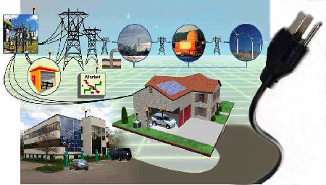
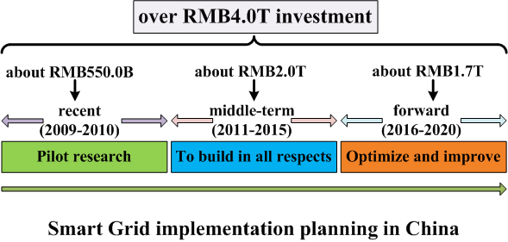
Smart Grid in China
The Chinese State Grid firstly published the plan of developing smart grid on May 21th 2009.
Different with other countries, include generation, transmission, substation, distribution and scheduling
Focus on reliable, safe, economical and efficient

Slide 4
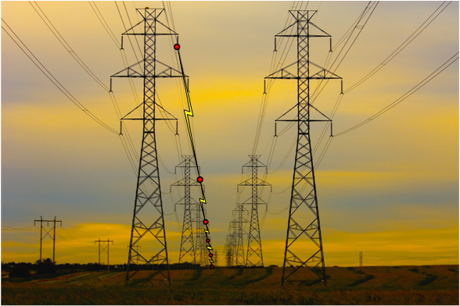
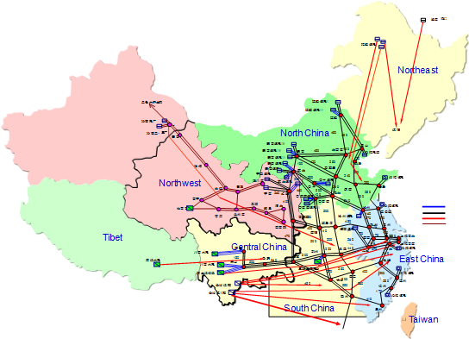
Electronic Equipment Monitoring
Monitoring electronic equipments
Find fault circuit quickly
Prevent from stolen or damage
……
Small data packet
Long distance transmission
High gain
Anti-Interference

Slide 5
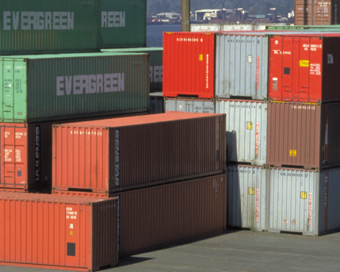
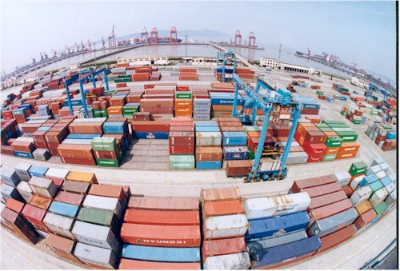
Container Monitoring
Real-time tracking of location of containers
Condition (temperature, humidity…) of containers monitoring
Throughput of containers from China is 1st in the world for these three years
Three of the world top 5 largest container throughput ports are in China

Slide 6
Container Monitoring
up to $200 billion global losses due to theft of container annually
Impossible to check every containers by human being or X-ray, random check can’t effectively prevent criminals smuggling in containers or transport of prohibited goods
RFID provides the ability to real-time identify and track of containers.
RFID can’t provide more detail information (radiation, biological, lighting, temperature, explosives and chemicals etc.)
the sensors inside of the containers can provide detail information

Slide 7
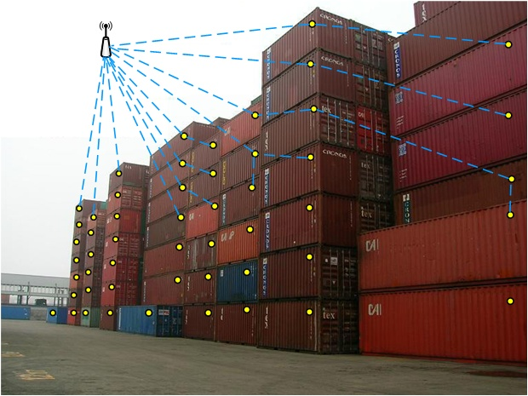
Application Requirements
Container information collect
Efficiency
Low energy
Low infrastructure and operational cost
Real-time tracking

Slide 8
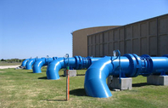
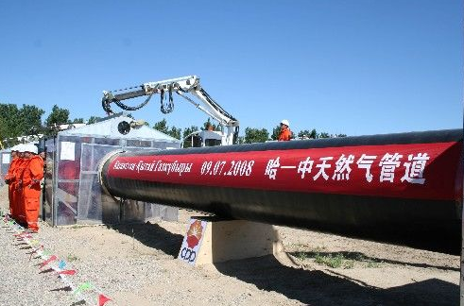
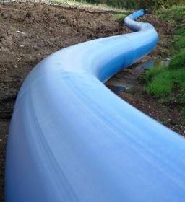
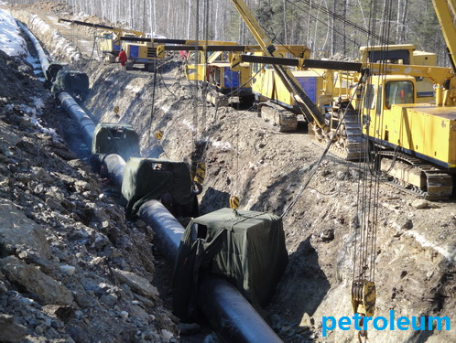
Pipeline Monitoring
Pipeline monitory
water pipeline
Total water pipe line is 236,000 km until 2008, from “National Bureau of Statistics of China”
oil-gas pipeline
60,000 km oil-gas pipeline in China at present, and will increase to100,000 km by the year of 2015

Slide 9
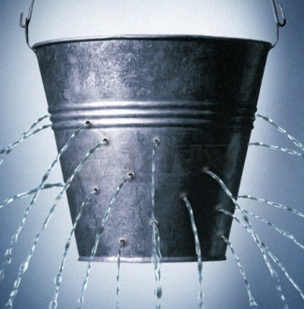
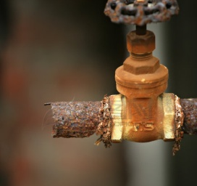
Water Pipeline Leak
Large population, but limited resources
Average percentage of water pipeline leak is 9.79% in 502 cities of China
Daily loss of water will be up to hundred million m
Water pipeline leak
Underground
Hard to detect
3

Slide 10
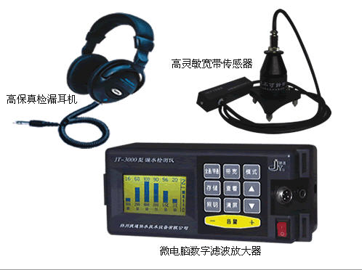
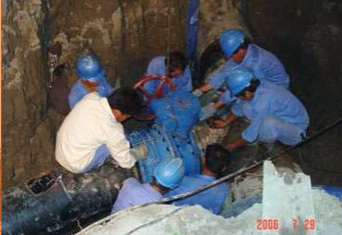
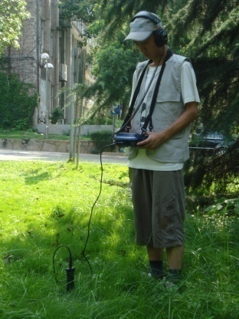
Traditional Water Leak Detection
Need professional leak detection team
Need leak detection instruments
Need quiet environment
Listen to each pipeline, find if there is a noise

Slide 11
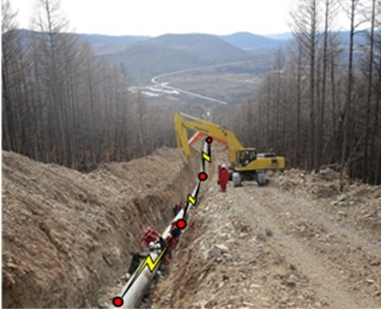
Pipeline Monitoring
Installed sensors on pipes to monitoring the pipelines
Application requirements
Small data packet
Low energy
Underground communication need high gain
Severe environment
Low install cost

