Slide 1
Project: IEEE P802.15 Working Group for Wireless Personal Area Networks (WPANs)
Submission Title: PHY Layer Comment Resolution
Date Submitted: 17. May 2010
Source: [Jaeseung Son, Taehan Bae,Sridhar Rajagopal, Ying Li, Atsuya Yokoi, E.T. Won]
Contact:
Voice:
E-Mail: js1007.son@samsung.com
Re:
Abstract:
Purpose: addresses comments pending on input from Samsung for comment resolution
Notice: This document has been prepared to assist the IEEE P802.15. It is offered as a basis for discussion and is not binding on the contributing individual(s) or organization(s). The material in this document is subject to change in form and content after further study. The contributor(s) reserve(s) the right to add, amend or withdraw material contained herein.
Release: The contributor acknowledges and accepts that this contribution becomes the property of IEEE and may be made publicly available by P802.15.
Slide 1
Euntae Won
Notes:
1

Slide 2
Samsung Comment Resolution
xx May, 2010

Slide 3
PHY Layer Technical comment

Slide 4
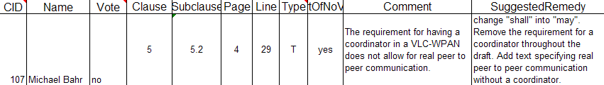
CID 107
Agree

Slide 5
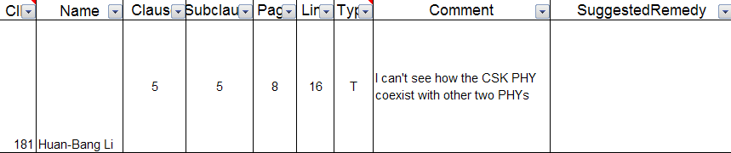
CID 181
PHY1 and PHY 2 can coexist.
PHY CSK can not coexist with PHY 1 and PHY 2.
Sridhar proposed a contribution about CSK connection procedure in last meeting.
Please refer 15-10-0027-00-0007-csk-operating-procedure-for-co-existence

Slide 6
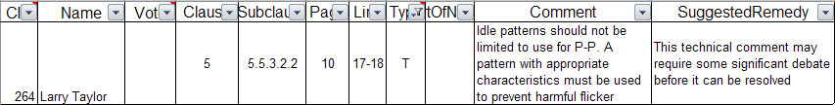
CID 264
Rewrite sentence

Slide 7
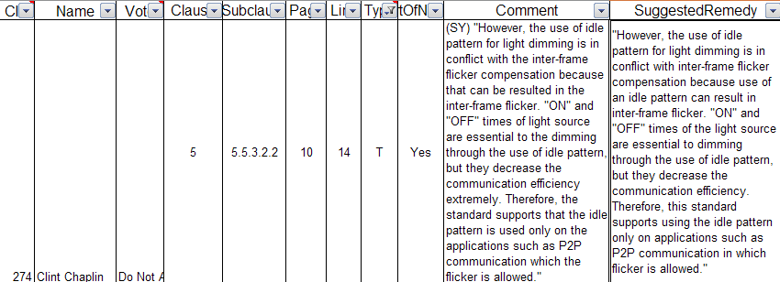
CID 274
We need a discussion within IEEE 15.7 members.

Slide 8
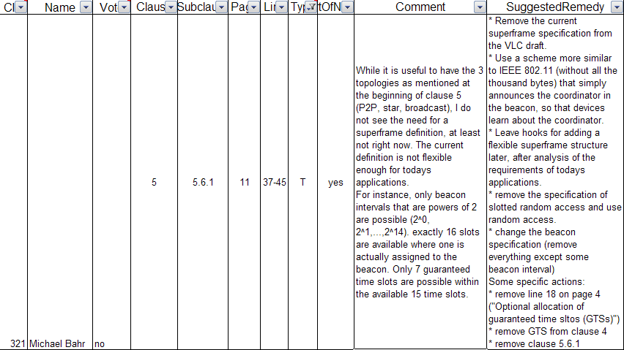
CID 321
We need a discussion within IEEE 15.7 members.

Slide 9
CID 386
We already presented about it.
Please refer contribution 15-09-0660-00-0007-samsung-vlc-phy-proposal

Slide 10
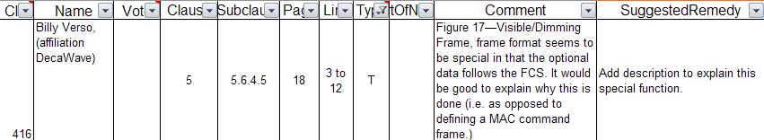
CID 416
Accept
We will upload document.
Please refer contribution xxxx

Slide 11
CID 518
We need more explanation.

Slide 12
CID 525
They have a different performance

Slide 13
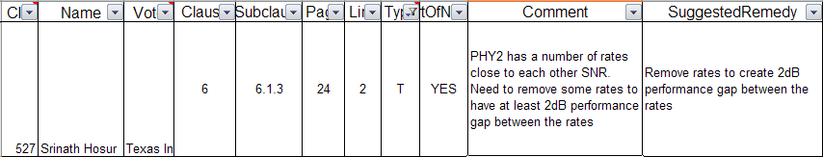
CID 527
They have a different performance

Slide 14
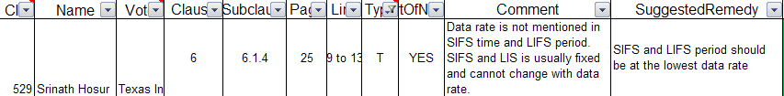
CID 529
This sentence is from IEEE 802.15.4.
We need a discussion with IEEE 15.7 members.

Slide 15

CID 557
We can not understand the comment.

Slide 16
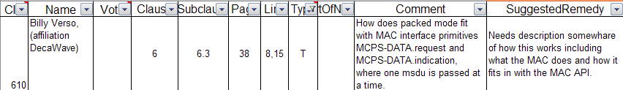
CID 610
We need a discussion with IEEE 15.7 members.

Slide 17
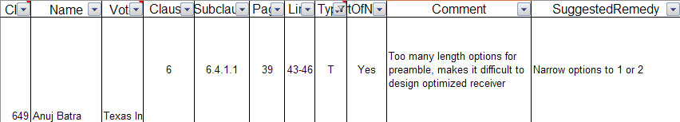
CID 649
We will add more explanation.

Slide 18
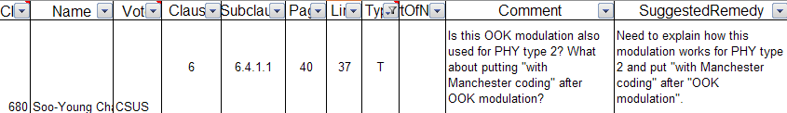
CID 680
VPM is used

Slide 19
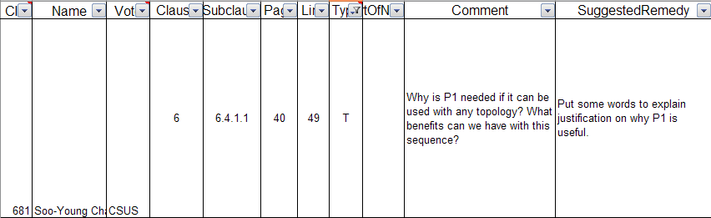
CID 681
Agree
P1 is default

Slide 20
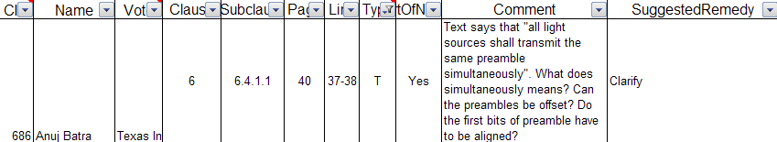
CID 686
Simultaneously means that different frequency bands.
We need more explanation.

Slide 21
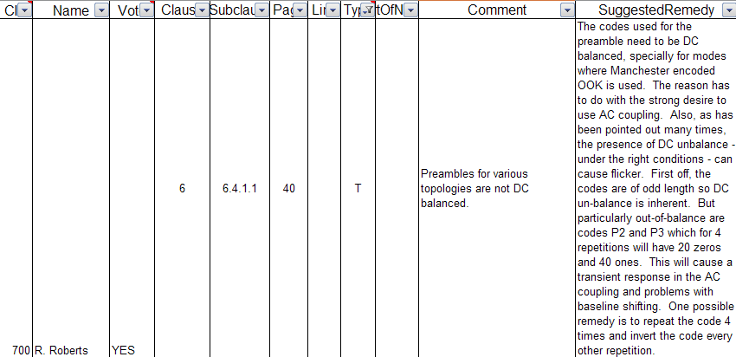
CID 700
Preamble is too short to make a problem.

Slide 22
CID 720
Sridhar will present about it.
Please refer document 15-10-xxxx-00-0007

Slide 23
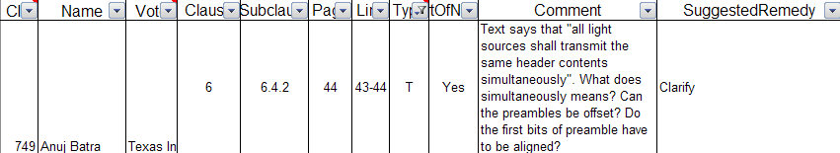
CID 749
Simultaneously means that different frequency bands.
We need more explanation.

Slide 24
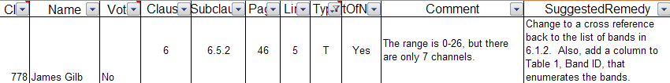
CID 778
0-6
26 is from Zigbee

Slide 25
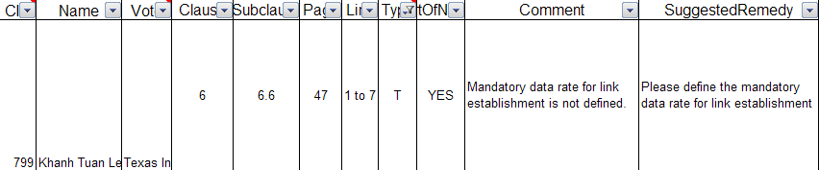
CID 799
We already defined in the document. But we need a clarification.

Slide 26
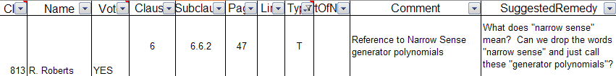
CID 813
Accept or we can explanation or delete

Slide 27
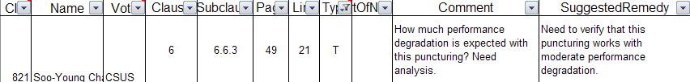
CID 821
We already presented.
Please refer 15-09-0846-00-0009.

Slide 28
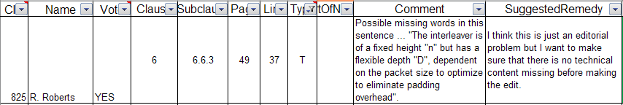
CID 825
Agree
It is editorial comment.

Slide 29
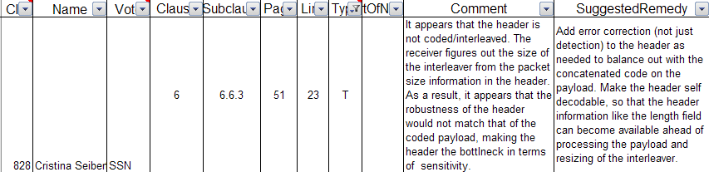
CID 828
Agree
We will have to clarify about header.

Slide 30
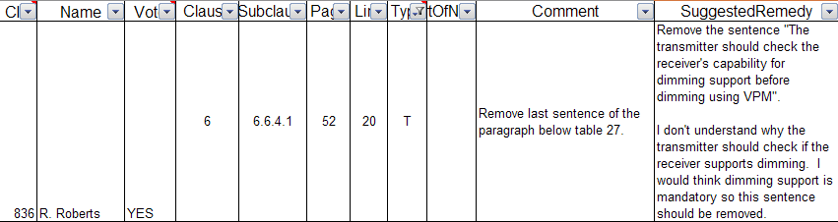
CID 836
Dimming is not mandatory.

Slide 31
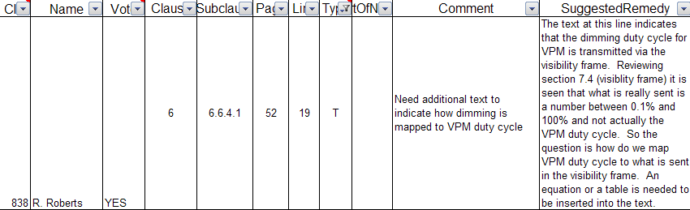
CID 838
The equation is already in the draft.

Slide 32
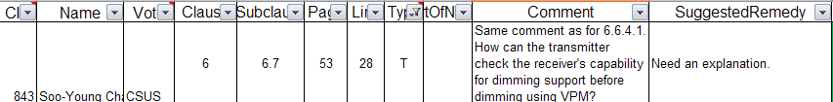
CID 843
We can explain.

Slide 33
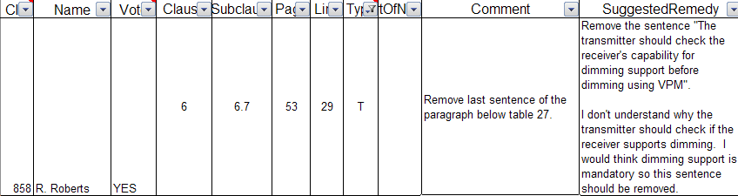
CID 858
Dimming is not mandatory.

Slide 34
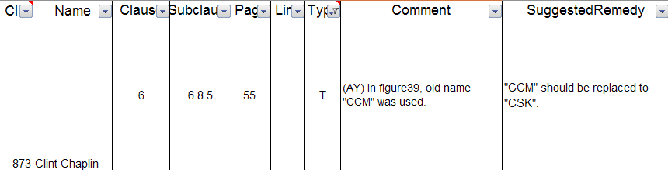
CID 873
Please refer contribution 15-10-0285-00-0007

Slide 35
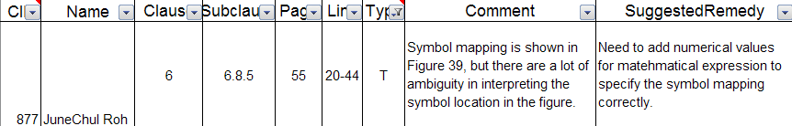
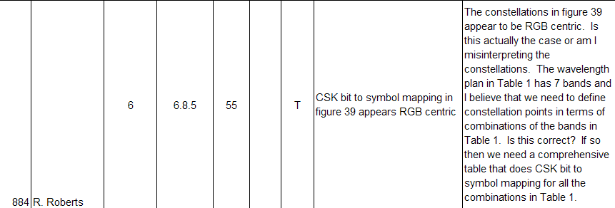
CID 877,884,885
Numerical values of CSK symbols in xy color coordinates should be shown as standard relating color bands.
Please refer contribution 15-10-0287-00-0007

Slide 36
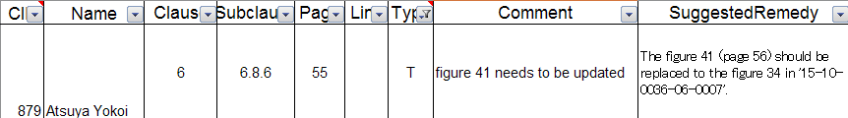
CID 879
Agree
Please refer contribution 15-10-0285-00-0007

Slide 37
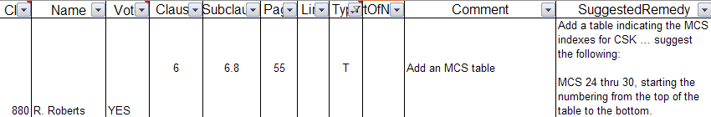
CID 880
Merge Table 2,3 and 4

Slide 38
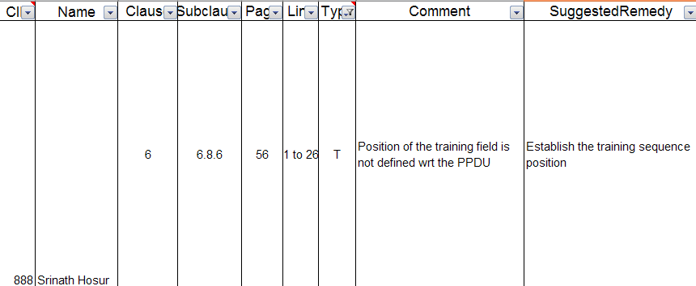
CID 888
'Training sequence' means 'Channel estimation sequence' in PPDU.
Replace 'Training sequence' to 'Channel estimation sequence' in figure 40 & figure 44.

Slide 39
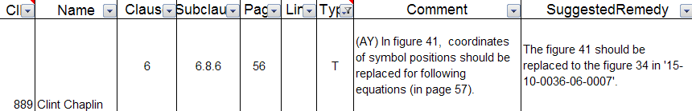
CID 889
Please refer contribution 15-10-0285-00-0007

Slide 40
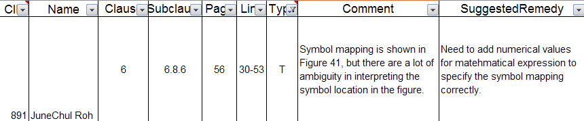
CID 891
This figure is shown for explaining CSK symbol mapping principle,
so the figure don't have to add the numerical values.

Slide 41
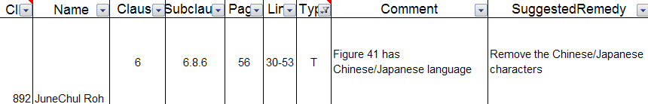
CID 892
Please refer contribution 15-10-0285-00-0007

Slide 42
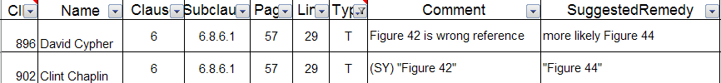
CID 896, 902
"Figure 42" --> "Figure 44"

Slide 43
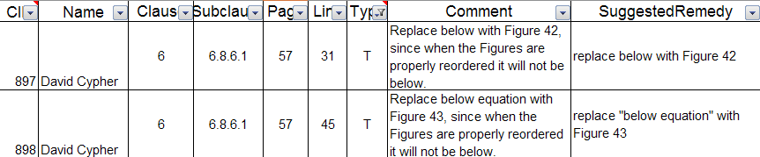
CID 897, 898
897: "below" --> "Figure 42“
898: "below equation" --> "Figure 43"

Slide 44
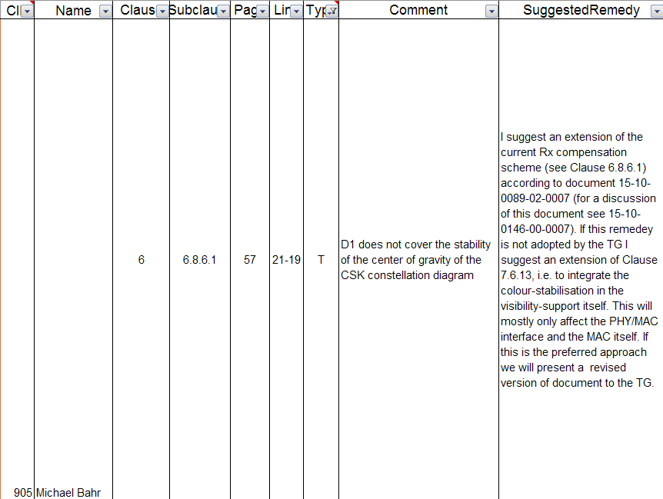
CID 905
VLC performance can be kept with current color compensation at Rx.
The extension scheme would be effective for guarantee color stability of light sources at Tx.
And, the extension scheme needs a up link for feedback information.
Therefore, the extension scheme should be described as a extension mode for color compensation in another clause.
Please refer contribution 15-10-0286-00-0007

Slide 45
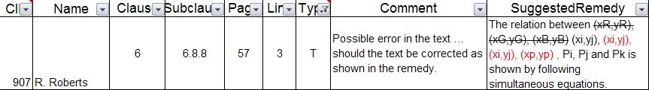
CID 907
Accept

Slide 46
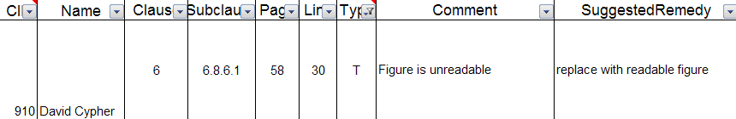
CID 910
Please refer contribution 15-10-0285-00-0007

Slide 47
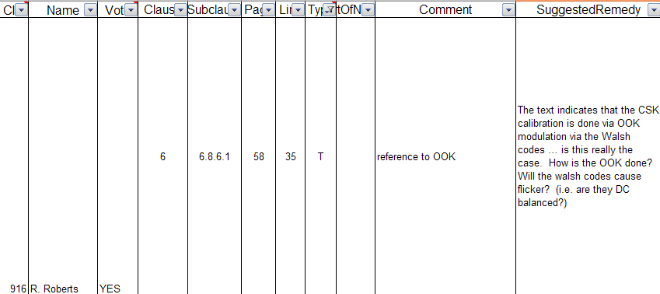
CID 916
We keep the original channel estimation code.

Slide 48
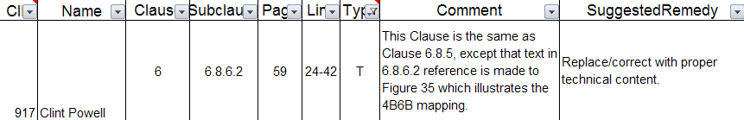
CID 917, 919,920,931,933
The contents in 6.8.6.2 are same as 6.8.5.Therefore 6.8.6.2 should be deleted.

Slide 49
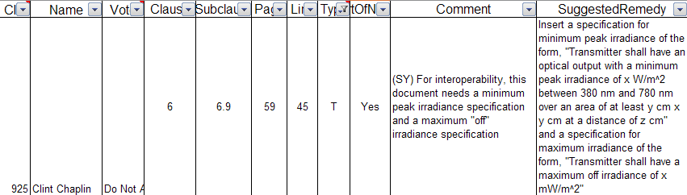
CID 925
We asked to R&D team about this issue, but they said it is dependent on LED specification.

Slide 50
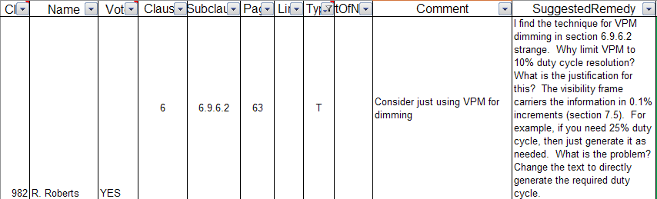
CID 982
VPM cannot generate high resolution duty cycles.

