Slide 1
Project: IEEE P802.15 Working Group for Wireless Personal Area Networks (WPANs)
Submission Title: PHY Layer Comment Resolution
Date Submitted: 17. May 2010
Source: [Jaeseung Son, Taehan Bae,Sridhar Rajagopal, Ying Li, Atsuya Yokoi, E.T. Won]
Contact:
Voice:
E-Mail: js1007.son@samsung.com
Re:
Abstract:
Purpose: addresses comments pending on input from Samsung for comment resolution
Notice: This document has been prepared to assist the IEEE P802.15. It is offered as a basis for discussion and is not binding on the contributing individual(s) or organization(s). The material in this document is subject to change in form and content after further study. The contributor(s) reserve(s) the right to add, amend or withdraw material contained herein.
Release: The contributor acknowledges and accepts that this contribution becomes the property of IEEE and may be made publicly available by P802.15.
Slide 1
Euntae Won
Notes:
1

Slide 2
Samsung Comment Resolution
xx May, 2010

Slide 3
MAC layer Technical comment

Slide 4

CID 1125
Agree
We need to fix it

Slide 5
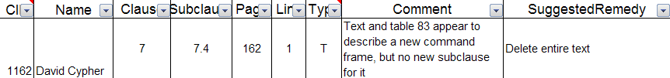
CID 1162
Make a clause 7.3.18 for new command.

Slide 6
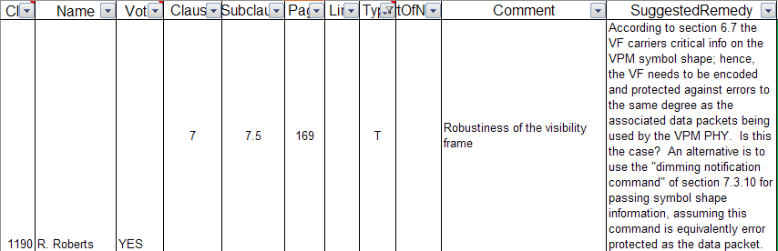
CID 1190
VF contains dimming percentage information. It needs to be protected. the dimming pattern does not need to be protected.

Slide 7
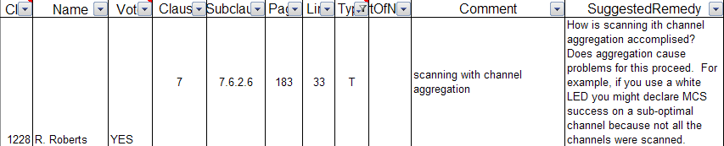
CID 1228
Rick misunderstands about channel aggregation.

Slide 8
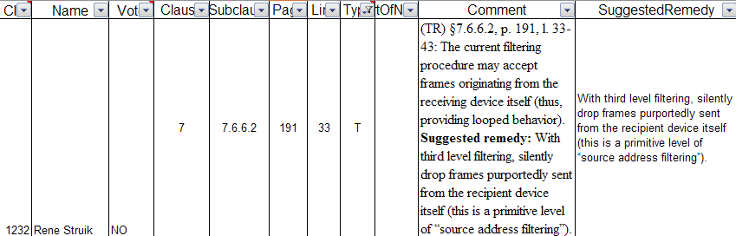
CID 1232
Rick misunderstands about channel aggregation.

Slide 9
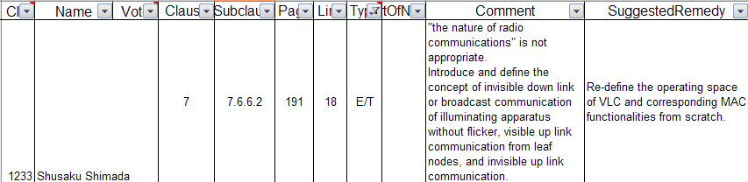
CID 1233
We can not understand.

Slide 10
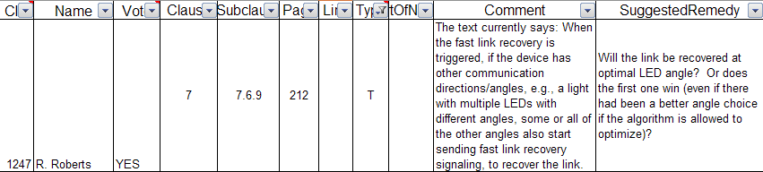
CID 1247
We think the algorithm of how to choose an optimal angle or whether the first one would win, is implementation issue. We may not need to restrict it in the standards.

Slide 11
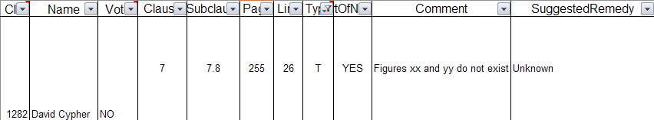
CID 1282
CSK does not have to do that.

Slide 12
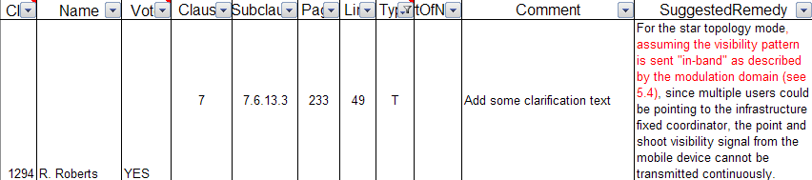
CID 1294
We need the committee modified text.

Slide 13
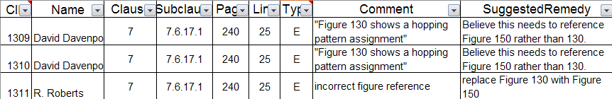
CID 1309,1310,1311
There are two subclause which has same contents
Delete subclause 7.6.16 and 7.6.17

Slide 14
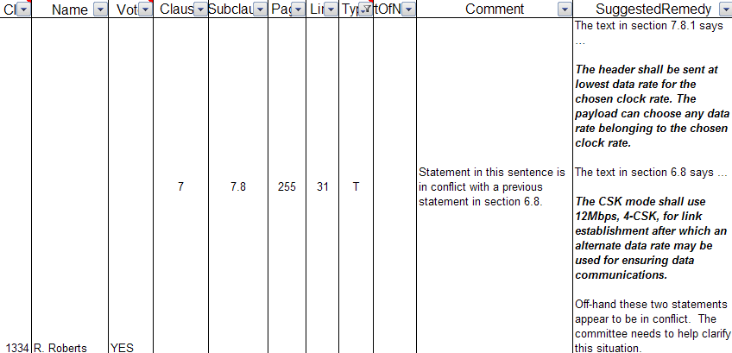
CID 1334
CSK does not have to do that.

Slide 15
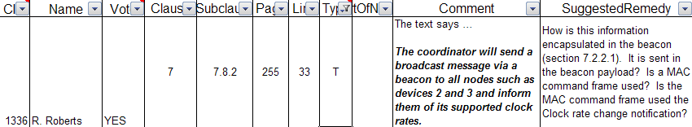
CID 1336
We need to update about it.

Slide 16
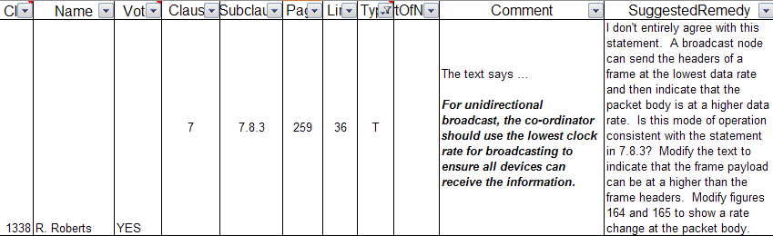
CID 1338
Rick misunderstands about channel aggregation.

