Slide 1
IEEE 15-10-0279-00-004f
Project: IEEE P802.15 Working Group for Wireless Personal Area Networks (WPANs)
Submission Title: [IEEE 802.15.4f Active RFID System Task Group Opening Introduction Document]
Date Submitted: [ ]
Source: Tim Harrington
Zebra Enterprise Solutions Corp.Company
Address [ ]
tharrington@zebra.com
Re : Opening Introduction document
Abstract: Description of IEEE 802.15.4f Task Group May 2010 meeting proceedings
Purpose: Introductory opening message to the IEEE 802.15.4f TG meeting attendees
Notice :This document has been prepared to assist the IEEE P802.15. It is offered as a basis for
discussion and is not binding on the contributing individual(s) or organization(s). The material in
this document is subject to change in form and content after further study. The contributor(s)
reserve(s) the right to add, amend or withdraw material contained herein.
Release:The contributor acknowledges and accepts that this contribution becomes the property of IEEE
and may be made publicly available by P802.15.

Slide 2
IEEE 15-10-0279-00-004f
802.15.4f Active RFID System Task Group Beijing, PRC Opening Introduction May 17, 2010

Slide 3
Instructions for the WG Chair
http://standards.ieee.org/board/pat/pat-slideset.ppt
IEEE 15-10-0279-00-004f
The IEEE-SA strongly recommends that at each WG meeting the chair or a designee:
Show slides #1 through #4 of this presentation
Advise the WG attendees that:
The IEEE’s patent policy is consistent with the ANSI patent policy and is described in Clause 6 of the IEEE-SA Standards Board Bylaws;
Early identification of patent claims which may be essential for the use of standards under development is strongly encouraged;
There may be Essential Patent Claims of which the IEEE is not aware. Additionally, neither the IEEE, the WG, nor the WG chair can ensure the accuracy or completeness of any assurance or whether any such assurance is, in fact, of a Patent Claim that is essential for the use of the standard under development.
Instruct the WG Secretary to record in the minutes of the relevant WG meeting:
That the foregoing information was provided and that slides 1 through 4 (and this slide 0, if applicable) were shown;
That the chair or designee provided an opportunity for participants to identify patent claim(s)/patent application claim(s) and/or the holder of patent claim(s)/patent application claim(s) of which the participant is personally aware and that may be essential for the use of that standard
Any responses that were given, specifically the patent claim(s)/patent application claim(s) and/or the holder of the patent claim(s)/patent application claim(s) that were identified (if any) and by whom.
The WG Chair shall ensure that a request is made to any identified holders of potential essential patent claim(s) to complete and submit a Letter of Assurance.
It is recommended that the WG chair review the guidance in IEEE-SA Standards Board Operations Manual 6.3.5 and in FAQs 12 and 12a on inclusion of potential Essential Patent Claims by incorporation or by reference.
Note: WG includes Working Groups, Task Groups, and other standards-developing committees with a PAR approved by the IEEE-SA Standards Board.
(Optional to be shown)

Slide 4
Participants, Patents, and Duty to Inform
IEEE 15-10-0279-00-004f
All participants in this meeting have certain obligations under the IEEE-SA Patent Policy. Participants:
“Shall inform the IEEE (or cause the IEEE to be informed)” of the identity of each “holder of any potential Essential Patent Claims of which they are personally aware” if the claims are owned or controlled by the participant or the entity the participant is from, employed by, or otherwise represents
“Personal awareness” means that the participant “is personally aware that the holder may have a potential Essential Patent Claim,” even if the participant is not personally aware of the specific patents or patent claims
“Should inform the IEEE (or cause the IEEE to be informed)” of the identity of “any other holders of such potential Essential Patent Claims” (that is, third parties that are not affiliated with the participant, with the participant’s employer, or with anyone else that the participant is from or otherwise represents)
The above does not apply if the patent claim is already the subject of an Accepted Letter of Assurance that applies to the proposed standard(s) under consideration by this group
Quoted text excerpted from IEEE-SA Standards Board Bylaws subclause 6.2
Early identification of holders of potential Essential Patent Claims is strongly encouraged
No duty to perform a patent search
Slide #1

Slide 5
Patent Related Links
IEEE 15-10-0279-00-004f
All participants should be familiar with their obligations under the IEEE-SA Policies & Procedures for standards development.
Patent Policy is stated in these sources:
IEEE-SA Standards Boards Bylaws
http://standards.ieee.org/guides/bylaws/sect6-7.html#6
IEEE-SA Standards Board Operations Manual
http://standards.ieee.org/guides/opman/sect6.html#6.3
Material about the patent policy is available at
http://standards.ieee.org/board/pat/pat-material.html
If you have questions, contact the IEEE-SA Standards Board Patent Committee Administrator at patcom@ieee.org or visit http://standards.ieee.org/board/pat/index.html
This slide set is available at http://standards.ieee.org/board/pat/pat-slideset.ppt
Slide #2

Slide 6
Call for Potentially Essential Patents
IEEE 15-10-0279-00-004f
If anyone in this meeting is personally aware of the holder of any patent claims that are potentially essential to implementation of the proposed standard(s) under consideration by this group and that are not already the subject of an Accepted Letter of Assurance:
Either speak up now or
Provide the chair of this group with the identity of the holder(s) of any and all such claims as soon as possible or
Cause an LOA to be submitted
Slide #3

Slide 7
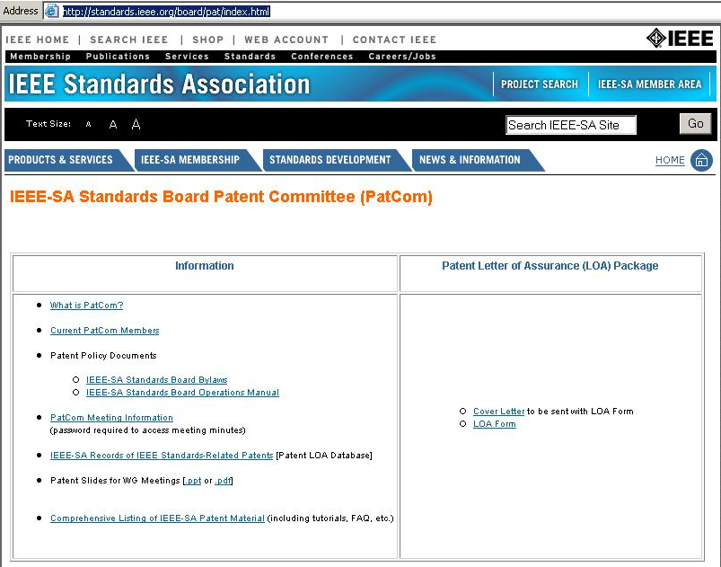
IEEE 15-10-0279-00-004f
http://standards.ieee.org/board/pat/index.html

Slide 8
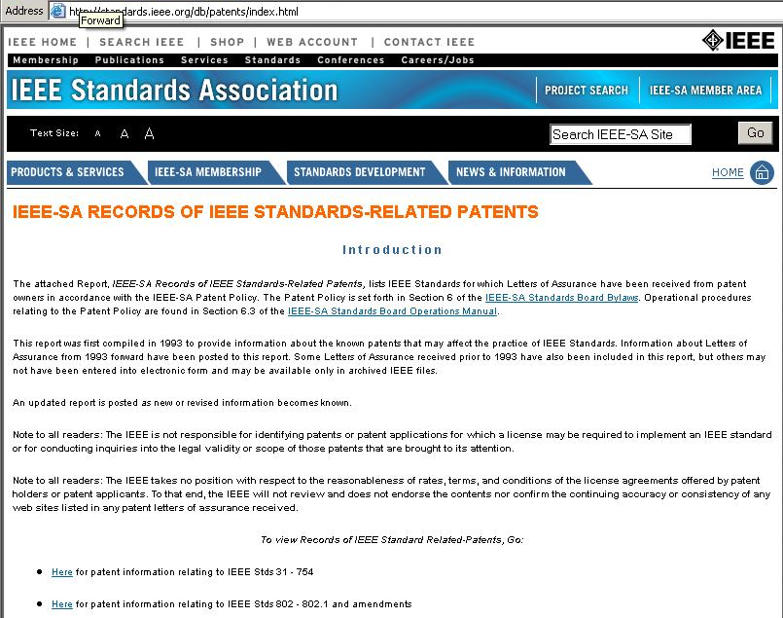
IEEE 15-10-0279-00-004f
http://standards.ieee.org/db/patents/index.html

Slide 9
Other Guidelines for IEEE WG Meetings
IEEE 15-10-0279-00-004f
All IEEE-SA standards meetings shall be conducted in compliance with all applicable laws, including antitrust and competition laws.
Don’t discuss the interpretation, validity, or essentiality of patents/patent claims.
Don’t discuss specific license rates, terms, or conditions.
Relative costs, including licensing costs of essential patent claims, of different technical approaches may be discussed in standards development meetings.
Technical considerations remain primary focus
Don’t discuss or engage in the fixing of product prices, allocation of customers, or division of sales markets.
Don’t discuss the status or substance of ongoing or threatened litigation.
Don’t be silent if inappropriate topics are discussed … do formally object.
---------------------------------------------------------------
See IEEE-SA Standards Board Operations Manual, clause 5.3.10 and “Promoting Competition and Innovation: What You Need to Know about the IEEE Standards Association's Antitrust and Competition Policy” for more details.
Slide #4

Slide 10
Chair’s Role
IEEE 15-10-0279-00-004f
http://ieee802.org/Mike_Spring_Article_on_Stds_Process.pdf
…the chairperson of the working group is key to what and how fast a standard is produced.
The chair of the committee acts as a facilitator with little power to legislate. The chair must be knowledgeable about the subject but also know how a standard may be used by various segments of the industry. A chairperson should be a leader-diplomat-observer, in equal proportions. Also, the chairperson should not be a doer, perfectionist or obstructionist. This is consistent with the view of the chairperson as a skilled leader with strong negotiation skills who delegates.

Slide 11
802.15.4f PAR Scope
IEEE 15-10-0279-00-004f
5.2 Scope of Proposed Standard: This amendment defines a PHY layer, and only those MAC modifications required to support it, for Active RFID (readers and tags). It allows for efficient communications with active RFID tags and sensor applications in an autonomous manner in a promiscuous network, using very low energy consumption (low-duty-cycle), and low PHY transmitter power. The PHY parameters are flexible and configurable to provide optimized use in a variety of active RFID tag operations including simplex and duplex transmission (reader-to-tags and tag-to-readers), multicast (reader to a select group of tags) uni-cast (reader to a single tag), tag-to-tag communication, and multi-hop capability.
The PHY specification supports a large tag population (hundreds of thousands) which may consist of a number of densely populated (closely situated or packed) tags within a single reader field and supports basic applications such as read and write with authentication and an accurate location determination capability. The communication reliability of the system is very high for applications such as active tag inventory counting or auditing.
The active RFID device frequency band(s) used are available world-wide, with or without licensing, and the active RFID PHY is capable of avoiding, or operating in the presence of interference from other devices operating within the Active RFID’s frequency band of operation. Where unlicensed bands are utilized, this amendment also addresses coexistence with other 802 wireless standards operating in the same bands.

Slide 12
802.15.4f PAR Purpose
IEEE 15-10-0279-00-004f
5.4 Purpose of Proposed Standard: To provide a standard for low cost, ultra low energy consumption, flexible and highly reliable communication means and air interface protocol for Active RFID and sensor applications. The air interface should be able to support a wide range of needs for which active RFID systems can be useful and enable improved performance and flexibility for future mass deployments of active RFID systems around the world.

Slide 13
Project Meeting Dates and Locations http://grouper.ieee.org/groups/802/15/pub/Meeting_Plan.html
IEEE 15-10-0279-00-004f
Meeting Date | Type | Location
Jan-09 | Interim | Los Angeles
Mar-09 | Plenary | Vancouver
May-09 | Interim | Montreal
Jul-09 | Plenary | San Francisco
Sep-09 | Interim | Kona, Hawaii
Nov-09 | Plenary | Atlanta, GA
Jan-10 | Interim | Los Angeles
Mar-10 | Plenary | Orlando, FLA
May-10 | Interim | Beijing, China
Jul-10 | Plenary | San Diego
Sep-10 | Interim | Kona, Hawaii
Nov-10 | Plenary | Dallas
Jan-11 | Interim | Los Angeles
Mar-11 | Plenary | Singapore

Slide 14
Draft 802.15.4f Timeline
IEEE 15-10-0279-00-004f
Our Timeline is slipping
May 2010 Interim
1st Letter Ballot cycle
2nd Letter Ballot cycle
3rd Letter Ballot cycle
Sponsor Ballot cycles

Slide 15
IEEE 15-10-0279-00-004f
TG4f Meeting Goals and Agenda May 2010 in Beijing, PRC
Discuss and resolve current UWB PHY and 2.4 GHz PHY TBD items in the TG4f merged PHY document.
Work on comments which may arise pertaining to the TG4f requested ‘BLINK’ frame in TG4e draft standard document.
Review and discuss TG4f draft text presented for the UWB, 2.4 GHz, and 433 MHz PHYs during the week.
Discuss next steps and the July 2010 meeting in San Diego, USA.

Slide 16
TG4f Meeting Sessions This Week
IEEE 15-10-0279-00-004f
Mtg | Monday | Tuesday | Wednesday | Thursday
AM1 0800-1000 |  | Resolution of 2.4 GHz TBD’s |  | Draft TG4f PHY standard text writing, planning, and discussion
AM2 1030-1230 |  | Draft TG4f PHY standard text writing, planning, and discussion |  | Draft TG4f PHY standard text writing, planning, and discussion Prepare for May meeting in San Diego.
PM1 1330-1530 | 1400-15:30 Opening/Agenda / Objectives/March 2010 Minutes/ Timeline / PAR/ Review and discussion of TGe BLINK frame progress. |  | Draft TG4f PHY standard text writing, planning, and discussion
PM2 1600-1800 |  |  | Joint TG4e/TG4f/TG4g meeting

Slide 17
Home IEEE 802 Organization Standards Download availability
IEEE 15-10-0279-00-004f
http://ieee802.org/
The IEEE 802 LAN/MAN Standards Committee develops Local Area Network standards and Metropolitan Area Network standards. The most widely used standards are for the Ethernet family, Token Ring, Wireless LAN, Wireless PAN, Wireless MAN, Bridging and Virtual Bridged LANs. An individual Working Group provides the focus for each area.
IEEE 802 Standards Available for Free Download!
The IEEE has begun making 802 standards available for download from the web. Twelve months after the initial publication of a standard, it will be available for download at http://standards.ieee.org/getieee802/
.

Slide 18
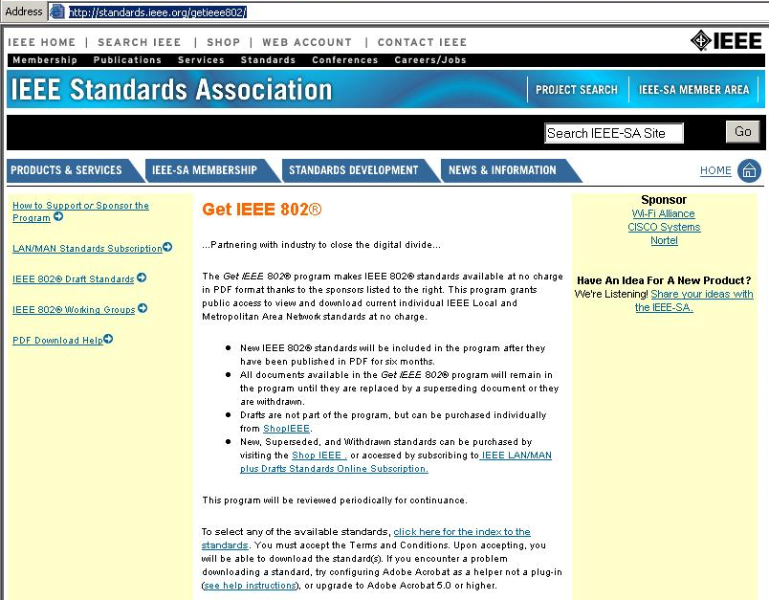
IEEE 15-10-0279-00-004f
http://standards.ieee.org/getieee802/
Click Here

Slide 19
IEEE 802 GENERAL INFORMATION
IEEE 15-10-0279-00-004f
http://ieee802.org/
IEEE 802 Orientation for new participants
http://ieee802.org/newcomer_orientation-v3.ppt
IEEE 802 Standards Process Course
http://ieee802.org/training.htm
IEEE 802 Detailed Overview
http://ieee802.org/IEEE-802-LMSC-Overview-and-Guide-01.pdf
Recommended Tools for Standards Developers
http://ieee802.org/stdstools.html

Slide 20
Suggestion - Review IEEE 802.15.4e MAC amendment Application Presentations/Preliminary Proposals/Final Proposals
IEEE 15-10-0279-00-004f
IEEE 802.15 Working Group for WPAN
http://grouper.ieee.org/groups/802/15/
IEEE 802.15 WPAN™ Task Group 4e (TG4e)
http://www.ieee802.org/15/pub/TG4e.html
The IEEE 802.15 Task Group 4e is chartered to define a MAC amendment to the existing standard 802.15.4-2006. The intent of this amendment is to enhance and add functionality to the 802.15.4-2006 MAC to a) better support the industrial markets

Slide 21
Suggestion – Review IEEE 802.15.4c, 15.4d, and 15.4g PHY development documents
IEEE 15-10-0279-00-004f
All IEEE 802.15 presentations are available;
Via Internet - https://mentor.ieee.org/802.15/documents
Via Meeting WLAN - http://newton.events.ieee.org/

Slide 22
Become a ‘Voter’
IEEE 15-10-0279-00-004f
Keep your meeting attendance up to date.
https://murphy.events.ieee.org/imat/login
15 Regular Time Slots (May 2010 Interim Session)
Must attend at least 12 Time Slots to meet the minimum 75% attendance requirement.
Attendance closes at the end of the 802.15 closing plenary on Thursday evening.
All requests for corrections to attendance credit must be submitted to Rick Alfvin by the end of the closing plenary on Thursday Eve.
ralfvin@gmail.com
alfvin@ieee.org

Slide 23
IEEE 15-10-0279-00-004f
Next Steps
Sign up for 802.15.4f Active RFID e-mail reflector
http://grouper.ieee.org/groups/802/15/pub/Subscribe.html
STDS-802-15-4f@listserv.ieee.org
Next Meeting
July 11-16, 2010 in San Diego, CA, USA
Manchester Grand Hyatt San Diego Hotel

Slide 24
TG4f Officers
IEEE 15-10-0279-00-004f
Chair: Mike McInnis
Vice Chair: Tim Harrington
Secretary: George Cavage
Technical Editors: Tim Harrington

