Slide 1
Project: IEEE P802.15 Working Group for Wireless Personal Area Networks (WPANs)
Submission Title: [Convolutional code for extended mode in 802.15.4f ]
Date Submitted: [7 May 2010]
Source: [Michael McLaughlin] Company [DecaWave]
Address [Digital Depot, Thomas Street, Dublin 8, Ireland]
Voice:[+353 688 2514], FAX: [none], E-Mail:[michael.mclaughlin@decawave.com]
Re: [extended mode in 802.15.4f]
Abstract: [Convolutional code for extended mode in 802.15.4f ]
Purpose: [Convolutional code for extended mode in 802.15.4f ]
Notice: This document has been prepared to assist the IEEE P802.15. It is offered as a basis for discussion and is not binding on the contributing individual(s) or organization(s). The material in this document is subject to change in form and content after further study. The contributor(s) reserve(s) the right to add, amend or withdraw material contained herein.
Release: The contributor acknowledges and accepts that this contribution becomes the property of IEEE and may be made publicly available by P802.15.

Slide 2
Convolutional code for extended mode in 802.15.4f

Slide 3
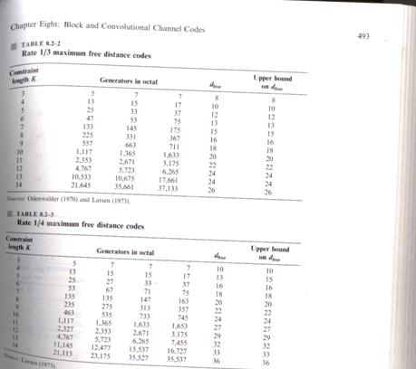
Proakis – Digital Communications Fourth edition :- page 493

Slide 4
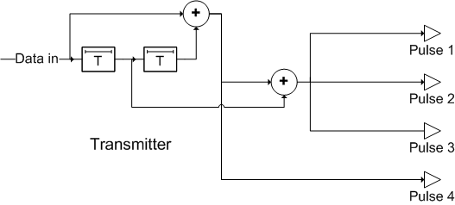
Rate ¼ Convolutional Code
Coder in transmitter. Octal generators are 5,7,7,7 for k=3
  4 pulses per input bit
Code designed for BPSK
  works equally well OOK pulses

Slide 5
Simple Pulse Voting Decoder possible
Because the code has three identical generators, three of the pulses will be identical.
Receiver can “Vote” on these three pulses
Convolutional code can be “undone” by feedback arrangement in the receiver.
Lose 1.2dB by sending the extra pulse (which is not used by the voting decoder), but this allows the option of a receiver using a full Viterbi decoder.

Slide 6
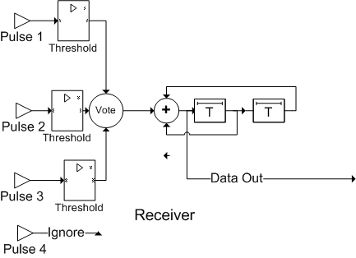
Decoder options
Use a conventional soft decision or hard decision Viterbi Decoder
Or we could threshold each pulse and then vote on the outcome
Error propagation: 1 bit error propagates for rest of the packet.
Bit error means that the packet is trashed anyway, so no problem!

Slide 7
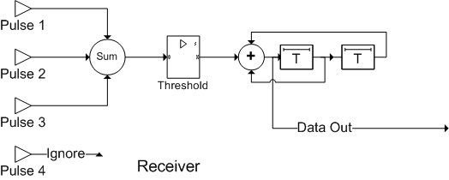
Better still we can threshold after summing
Again there is error propagation; but again it does not reduce the packet error rate.

Slide 8
Viterbi Decoder Option
Conventional Soft Decision Viterbi Decoder
  802.15.4a Rate ½, K=3 complexity ~3100 gates
  Rate ¼, K=3 ~5000 gates
  Small FPGA, a very few dollars, low power consumption
d_{free} ⁼ 10
  Coding gain of up to 10dB vs base mode of 1 pulse / bit
    > x 3 times the range
  Compares with up to 4.7dB gain for x3 repetition code
    Less for hard decision voting

Slide 9
Standard Rate ¼ code: Pros
Close to 10dB of coding gain is possible
Transmit is ultra low complexity
Viterbi decoder in receiver in ~5k gates
Allows an even lower complexity “voting” receiver to be used which gives up to 3.5dBs of gain versus sending just one pulse per bit.
  Voting is particularly robust against impulse noise

Slide 10
Standard Rate ¼ code: Cons
Peak & Average limiting:
  In order to comply with FCC and ECC UWB regulations, at 1MHz PRF, packets which have fewer than 186 pulses are peak limited.
  This means that for all packets with 186 or fewer pulses, the individual pulses have to be a maximum power of 0dBm in any 50MHz region of spectrum, regardless of how few pulses there are.
  Another limitation is on mean power. This is measured as the average power in 1ms in any 1MHz bandwidth. This must be below -41.3dBm.
  This means that for packets with more than 186 pulses in any 1ms timeframe, the individual pulses must be sent at a lower power than packets with 186 pulses or less
  For example: a packet which is shorter than 1ms but has 372 pulses needs to be sent at half the power that a sub 1ms packet with 186 pulses can be sent at.
This rate ¼ code increases the number of pulses by a factor of four. If this causes the packet to have more than 186 pulses, the power each pulse can be sent at must be reduced, dropping the overall performance by up to 6dBs for a coherent receiver.
Non-coherent receivers typically use a squaring operation so they will be even more adversely affected

Slide 11
Pulse Position Modulation: Pulse Density Reduction
Gather together 4 bits of data
Instead of sending these bits as 4 pulses, send them as just one pulse in one of the next 16 possible pulse positions
This gives pulse density reduction in 3 ways
  Average of 1 pulse for 4 bits instead of 2 pulses
  Worst case 1 pulse for 4 bits instead of 4 pulses
  Pulses are spread out over period 4 times as long
e.g. Worst case of 1ms of 1000 pulses becomes 4ms with ~63 pulses in each 1ms portion
This would allow an increase to as much as 3MHz PRF and still have a peak limited signal

Slide 12
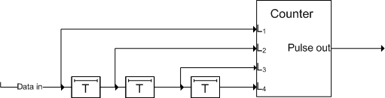
16-ary Pulse Position Modulation Transmitter
For a 1MHz PRF, every 16µs, the counter here outputs a single 1µs wide pulse after the count programmed by L₁ .. L₄
  Data rate is therefore, 250kbps
There is a small penalty to pay (0.4dB) in the receiver, because for every 4 bits, there are 16 ways to make an error instead of 4 ways

Slide 13
16-ary PPM Performance

Slide 14
New Proposal: Add FEC to PPM
Code data with a standard, K=3, rate ½ convolutional code,.
  Octal generators (5,7) are best (Same as for BPSK)
  Low complexity Viterbi decoder (~3.3k gates for soft decoder)
Gather together 4 bits of coded data
Instead of sending these bits as 4 pulses, send them as just one pulse in one of the next 16 possible pulse positions, i.e. Use 16-ary ppm
dfree = 6 => Asymptotic gain = 7.8dB
Actual gain = 5.8dB at 10⁻⁴BER (Lose 1.6dB for 10⁻⁴BER + 0.4dB noted above)
  Could use a higher constraint length K
    Each increment of K approximately doubles complexity of Viterbi decoder
    K=4 => dfree = 8 => 9dB asymptotic gain
    K=5 => dfree = 10 => 10dB asymptotic gain
    K=6 => dfree = 12 => 10.8dB asymptotic gain
    K=7 => dfree = 14 => 11.5dB asymptotic gain

Slide 15
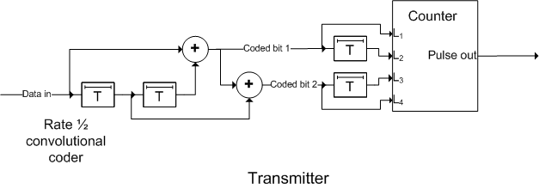
Proposed New Transmitter
At 1MHz PRF, every 16µs, the counter here outputs a single 1µs wide pulse after the count programmed by L₁ .. L₄
  Each pulse represents 4 coded bits or 2 data bits
  Bit rate is 125kbps
  3MHz PRF would give 375kbps and pulses would still be max power

Slide 16
Pulse Power
Always peak Limited => same range for all packet sizes

Slide 17
Performance vs Base Mode
Assumes coherent demodulation but non-coherent demodulation will have similar gain compared to base mode because pulses are at maximum power

Slide 18
Gain translated to range increase
Range improvement is twofold for small packets and almost fivefold for the longest packets

Slide 19
Other Advantages
There is always one pulse for every two input data bits
  Base mode has an average of one pulse per two data bits
  Base mode has a worst case of two pulses per two data bits
Guarantees a pulse in each 16 pulse slot
  Great for timing recovery
Pulses are always at max power, so non-coherent receiver can see them after squaring operation

Slide 20
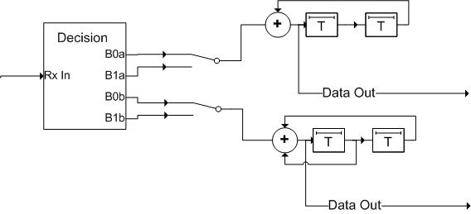
Decoder options
A) Use a conventional soft decision Viterbi Decoder (3k3 gates)
B) Use hard decision Viterbi Decoder (much smaller but lose 2dBs)
C) Make an immediate decision on biggest pulse of 16 positions
  Error propagation: 1 bit error propagates for rest of the packet.
  Bit error means that the packet is trashed anyway, so no problem!
  Don’t need to decode both bits. Data out in both cases should be identical. but could decode both and use the CRC to decide which stream was right
  Lose the 6dBs coding gain, so no better than base mode for short packets

Slide 21
Extended Mode PHY Fields
Preamble
SFD
PHR
Up to 96 pulses (TBD)
0001 0011 0101 1110
22 bits
Exact number of preamble pulses TBD
Runs @ 1 MHz PRF
SFD at 1 pulse per symbol (SFD is very robust)
First 3 bits of PHR at 1 pulse per symbol
Rest of PHR coded as for data
Rest of packet coded with pulse remapping and rate ½ conv. code

Slide 22
PHY Header – Encoding Type
Have swapped these around
Encoding Type
Frame
Length
LEI
Type
Header Extension
SECDED bits
3
bits
7
bits
5
bits
1
bit
6
bits
Field | Value
Encoding Type | 0b000: Base mode: 1 pulse per bit 0b001 – 0b110: Reserved (Already know if long range mode) 0b111: Extended mode

