Slide 1
Project: IEEE P802.15 Working Group for Wireless Personal Area Networks (WPANs)
Submission Title: [Convolutional code for extended mode in 802.15.4f ]
Date Submitted: [22 April, 2010]
Source: [Michael McLaughlin] Company [DecaWave]
Address [Digital Depot, Thomas Street, Dublin 8, Ireland]
Voice:[+353 688 2514], FAX: [none], E-Mail:[michael.mclaughlin@decawave.com]
Re: [extended mode in 802.15.4f]
Abstract: [Convolutional code for extended mode in 802.15.4f ]
Purpose: [Convolutional code for extended mode in 802.15.4f ]
Notice: This document has been prepared to assist the IEEE P802.15. It is offered as a basis for discussion and is not binding on the contributing individual(s) or organization(s). The material in this document is subject to change in form and content after further study. The contributor(s) reserve(s) the right to add, amend or withdraw material contained herein.
Release: The contributor acknowledges and accepts that this contribution becomes the property of IEEE and may be made publicly available by P802.15.

Slide 2
Convolutional code for extended mode in 802.15.4f

Slide 3
Proakis – Digital Communications Fourth edition :- page 493

Slide 4
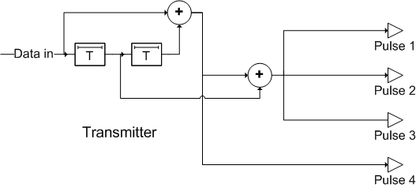
Rate ¼ Convolutional Code
Coder in transmitter. Octal generators are 5,7,7,7 for k=3
4 pulses per input bit
Code designed for BPSK
works equally well OOK pulses

Slide 5
Simple Pulse Voting Decoder possible
Because the code has three identical generators, three of the pulses will be identical.
Receiver can “Vote” on these three pulses
Convolutional code can be “undone” by feedback arrangement in the receiver.
Lose 1.2dB by sending the extra pulse (which is not used by the voting decoder), but this allows the option of a receiver using a full Viterbi decoder.

Slide 6
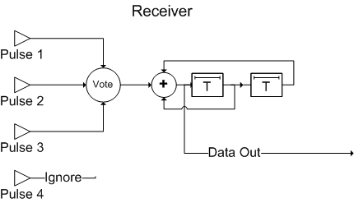
Decoder options
Conventional Viterbi Decoder
or
Error propagation: 1 bit error propagates for rest of the packet.
Bit error means that the packet is trashed anyway, so no problem!

Slide 7
Viterbi Decoder Option
Conventional Soft Decision Viterbi Decoder
802.15.4a rate ½, K=3 complexity ~3100 gates
Rate ¼, K=3 <5000 gates
Small FPGA, few dollars, low power consumption
d_{free} ⁼ 10
Coding gain of up to 10dB vs base mode of 1 pulse / bit
> x 3 times the range
Compares with up to 4.7dB gain for x3 repetition code
Less for hard decision voting

Slide 8
Code is good for two main reasons
Allows a low complexity Viterbi decoder to be used and give close to 10dB of gain over sending just one pulse per bit.
Allows an even lower complexity “voting” receiver to be used which gives up to 3.5dBs of gain versus sending just one pulse per bit.
Voting is particularly robust against impulse noise

