Slide 1
IEEE 802.15-10-0238-00-004f
Project: IEEE P802.15 Working Group for Wireless Personal Area Networks (WPANs)
Submission Title: [Non-coherent UWB Tag Crystal Tolerance Issues]
Date Submitted: [7 April, 2010]
Source: [Ed Richley] Company [Zebra Enterprise Solutions]
Address [20300 Century Blvd., Germantown, MD 20874 USA]
Voice:[+1 301-528-1745 x1117], FAX: [+1 301-528-1749], E-Mail:[erichley@zebra.com]
Re: [Non-coherent UWB tag crystal tolerance issues.]
Abstract: [This document presents issues associated with crystal tolerances for UWB tags.]
Purpose: [To resolve outstanding issues on the current baseline proposal]
Notice: This document has been prepared to assist the IEEE P802.15. It is offered as a basis for discussion and is not binding on the contributing individual(s) or organization(s). The material in this document is subject to change in form and content after further study. The contributor(s) reserve(s) the right to add, amend or withdraw material contained herein.
Release: The contributor acknowledges and accepts that this contribution becomes the property of IEEE and may be made publicly available by P802.15.

Slide 2
Non-Coherent UWB tag crystal tolerance issues
IEEE 802.15-10-0238-00-004f
Ed Richley
erichley@zebra.com
+1-301-528-1745

Slide 3
Background
IEEE 802.15-10-0238-00-004f
802.15.4a specifies 20ppm tolerance with temperature range of 0 to 40C.
RFID tags are expected to experience wider temperature ranges
AT-cut crystals deviate strongly far from room temp
Tolerance requirement may be tighter than needed for most tags

Slide 4
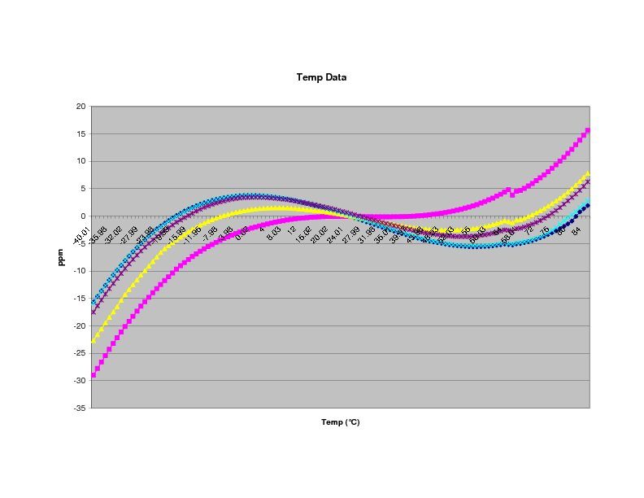
IEEE 802.15-10-0238-00-004f

Slide 5
Quote from Crystal Manufacturer:
IEEE 802.15-10-0238-00-004f
Total tolerance: | Spec Temp Range: | Cost:
20ppm | -40 to +80C | Can’t supply
20ppm | -20 to +50C | $0.21
25ppm | -20 to +70C | $0.20
40ppm | -40 to +80C | $0.20
80ppm | -40 to +85C | $0.195

Slide 6
Tolerance Requirement
IEEE 802.15-10-0238-00-004f
Based on longest string of “0”s
ppm = 10^4/N for 10nsec window, 1Mpps
For N = 500, ppm = 20
For N = 64, ppm = 156
For N = 32, ppm = 312

Slide 7
Additional Considerations
IEEE 802.15-10-0238-00-004f
Standard Blink has 64-bit ID
With no payload, very unlikely to have run of 64 “0”s.
Can easily eliminate runs of 32 or more
Lower tolerance can satisfy drift constraint with lots of margin over wide temp range
SC-cut is more accurate, but expensive and not common (mainly for OCXOs)

