Slide 1
Project: IEEE P802.15 Working Group for Wireless Personal Area Networks (WPANs)
Submission Title: [UWB Enhanced Mode Performance and Encoding Proposal]
Date Submitted: [17 Mar, 2010]
Source: [Adrian Jennings] Company [Time Domain]
Address [330 Wynn Drive, Suite 300, Huntsville, AL. 35805. USA]
Voice:[+1 256 759 4708], FAX: [+1 256 922 0387], E-Mail:[adrian.jennings@timedomain.com]
Re: [Simple FEC scheme for UWB RFID PHY]
Abstract: [This document describes a simple triple-voting error correction scheme for the UWB RFID PHY]
Purpose: [To resolve outstanding issues on the current baseline proposal]
Notice: This document has been prepared to assist the IEEE P802.15. It is offered as a basis for discussion and is not binding on the contributing individual(s) or organization(s). The material in this document is subject to change in form and content after further study. The contributor(s) reserve(s) the right to add, amend or withdraw material contained herein.
Release: The contributor acknowledges and accepts that this contribution becomes the property of IEEE and may be made publicly available by P802.15.

Slide 2
UWB Enhanced Mode Performance and Encoding Proposal
Adrian Jennings
adrian.jennings@timedomain.com
+1 256 759 4708

Slide 3
Background
The current baseline draft has a question mark over the effectiveness of the “Enhanced Mode”
This document presents data showing the value of triple-voting redundancy
This document also proposes a modified encoding scheme to aid ease of implementation.

Slide 4
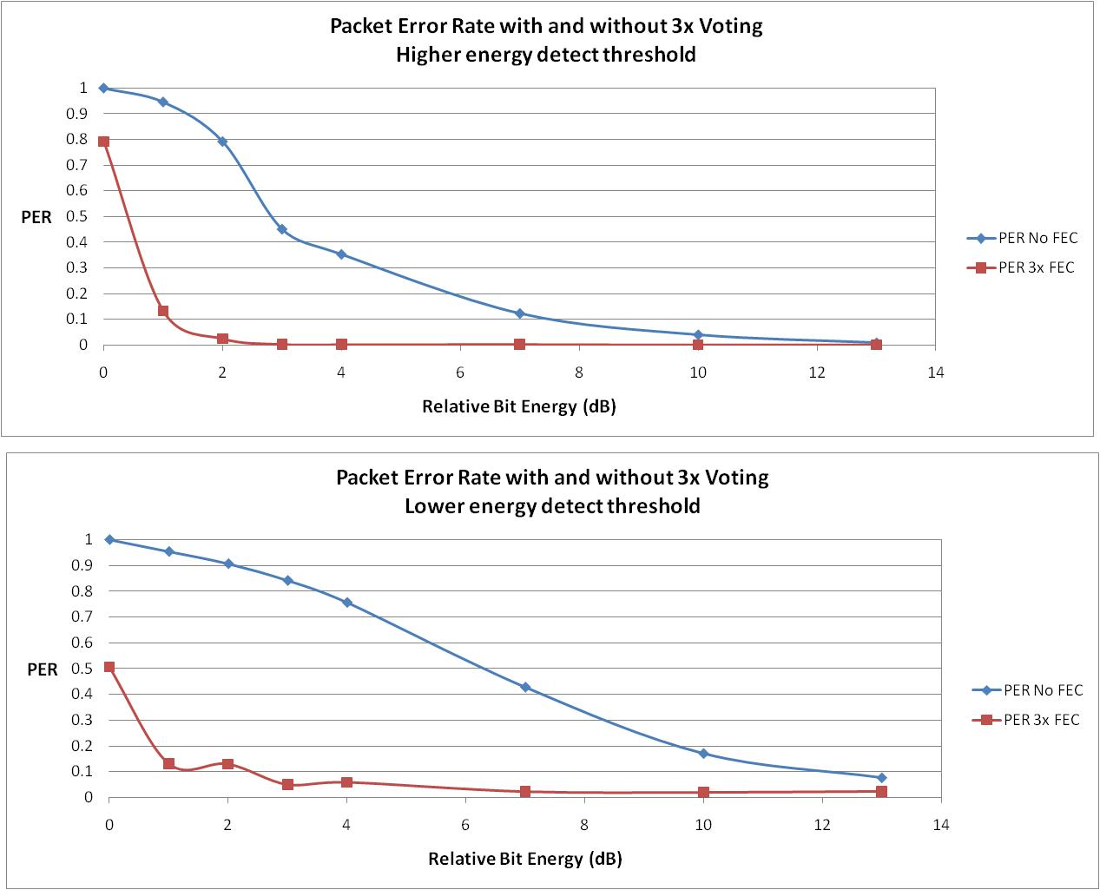
Experimental Data
~2dB gain at 50% PER

Slide 5
Notes About Data
The top plot shows that triple voting redundancy has 2dB or more advantage at the fringes of coverage
The bottom plot shows how this simple FEC allows the energy detect threshold to be pushed further into the noise
However, caution should be read when reading this distance between curves as system gain, since pushing the threshold into the noise will break other system parameters (e.g. TOA robustness)

Slide 6
Encoding Scheme
Rather than 3 pulses per bit, it is proposed that the payload and CRC are repeated three times
This has two advantages
  Main advantage: very simple implementation in tag
  Peripheral advantage: the CRC is also protected
Base Mode:
Preamble
SFD
PHR
Payload
CRC
Enhanced Mode:
Preamble
SFD
PHR
Payload
CRC
Payload
CRC
Payload
CRC

Slide 7
Decoding Scheme
The specifics of the decoding scheme are out of scope of the standard
However, the standard can give guidance
  The data can be evaluated using “best of 3” voting
  This might be done at the bit level, symbol level, or at some other intermediate level, according to the implementer’s discretion

Slide 8
Proposal
It is proposed that Enhanced Mode be retained in the 4f standard with the encoding scheme as described on slide 6 of this presentation

