Slide 1
Project: IEEE P802.15 Working Group for Wireless Personal Area Networks (WPANs)
Submission Title: Intel simulation of the Type 1 OOK FEC schemes
Date Submitted: 14 March 2010
Source: Rick Roberts, Rich Nicholls [Intel Labs]
Address
Contact: 503-929-5624, richard.d.roberts@intel.com
Re:
[Abstract:
Purpose:
Notice: This document has been prepared to assist the IEEE P802.15. It is offered as a basis for discussion and is not binding on the contributing individual(s) or organization(s). The material in this document is subject to change in form and content after further study. The contributor(s) reserve(s) the right to add, amend or withdraw material contained herein.
Release: The contributor acknowledges and accepts that this contribution becomes the property of IEEE and may be made publicly available by P802.15.

Slide 2
Intel simulation of the Type 1 OOK FEC schemes presented in document 15-10-0097-02-0007
Conclusions
We were able to duplicate some results but not all.

Slide 3
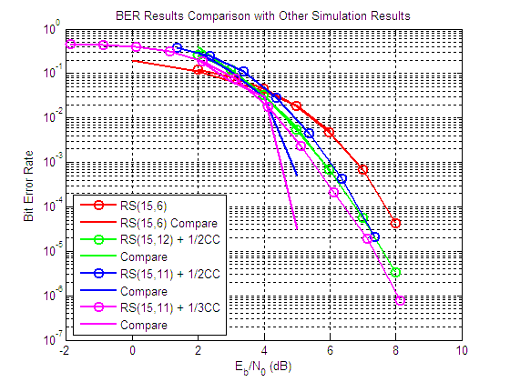
Match:
RS(15,6) and
RS(15,12) + 1/2CC
Divergent:
RS(15,11) + 1/2CC and
RS(15,11) + 1/3CC
Ec/No = Eb/No + 10log₁₀(Data Rate/Optical Rate)

Slide 4
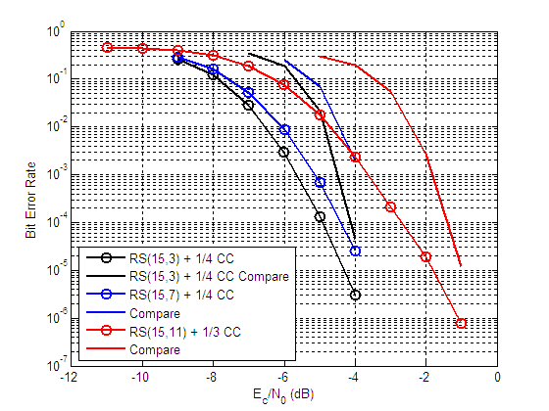
~2 dB discrepancy
Same divergence observed at higher SNR’s
Relative performance
consistent.

