Slide 1
Project: IEEE P802.15 Working Group for Wireless Personal Area Networks (WPANs)
Submission Title: [Container Monitoring Application]
Date Submitted: [March 2010]
Source: [Roberto Aiello] Company [Independent]
Address [San Diego, CA USA]
Voice:[], FAX:], E-Mail:[aiello@ieee.org]
Abstract: [This presentation describes a potential application for LECIM]
Purpose: [For information]
Notice: This document has been prepared to assist the IEEE P802.15. It is offered as a basis for discussion and is not binding on the contributing individual(s) or organization(s). The material in this document is subject to change in form and content after further study. The contributor(s) reserve(s) the right to add, amend or withdraw material contained herein.
Release: The contributor acknowledges and accepts that this contribution becomes the property of IEEE and may be made publicly available by P802.15.

Slide 2
Summary
Motivation
  LECIM: Low energy critical infrastructure monitoring
  Container monitoring is interesting application
Objective
  Application description
  Application requirements
  Challenges
  No discussion on technical solutions

Slide 3
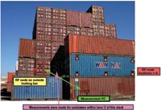
Opportunity
$120B industry
90% of non-bulk cargo shipped in containers
11 million containers per year enter the U.S. alone and only 3% are inspected – Billion Dollar Wireless System Market Opportunity
  Growth in global trade poses an enormous security risk & logistics automation is required to keep up with expansion
No real-time tracking of location or conditions (temp, vibration, chemicals)
Ad hoc tracking and inspection only at choke points (RFID)

Slide 4
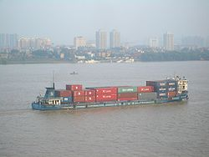
Application challenges
No single player responsible for everything in the container transportation process
Large number of handoff between various players
Often cross international lines: useful to know the exact point of failure
Features
  Ensure container’s security
  Streamline supply chain
  Prevent loss
  Reduce terrorism risk
  Reduce cost
  Improve customer service
  Update status real-time status

Slide 5
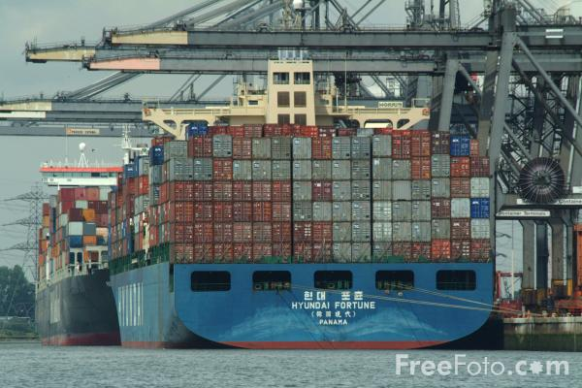
About containers
Size defined by ISO
  10ft, 20ft and 40ft length
Other sizes
  Super-high cube containers (oversize containers)
  Air containers (for air transport)
Others
  45ft, 48ft, 53ft length
  8ft, 8ft6in, 9ft6in height
Ship size
  10-15,000 containers per ship

Slide 6
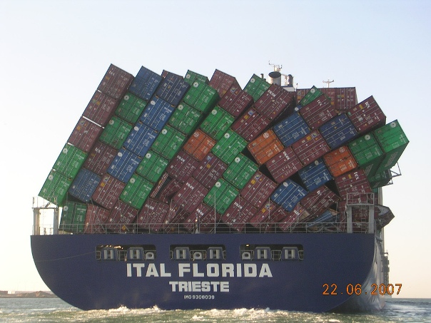
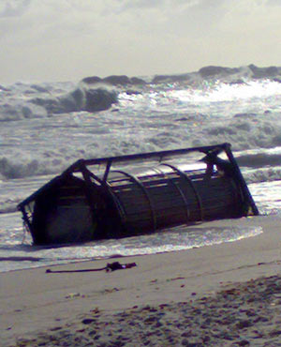
Lost containers
10,000 containers lost at sea per year

Slide 7
Monitoring communication technologies
Satellite communication
  Advantage: ubiquitous coverage
  Disadvantage: expensive
RFID
  Advantage: low operating cost
  Disadvantage: expensive infrastructure
Others
  Smaller deployments with Wi-Fi, UWB, Bluetooth, OCR, ZigBee

Slide 8
Major security initiatives
Operation Safe Commerce (OSC)
  Joint industry/ government project to demonstrate advanced techniques and technologies
Container Security initiative (CSI)
  Target and screens containers at foreign seaports before shipping to US
  Over 20 overseas ports involved since 2002
Smart and Secure Tradelanes (SST)
  Commercial deployment of end-to-end security
  Over 70 companies involved

Slide 9
Application requirements
Real Time Seamless Monitoring
  Good coverage
  Low infrastructure cost
  Low operational cost
Ability to install node inside container
Battery life: > 2 years
Includes variety of sensors in same node (temperature, vibration, door open/ close
Access point connected to backhaul
Access point
Sensor Node inside container

Slide 10
RF signal in-out of container
Up to 80dB attenuation at 915MHz
Ref: “RFID behavior study in enclosed marine container for real time temperature tracking”, Magalie Laniel Jean-Pierre Emond Ahmet E. Altunbas, Sens. & Instrumen. Food Qual. (2009) 3:34–40, DOI 10.1007/s11694-009-9075-3

Slide 11
Conclusions
Container monitoring part of LECIM
Substantial commercial opportunity
Challenging technical problem
Not a good technical solution available
Need a standard

