Slide 1
Project: IEEE P802.15 Working Group for Wireless Personal Area Networks (WPANs)
Submission Title: [Errors in 802.15.4a]
Date Submitted: [19 February, 2010]
Source: [Michael McLaughlin] Company [DecaWave]
Address [Digital Depot, Thomas Street, Dublin 8, Ireland]
Voice:[+353 688 2514], FAX: [none], E-Mail:[michael.mclaughlin@decawave.com]
Re: [Errors in 802.15.4a]
Abstract: [Errors in 802.15.4a]
Purpose: [To correct errors in 802.15.4a]
Notice: This document has been prepared to assist the IEEE P802.15. It is offered as a basis for discussion and is not binding on the contributing individual(s) or organization(s). The material in this document is subject to change in form and content after further study. The contributor(s) reserve(s) the right to add, amend or withdraw material contained herein.
Release: The contributor acknowledges and accepts that this contribution becomes the property of IEEE and may be made publicly available by P802.15.

Slide 2
Errors and ambiguities in 802.15.4a

Slide 3
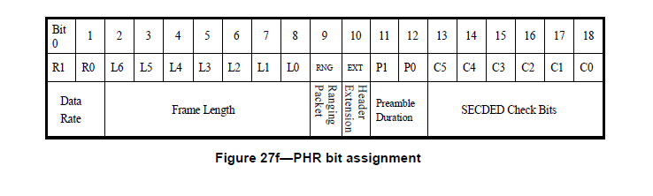
SECDED code in PHR
There is an error in paragraph *6.8a.7.2*:
C5 = XOR(R0, R1, L5, L6, C3, C4)
should read
C5 = XOR(R1, R0, L6, L5, L4, L3, L2, L1, L0, RNG, EXT, P1, P0, C4, C3, C2, C1, C0)

Slide 4
When to switch to 6.8M bit/sec
The IEEE 802.15.4a standard is not entirely clear as to when the switch from PHY Header mode modulation into modulation at the data rate should be made
This is only relevant when at 6.8Mbps and 27Mbps. The other two rates use identical modulation for PHY header and data
Annex I does not clear this ambiguity up because the data rate used in the example is 850kbps

Slide 5
Let us denote the 19 PHY header bit as H₀ to H₁₈
Let this be followed by N data bits, D₀ to D_{N-1}
Appended to this are two tail bit T₀ and T₁
There are then three possible interpretations as follows:

Slide 6
Interpretation 1
19 Symbols of Pure Header at 850kbps
N+2 Symbols of Data at e.g. 6.8 Mbps

Slide 7
Interpretation 2
20 Symbols of Header at 850kbps
N+1 Symbols of Data at e.g. 6.8 Mbps

Slide 8
Interpretation 3
21 Symbols of Header at 850kbps
N Symbols of Data at e.g. 6.8 Mbps

Slide 9
Arguments for various interpretations
Figure 27b of the standard says that there are 19 symbols of PHY header followed by 0 – 1209 symbols of Data
19 Symbols is consistent with interpretation 1
  In this case the data field should be 2-1210 symbols long. 0 is not allowed and two tail bits are added
Interpretation 3 is consistent with the view that all symbols which contain information coming from the header need to be encoded at the lower data rate. In this case Figure 27b should have 21 symbols in the header and 0-1208 symbols in the data.
Interpretations 1 & 2 both require the strange situation where, even with an empty data field, the data rate needs to be switched, e.g. to 6.8Mbps, to send the last one or two symbols.

Slide 10
Personal view
My own view is that interpretation 3 is the correct one
  The switch to a higher data rate happens AFTER all the header bits, including the convolutional parity bits have been received.
  This makes the most sense, since
    (a) all these bits are required to use the SECDED code to correct the R0 and R1 bits which tell you if you need to switch rates.
    (b) all the header bits are sent at the robust 850k default rate
Fig 27b needs to be corrected to show 21 symbols in the header and 0-1208 symbols in the data.
We should put interpretation 3 into the standard (Perhaps into Annex I?)

Slide 11
Is the leading zero transmitted?
It has been said to me that a reasonable interpretation of the text of the standard is that the first symbol with the “initialisation zero” as the position and the first data bit as the polarity is not transmitted.
In this interpretation, the first bit to be transmitted is symbol 1 in the above tables

Slide 12
Annex I clears this up
This interpretation is most likely to occur to implementers of a non-coherent receiver, because, in this case, the first symbol contains absolutely no information.
This interpretation is wrong because it results in the first data bit having less redundancy than the other bits.
Annex I clearly shows that this first symbol IS transmitted
Nonetheless, to avoid misinterpretation, the main body of the text should explicitly state that this symbol is transmitted.

Slide 13
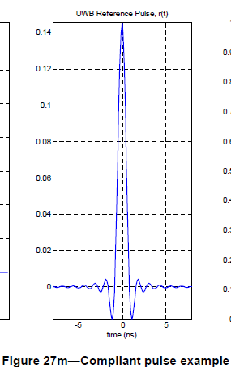
Various small corrections
Table 39c - Nhdr=19 not 16
Table 39c - Thdr should be 19.5, 20.0, 77.9
Table 39c - Ndata is given by -> (round up to =8*(6*ROUNDUP(Length*8/(6*55)+Length))
Fig 27m shows an example of a 1ns pulse width (which does not correspond to any specified bandwidth). The text says it is 2ns, but it is not.
Incorrect figure

Slide 14
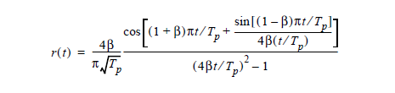
Various small corrections
The equation for r(t) is wrong. to correct:
a) Remove square bracket at end of Sin term
b) Add a square bracket at end of cos term, just before the +
c) put a minus sign in front of the whole thing, i.e. negate the whole thing.
Incorrect equation

Slide 15
Various small corrections
Clarifications:
110kbps bit rate always uses length 64 SFD. Paragraph 6.8a.6.2 is ambiguously worded. It could be read as meaning that either length SFD can be used with 110kbps. This is not the case. It must be the longer one, otherwise you cannot know how to demodulate the PHR.
Receiver is not aware of bit rate and must decode from received PHR, can determine bit rate of PHR 110kbps or 850kbps based on number of SFD symbols received, 64 or 8 respectively.
PHY PIB parameter 0x08 phyPreambleSymbolLength (0 = 31 symbols, 1 = 127 symbols) is redundant since PHY PIB parameter 0x1A phyCurrentCode which specifies the preamble code index, essentially gives this same information. Here codes 1 to 8 are 31 symbols long, while codes 9 to 24 are 128 symbols long.
Proposed Fix: Make phyPreambleSymbolLength a ReadOnly element of the PIB. The MAC will return 0 if phyCurrentCode is less than or equal to 8

Slide 16
Figure 27d
Corrected Figure 27d
Signs of last 2 shown Si’s need to be swapped

