Slide 1
Project: IEEE P802.15 Working Group for Wireless Personal Area Networks (WPANs)
Submission Title: [ZES UWB Band Plan Proposal]
Date Submitted: [10 March, 2010]
Source: [Tim Harrington] Company [Zebra Enterprise Solutions]
Address [2940 N. 1st Street, San Jose, CA. 95134. USA]
Voice:[+1 408 473 8513], FAX: [+1 408 473 8501], E-Mail:[tharrington@zebra.com]
Re: [Band Plan Proposal for UWB RFID PHY.]
Abstract: [This document proposes a simple band plan that allows a single tag to be used throughout North America, the EU, and China, with an alternate band for Korea and other countries that require frequencies above 7 GHz.]
Purpose: [To resolve outstanding issues on the current baseline proposal]
Notice: This document has been prepared to assist the IEEE P802.15. It is offered as a basis for discussion and is not binding on the contributing individual(s) or organization(s). The material in this document is subject to change in form and content after further study. The contributor(s) reserve(s) the right to add, amend or withdraw material contained herein.
Release: The contributor acknowledges and accepts that this contribution becomes the property of IEEE and may be made publicly available by P802.15.

Slide 2
UWB PHY Band Proposal
Tim Harrington
tharrington@zebra.com
+1-408-473-8513

Slide 3
Background
This presentation is provided to foster further discussions introduced in documents
802.15-10-0147-00-004f and
802.15-10-0148-00-004f

Slide 4
Goals
Primary
  Compliance with regional radio law
  Maximize value of new, and changes to, regional radio law
  Provide cost effective approach to promote accelerated growth to UWB in RFID/RTLS industry
  Co-exist with current standards
Additional Goals
  Allow 802.15.4a interoperability with minimal performance trade-offs
  Provide path to lowest cost tag

Slide 5
Consistency with Regional Radio Law
Compliance Only Possible in Regions that have Defined Laws
“Early Adopter” Countries Serve As Models For Countries Which Do Not Yet Have Rules
  ETSI and FCC standards serve as guides to many countries regulatory agencies
Standards Influence Changes in Local Radio Law
  Japan adopted 2.400-2.483 GHz after IEEE 802.11 was published
    Move from 2.470-2.497 GHz
  South Korea adopted “Wide Band” DSSS rules allowing 80 MHz DSSS after publication of ISO 24730-2
    Expansion from maximum bandwidth of 26 MHz

Slide 6
Maximize Value of Changes in Radio Law
New Rules Provide the Ability to Find “Sweet Spots” of Commonality
During Development of 4a
  EU rules were not yet set
  Chinese Rules were not yet set
  Canadian rules were not yet set
The Establishment Of These Rules Afford An Opportunity That Was Not Available To Members Of The 4a Committee

Slide 7
Accelerate Growth of UWB in
RFID/RTLS Industry
Key Premises
  Standardization is conducive to market growth
  RFID Standards that allow passage across international boundaries have widest applicability and desirability
  Key 4f goal is to foster international adoption of RFID devices for rapid market growth
  Low cost tags are a vital component to rapid market growth
Cost Components
  High volume, single product manufacturing is key to low cost
  Multiple bands requires multiple products or higher cost multiple frequency transmitters
  Lowest cost tags are single frequency devices
Key Assertions
  Single frequency tags are not conducive to remote frequency changes
  PHY standards with multiple bands have less value than single band standards
    1 Band would be optimal, but is not attainable at this time
    …But 2 is better than 3 and provides a potential path to 1
  International adoption of a single frequency will be hampered by more bands
  Single frequency, high volume product is less costly than a filter

Slide 8
Commonality Possible with 2 Bands
Legend:
Band 0:
Band 1:
Not Defined:
~ 37.5% of World Population has UWB Regulations Defined
~ 35% of World Population can be accommodated by 1 Band
93 % of Currently Available Market by Population Can Use 1 Band

Slide 9
Amended Band Plan Recommendation
Band 0 – 6.489 GHz CF, minimum 400 MHz -10 dB Bandwidth
  4a Channel 5 499.2 spacing, Channel 7 1081.6 spacing
  Maximum compatibility with 4a, and compatibility w/ wide channels
  Allows single tag that provides maximum compliance compatibility – NA, EU, China
  Filtering can be achieved at very low cost
Band 1 – 7.987 GHz CF, minimum 400 MHz -10 dB Bandwidth
  4a Channel 9 499.2 spacing, Channel 11 1081.6 spacing
  Maximum compatibility with 4a, and compatibility w/ wide channels
  Allows single tag that provides maximum compliance compatibility – EU, China, Korea

Slide 10
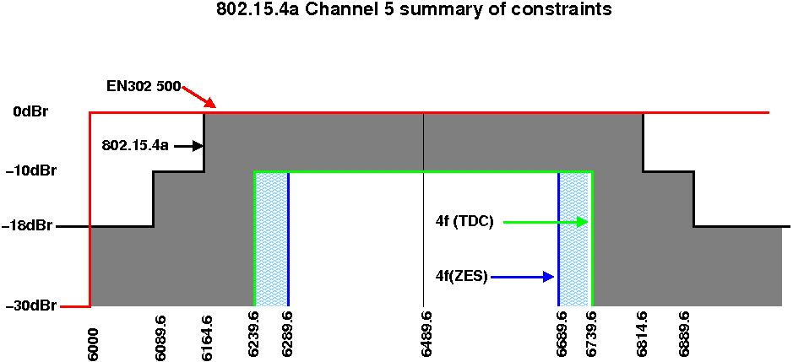
Amended Band Plan Proposal
802.15.4f Band 0

Slide 11
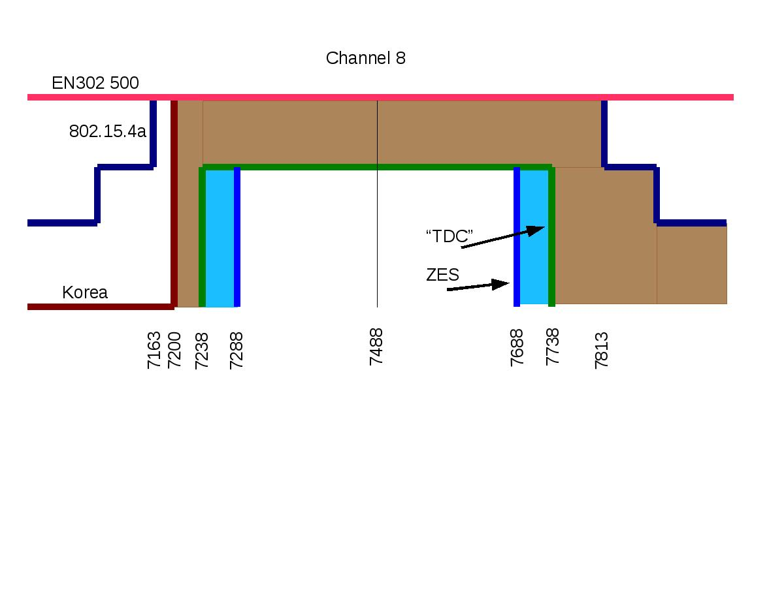
4a Channel 8
Not conducive to shared band

Slide 12
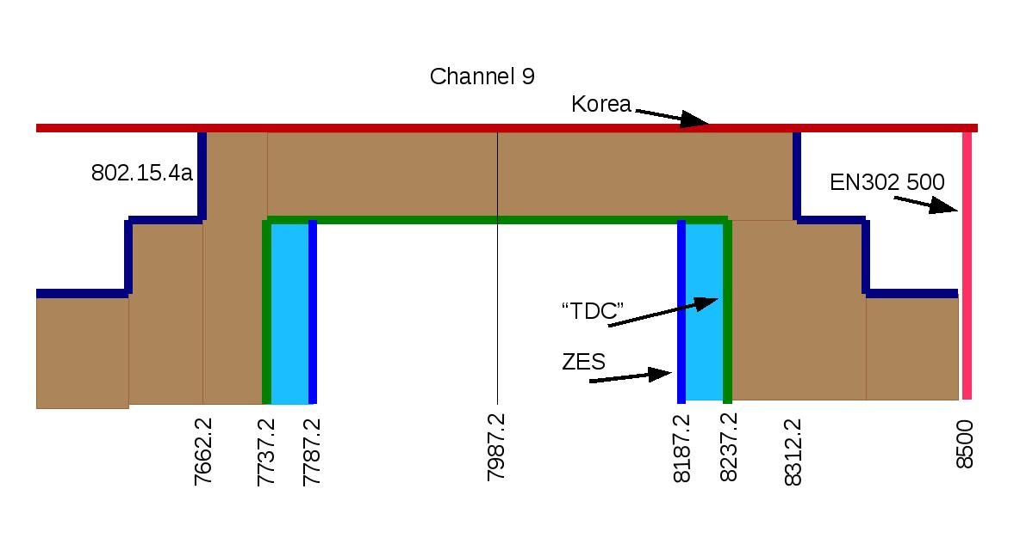
4a Channel 9
Can provide shared band for EU and Korea

