Slide 1
Project: IEEE P802.15 Working Group for Wireless Personal Area Networks (WPANs)
Submission Title: Amplitude Modulated VLC Dimming Challenges
Date Submitted: March 2010
Source: Rick Roberts, Praveen Gopalakrishnan [Intel Corporation]
Address:
Contact Information: 503-929-5624 [richard.d.roberts@intel.com]
Re:
Abstract:
Purpose:
Notice: This document has been prepared to assist the IEEE P802.15. It is offered as a basis for discussion and is not binding on the contributing individual(s) or organization(s). The material in this document is subject to change in form and content after further study. The contributor(s) reserve(s) the right to add, amend or withdraw material contained herein.
Release: The contributor acknowledges and accepts that this contribution becomes the property of IEEE and may be made publicly available by P802.15.

Slide 2
March 2010
Problem Statement
This presentation pertains to PHY 1 and PHY 2 type devices and the challenges that dimming poses. In this presentation we’ll discuss:
1. While 802.15.7 must honor all dimming requests, it is not possible to support useful data communications under all dimming conditions.
2. The useful bit rate is dimming related; that is, for different dimming requirements the minimum bit rate varies.
3. The un-resolved issue is “ if the minimum bit rate is dimming dependent, then what bit rate shall be used for link establishment?”

Slide 3
March 2010
Assumptions
In regards to PHY 1 and PHY 2 … dimming is challenging and problematic.
Assumptions in this presentation:
1. During amplitude modulation the LED is either ON or OFF
2. The optical rate is so high that intra-frame flicker is not a problem

Slide 4
March 2010
Terminology interpretation:
1. Intra-frame flicker has two possible causes (need to modify definition)
Optical rate (which we assumed is very high – so not a problem)
Frame modification to accommodate dimming (potential problem)
2. Inter-frame flicker is the flicker between frames
Requires compensation transmission between frames (no problem)
Active
Time
Comp
Time
Active
Time
Comp
Time
Active
Time
Comp
Time
Active
Time
Comp
Time
Active Data Frame
Active Data Frame
Compensation Frame
Active Data Frame

Slide 5
March 2010
Dimming impacts performance three ways:
1. Causes data rate reduction in OOK and range reduction in VPM.
2. Can cause dimming related intra-frame flicker in OOK and link reliability problems in VPM.
3. Given a minimum size link establishment packet and a practical dimming limit, a minimum data rate restriction is imposed.
We now qualitatively expound on these three points in the following slides.

Slide 6
March 2010
Point #1 – impact of dimming on data rate and range
As the LED dims, the energy available for amplitude modulated data transmission has to decrease.
OOK impact: constant range with reduced data rate
OOK sends data with either the LED full-on or full-off (stated assumption), so if the energy per bit stays constant then the data rate must be reduced (because of less available energy)
This is manifested in the fact that to achieve dimming with OOK, intra-frame dead time must be inserted
VPM impact: constant data rate with reduced range
As the light dims, VPM continues to send data at the same rate but with less energy per bit; hence, the range must be reduced

Slide 7
March 2010
Point #1 – impact of dimming on data rate and range (continued)
Impact of using OOK for link establishment and then switching to “dimmed VPM” for packet data transmission
According to the draft, VPM does link establishment using OOK (50% duty cycle VPM) and then switches to “dimmed VPM” (less than 50% duty cycle) for the packet body.
Dead time is inserted between the OOK transmission and the VPM transmission to compensate for the OOK part of the frame
It is possible that the link can be established at longer range than the packet body can be transmitted. This will result in being able to connect but not being able to pass data.
OOK Link Establishment
Comp Time
VPM Data Body

Slide 8
March 2010
Point #2 - dimming related intra-frame flicker in OOK
Intra-frame dimming in OOK is achieved by the insertion of compensation time into the active frame.
Active
Time
Comp
Time
Active
Time
Comp
Time
Active
Time
Comp
Time
Active
Time
Comp
Time
Active Data Frame
If the repetition rate of the active and comp time becomes too low then flicker can start to occur
Active
Time
Comp
Time
T_{rep}

Slide 9
March 2010
Point #2 - dimming related intra-frame flicker in OOK (cont.)
The minimum active time is determined by a null packet (no data body, as shown below)
PHY rates and corresponding active times for null packet:
5 kbps ➔ 40.8 msec
50 kbps ➔ 4.08 msec
100 kbps ➔ 2.04 msec
PHY Preamble
(124 bits)
PHY Header
(40 bits)
MAC Header
(40 bits)

Slide 10
March 2010
Point #2 - dimming related intra-frame flicker in OOK (cont.)
The amount of required comp time is determined by three factors:
1. Number of bytes (bits) in a null packet (minimum length packet)
2. The bit rate used to transmit the null packet
3. The actual dimming required (i.e. necessary duty cycle)
The fact is - given any null packet length and reasonable bit rate, we can always find an extreme dimming requirement that will result in flicker; that is, in theory it is not possible to avoid intra-frame flicker due to dimming UNLESS we pragmatically state that at some degree of dimming we NO LONGER ATTEMPT data communications!
Active
Time
Comp
Time
T_{rep}

Slide 11
March 2010
Point #3 - Given a minimum size link establishment packet and a practical dimming limit, a minimum data rate restriction is imposed
T_{rep}
Active
Time
Comp
Time
Active
Time
Comp
Time
Active
Time
Comp
Time
Active
Time
Comp
Time
T_{A}
T_{C}
Active Data Frame
If T_{c}>0 then T_{rep} = T_{A}+T_{C} <= T_{flicker}
T_{C} = T_{A} x K_{dim} where K_{dim} is the required dimming constant
T_{A} = L_{bits min} x T_{rate} where T_{rate} = 1/(data rate)
Solving for T_{rate} in terms of constants: T_{rate} ≤ T_{flicker} / {(1+ K_{dim} )L_{bits min} }

Slide 12
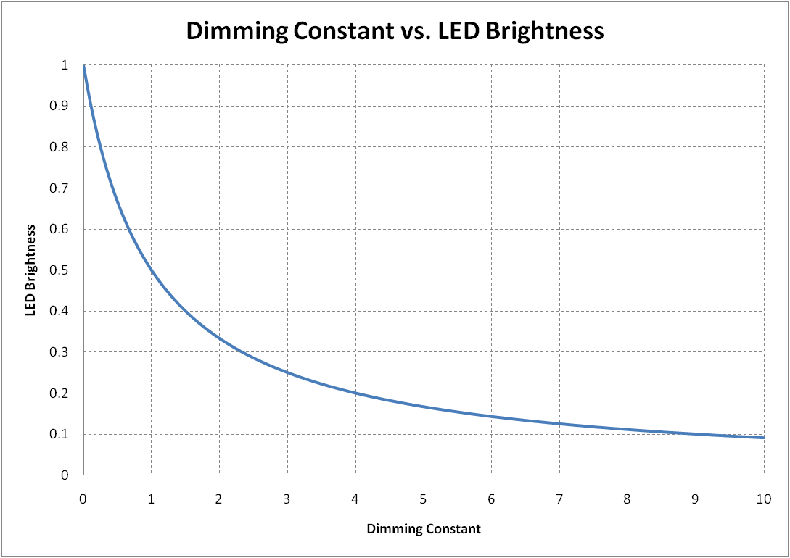
March 2010
Point #3 - Given a minimum size link establishment packet and a practical dimming limit, a minimum data rate restriction is imposed (cont.)
So for a given dimming constant and minimum length “null packet”, there is a minimum bit rate that can be used and still avoid flicker.
If T_{c}>0 then T_{rate} ≤ T_{flicker} / {(1+ K_{dim} )L_{bits min} }
If no constraints are placed on the dimming constant then in theory the minimum data rate, to avoid flicker, is unconstrained.
The question is “what to do about this”?

Slide 13
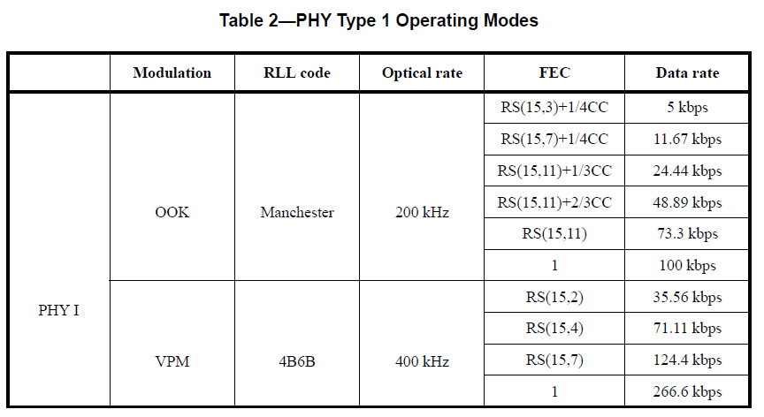
March 2010
The authors suggested way forward is two fold:
1. For PHY TYPE 1 … for link establishment, OOK and VPM use different bit rates according to the modulation type.
Delete – too slow
Use for OOK LE
Use for VPM LE
LE means Link Establishment

Slide 14
March 2010
2. All PHY types must support dimming down to 0.1% (as currently in the draft) BUT the transmission of data under any given dimming condition is an implementation option.
To clarify, a device can decide to no longer support data transmission for an arbitrary level of dimming. To do this the device simply no longer participates in the link establishment.
If a problematic amount of dimming is requested during a data transmission session, the device can issue a “stopping transmission due to dimming” command and then go off the air. This command would have to be added to the draft.

Slide 15
Phy Header Modifications to support OOK dimming

Slide 16
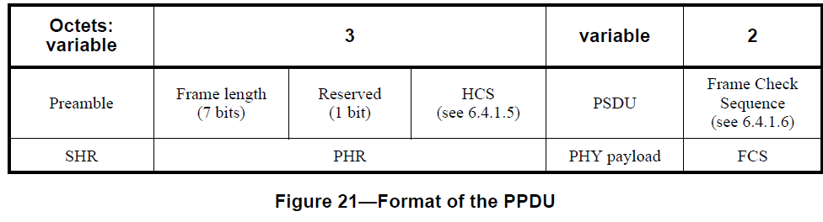
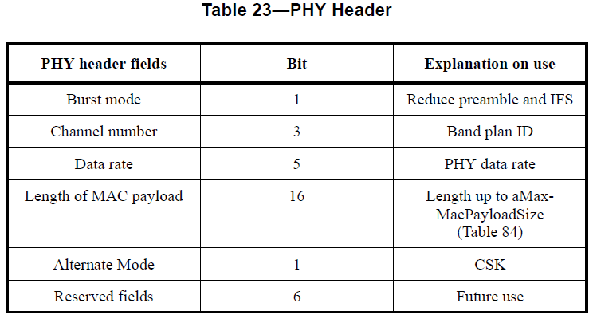
Current Text in LB50 Draft
There seems to be a discrepancy between the PHR defined in Figure 21 and the PHR details as shown in Table 23.
We propose a modified approach.

Slide 17
We suggest the following 4 byte PHY Header
PHY header fields | Bits | Explanation on use
Mode | 2 | 00=Single Mode 01=Packed Mode 10=Burst Mode
Spectral Peak Band | 3 | Band plan ID
 | 2 | reserved
MCS Number | 5 | PHY 1: MCS 1-9 PHY 2: MCS10-23 PHY 3: MCS 24-30
 | 3 | reserved
Length of MAC payload | 16 | Length up to aMax-MacPayloadSize (Table 84)
PHR Extension Field Indication | 1 | Indicates the presence of optional PHR extension

Slide 18
The format of the suggested PPDU
Octets: variable | 4 | 3 | 2 | variable | 2
SHR | PHR | Optional PHR Ext. | HCS | PSDU | FCS

Slide 19
We suggest the following variable length PHY Header Extension
PHY header extension fields | bits | Explanation on use
Length of Short Sync Field | 4 | 0 to N symbols
Length of sub-packet | 10 | Sub-packet length symbol
Number of compensation symbols | 10 | i.e. number of symbols that the LED is turned OFF
Packet Length
Short Sync Field
i.e. 1010 pattern
Data Sub-packet
Compensation
symbols

Slide 20
March 2010
Backup Slides

Slide 21

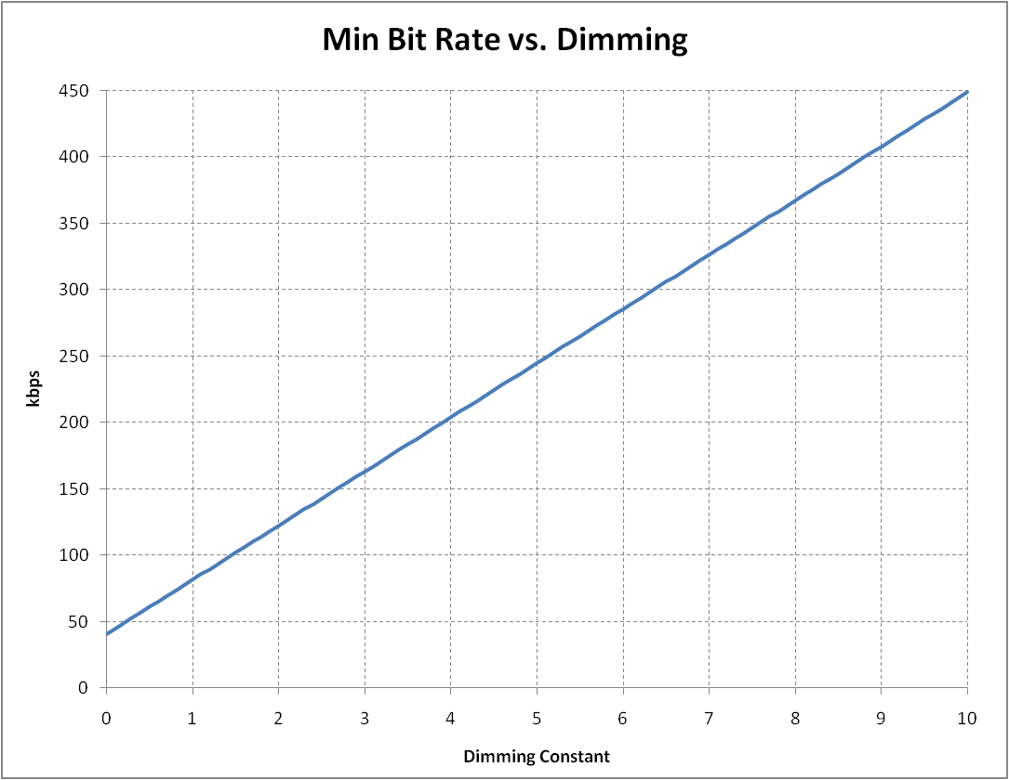
March 2010
Calculated Bit Rates vs. Dimming
Lbits=204; Tflicker=5 mS
The missing data is related to the link budget: what does the Range vs. Data Rate curve look like (specifically for the auto use case)? I fear the standard is getting out in front of the science!
???
Data Rate (kbps)
Auto Use Case
How many kbps at 100 meters
Range (10s of meters)

