Slide 1
Project: IEEE P802.15 Working Group for Wireless Personal Area Networks (WPANs)
Submission Title: [Time Domain UWB Band Plan Proposal]
Date Submitted: [18 March, 2010]
Source: [Adrian Jennings] Company [Time Domain]
Address [330 Wynn Drive, Suite 300, Huntsville, AL. 35805. USA]
Voice:[+1 256 759 4708], FAX: [+1 256 922 0387], E-Mail:[adrian.jennings@timedomain.com]
Re: [Band Plan Proposal for UWB RFID PHY.]
Abstract: [This document proposes a frequency band plan that is global, easy to implement in low cost devices, and consistent with the existing 802.15.4a UWB band plan. See also the companion document # 15-10-0148-00-004f]
Purpose: [To resolve outstanding issues on the current baseline proposal]
Notice: This document has been prepared to assist the IEEE P802.15. It is offered as a basis for discussion and is not binding on the contributing individual(s) or organization(s). The material in this document is subject to change in form and content after further study. The contributor(s) reserve(s) the right to add, amend or withdraw material contained herein.
Release: The contributor acknowledges and accepts that this contribution becomes the property of IEEE and may be made publicly available by P802.15.

Slide 2
UWB PHY Band Plan Proposal
Adrian Jennings
adrian.jennings@timedomain.com
+1 256 759 4708

Slide 3
Band Plan Proposal
4f Band | Low Edge | High Edge | Band Fc | Band BW | 4a Channel | Channel Center
0 Min | 6289.6 | 6689.6 | 6489.6 | 400 | 5 | 6489.6
0 Max | Uses instead 4a band: |  |  |  | 7 | 6489.6
1 Min | 7288 | 7688 | 7488 | 400 | 8 | 7488
1 Max | Additionally spans 4a band: |  |  |  | 6 | 6988.8
2 Min | 8785.6 | 9185.6 | 8985.6 | 400 | 12 | 8985.6
2 Max | Additionally spans 4a band: |  |  |  | 10 | 8486.4
Notes
  4f devices must span at least the minimum band specified
  4f devices must not exceed the maximum band specified
  This band plan directly uses existing 4a bands to aid interoperability and coordination
  This band does not use the 4a mandatory band to leave that channel open for 4a device interoperability

Slide 4
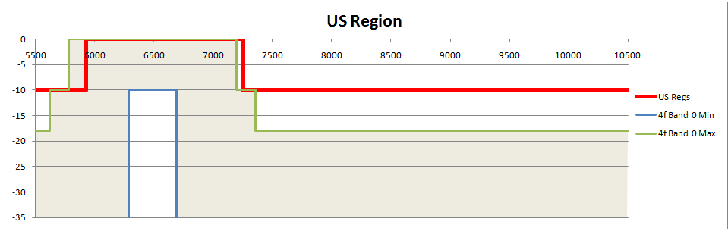
Band Plan Plots – Band 0
Note: 4f Device PSD envelope must stay in grey area

Slide 5
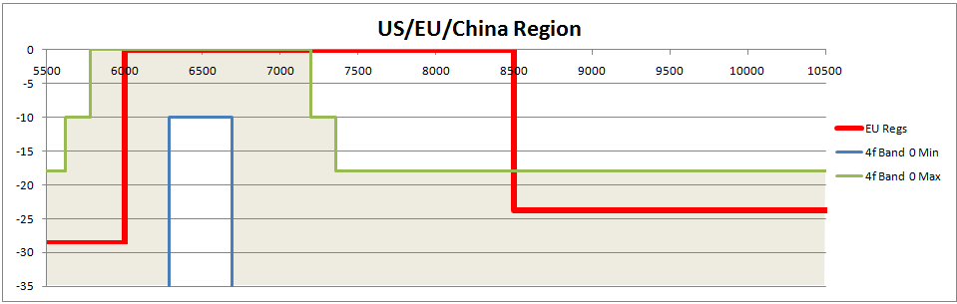
Band Plan Plots - Band 0
Note: 4f Device PSD envelope must stay in grey area

Slide 6
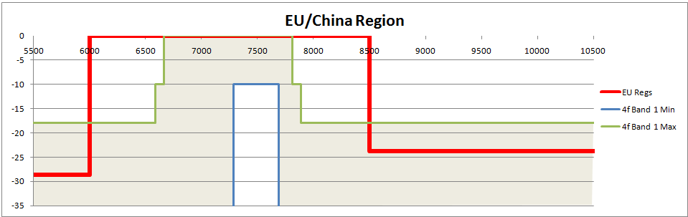
Band Plan Plots - Band 1
Note: 4f Device PSD envelope must stay in grey area

Slide 7
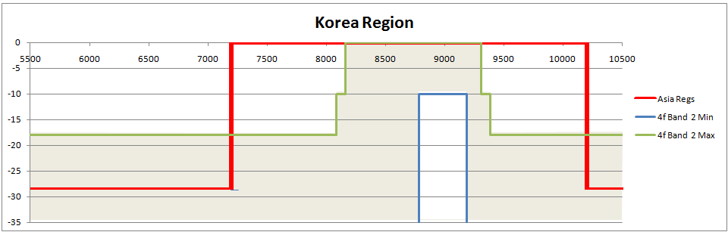
Band Plan Plots – Band 2
Note: 4f Device PSD envelope must stay in grey area

