Slide 1
Project: IEEE P802.15 Working Group for Wireless Personal Area Networks (WPANs)
Submission Title: [Time Domain UWB Band Plan Proposal]
Date Submitted: [11 March, 2010]
Source: [Adrian Jennings] Company [Time Domain]
Address [330 Wynn Drive, Suite 300, Huntsville, AL. 35805. USA]
Voice:[+1 256 759 4708], FAX: [+1 256 922 0387], E-Mail:[adrian.jennings@timedomain.com]
Re: [Band Plan Proposal for UWB RFID PHY.]
Abstract: [This document proposes a frequency band plan that is global, easy to implement in low cost devices, and consistent with the existing 802.15.4a UWB band plan. See also the companion document # 15-10-0148-00-004f]
Purpose: [To resolve outstanding issues on the current baseline proposal]
Notice: This document has been prepared to assist the IEEE P802.15. It is offered as a basis for discussion and is not binding on the contributing individual(s) or organization(s). The material in this document is subject to change in form and content after further study. The contributor(s) reserve(s) the right to add, amend or withdraw material contained herein.
Release: The contributor acknowledges and accepts that this contribution becomes the property of IEEE and may be made publicly available by P802.15.

Slide 2
UWB PHY Band Plan Proposal
Adrian Jennings
adrian.jennings@timedomain.com
+1 256 759 4708

Slide 3
Note
Some of the plots in this document are difficult to read. The plots are pasted from a companion spreadsheet to which the reader is referred in order to inspect the plots in more detail, and to review the tag survey data. The companion document is
15-20-0148-00-004f: Companion Document to Time Domain UWB Band Plan Proposal

Slide 4
Background
The band plan proposed in this document seeks to balance multiple requirements
  It must be consistent with global UWB spectrum regulations
  It must be possible to implement with very low cost tags
  There is a strong motivation to make it consistent with the 802.15.4a UWB band plan for two reasons:
    Interoperability between the standards
    Coexistence between the standards
The band plan should also look to industry best practice to understand implementation issues
A further goal is to accommodate inter-region tags that are proposed to span two geographic regions at a single center frequency

Slide 5
Proposed Band Plan
The proposed band plan defines three 499.2 MHz wide bands (measured at the 10dB points) centered on 4a channels 7,8 and 10.
Each channel corresponds to a set of global spectrum regulations
4f devices can be single region, implementing only one band, or multi-region, implementing any two or all three bands
The bands define the minimum spectrum requirement for a 4f device: devices must have 10dB edges which AT LEAST span the defined 4f band. Devices may span a wider band

Slide 6
4f UWB Band Definition
Notes:
* Using the optional 2.4 GHz link

Slide 7
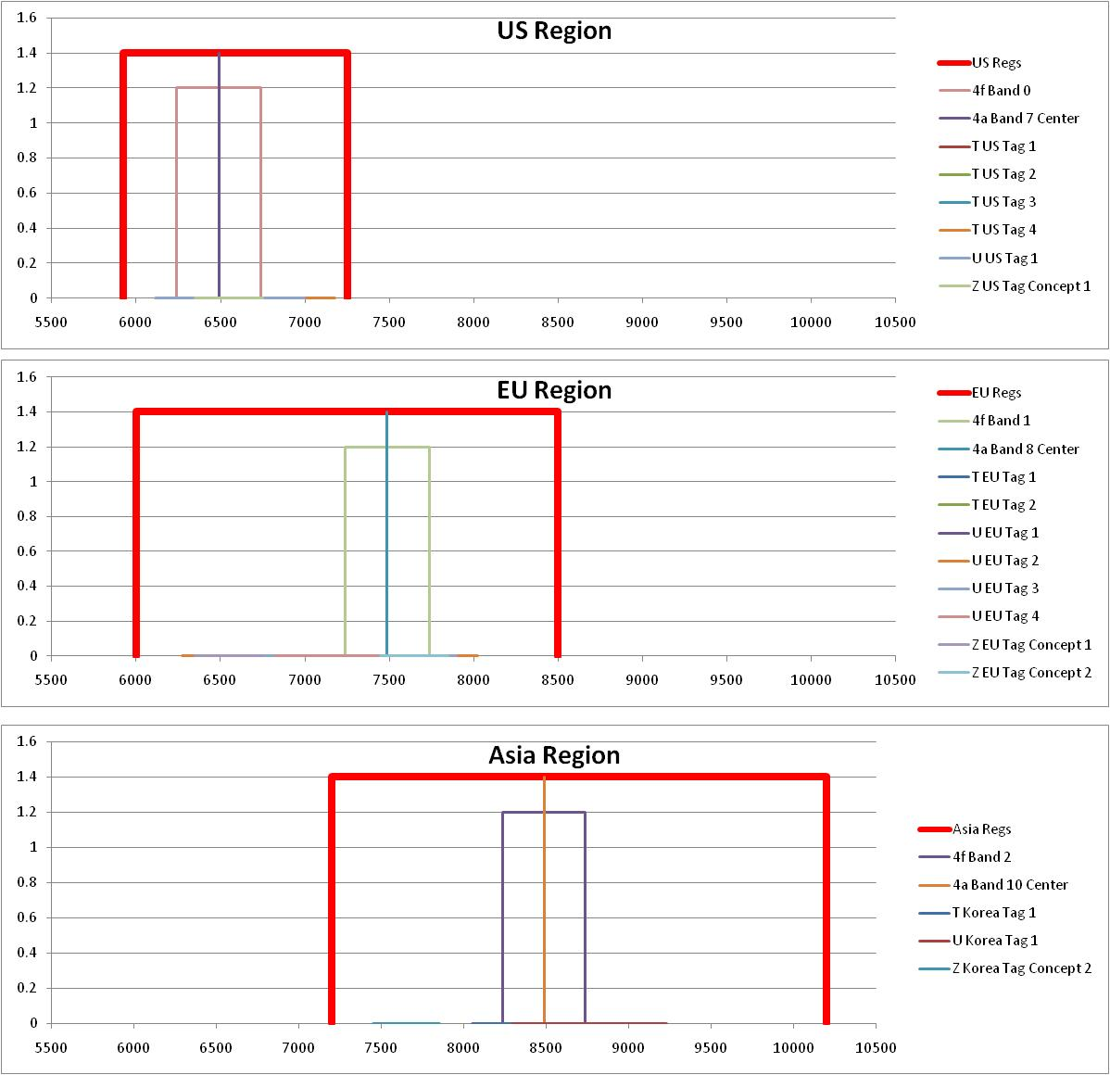
4f Band Plan – Not to Scale

Slide 8
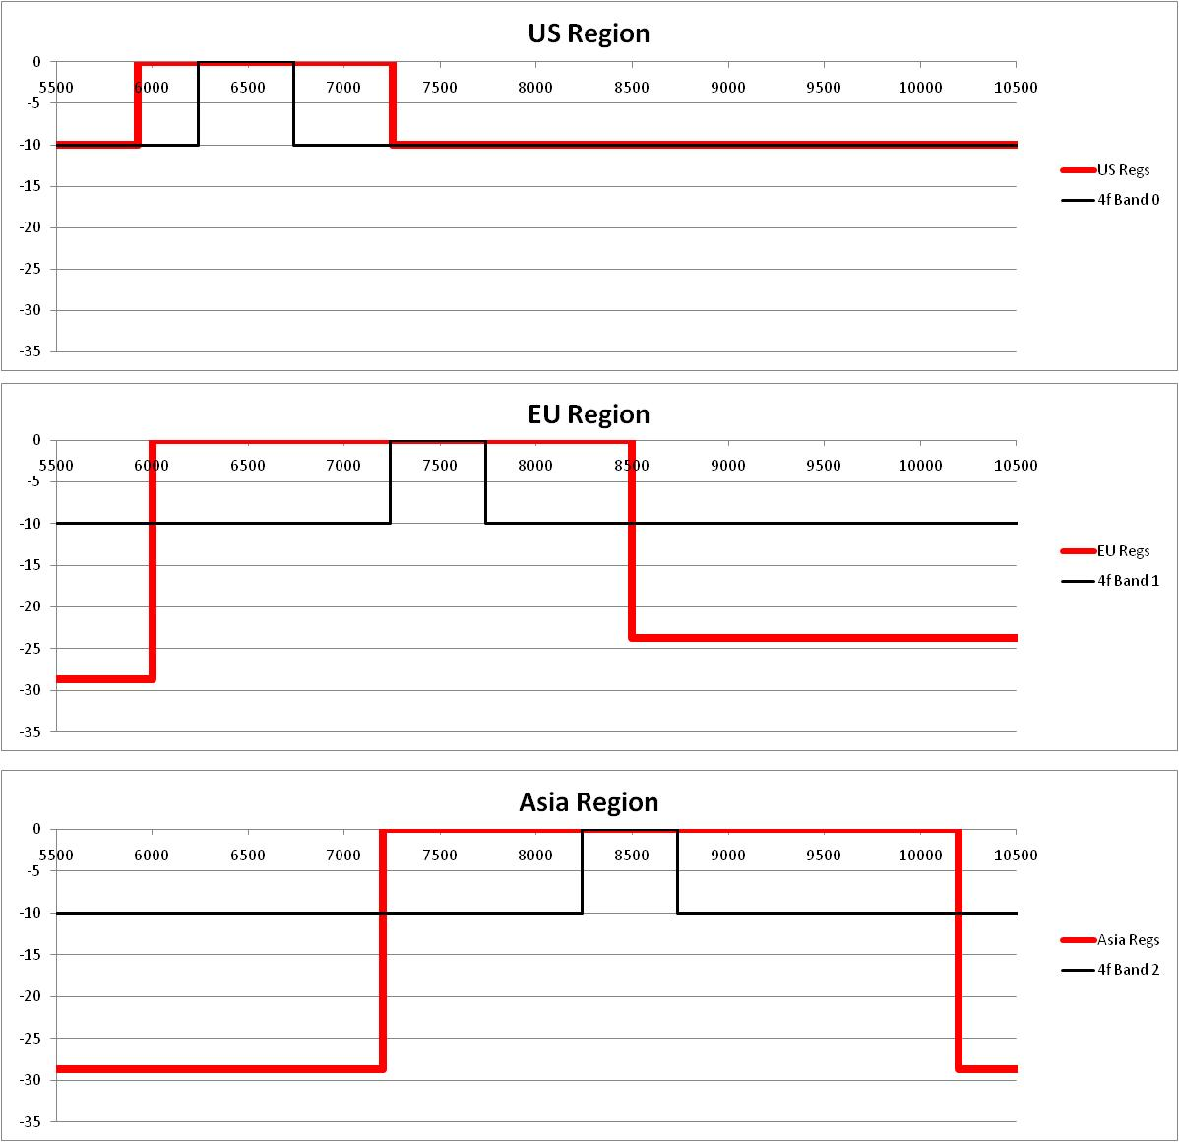
4f Band Plan – To Scale

Slide 9
Discussion: Regulatory Compliance
Each band fits easily within the corresponding regional spectrum regulations

Slide 10
Discussion: Implementation Cost
Bands are sufficiently far from deep European and Korean regulatory band edges so as not to require extra filtering on the tag
EU band is biased slightly higher to take further advantage of the slightly less deep upper regulatory band edge
1:1 correspondence with 802.15.4a band plan allows 4a RF silicon to implement 4f band plan without modification
An inter-region US/EU/China band is available but requires extra filtering on the tag

Slide 11
Discussion: 802.15.4a Consistency
The 4f band plan is 100% consistent with the 4a band plan
  Same center frequencies as 4a channels 7,8, and 10
  Same 499.2 MHz bandwidth as defined in 4a
The mandatory 4a channels are avoided to further help interoperability

Slide 12
Discussion: Industry Best Practice
Of the 13 existing, certified tags surveyed
  7 already fill 100% of the proposed band plan
  10 already fill >80% of the proposed band plan
  Only minor modifications are required for all 13 to fill 100% of the band plan with no tag cost impact
Of the 2 inter-region tag concepts proposed
  1 occupies 78% of Band 0
  1 occupies 58% of Band 1
  Neither occupies any of Band 2
Bands allow sufficient space to deploy systems with significantly higher bandwidth than the 499.2 MHz minimum

Slide 13
Inter-Region Tags Break 4a Convergence
The inter-region concept tags are not compatible with the goal of 4a convergence for China/Korea tags
In order to accommodate these tags and maintain 4a convergence, the 4f band plan would have to be altered as follows:
4f Band | Current 4a Band | New 4a Band
0 | 7 | 7
1 | 8 | 7
2 | 10 | 8
This would make 4f a two band standard, but see next slide

Slide 14
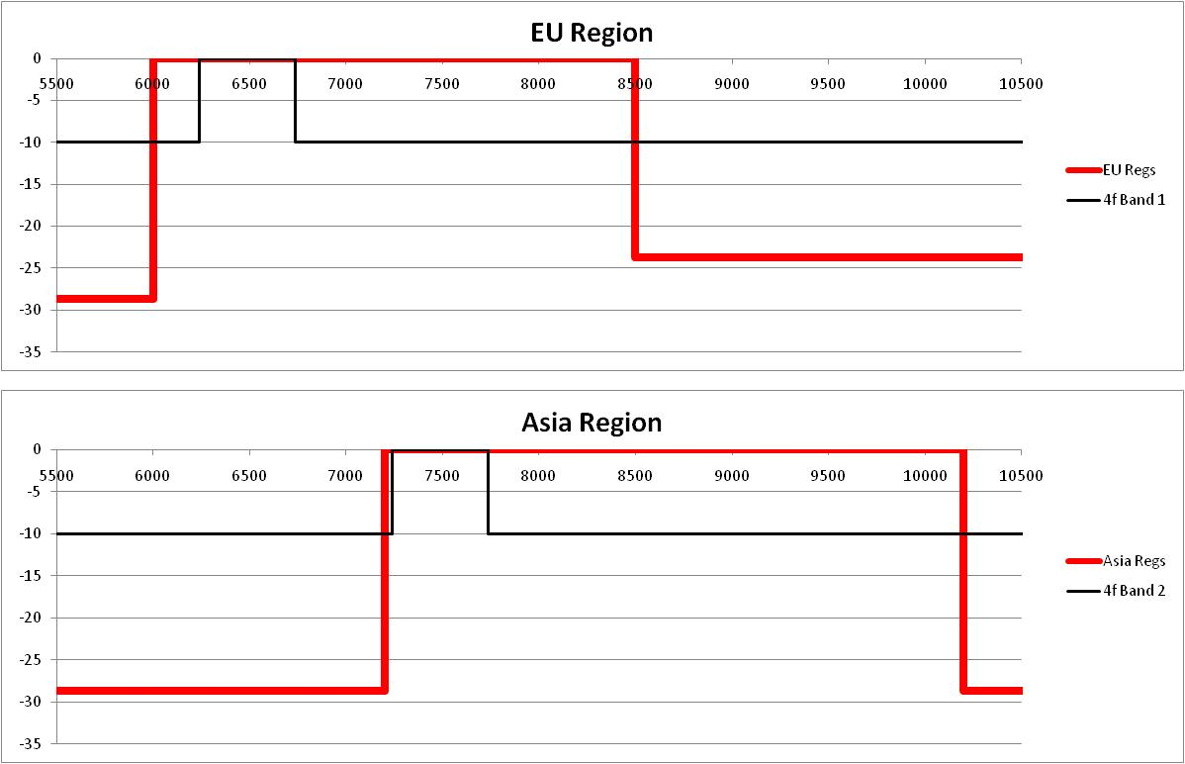
The Trouble With The 2 Band Option
Very close to the deep regulatory band edge but possible using spectral filtering
Impossibly close to the deep regulatory band edge.

Slide 15
Summary
The proposed band plan is the best compromise meeting most desired outcomes:
  Global regulatory compliance
  Enables very low cost tags
  100% convergence with 4a
  Inter-region band for US/EU/China
  Inter-region band for US/EU/Korea (using DAA in EU)
  Excellent agreement with best practice
The band plan does not accommodate the inter-region tags for China/Korea
  It is not possible to do this and maintain 4a convergence
  We must decide which is more important
    4a convergence, or
    Inter-region tags for China/Korea

Slide 16
Band Plan In Brief
Band Plan Summary
4f Band | Complementary 4a Channel | Center Frequency (MHz) | 10dB Bandwidth (MHz)
0 | 7 | 6489.6 | 499.2
1 | 8 | 7488.0 | 499.2
2 | 10 | 8486.4 | 499.2
Regions Covered
4f Band | US | EU | China | Korea
0 | ✓ | ✓ | ✓ | -
1 | ✓* | ✓ | ✓ | -
2 | ✓* | ✓** | - | ✓
* Two-way only, using 2.4 GHz side channel
** Using Detect and Avoid (pending ratification)

