Slide 1
Project: IEEE P802.15 Working Group for Wireless Personal Area Networks (WPANs)
Submission Title: [Low Energy Critical Infrastructure Monitoring]
Date Submitted: [January 2010]
Source: [Johan Becker, Mike Calcagno, David Howard] Company: [Amplex, Inc., Sempra Energy, On-Ramp Wireless, Inc.]
Address: [10920 Via Frontera, Suite 200, San Diego, CA 92127 USA]
Voice: [+1 858-592-6008], FAX: [+1 858-592-6009], E-Mail: [david.howard@onrampwireless.com]
Abstract: [This presentation contains the material related to the panel presentation at WNG]
Purpose: [For information]
Notice: This document has been prepared to assist the IEEE P802.15. It is offered as a basis for discussion and is not binding on the contributing individual(s) or organization(s). The material in this document is subject to change in form and content after further study. The contributor(s) reserve(s) the right to add, amend or withdraw material contained herein.
Release: The contributor acknowledges and accepts that this contribution becomes the property of IEEE and may be made publicly available by P802.15.

Slide 2
Low Energy Critical Infrastructure Monitoring
Addressing assets and infrastructure essential for the functioning of a society and economy
  Water supply, energy production and distribution, agriculture, transportation, security services, bridges, levees, etc.
  More at http://en.wikipedia.org/wiki/Critical_infrastructure
Why is monitoring needed?
  Preventive maintenance: repairs can be scheduled, costs are reduced
  Safety: prevention of catastrophic failures, environmental damage, hazardous leaks/spills
  Reliability: reduces outage and speeds restoration of service
  Cost reduction through improved operations and efficiency
Applications represent billions of endpoints which cannot be cost effectively addressed by existing technologies

Slide 3
Critical Infrastructure Application Overview
Infrastructure
Monitoring
Transportation & Asset tracking
Security &
Life Safety
Water leak detection
Sewer monitoring
Bridge/structural integrity monitoring
Streetlight control systems
Fault Circuit Indicators
Soil monitoring
Oil & gas pipeline monitoring
Public transport tracking
Cargo container monitoring
Railroad condition monitoring
Traffic congestion monitoring
Gas/hazardous material detection
Perimeter security
Border surveillance
Medical alert for at-risk populations
First responder tracking
Small data packet, widely dispersed endpoints or hard to reach locations, high capacity, battery operated applications requiring a secure, reliable and cost effective wireless network

Slide 4
User Case
Sempra Energy
Mike Calcagno
Distribution Fault Current Indicator
Substation Monitoring

Slide 5
SDG&E Background
3,300,000 population in territory
700,000 gas meters
> 60 % underground infrastructure
1,400,000 electric meters
Significant IT programs
  OpEx 20/20 – leveraging technology
  VoIP
  Wide-area network rebuild – TDM to IP/MPLS
  LAN rebuild
  Wireless wide area network rebuild

Slide 6
Sample of Wireless at SDG&E
System | Purpose | Frequency | Scope
SCADA | Distribution monitoring and control | 900 MHz MAS | 1500 RTUs
DataTac | Mobile Data | 800 MHz | 400 MDTs
Smartzone | PTT mobile voice | 900 MHz | 2000 units
Wirestring radio | Tactical field use | 450 MHz | 1000 units
Satellite links | Emergency comm | 12 GHz | 5 quick deployment
WiFi | LAN | 2.4 GHz | Offices
Commercial | Remote access | Various | 16,000

Slide 7
Gaps In Technology
Point to multi-thousands of point communications
Relatively small amount of data
Latency in seconds
Ability to operate without primary power
Minimal network complexity and number of active nodes
Standard network interface – IP
Standard device interface – Serial or IP
Available embedded through an OEM
Easily deployable
Able to communicate to underground assets
Addresses spectrum issues

Slide 8
Target Use Cases at SDG&E
Fault Current Indicators
  In the tens of thousands
  Overhead and underground
  Monitor state, possibly number of events
Distribution Transformers
  In the hundreds of thousands
  Voltage and current, power out
Monitoring Remote Terminal Units
  Condition based monitoring
  Improve outage resolution

Slide 9
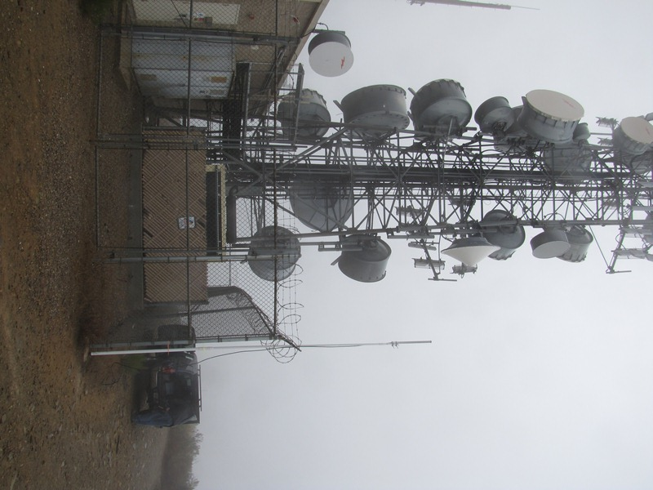
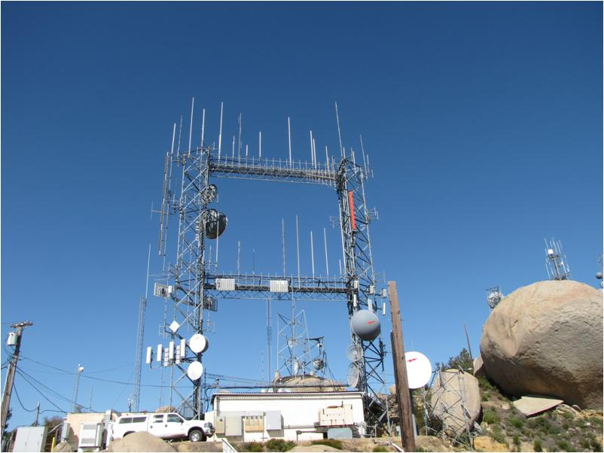
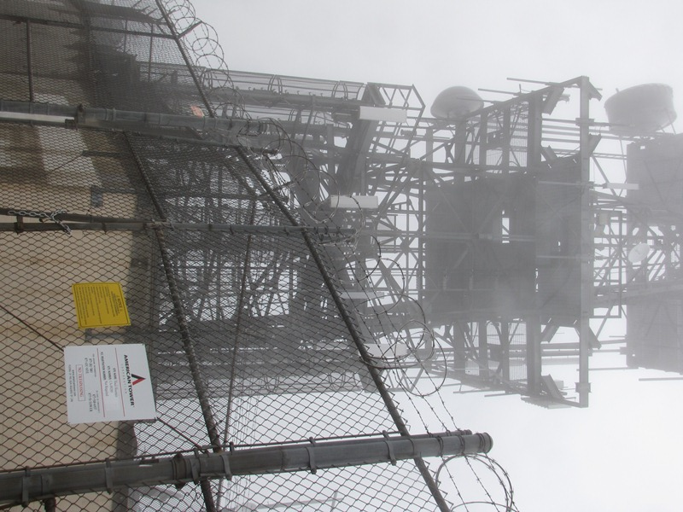
SDG&E Territory: Examples
Tower Shared Space / High Interference

Slide 10
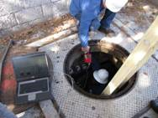
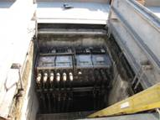
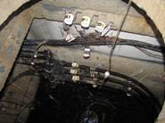
SDG&E Territory: Examples
FCI: Below Ground Deployment

Slide 11
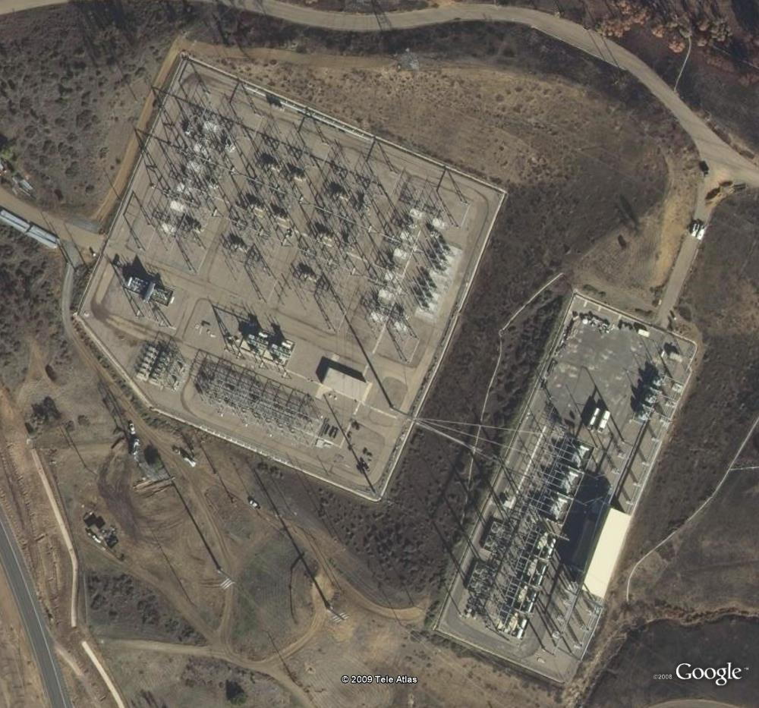
SDG&E Territory: Examples
Substation Monitoring: 500 KV / 230 KV

Slide 12
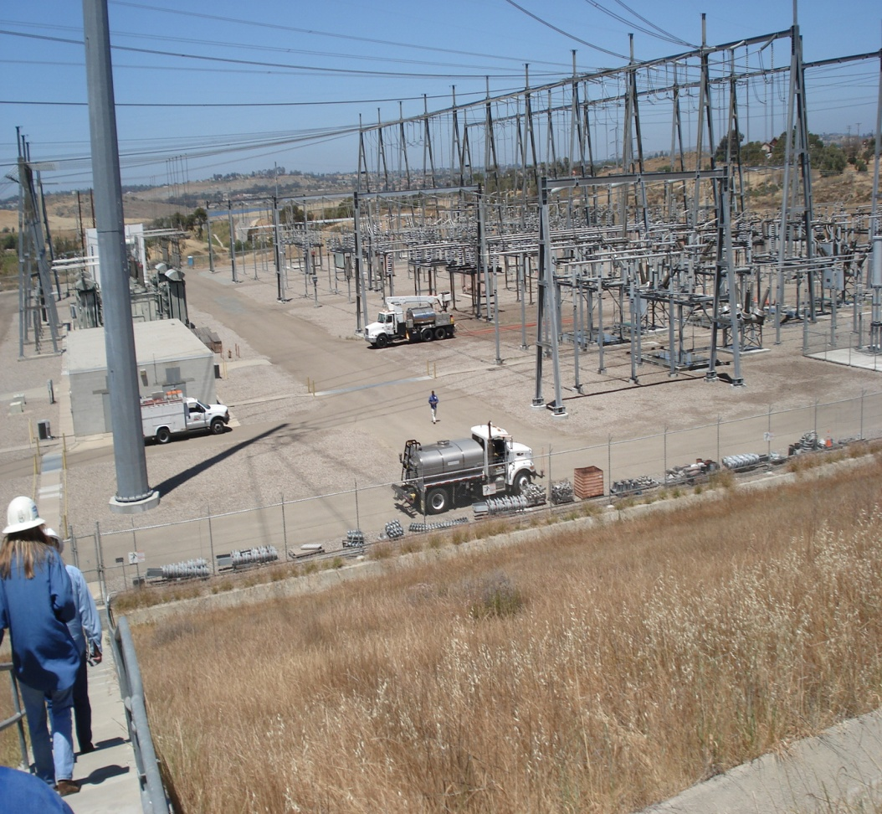
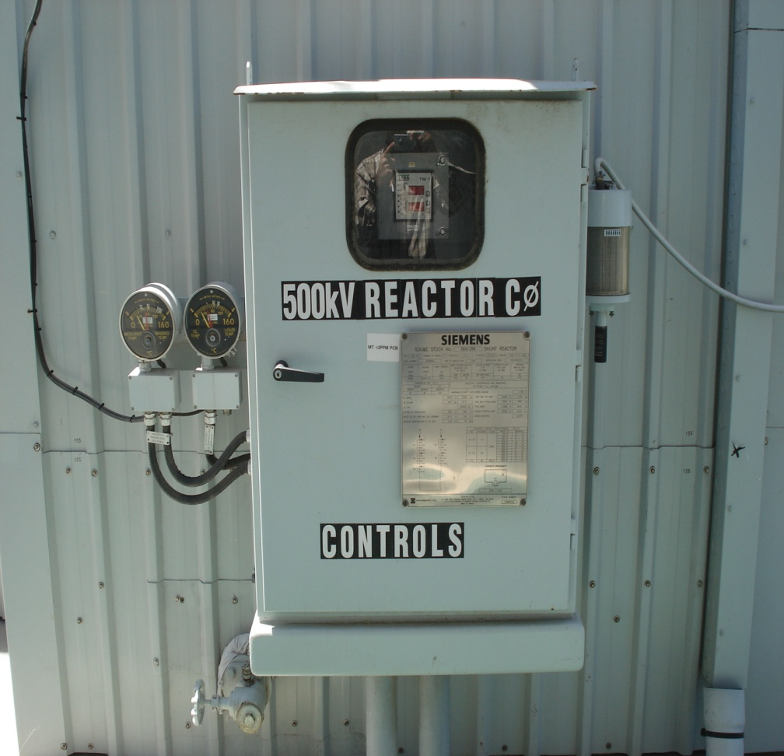
SDG&E Territory: Substation Monitoring
Harsh Environment
Inside Metal Cabinets

Slide 13
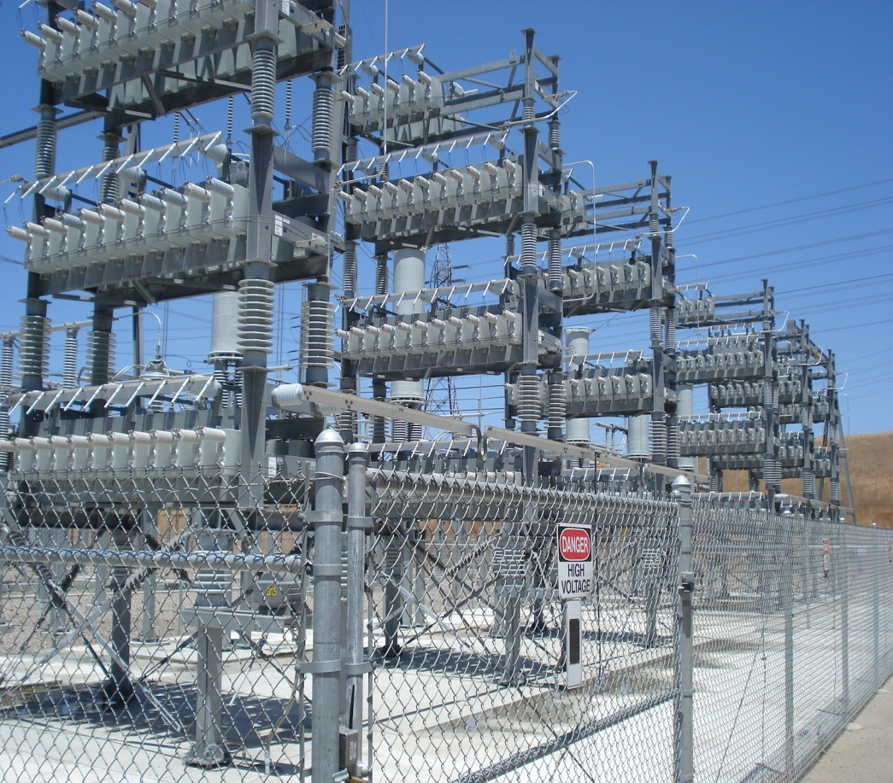
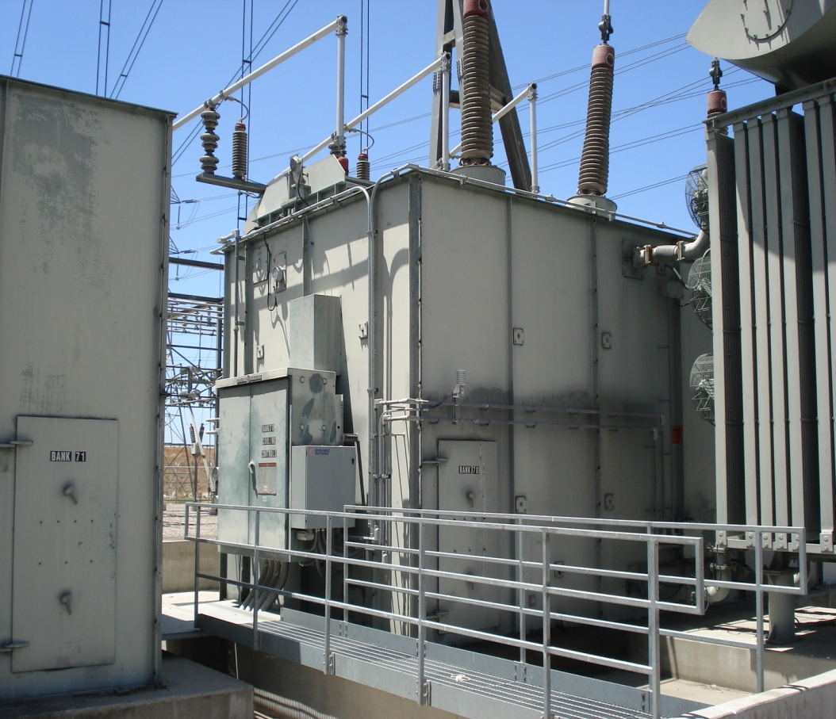
SDG&E Territory: Substation Monitoring
Harsh Environment: 230 KV

Slide 14
User Case
Amplex Inc.
Johan Becker
Water Leak Detection

Slide 15

Water Leakage Detection
Next generation water leak detection system

Slide 16

Water is an expensive scarce resource
Water resources are often found far away from where it is being used
  Water must be transported from supply to consumer
  Fresh water produced at desalination plants
Global problem
  California has put restrictions on water usage
  Australia is transporting water by trucks to dry regions.
  Within the European Union it is estimated that 11% of the population and 17% of the area has limited water resources
  Mediterranean countries are highly dependant on rainfall (Cyprus needed to ship in water in 2008)

Slide 17
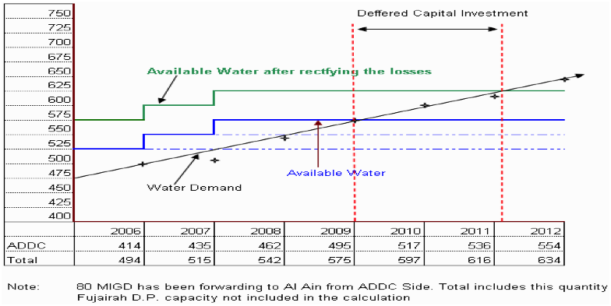
Case example - United Arab Emirates
ADDC provides 375 million gallons of water per day. Fresh water is produced at a desalination plant and transported to consumer
Demand for water is increasing in UAE. New desalination plants are being built and existing ones enlarged.
Pilot project screening 207 km of distribution pipe. 460 leaks were detected, equal to 17% loss of water.
Projecting this number to the entire distribution network, loss of water could be approx. 65 million gallons per day
(USD 9.5 million).
By detecting and repairing the leaks investments in new plants can be delayed by 2 years.

Slide 18
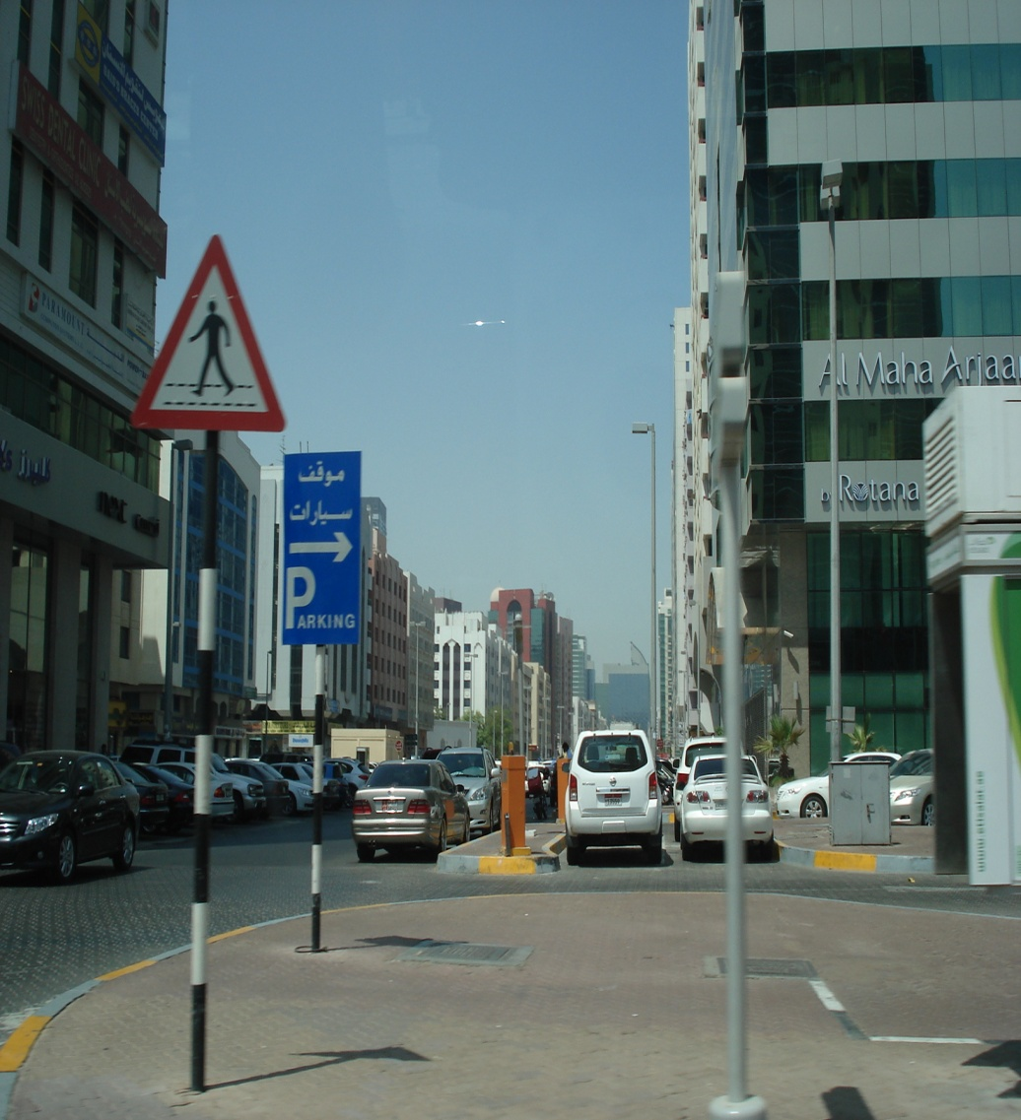
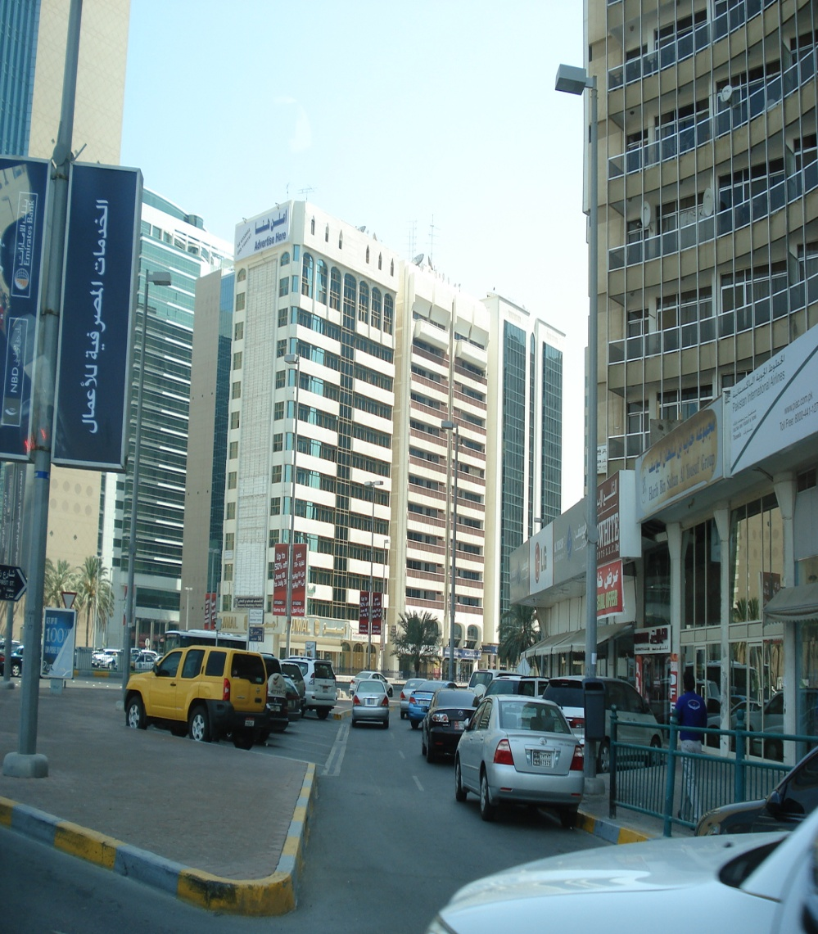
Case example - United Arab Emirates

Slide 19
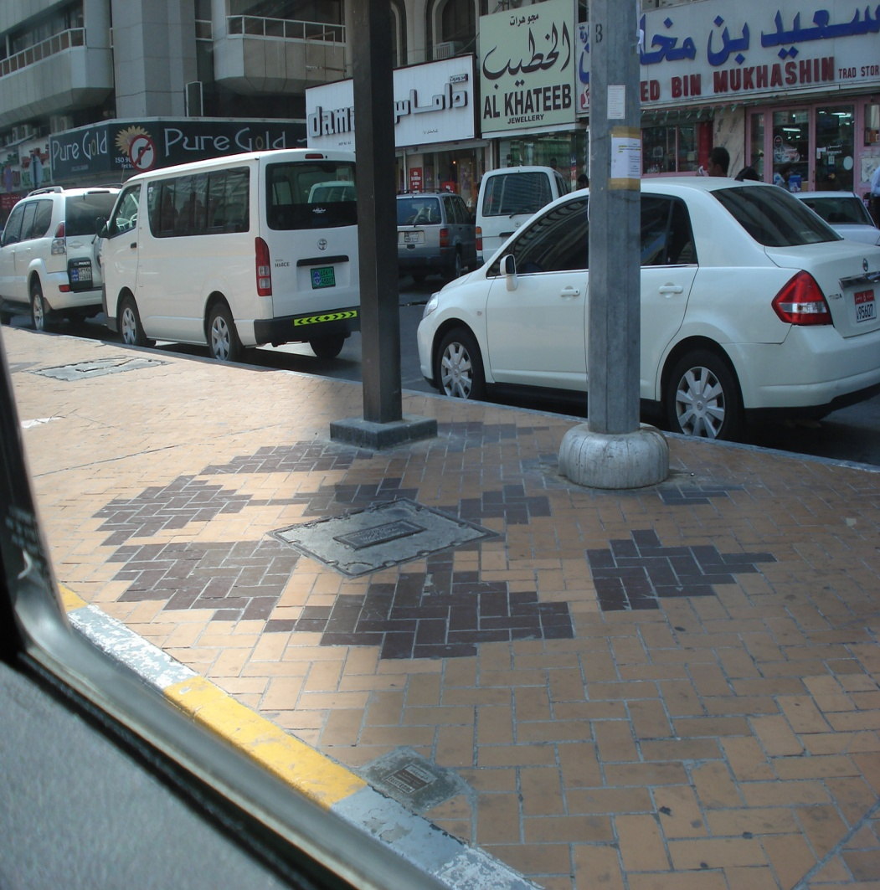
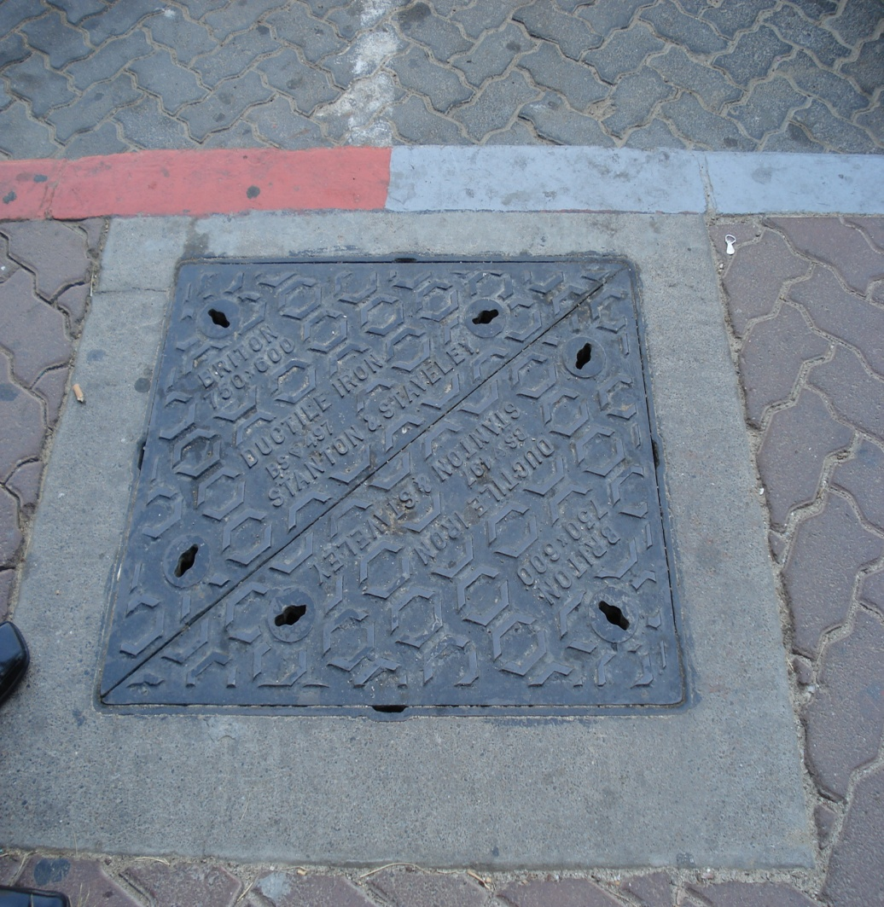
Case example - United Arab Emirates

Slide 20
Traditional leak detection method take time and resources
Distribution Area
Divide distribution area into smaller and easier controlled areas and install flow meters
Define baseline leakage and intervention trigger level
Increasing accuracy of pinpointing location of leaks
Increasing time and resource consumption
Monitor monthly average flow in each area; prioritize according to water loss
Carry out Active Leak Detection in identified area
… and in the meantime water is wasted

Slide 21
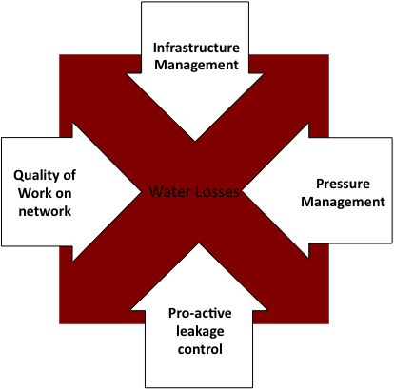
Leak detection is difficult underground
Large leaks are often visible on the ground
Small leaks often can run for a long time and waste more water. Pro-active approach to leakage detection is necessary in order to find small leaks
Traditional leak detection requires resources in the field
  Leakage engineer listens to pipes. When a leak appears, there is a noise from water passing the damaged piece of pipe
  Leakage engineer creates report and leakage team is sent out in the field to identify exactly where the leak is so that a repair team can fix the pipe

Slide 22

Noise loggers exist but have challenges
Replaces human listening for acoustic signals
Temporarily installed on pipes (lift and shift), every 150 yards, one week per site
Manpower collects information from noise loggers
  Radio signals with drive-by solution (require manpower and only once a day)

Slide 23
Solution: Underground installation of logging systems that can be remotely monitored
Key Requirements
Permanent installation of large number of sensors underground
Long range and ability to penetrate underground vaults
Battery operated – long lifetime
  small data messages once per day and in case of alarm event (leak detected)
Low installation cost (easy deployment), and low cost of maintenance
Severe environments put demands on the noise logger equipment
  Pump station, heavy traffic, house connections, connected pipes, etc. make noise

Slide 24
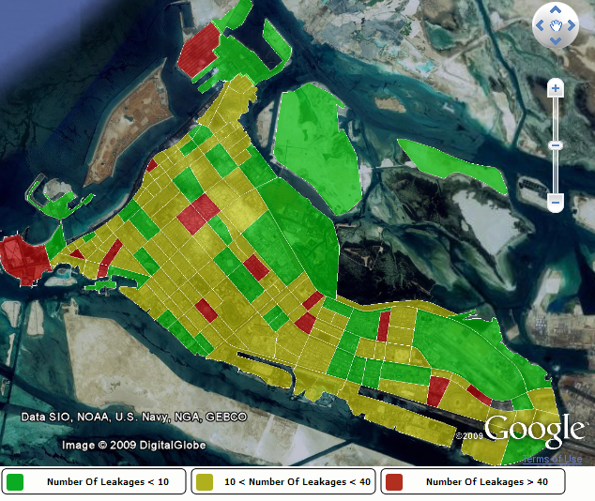
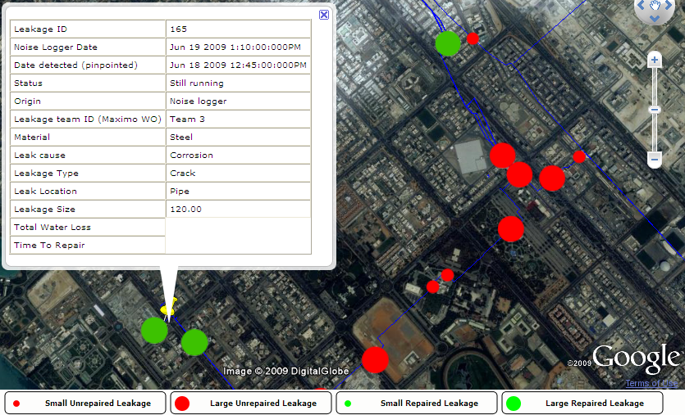
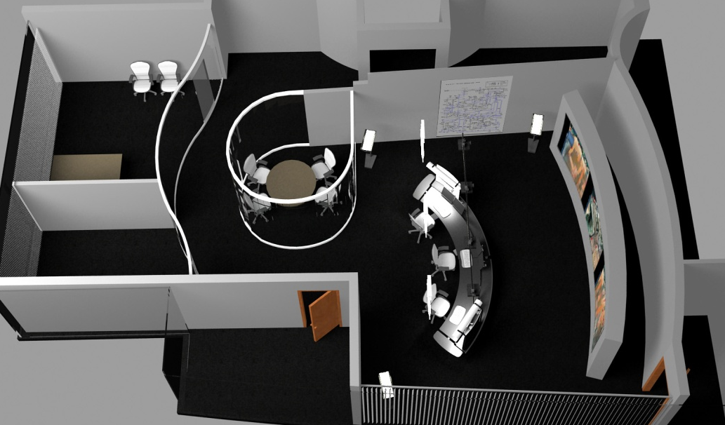
Control room

Slide 25
Low Energy
Critical Infrastructure Monitoring
Why New Standards Group?
David Howard

Slide 26
Application requirements
Mains power rarely available
  Battery operation (up to 20 years) – low energy consumption
  Low duty cycle
Low node density
  long range
Hard to reach locations(i.e. at or underground, in building, in cabinet/vault)
  Large link budget, low receive sensitivity
Large number of endpoints
  high capacity uplink
  Broadcast/multicast capability

Slide 27
Application requirements
Mobility
  Asset tracking
  Dynamic fail-over
Worldwide use
  Operates in all regulatory domains
  Low transmit power compliant with international regulations
Low cost
  Low operational cost: unlicensed, lightly licensed spectrum
  Low infrastructure, maintenance , and system cost
  Ease of deployment

Slide 28
Existing Architectures
Satellite link
  high power
  high cost
  subscriber fees
Cellular
  high power
  coverage
  subscriber fees
Wireless SCADA
  high unit, and installation costs
  limited capacity
  high power
  proprietary

Slide 29
Existing architectures (continued)
IEEE 802 Wireless
802.11 WLAN
802.15 WPAN
802.16 WMAN
802.20 MBWA
802.22 WRAN

Slide 30
802.11/ Wi-Fi - WLAN
Optimized for computing (and smart phone) applications demanding high data rate, high duty cycle, and high performance in areas such as QOS and roaming
Local area coverage (hot spots)
High power, not suitable for multi year battery life
Notes:
Infrastructure costs

Slide 31
802.15.1/3/4f/6/7 - WPAN
15.1 - Bluetooth
  Short range
  Low capacity
  focused on apps of multimedia and regular recharging (days between charges)
15.3 - High Rate (multi-media)
  Short range
15.4f - RFID
  focus is for very low cost with no mechanisms to enhance range
15.6 - Body Area Network
  ‘short range, wireless communication in the vicinity of, or inside, a human body (but not limited to humans)’
15.7 - Visible Light Communications
  ‘short-range optical wireless communication using visible light.’

Slide 32
802.15.4/4g – WPAN
15.4-2006
15.4g Smart Utility Network
Unlicensed spectrum
Low complexity
Compatible data rates
Not designed for outdoor propagation environment
Short range
Requires powered network infrastructure to extend range
Low capacity of nodes per collector
Neighborhood area range
Higher data rate per node
Higher power consumption
Focused on forming connectivity for electric meters
System trade-offs make use of fact that mains power is available for most end nodes
Uses mesh for range enhancement
Large payload

Slide 33
802.16/20/22 – WMAN/MBWA/WRAN
802.16 Metropolitan Area Network
  Broadband Wireless Access Working Group
802.20 Mobile Broadband Wireless Access
802.22 Wireless Regional Area Network
  Designed for broadband - high data rate
  Architectural Complexity
    Infrastructure based architecture
  High cost
  Infrastructure intensive
    Deployment cost and complexity
  High power (“cell phone battery life” .16m)
  Medium capacity (users)

Slide 34
Conclusions
Low Energy Critical Infrastructure Monitoring needs a standard solution
Application requirements for critical infrastructure monitoring
  Low energy
  Low data rate, payload and duty cycle
  Low cost infrastructure and endpoints
  Low maintenance
  High link margin for challenging environments and long range
Application space is not well served by any existing or planned standards
802.15 family is the right place to begin investigating new group
  Good fit for application space
  Good fit for data rates and complexity
  No overlap with existing or planned PHY standards

Slide 35
Low Energy
Critical Infrastructure Monitoring
Q&A

Slide 36
Appendix:
User Case
Upland Consulting
Oil and Gas Pipeline Monitoring

Slide 37
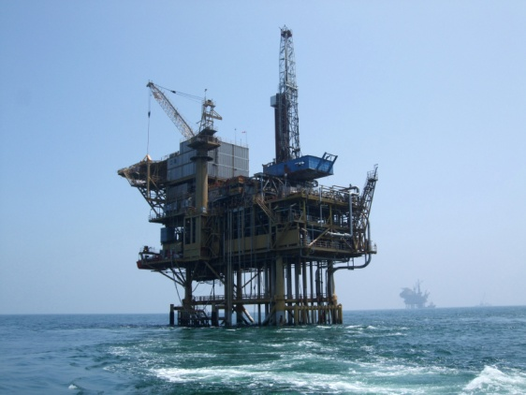
Oil and Gas Pipeline Monitoring
Deployment environment
City, urban, suburban, undeveloped and very remote areas
Critical infrastructure:
  supply of energy resource
  high risk for damage to people and environment
Need to protect and monitor pipelines
for failures, damage and theft
Corrosion, flow, pressure, temperature,
vibration

Slide 38
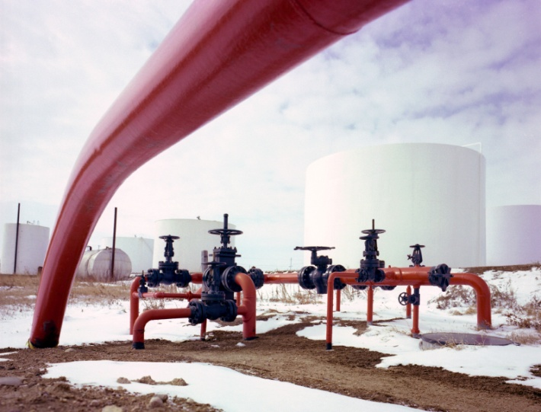
Oil and Gas Pipeline Monitoring
The Market
25 million unit estimated Total Potential Market for wireless sensors in Oil & Gas [ONWorld Research, 2008]
Key drivers of pipeline monitoring
  Safety (human / environment)
  Reliability (critical resources)
  Cost savings (increasing cost)
  Compliance (regulators)

Slide 39
Shell Petroleum Development Company of Nigeria (SPDC)
SPDC network 6,000 km of pipelines, flow-lines, manifolds, flow-stations and gas plants
Major challenge is to monitor this vast pipeline network for various incidents of spills due to
  Pipeline sabotage
  Vandalism
  Other security related issues
Results in increased operational costs, lost revenue and damage to corporate image

Slide 40
Key Drivers of Monitoring System
Reduction in Hydrocarbon loss as response time is substantially reduced and the station is shutdown as soon as it is spill is observed
Environmental impact of the spill is substantially reduced, as damage area will be less
Reduction in cost of remediation
Due to the proactive response media communication is better co-ordinated and managed hence protecting Shell corporate image

Slide 41
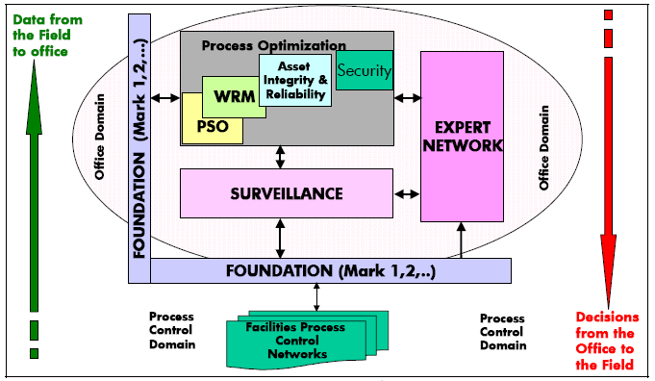
Remote Operations Framework
Source: Shell EP ROCI newsletter July/August 2007

Slide 42
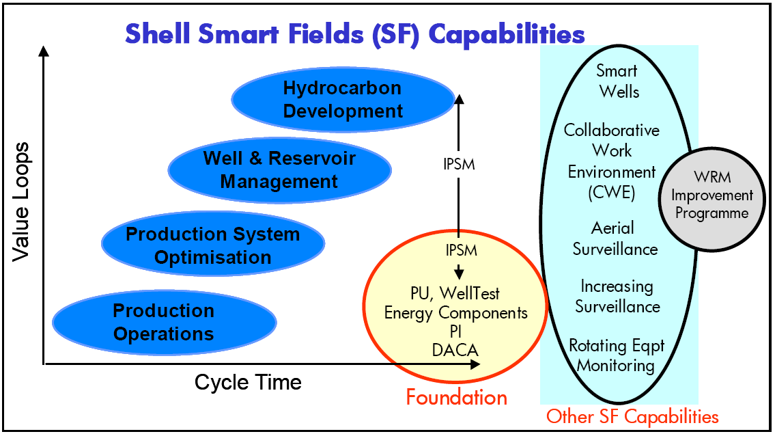
Smart Fields Capabilities
Source: Shell EP ROCI newsletter July/August 2007

Slide 43

Oil and Gas Pipeline Monitoring
Summary of Application Requirements for Wireless Monitoring
Remote Area with Challenging Environment need to be covered
No powered infrastructure available
Very long distances over
non accessible terrain
High sabotage and vandalism rate
→ small and low profile devices
Low to no maintenance required
Simple and easy installation

