Slide 1
Project: IEEE P802.15 Working Group for Wireless Personal Area Networks (WPANs)
Submission Title: [DecaWave PHY Proposal]
Date Submitted: [16th Nov 2009]
Source: [Michael Mc Laughlin]
Company [DecaWave Limited]
Address [Digital Depot, Thomas Street, Dublin 8, Ireland]
Voice:[+353-87-688-2514 ] Fax:[What’s a fax?] E-Mail:[michael.mclaughlin@decawave.com]
Re : [Response to Call for Proposals]
Abstract:[Summary of DecaWave PHY Proposal]
Purpose:[Introduce IEEE 802.15.4f TG meeting attendees to DecaWave’s proposal for a PHY for
802.15.4f active RFID]
Notice: This document has been prepared to assist the IEEE P802.15. It is offered as a basis for discussion and is not binding on the contributing individual(s) or organization(s). The material in this document is subject to change in form and content after further study. The contributor(s) reserve(s) the right to add, amend or withdraw material contained herein.
Release: The contributor acknowledges and accepts that this contribution becomes the property of IEEE and may be made publicly available by P802.15.

Slide 2
Proposal for 802.15.4f
Use UWB PHY from 802.15.4a as the PHY layer for 802.15.4f
Instead of 8GHz mandatory high band make either 6.5GHz or 8GHz mandatory for high band modes, depending on national availability.
Make COOK (Annex H of 15.4a) mandatory in a 15.4f receiver
Incorporate known 802.15.4a errata (15-07-0666-01-004a-802-15-4a-2007-errata-DRAFT.doc)
Add new one-way messaging capability to the MAC or clarify how the existing MAC can be used for this.

Slide 3
IEEE 802.15.4a Standard
"An international standard for an ultra-low complexity, ultra-low cost, ultra-low power consumption alternate PHY for IEEE Std 802.15.4.”
802.15.4a
Baseline: Q1 ’05
Completed: Q4 ’06
Ratified: Q1 ‘07
802.15.4a
Ratified Q1 ‘07
Up to 27 Mbps,
with location & mobility
Location,
Communication,
Control
IEEE Standard
Capability
Utility

Slide 4
Summary of 802.15.4a- UWB I
Ultra-Wideband alternative PHY for 802.15.4
Advantages vis-à-vis 15.4:
  Lower power
  Better multipath immunity
  Precision RTLS capable
  High Data rates
    Allows shorter packets, higher tag density, even lower power
Bitrates
  110kbps, 850kbps, 6.8Mbps, 27Mbps
Pulse Repetition Frequencies
  4MHz, 15.6MHz, 62.4MHz
Modulation scheme
  Burst position modulation with BPSK
FEC Scheme
  Systematic Convolutional Code
  Reed Solomon code

Slide 5
Summary of 802.15.4a- UWB II
Ideal channel sounding preamble
  Periodic autocorrelation is an impulse or kronecker delta function
Bandwidth
  500MHz, 1100MHz or 1300MHz
Channels
  15 channels from 3GHz to 10GHz
Designed to be usable for one-way or two way ranging
Complexity choice for receiver
  coherent or non-coherent demodulation
  FEC can be ignored by receiver
Complexity choice for transmitter. Either:
  Pseudo Random Burst of Bipolar Pulses
    Allows Coherent Decode
  Spurge of Energy whose position is determined by data (C.O.O.K.)
    Only Non-coherent Decode

Slide 6
Coherent Link Margin and Range: Tag to Reader

Slide 7
Coherent Link Margin and Range: Reader to Tag

Slide 8





Bandplan Facilitating WorldWide Deployment
15
Double-ended arrows
show allowed UWB frequency
bands in various regions.
LDC = low duty cycle
i.e. infrequent TX
14
Pink and purple
lines show the .4a defined
frequency channels
and bandwidths
13
12
11
10
9
8
802.15.4a UWB Channel Number
7
6
5
4
3
2
1
0
0
1000
2000
3000
4000
5000
6000
7000
8000
9000
10000
Frequency, MHz
North America
USA indoors and out
Europe
Europe with LDC
China
Japan @ >50Mbps
Japan until end 2010
Korea
Korea with LDC
China
.4a 500MHz
.4a >1GHz
802.15.4
Notes:
8

Slide 9
COOK Transmitter option
Many of the original companies who worked on 802.15.4a wanted a way to do a simple OOK transmitter and receiver.
A joint contribution was submitted by a group of these companies, including Samsung and ETRI. The full contribution can be downloaded from the IEEE website:
15-05-0132-03-004a-merged-proposal-chaotic-uwb-system-802-15-4a.pdf
The task group listened to their concerns and the result was Annex-H of 802.15.4a.
This defines an optional OOK type modulation

Slide 10
802.15.4a Annex H: COOK option
Extract from 802.15.4a:
“Another noncoherent optional pulse shape that may be used is a chaotic waveform. This optional pulse shape shall be used only when all other devices within the PAN are using a chaotic pulse. This mode can be used for low-power applications where long battery life is critically important.
Since chaotic on-off keying (COOK) is noncoherent modulation, the receiver does not need to generate a corresponding chaotic signal for demodulation. For that reason, the technique chosen for generating a chaotic waveform can be freely determined by implementers.”
For 15.4f, make it mandatory that all receivers must be capable of receiving a COOK type signal

Slide 11
Benefits of COOK
The UWB transmitter can be implemented with a few discrete components
Instead of a coherent burst of pseudo ransom pulses with a predictable pattern that the receiver can compare with, in Annex H, the transmitter just sends a burst of energy in the band of interest.
The beauty of Annex H from a non-coherent OOK point of view is that it doesn't matter what type of energy you send. The receiver is not expecting a coherent signal. Although it is referred to as a chaotic signal, it can be anything at all. The implementer decides what to generate and how to generate it.
This allows a conventional 4a transmitter to transmit a coherent train of pseudo random pulses, but also allows, for example, a COOK transmitter, which works directly in the band of interest, to just send a spurge of energy.
This system has precisely the same performance as conventional OOK for the same average transmit power
Because regulations limit the power of the worst case data packet, COOK has a 3dB advantage over OOK in practice

Slide 12
IC Friendly PRFs are required
802.15.4f will need to be implementable by a CMOS integrated circuit to service large volume markets
To “fill-out” a 1 GHZ wide UWB spectrum at 15.6MHz PRF, requires a 1.9 Volt supply
To “fill-out” a 1 GHZ wide UWB spectrum at 2MHz PRF, requires a 4.3 Volt supply
To “fill-out” a 1 GHZ wide UWB spectrum at 1MHz PRF, requires a 5.7 Volt supply
1 or 2 MHz PRFs require high voltages that are not friendly to small geometry CMOS ICs

Slide 13
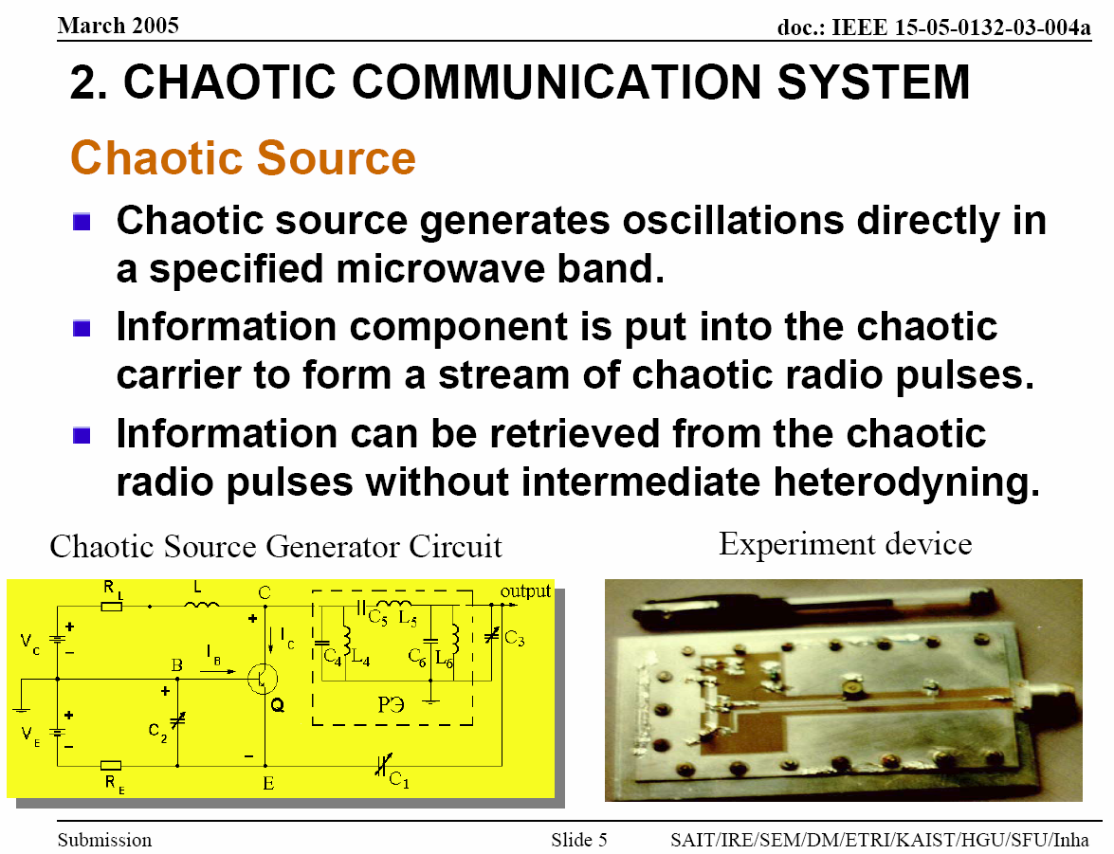

Slide 14
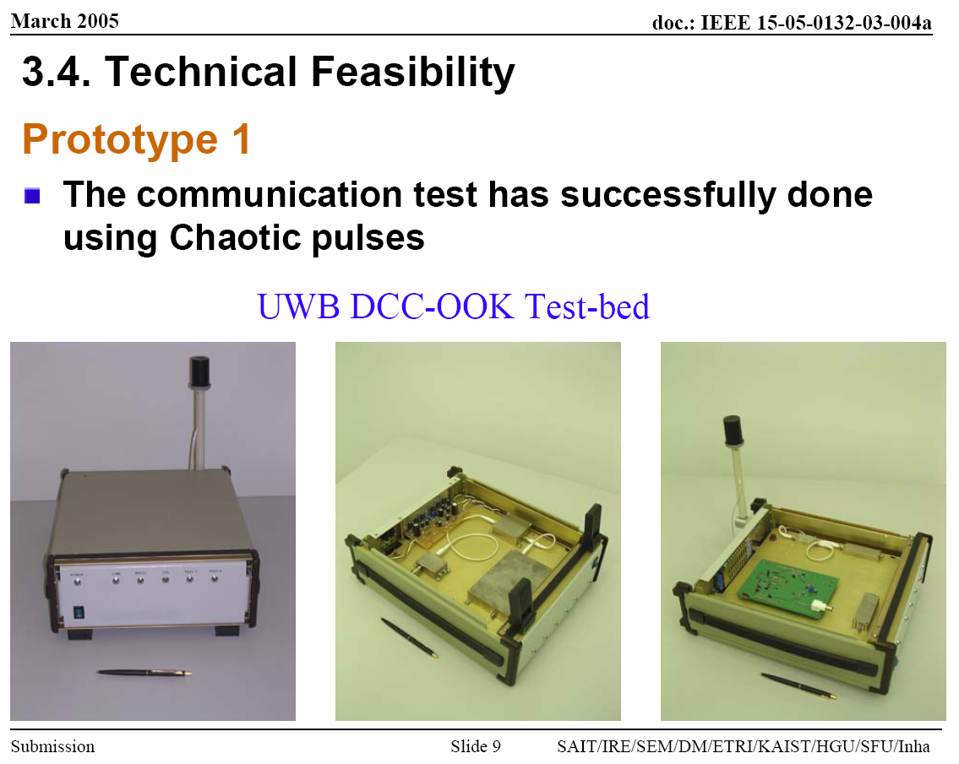

Slide 15
In brief
IEEE802.15.4a-UWB is an extremely low complexity ultra wideband communications and RTLS Standard
Tag to reader LOS distance of close to 1 km are possible
6.8Mbps data rate allows very short packets => large density, low power consumption
Many companies and individuals with wide-ranging expertise worked on 4a
  It has been scrutinised by many pairs of eyes
Non-coherent option enables ultra-low cost receiver implementations
Transmitter is very simple to implement
  COOK option can be assembled from readily available components
Coherent receiver option allows much larger range
    Complexity of RFID reader is usually less critical than tag
  15.6MHz PRF and higher are CMOS IC friendly

Slide 16
802.15.4f Proposal Summary
Use UWB PHY from 802.15.4a as the PHY layer for 802.15.4f
Make COOK (Annex H of 15.4a) mandatory in 15.4f receiver
  This will mean that all compliant receivers in any network are capable of communicating with a COOK transmitter

