Slide 1
Project: IEEE P802.15 Working Group for Wireless Personal Area Networks (WPANs)
Submission Title: ZES UWB PHY Proposal to 802.15TG4f
Date Submitted: 13 September 2009
Source: Tim Harrington Company: Zebra Enterprise Solutions Corp.
Address: 2858 De La Cruz Blvd., Santa Clara, CA 95050 USA
Voice: +1 408-845-8513, FAX: +1 408-845-8501, E-Mail: tharrington@zebra.com
Re: 802.15.4f Active RFID System Call for Preliminary Proposals and Final Proposals 15-09-0409-05-004f
Abstract: UWB Blink PHY proposal for 802.15.4f
Purpose: The information in this proposal is for consideration by 802.15TG4f for PHY layer of 802.15.4f
Notice: This document has been prepared to assist the IEEE P802.15. It is offered as a basis for discussion and is not binding on the contributing individual(s) or organization(s). The material in this document is subject to change in form and content after further study. The contributor(s) reserve(s) the right to add, amend or withdraw material contained herein.
Release: The contributor acknowledges and accepts that this contribution becomes the property of IEEE and may be made publicly available by P802.15.

Slide 2
802.15.4f PHY Proposal
Zebra Enterprise Solutions Corp.

Slide 3
Ultra-Wide RFID Band Use Cases
Asset Identification and Presence
  Traditional AIDC
Handheld Ranging
  “Geiger Counter” Asset Search
Real Time Locating System (RTLS)
  WIP location tracking
    Process Stepping
    Off-Line Tracking
  High-value asset location tracking
    Hospital instrumentation tracking
    High-value tool tracking
  Personnel tracking
    Personnel safety tracking
    Muster reporting

Slide 4
Additional Use Case Requirement
Support Portal / Chokepoint
  Requires Optional Low Frequency Interface
    ASK
    Magnetic Link
      Fast Drop-Off
        (Power Falls at 1/R⁶)
      Predictable Range
      Increased Resistance to Blockage
        Dense Non-Metalic Materials

Slide 5
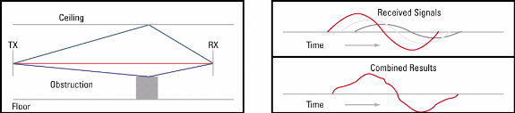
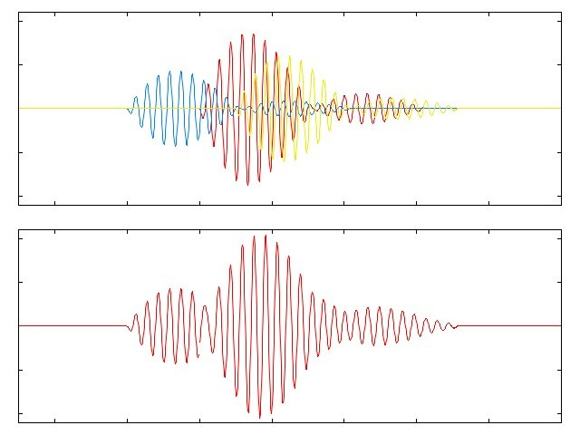
Multipath
The reflected RF waves travel farther and arrive later in time than the direct RF wave
The desired wave is combined with many reflected waves in the receiver
When the different waveforms combine, they cause distortion of the desired waveform and affect the decoding capability of the receiver. When the reflected signals are combined at the receiver, even though the signal strength is high, the signal quality is poor.

Slide 6
Multipath (cont.)
Time (microseconds)
Time (microseconds)
Transmitted Pulse
0
0.1
0.2
0.3
0.4
0.5
1.5
Leading edge of 1st
pulse readily detected
0
0.5
1
1.5
2
2.5
1
UWB
1
WiFi 802.11
0.5
0.5
Relative Amplitude
Relative Amplitude
0
0
-0.5
-0.5
-1
-1
Received Pulse
with multipath distortion
Received Pulse with multipath
(no pulse shape distortion)

Slide 7
UWB Phy Proposal Unique Characteristics
Designed for accurately locating assets
  Accurate to better than 0.1 m RTLS resolution
  Excellent performance in high multi-path environments
“Blink” Protocol for high transmission rate with long battery life
  Short messages (32 bit UID)
    Alternative UIDs of (48, 64 and 96 bits)
  Extremely low power required for transmissions
  1 Hz transmission rates yield 7 year battery life
Designed for global applicability
  5.5 GHz Center operates in USA/ EU Accepted 6 to 8.5 GHz ISM Band
  Expandable to add 7 GHz Mode with 2.5 GHz Optional Backhaul other reqions
Very Short Packets
  Allows discrete technology to discriminate thousands of tags per second in field of view
    Demonstrated with current technology to yield empirical evidence
    Higher sophisticated receivers could push even higher
    Protocol will not encumber future developments
  Translates to very High Tag Populations

Slide 8
New Frame Optimized for Blink Transmission

Slide 9
New Frame Optimized for Blink Transmission

Slide 10
UWB Regulations Vary Greatly By Region
Greatest common Denominator:
  6 GHz to 8.5 GHz
  Common to EU, USA, Canada, China
“Blink Only” Protocol
  USA Wideband: Part 15.250
  EU: ETSI Draft 302 500
400 MHz Bandwidth
  Meet Accuracy Requirements in Common Band
Anticipate Elimination of Acknowledge Requirements
  Not Required for Low Duty Cycle RFID

Slide 11
Optimized Data Rate for RFID/RTLS
Simplicity is Key
  Low cost to manufacture
  Should not require custom chip
  Allows Small size
1 Mps
  Long Range with High Energy per Bit
  Low Cost COTS Components
  Maximum Power Efficiency
    Allows 4 MHz Crystal

Slide 12
Link Budget
(Po+G1) + G2 + L -NF - M - N0 = 20log(R)
where:
Po = transmit power
G1 = transmit antenna gain
G2 = receive antenna gain = 8dBi for a mid gain
L = 20log(lambda/(4pi)) = -48.76
NF = 1dB
M = Margin (15dB)
N0 = noise power at 400MHz = -88dBm
and regulatory limits constrain (Po+G1) to be 18dBm.
R = 289.7M = 950 Ft.

Slide 13
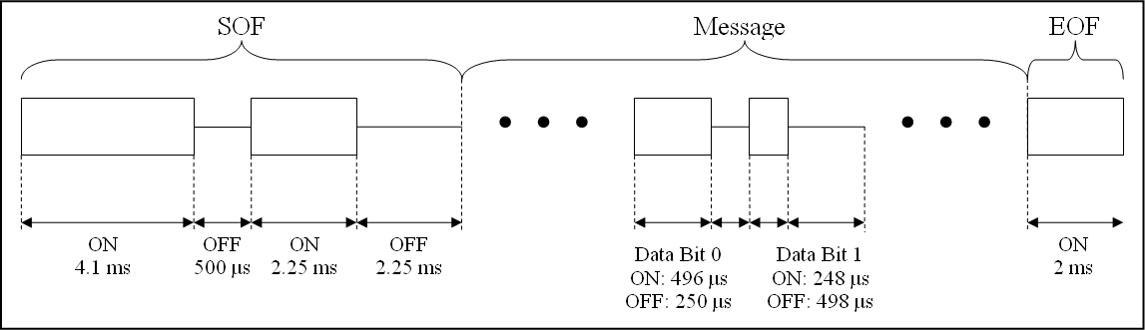
ASK Modulation Timing
Utilizes single IC, low power COTS receiver
Start-of-Frame (SOF) requires specific sequence of pulses to prevent waking up microcontroller due to noise or unwanted input signals when using the COTS receiver
Message data can be nearly any desired length
End-of-Frame (EOF) allows for simple message termination

Slide 14
LF Magnetic Interface Features
Utilizes Amplitude-Shift Keying (ASK)
125 kHz carrier frequency
The LF interface is used to configure or command a tag to perform specific functions before or after shipment to the end user.
  Turns Tag Blink On/Off
  Changes Tag’s Blink Rate
  Allows for changing Tag configurations based on user’s use case.
  Responds to exciters deployed throughout the end users environment

Slide 15
ASK Modulation Timing
Utilizes single IC, low power COTS receiver
Start-of-Frame (SOF) requires specific sequence of pulses to prevent waking up microcontroller due to noise or unwanted input signals when using the COTS receiver
Message data can be nearly any desired length
End-of-Frame (EOF) allows for simple message termination

Slide 16
LF ASK Message Content
1 Byte | 4-12 Bytes* | Variable | 2 Bytes
Command | Tag ID | Data | CRC16
*Tag ID not transmitted for exciter commands
Command: 5-bit op-code (3 bits reserved)
Tag ID: Unique identification for the tag (4-12 bytes) or all 0’s for broadcast.
Note: Leading zeros are significant (example: 0x12345678 is different than 0x000012345678)
Data bytes are not required. Data is variable in length and can contain information such as configuration data, exciter IDs, etc.
CRC16 utilizes CRC-CCITT-16 (Polynomial 0x1021; Initialized value 0xFFFF

