Slide 1
Project: IEEE P802.15 Working Group for Wireless Personal Area Networks (WPANs)
Submission Title: [Physical Layer proposal outline]
Date Submitted: [July. 15. 2009]
Source: [Taehan Bae, Hyuk-Choon Kwon, Jaeseung Son, Ying Li, Sridhar Rajagopal, Farooq Khan] Company [Samsung Electronics Co.,LTD]
Address [Dong Suwon P.O. Box 105, 416 Maetan-3dong, Yeongtong-gu, Suwon-si, Gyeonggi-do, 443-742 Korea]
Voice:[82-31-279-7293], FAX: [82-31-279-5130], E-Mail:[taehan.bae@samsung.com]
Re: []
Abstract: [PHY layer proposal outline is described in this document. Some consideration point of proposal is also presented.]
Purpose: [Contribution to IEEE 802.15.7 TG-VLC]
Notice: This document has been prepared to assist the IEEE P802.15. It is offered as a basis for discussion and is not binding on the contributing individual(s) or organization(s). The material in this document is subject to change in form and content after further study. The contributor(s) reserve(s) the right to add, amend or withdraw material contained herein.
Release: The contributor acknowledges and accepts that this contribution becomes the property of IEEE and may be made publicly available by P802.15.

Slide 2
Physical Layer
proposal outline
2009. 07
Samsung Electronics

Slide 3
Outline
Samsung PHY considerations
Proposal scope
Block Diagram of VLC System
Band Plan
Guard Color
Considerations of Modulation for VLC
Summary

Slide 4
Samsung PHY considerations
PHY considerations based on Current TCD
Data rate
  High data rate
  1~100Mbps
Distance
  Short range
  <= 3m
Device characteristic of light source (& receiver)
  Divergence angle:
  10 degree ~ 30 degree (high data rate)
  FOV: 10 degree ~ 30 degree (high data rate)
Visibility support

Slide 5
Proposal scope
Scope based on the classification of VLC
  Mobile to Mobile (1:1 communication)
    Full duplex
    ~100Mbps
    Distance: 1m
  Infrastructure to Mobile (1:N comm.)
    Visible LAN (1:N, N is limited)
      Full duplex
      Distance: 3m
    Information broadcasting (1:N comm.)
      Uni-direction
      Distance: 3m
      Support WDM

Slide 6
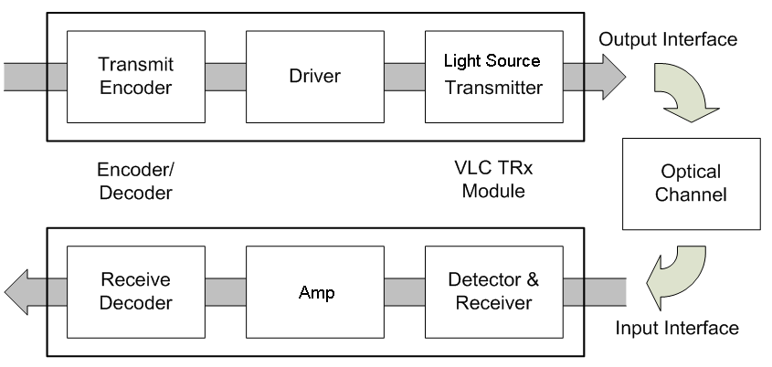
Block Diagram of VLC System

Slide 7
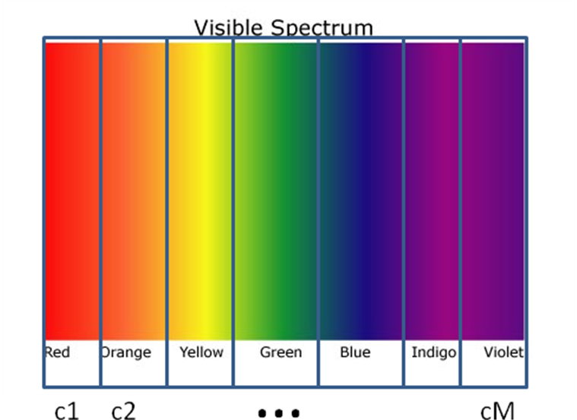
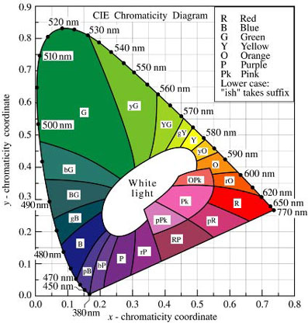
Band plan design for communicating supported channels
Source: http://www.ecse.rpi.edu/~schubert/Light-Emitting-Diodes-dot-org/chap17/F17-03%20Chromaticity%20diagram%20(Gage).jpg

Slide 8
Notes from CIE diagram
Center colors are narrower in width than outer colors.
Human eye is more sensitive to center colors
pB, R occupy 100~200 nm while G occupies ~ 30 nm
LED manufacturers make LEDs depending on human color perception and not frequency band
=> Non-linear widths needed for band plan

Slide 9
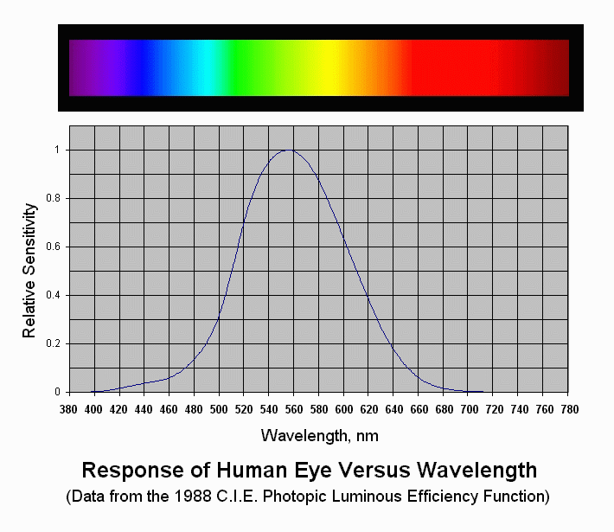
Human eye response to wavelength

Slide 10
Proposed Band Plan
(based on CIE diagram)
Frequency band (nm) |  | Spectral width (nm) | Color | Proposed Code
380 | 450 | 70 | pB | 000
450 | 510 | 60 | B, BG | 001
510 | 560 | 50 | G | 010
560 | 600 | 40 | yG,gY, Y,yO,O | 011
600 | 650 | 50 | rO | 100
650 | 710 | 60 | R | 101
710 | 780 | 70 | R | 110
 |  |  | Reserved | 111
Red – popular
LED for comm.
Provides support for up to 7 independent and parallel channels – can consider expansion to more channels
Non-uniform distribution based on CIE diagram
Human eye most sensitive to green color and visible LEDs are designed to match human eye sensitivity

Slide 11
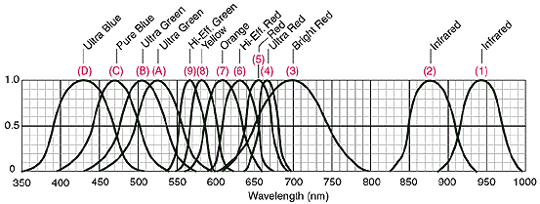
Bandplan issue:
Leakage from other LED colors
Source: http://www.theledlight.com/technical3.html

Slide 12
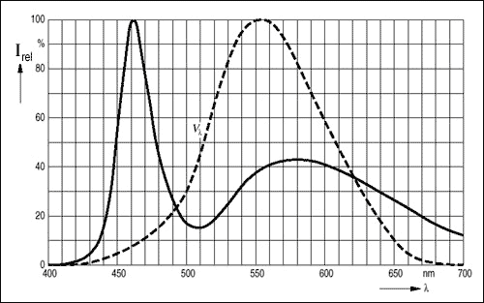
White LED spectrum (Blue + Phosphor)
Blue LED
(GaInN)
Light sensitivity to human eye
Yellow Phosphor
yttrium aluminum garnet
(YAG) –
leakage if not used at RX
Source: Maxim, Application Note 3070 : Standard and White LED Basics and Operation

Slide 13
Need for guard colors
Many LEDs (such as white) may not support saturated colors and may transmit in multiple bands
Spectrum affected by leakage may be unusable
Significant variations in LED spectral width and peak wavelengths for different manufacturers and costs
LED peak wavelength can change with forward current variations.
For FDD mode, adjacent bands may be impacted by spectral leakage from own transmitter

Slide 14
Guard colors
We define “guard color” channels for each channel used for transmissions.
For every channel color, we define a list of guard colors that cannot be used simultaneously for TX or RX when that channel is in use for TX due to leakage.
For example, white led (blue + phosphor) Color code : 001 Guard codes : 011, 100
The criteria used for defining a guard color channel could be based on out-of-band leakage, exceeding a certain value (for example, 10 -20 dB) over the in-channel value that causes a considerable loss in receiver sensitivity in those channels.
The guard colors are defined on a per channel basis and could be also be defined as a N-bit number with a ‘1’ in the location where the channel cannot be used.
Example: Guard colors (011,100) for 001 can be represented as: 00011000

Slide 15
Considerations of VLC PHY Modulation
Illumination Property
Can be mainly used and considered in case of lighting communication using an LED.
(e.g. Information Broadcasting, and Visible LAN)
    In general, PWM method is used in order to adjust the brightness of LED lighting.
    But, the method may not be suitable for high speed communication.
    Also, the lighting function can not be ignored.
High Data Rate
    Single LED device based
    - Intensity Modulation / Complex Modulation
    Multiple LED device based
    - WDM Multiplexing method / Optical MIMO
* Source: 2008-11_15-08-0788-01-0vlc-considerations-on-vlc-modulation

Slide 16
Considerations of VLC PHY Modulation
Channel Model
The VLC may be almost expected to LOS channel
    Mobile to Mobile (Short range environment)
    - relatively little multipath/Interference distortion
    Infra to Mobile
    - Interference can be existed. / Downlink beam angle is relatively wider.
* Source: 2008-11_15-08-0788-01-0vlc-considerations-on-vlc-modulation

Slide 17
Summary
PHY considerations
  Data rate: ~100Mbps
  Short range
  Full Duplex (except for some application)
Band Plan supporting 7 independent color channels proposed
  Can consider more channels
Guard colors proposed for interference mitigation due to leakage
Consideration of modulation
  Illumination
  High data rate
  Channel model

