Slide 1
Project: IEEE P802.15 Working Group for Wireless Personal Area Networks (WPANs)
Submission Title: [Line coding performance in wireless optical channel]
Date Submitted: [07.15.09]
Source: [Doyoung Kim , Jaeseung Son, Taehan Bae] Company [Samsung Electronics Co.,LTD]
Address [Dong Suwon P.O. Box 105, 416 Maetan-3dong, Yeongtong-gu, Suwon-si, Gyeonggi-do, 443-742 Korea]
Voice:[82-31-279-5099], FAX: [82-31-279-5130], E-Mail:[doyoung@samsung.com]
Re: []
Abstract: [We propose new line coding schemes.]
Purpose: [Contribution to IEEE 802.15.7 TG-VLC]
Notice: This document has been prepared to assist the IEEE P802.15. It is offered as a basis for discussion and is not binding on the contributing individual(s) or organization(s). The material in this document is subject to change in form and content after further study. The contributor(s) reserve(s) the right to add, amend or withdraw material contained herein.
Release: The contributor acknowledges and accepts that this contribution becomes the property of IEEE and may be made publicly available by P802.15.

Slide 2
Line coding performance in wireless optical channel
2009. 07.15
Samsung Electronics

Slide 3
Contents
Outline of VLC(Visible Light Communication)
  Block diagram of VLC system
Existing optical line coding method
  NRZ/RZ/Manchester/4B5B/8B6T/B8ZS/HDB3
Channel modeling of VLC system
Proposed ling coding method
  3B-HBT
Performance comparison

Slide 4
Outline of VLC(Visible Light Communication)
Block diagram of VLC system
  The following figure is block diagram of VLC system.

Slide 5
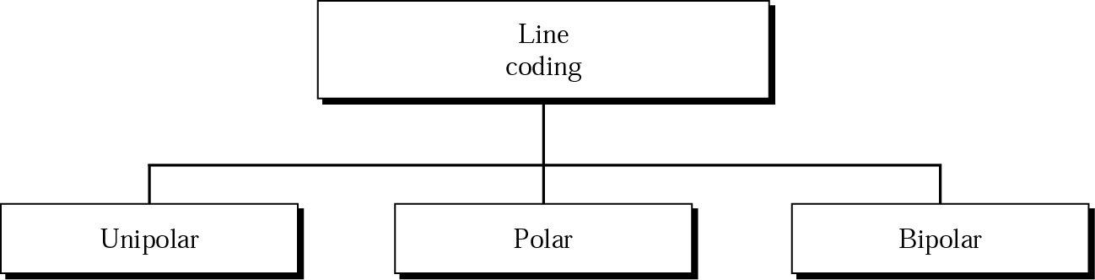
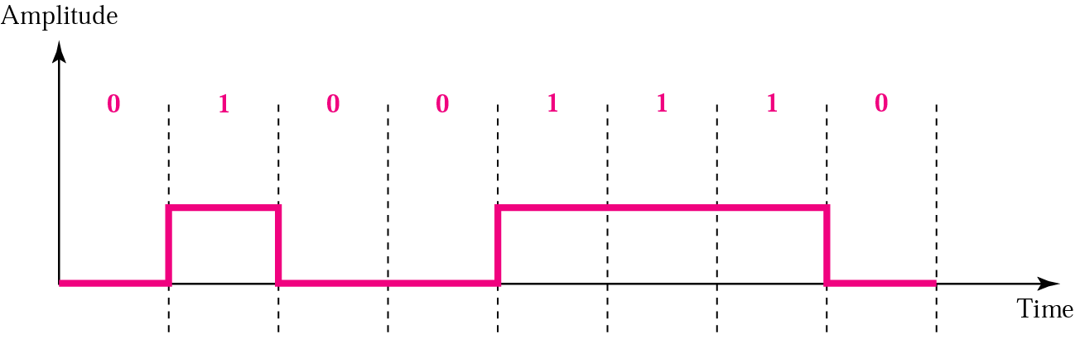
Existing optical line coding method
Line coding
  Unipolar
    Positive , zero
  Polar
    Positive value, negative value
  Bipolar
    Positive value, negative value, zero
Unipolar
  Advantage
    Simple implementation
  Disadvantage
    Direct Current component and synchronization

Slide 6
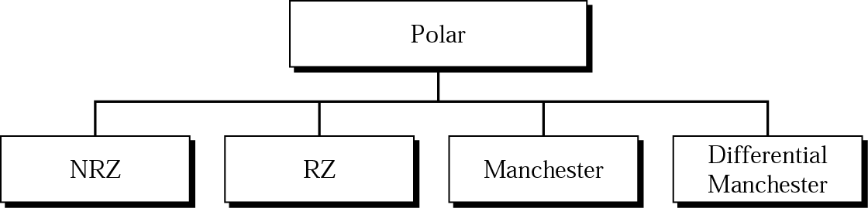
Existing optical line coding method
Polar
  Use positive and negative voltage
  Advantage
    Decrease of average voltage
    Decrease of Direct Current component
  Example
    NRZ(Non Return to Zero), RZ(Return to Zero), Manchester, Differential Manchester

Slide 7
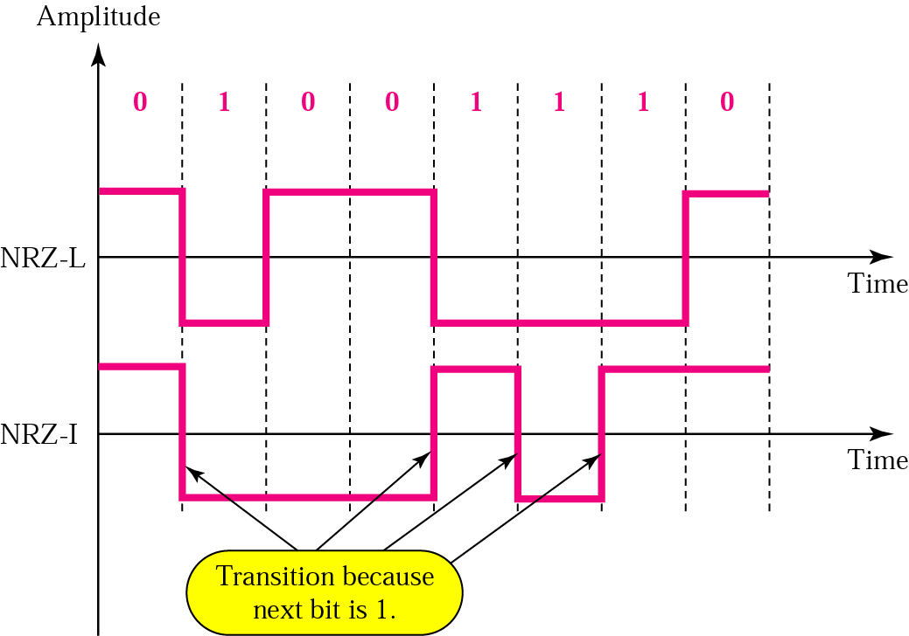
Existing optical line coding method
NRZ(Non Return to Zero)
  NRZ-L(Non Return to Zero-Level)
    Positive voltage: 0 bit, Negative voltage: 1 bit
    Synchronization problem by long stream same bit
  NRZ-I(Non Return to Zero, Invert on ones)
    One of differential encoding example
    Inversion of voltage is bit 1.
    No inversion is bit 0.
    Provide synchronization by inversion of voltage

Slide 8
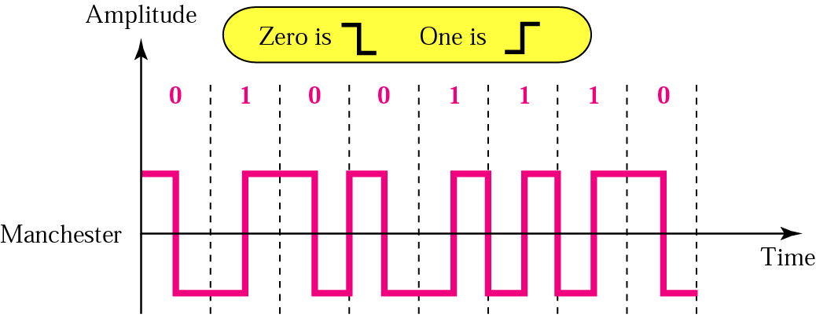
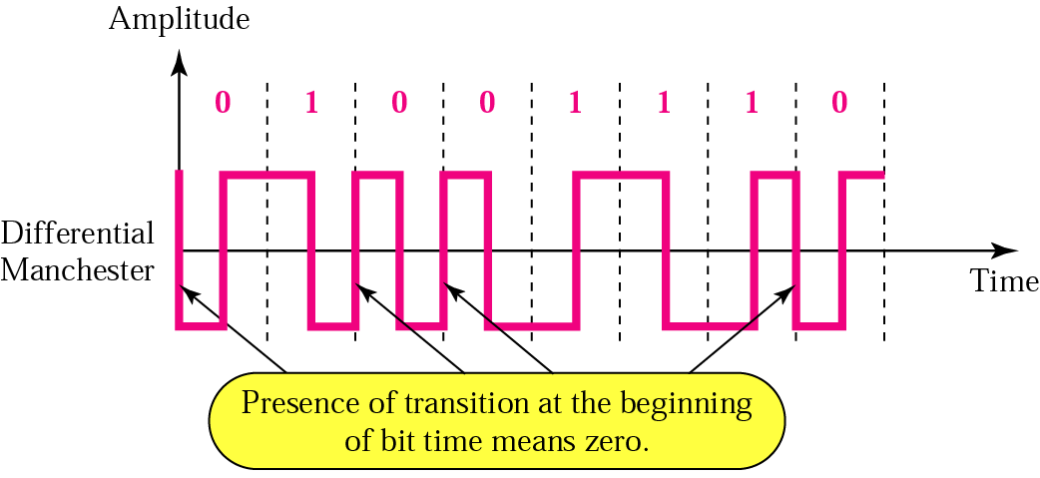
Existing optical line coding method
Manchester
  Data expression
    Inversion between bit duration
  Advantage
    Provide synchronization
      Self clocking code
    No Direct Current component
    Error Detection
  Used
    Baseband coaxial cable, IEEE 802.3
Differential Manchester
  Data expression
    Inversion between bit duration
    0 bit: inversion at the start of bit duration

Slide 9
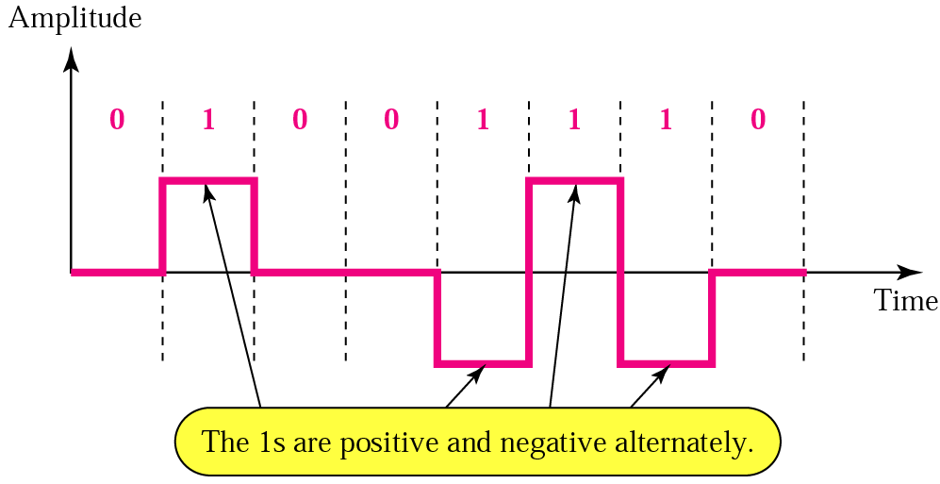
Existing optical line coding method
Bipolar
  AMI(Alternate Mark Inversion)
    Data expression
      0 bit: zero voltage
      1 bit: positive and negative voltage alternately
    Advantage
      Provide synchronization in consecutive ‘1’ bit
      No Direct Current component
      Smaller bandwidth than NRZ
      Error detection
    Disadvantage
      Consecutive ‘0 bit ‘ can cause Direct Current component and synchronization problem.

Slide 10
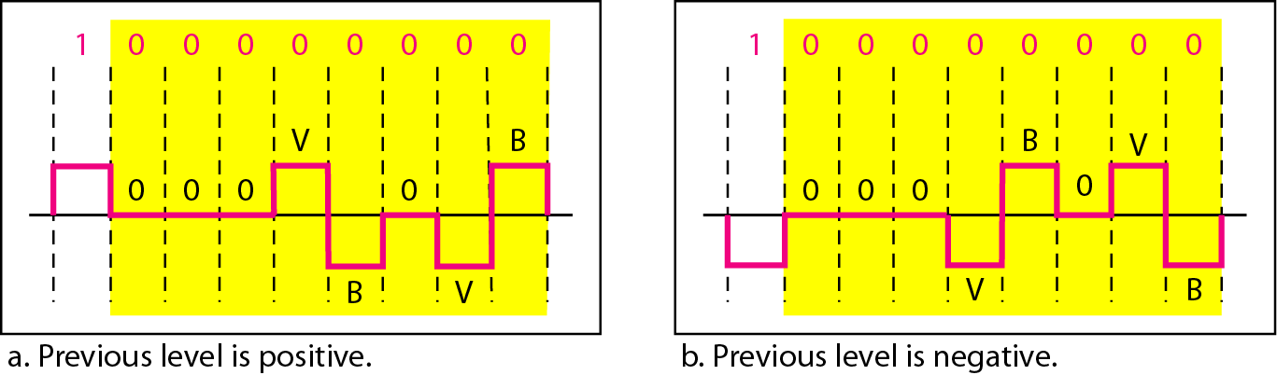
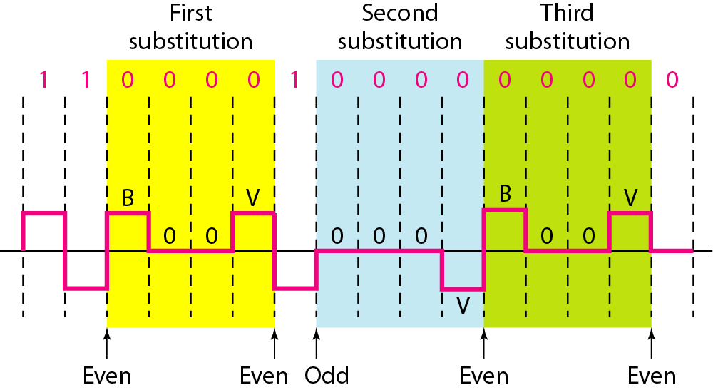
Existing optical line coding method
B8ZS (Bipolar with 8 zero substitution)
  Replace consecutive eight 0 bit to 000VB0VB
HDB3 (High-density bipolar 3-zero)
  Replace consecutive four 0 bit to 000V or B00V

Slide 11
Existing optical line coding method
4B5B block coding
  Extra bit used for synchronization
  Extra bit used for error detection
Conversion process
  1 stage : separation
    Separate bits into m bit groups
  2 stage : alternation
    Alternation from m bit groups to n bit groups
      4 bit group(16 groups) to 5bit group(32 groups)
    Use code which there is not consecutive zero or one
    Used for error detection
  3 stage : line coding
    Simple line coding

Slide 12
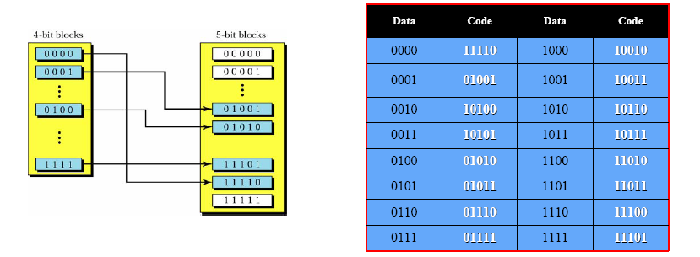
Existing optical line coding method
4B5B
  Advantage
    Better error detection performance than AMI
    Prevention of consecutive 0 and 1 bit
  Disadvantage
    Waste of bandwidth(25%)

Slide 13
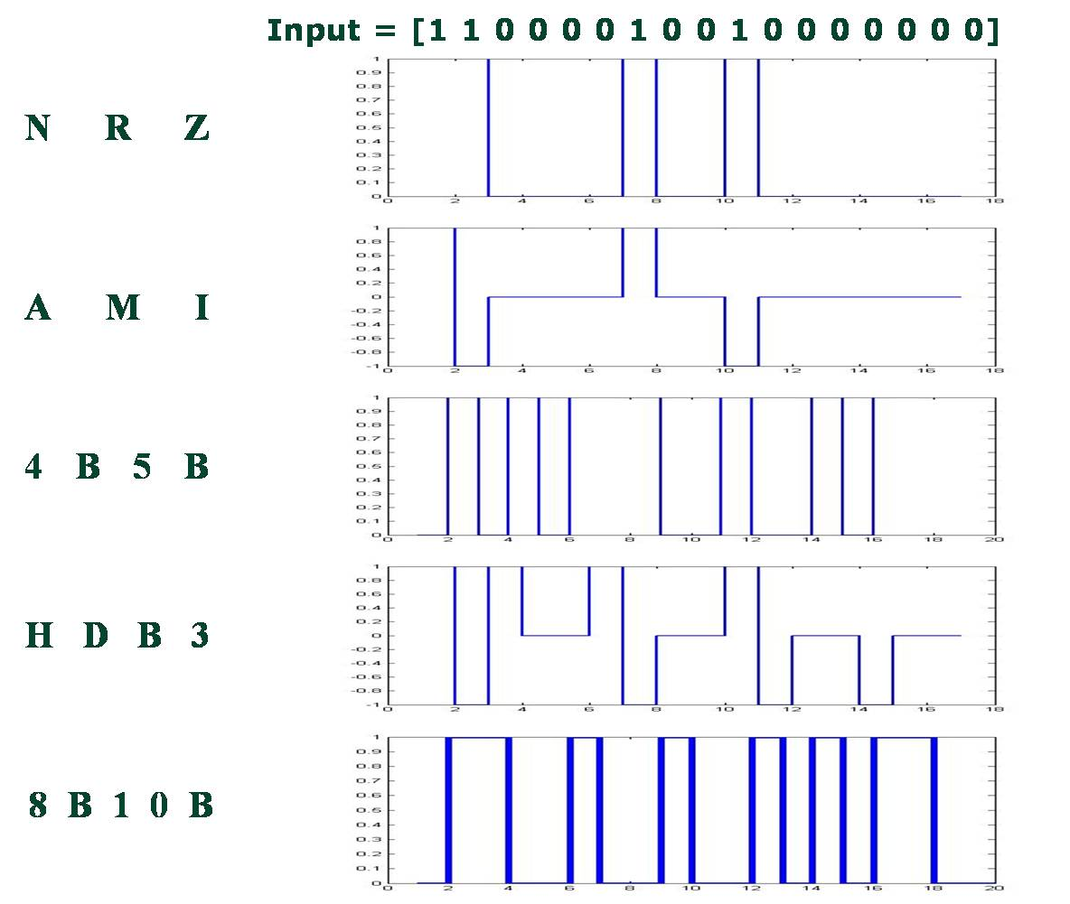
Existing optical line coding method

Slide 14
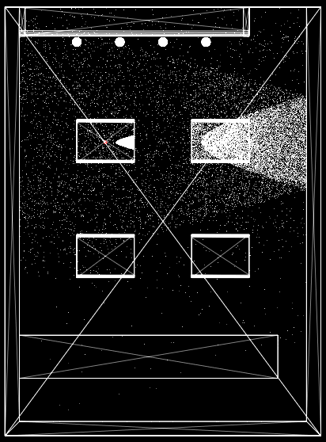
Channel modeling of VLC system
Simulation parameter
  Mobile to mobile case
    Café environment
    Divergence angle: 30º
    Distance: 30cm

Slide 15
Proposed Line Coding
B4-HBT
  Input = [1 1 0 0 0 0 1 0 0 1 0 0 0 0 0 0 0]
    Current bit level: -1
      Input bit “1”: Half transition from “-1” to “+1”
      Input bit “0”: in case of five consecutive zeros, the first and the last 0 bit become “+1” and half transit from “-1” to “+1”
    Current bit level: 0
      Input bit “0”: 0 except five consecutive zeros
      Input bit “1”: Opposite conversion of previous 1’s switching
    Current bit level: +1
      Input bit “1”: Half transition from “+1” to “-1”
      Input bit “0”: in case of five consecutive zeros, the first and the last 0 bit become “+1” and half transit from “+1” to “-1”
    Consecutive five zeros
      Previous and next five zeros have opposite conversion

Slide 16
Performance comparison
B4-HBT vs 4B5B
AWGN
Optical Channel

Slide 17
Characteristic of proposed line coding method
B4-HBT | Reduce synchronization error by consecutive “0” Error detection capability No DC component Easy synchronization

Slide 18
Thank you
Q&A

Slide 19
Reference
http://en.wikipedia.org/wiki/Line_coding
http://en.wikipedia.org/wiki/4B5B

