Slide 1
Project: IEEE P802.15 Working Group for Wireless Personal Area Networks (WPANs)
Submission Title: Future Proof Platform for SUN – Technical Overview
Date Submitted: July 6, 2009
Source: Steve Shearer, Independent
Address: Pleasanton, CA, USA
Voice: (408) 417 1137 , FAX: [], E-Mail: Shearer_inc @ yahoo.com
Re: [802.15.4g] TG4g Call for Proposals, 2 February, 2009
Abstract: Technical Overview of the merged OFDM proposals of Steve Shearer, Landis&Gyr, Maxim and ETRI. This document highlights key signal processing areas of the proposal that make this a good choice for the new SUN PHY.
Purpose: Technical Proposal to be discussed by IEEE 802.15 TG4g
Notice: This document has been prepared to assist the IEEE P802.15. It is offered as a basis for discussion and is not binding on the contributing individual(s) or organization(s). The material in this document is subject to change in form and content after further study. The contributor(s) reserve(s) the right to add, amend or withdraw material contained herein.
Release: The contributor acknowledges and accepts that this contribution becomes the property of IEEE and may be made publicly available by P802.15.

Slide 2
A Future Proof Platform for Smart Utility Networks
Top Level Technical Overview
Steve Shearer
July 2009
Contributors: Roberto Aiello [Independent], Sangsung Choi [ETRI], Bob Fishette [Trilliant], Michel Veillette [Trilliant], David Howard [On-Ramp], Rishi Mohindra [MAXIM], Emmanuel Monnerie [Landis & Gyr], Partha Murali [Redpine Signal], Shusaku Shimada [Yokogawa Electric Co.], Kendall Smith [Aclara], Mark Wilbur [Aclara], Mark Thomson [Aclara]

Slide 3
Introduction
The purpose of this presentation is to introduce key technical aspects of the Future Proof Platform merged OFDM proposal
  Demonstrates that an OFDM system, properly configured to the application at hand, can lead to a highly efficient, low complexity PHY
This presentation shows how the combination of several simple signal processing methods have been used to create the SUN OFDM PHY proposal
  And shows how this proposal is compatible with the existing standard and some new proposals
We believe that this proposal is worthy of consideration as a candidate for new Smart Utility Networks PHY standard.

Slide 4
Contents
Proposal meets the requirements of the PAR
Some common concerns about OFDM
Key aspects of this proposal
  Data rates / Bandwidth
  Compatibility with existing MAC
  Modulation
  Soft decisions
  Convolutional coding
  Time and Frequency Spreading
  Data structure
  Reference Transmitter Diagram
How Multicarrier systems maximize the use of the radio channel
  Inter Symbol Interference
  Frequency selective fading
  Rayleigh fading
  Performance Advantage Snapshot
Conclusions

Slide 5
Requirements of the PAR
Operation in any of the regionally available license exempt frequency bands, such as 700MHz to 1GHz, and the 2.4 GHz band.
Data rate of at least 40 kbits per second but not more than 1000 kbits per second
Carrier Grade Reliability
Achieve the optimal energy efficient link margin given the environmental conditions encountered in Smart Metering deployments.
Principally outdoor communications
  “highly obstructed, high multipath locations with inflexible antenna orientation”
  “Applications for Wireless Smart Metering Utility Network further intensify the need for maximum range”
  “Wireless Smart Metering Utility Network requirement of 100% coverage”
  “ability to provide long-range point-to-point circuits available for meshing”
PHY frame sizes up to a minimum of 1500 octets
Simultaneous operation for at least 3 co-located orthogonal networks
Connectivity to at least one thousand direct neighbors characteristic of dense urban deployment

Slide 6
This Proposal meets the PAR
It is applicable to the 700, 800, 900 MHz and 2.4Ghz bands
Scalable data rates from 780 kbps down to 46 kbps
  Enables accessing “difficult-to-get-to” nodes
Achieves excellent energy efficient link margin (E_{b}/N₀) to achieve Carrier Grade reliability without wasting power
Designed for outdoor environments because it addresses
  Multipath by using long symbol times and a cyclic prefix
  Spatial nulls by using slow frequency hopping or Frequency Diversity
  Fading by employing channel coding and Time Diversity for improved packet error performance
  Provides long range where necessary
Supports packet sizes up to 2047 octets with low PER in outdoor environments
Is adjacent channel friendly to allow co-located orthogonal networks
Supports connectivity to multiple neighbors
In addition, battery consumption can be shown to be as low, or lower, than single carrier systems

Slide 7
Common concerns about OFDM
High SNR?
  This proposal shows reliable operation in negative SNR conditions also in other presentations system & implementation
High PAPR?
  Low order modulation allows PA back-off to be 3dB or less
High TX Power?
  15 to 30dB link margin advantage allows lower TX power
Complexity?
  Orders of magnitude lower than popular WLAN systems
Cost?
  System cost can be as low as single carrier systems
Accurate Xtal oscillators?
  20 ppm is sufficient, 40 ppm can be tolerated
High Power consumption?
  Analysis shows superior performance for battery operated devices
‘Brick wall’ analog filters?
  Not necessary

Slide 8
Key Parameters
Several configurations to suit different Regulatory b/w requirements
  Option 1 1060 kHz 128 pt FFT
  Option 2 518 kHz 64 pt FFT
  Option 3 264 kHz 32 pt FFT
  Option 4 146 kHz 16 pt FFT
  Option 5 68 kHz 8 pt FFT
Common parameters for all options
  Symbol time 128us
  Cyclic prefix 25.6us
  Tone spacing 9.7kHz
  Multipath tolerance > 25us at all data rates
  Low order modulation BPSK, QPSK, 16QAM
Supports low packet-by-packet frequency
hopping to mitigate spatial nulls
Non hopping mode to ease concerns
on battery consumption
Complexity is orders of magnitude
lower than WLAN
Channel Coding derived from ½ rate convolutional mother code
Coding rates from 3/4 through to 1/8 using
  Puncturing
  Frequency Repetition
  Time Repetition
Soft decision decoding for higher performance
 | OFDM Option 1 | OFDM Option 2 | OFDM Option 3 | OFDM Option 4 | OFDM Option 5 | Unit
FFT size | 128 | 64 | 32 | 16 | 8
Active Tones | 108 | 52 | 26 | 14 | 6
# Pilots tones | 8 | 4 | 4 | 2 | 2
# Data Tones | 100 | 48 | 22 | 12 | 4
Approximate Signal BW | 1064.45 | 517.58 | 263.67 | 146.48 | 68.36 | kHz
BPSK 1/2 rate coded and 4x repetition | 97.66 | 46.88 | 21.48 | 11.72 | 3.91 | kbps
BPSK 1/2 rate coded and 2x repetition | 195.31 | 93.75 | 42.97 | 23.44 | 7.81 | kbps
BPSK 1/2 rate coded | 390.63 | 187.50 | 85.94 | 46.88 | 15.63 | kbps
BPSK 3/4 rate coded | 585.94 | 281.25 | 128.91 | 70.31 | 23.44 | kbps
QPSK 1/2 rate coded | 781.25 | 375.00 | 171.88 | 93.75 | 31.25 | kbps
QPSK 3/4 rate coded | 1171.88 | 562.50 | 257.81 | 140.63 | 46.88 | kbps
16-QAM 1/2 rate coded | 1562.50 | 750.00 | 343.75 | 187.50 | 62.50 | kbps
16-QAM 3/4 rate coded | 2343.75 | 1125.00 | 515.63 | 281.25 | 93.75 | kbps

Slide 9
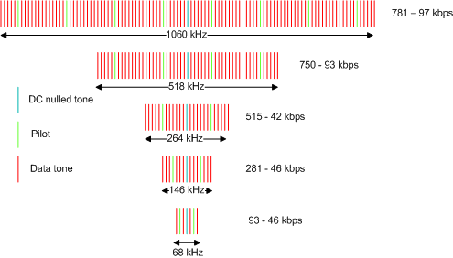
Scalable Data Rates / Bandwidth

Slide 10
Multicarrier Modulation
This proposal modulates each carrier using BPSK, QPSK, or 16-QAM
The PSK symbols are mapped onto individual tones in the frequency domain
Several frequencies are nulled out
  The nulled DC component helps in the implementation of cheap, zero-IF receivers (does not exclude passband receivers)
  The nulled frequencies at the band edges significantly ease filtering complexity for adjacent channel performance
An appropriate size Inverse FFT produces the time domain samples for transmission

Slide 11
Modulation and PAPR
Amplitude of an OFDM signal is
approximately Rayleigh distributed
  The signal has peaks, but they
  are infrequent
Non-linearity leads to high EVM
  Low order Phase Modulation can tolerate
  high EVM
Therefore PA linearity requirements for this proposal are considerably reduced
  See IEEE 802.15-15-09-xxxx-xx-004g for details

Slide 12
Compatibility
The basic concept of this PHY is directly compatible with the current 802.15.4e work
  It does not impose any further requirements on the MAC
  Allows the entire upper s/w stack to be re-used
All modes can use packet-by-packet frequency hopping
  Although this is probably only necessary for narrowband modes
  Wider band modes allow Battery efficient non-hopped operation in many popular bands (e.g. 900MHz)
The time domain waveform leaving the antenna is different in nature to that of FSK or DSSS systems, but this is invisible to the upper layers

Slide 13
OFDM enables simple Soft decision generation
The demodulator for each tone outputs the bits as ‘confidence levels’ based on an estimate of the channel quality
  Bits demodulated during a fade will have small +/- confidence levels
  Bits demodulated in a peak will have larger +/- confidence levels
Provides additional information about where errors may lie
  Decoder can concentrate its error correction capabilities on the bits that are most likely in error
Allows Maximal Ratio Combining for Frequency Spreading and Time Spreading modes

Slide 14
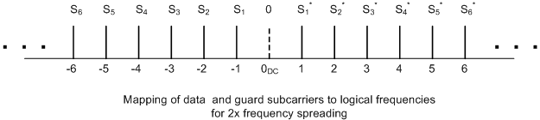
Frequency Spreading
Frequency spreading is a method of replicating PSK symbols on different carriers
The diagram indicates how the left half of the spectrum is replicated using conjugated versions of the PSK symbols
Protects against frequency selective fading by providing Frequency Diversity
  Enhances SNR performance

Slide 15
Frequency De-spreading
PSK symbols can be optimally recombined at the receiver with little computational overhead
Diagram illustrates how
this combining improves
the quality of the data

Slide 16

Time Spreading
Time spreading is a method of replicating PSK symbols at different times
The diagram indicates how symbols are repeated
Protects against Rayleigh fading by providing Time Diversity
  Enhances SNR performance
Frequency Spreading and Time Spreading can be used together for additional robustness

Slide 17
Convolutional Code
Convolutional Codes are well know for their ability to effectively use soft decisions to correct errors
  Coding gain is normally quoted as Eb/N0
  SNR improvement at a normalized net information rate
  And with modern hardware, they are easy to implement
This proposal uses a constraint length 7, ½ rate code
  Well known generator polynomials G_{1,2} = [133, 171],
Offers a coding gain of 6 dB for the same information rate

Slide 18
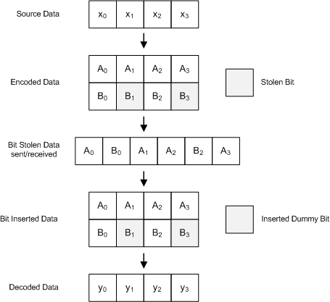
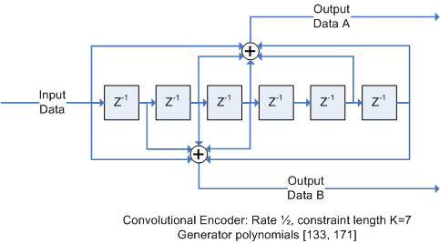
Puncturing for Flexible data rates
Puncturing is a process of removing redundancy to increase the coding rate
  Bits are removed before transmission
  And replaced with dummy bits on reception
This is a well researched area (Hagenauer et al.)
  Used in many systems
Easy to implement using array indexing
operations
Provides very flexible data rates with no
computational overhead

Slide 19

Interleaving
Interleaving used to spread bits in frequency over one symbol
  Investigating if interleaving over more symbols gives a performance advantage
Interleaving equation for 32-FFT shown below
Details for other n-FFT’s given in detailed document IEEE 802.15-15-09-xxxx-xx-004g

Slide 20
Data Structure ***
Packets are made up of:-
  Synchronization sequence
  PHY header coded for maximum robustness
  Variable length data payload coded according to data rate
  Update in progress

Slide 21
Frame Synchronization ***
  Description in progress

Slide 22

PHY Header
The PHY header contains 6 fields
  Rate field specifies the data rate of the payload frame
  Length specifies the length of the payload
  Scrambling seed
  Header Check sequence
    8 bit CRC taken over the data fields only
    Avoids erroneous decoding of payloads and saves power consumption
  Tail bits for Viterbi decoder flushing
Encoded at the lowest data rate for robustness

Slide 23

Data Unit (PSDU)
Frame Payload
  8 to 2047 octets
CRC
  32 bit IEEE CRC for error detection
Tail and Pad bits
  Used to clear encoder memory

Slide 24
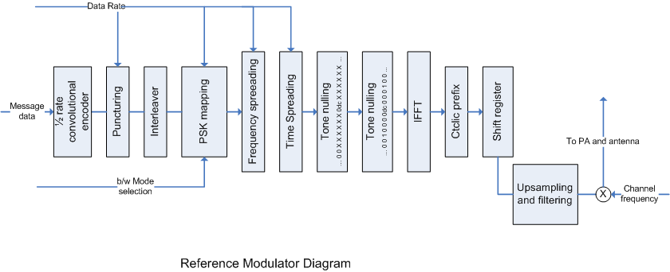
Reference Transmitter Diagram
Summary of transmitter signal processing
PSK Mapping block determines mapping of PSK symbols and number of tones

Slide 25

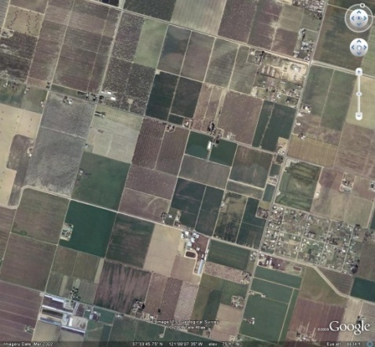

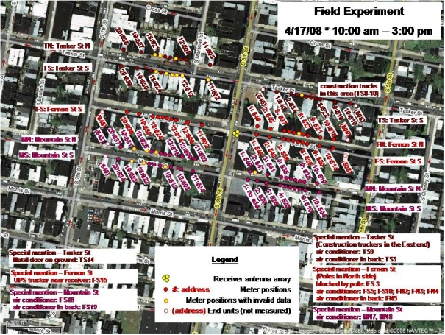
Representative SUN Channels
Simple two tap channel models used for performance evaluation
  ETSI ETSI EN 300 392-2 V3.2.1 (2007-09)
Performance simulations use Pseudo Static methodology
  see doc xx-xxx-xx
Channel Models taken from ETSI ETSI EN 300 392-2 V3.2.1 (2007-09)
Propagation Model | Tap Number | Relative delay (us) | Average relative power (dB)
Rural Area (Rax) | 1 | 0 | 0
Typical Urban (Tux) | 1 | 0 | 0
 | 2 | 5 | -22.3
Bad Urban (Bux) | 1 | 0 | 0
 | 2 | 5 | -3
Hilly Terrain (HTx) | 1 | 0 | 0
 | 2 | 15 | -8.6

Slide 26
Key Channel Impairments
Amplitude fading due to non LOS path
Multipath due to reflections
  Frequency selective fading
  Inter Symbol Interference
How does OFDM
overcome these
problems?
Spectral analysis of 300 kHz channel.
Two ray channel, 5us multipath

Slide 27
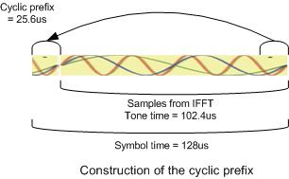
Multipath - ISI
Multipath introduces Inter Symbol Interference
  Every previous bit degrades every current bit
OFDM overcomes ISI by
  making the symbol much longer than the multipath
  And using a cyclic prefix to contain the ISI
OFDM retains the data rate by adding more carriers in the same proportion as the lengthening of the symbol
The delayed multipath components are contained in this prefix at the receiver and do not contaminate the demodulation process.

Slide 28
Multipath – Frequency selective fading
Multipath also causes frequency nulls in the received spectrum
OFDM overcomes frequency nulls by dividing up the channel into individual carriers
  So if one is knocked out, at least
  the others aren't affected
Interleaving across
frequency, together
with FEC, help to
‘fill in the gaps’

Slide 29
Visualization of OFDM’s advantage
Notice how the multiple carrier soft decision streams actually re-create a picture of the channel conditions
This valuable information allows
effective combination of
Time and Frequency diversity
This is the key to
why OFDM systems
have such a
performance
advantage
Surface of 300 kHz channel constructed using demodulated soft decisions.
Two ray channel, 5us multipath

Slide 30
Performance Advantage Snapshot
Bu0 and Ht0 as defined by ETSI
  5us and 15us multipath respectively
FS10 and TN19 as measured by L&G
  1.6us multipath
Short 125 byte packets
OFDM shows 18 – 29 dB
advantage in benign
multipath channels
at 99% packet success
rate
The advantage is even greater
for Bu0 and Ht0 !

Slide 31
Conclusions
This Proposal adequately meets all the requirements of the PAR
  Wide applicability in a range of Regulatory requirements
  Wide range of data rates
  Superior performance in the outdoor channels defined in the PAR
  Carrier Grade Reliability
  Wide range of packet lengths
  Excellent link margin and efficiency
Addressed some common concerns about OFDM
Detailed the key Technical aspects that make up the Proposal
Showed how OFDM achieves its performance in the chosen channels
  Hinted at some results
  See later presentations for more details

Slide 32
Thank You for your attention
What will you do with the dB’s you’ve saved?
Questions

