Slide 1
Project: IEEE P802.15 Working Group for Wireless Personal Area Networks (WPANs)
Submission Title: Future-Proof Platform: Introduction & Conclusion
Date Submitted: July, 2009
Source: Emmanuel Monnerie, Roberto Aiello Company: Landis+Gyr, Self
30000 Mill Creek Avenue, Alpharetta, GA 30022 USA
Voice: +1 678 258 1695, E-Mail: emmanuel.monnerie@landisgyr.com, aiello@ieee.org
Re: IEEE 802.15 Task Group 4g Call for Proposals (CFP) on 22 January, 2009
Abstract: This presentation summarizes the advantages of OFDM for SUN
Purpose: Proposal for consideration by the TG4g
Notice: This document has been prepared to assist the IEEE P802.15. It is offered as a basis for discussion and is not binding on the contributing individual(s) or organization(s). The material in this document is subject to change in form and content after further study. The contributor(s) reserve(s) the right to add, amend or withdraw material contained herein.
Release: The contributor acknowledges and accepts that this contribution becomes the property of IEEE and may be made publicly available by P802.15.

Slide 2
A Future-Proof Platform for Smart Utility Networks
Introduction & Conclusion
Emmanuel Monnerie & Roberto Aiello
Contributors: Roberto Aiello [Independent], John Buffington [Itron], Sangsung Choi [ETRI], Bob Fishette, Michel Veillette [Trilliant], Rodney Hemminger [Elster], David Howard [On-Ramp], Bob Mason [Elster] Rishi Mohindra [MAXIM], Emmanuel Monnerie [Landis & Gyr], Partha Murali [Redpine Signal], Daniel Popa [Itron], Steve Shearer [Independent], Shusaku Shimada [Yokogawa Electric Co.], Kendall Smith [Aclara]

Slide 3
Outline
SUN requirements
Future-Proof Platform
Merged proposal
Characteristics of OFDM
Advantages and disadvantages of OFDM
Benefits of Link Robustness
Better Protection against Multipath
Link Margin versus Data rate
What is covered in this merged proposal?
Some flexible features
Conclusions (3 slides)
Possible Next Steps
References

Slide 4
Merged Proposal
This merged proposal combines the following individual proposals:
15-09-0275-02-004g Sangsung Choi , Cheolho Shin and Byounghak Kim (ETRI)
15-09-0289-01-004g/15-09-0294-02-004g Steve Shearer (self)
15-09-0291-00-004g Emmanuel Monnerie (Landis+Gyr)
15-09-0293-03-004g Rishi Mohindra (MAXIM)

Slide 5
SUN requirements
TG4g PAR:
  Achieve the optimal energy efficient link margin
  Principally outdoor communications
  Keep infrastructure to a minimum
  Need for maximum range as many devices are located sub-optimally (meters located in highly obstructed, high multipath locations with inflexible antenna orientation)
  Data rate of at least 40 kbits per second but not more than 1000 kbits per second
  Largest number of orthogonal traffic carrying channels (ie spectrally efficient modulation)

Slide 6
Future-Proof Platform
Future-Proof views and roadmap for higher data rates. Coverage from low data rates (40kbps) to higher data rates (>100kbps and less than 1Mbps).
Consideration for different types of devices and different applications (AC powered meter, battery powered meter, network device, in-home device).
Availability for growth in data rate, modulation scheme, future band allocation/regulatory changes

Slide 7
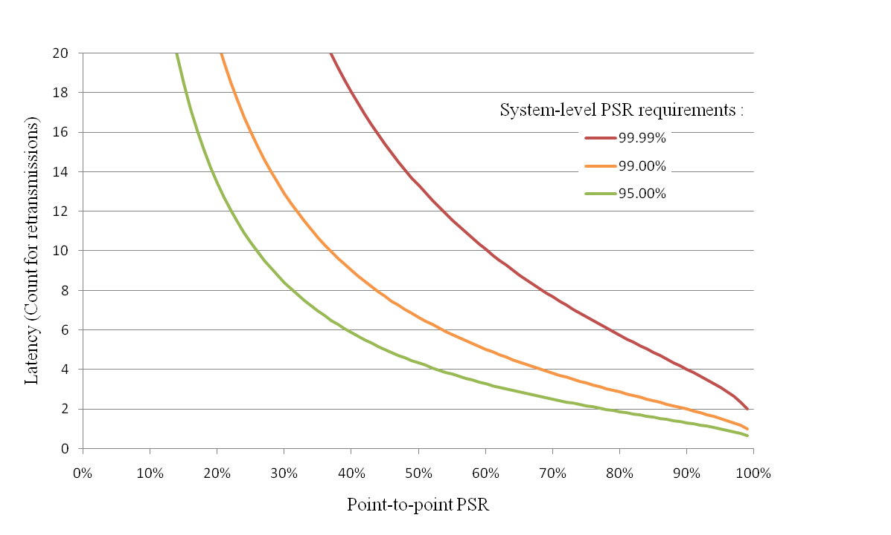
Benefits of link robustness
Lower system cost (reduced need for repeaters)
Lower energy consumption (less retransmissions, reduced “Tx ON” time)
Lower system latency/increased data rates

Slide 8
Better Protection against Multipath
Zone of InterSymbol Interference
Obstacle (Building, Mountain, etc…)
Received Symbols
Symbol N
Symbol N+1
Symbol N
Symbol N+1
Tx
Rx
Transmitted Symbols
Each symbol includes a Guard Interval with a greater duration than the ISI. This guard interval is removed by the receiver, thus eliminating, at the same time, the ISI.
Symbol N
Symbol N+1
OFDM

Slide 9
Characteristics of OFDM
Adopted & proven many times
  Asymmetric DSL (ADSL)
  IEEE 802.11a, 802.11g & 802.11n
  IEEE 802.16 (WiMax)
  Power Line Networking (HomePlug and HomePlug A/V)
  Digital Audio (DAB) & Video (DVB), HD Radio
  Many others
Typically chosen for multipath characteristics, not high bit rate
Higher complexity required for processing multiple carrier is typically balanced by less processing to mitigate multipath effects

Slide 10
Advantages and disadvantages of OFDM
Pros
  Spectrally efficient modulation
  RF Robustness and Performance
  Scalable Data rates
  Adaptability to regulatory considerations
Cons
  More complex PHY definition/specification for the device *
* better multipath characteristics usually simplify system complexity

Slide 11
What is covered in this merged proposal?
PHY parameters: modulation, interleaving and encoding, data rate, symbol rate, guard interval, short training field, long training field, tone definition, signal bandwidth.
Regulatory considerations: USA, Europe, Korea, Japan, TV white space.
Performance and simulations: Bit Error Rate, Packet error rate, channel characteristics.
Implementation considerations: Relative cost, power consumption.

Slide 12
Link Margin versus Data Rate
Typically:
Low data rate OFDM (<100 kbps) addresses long range, rural applications.
Medium data rate OFDM (around 100kbps) address most deployments in suburban and urban areas.
Higher data rate (above 100/200 kbps) address the network traffic through pole top devices.
Practically:
The system implementer and the chip manufacturer can design a solution with the appropriate sets of data rates.
Each radio can automatically compute the required link margin, thus the appropriate data rate.

Slide 13
Some flexible features
Channel Spacing: We recommend a band agnostic approach as defined in doc # 453 from C. Seibert (SSN).
PHY Header: We recommend at least the following:
  Error protection of the PHY header
  11 bits of length field
  Possibly other fields (Network ID, Scrambler, …) as defined in other merged proposals.

Slide 14
Detailed Presentations

Slide 15
Conclusions
Future-Proof Platform
Widely adopted and proven OFDM modulation schemes
From network devices to battery-powered devices
Low and high data rate options
Wide regulatory coverage
High robustness for outdoor applications and long range communication
Compatibility with low cost, low complexity and low power SUN requirements

Slide 16
Worldwide Coverage
International 2.4GHz (FCC Part 15.247)
US 915-ISM band (FCC Part 15.247)
Europe 863-870 band (ERC REC70-03/ETSI EN300-220)
Japan 951-956 MHz (ARIB T-96)
China 779-787 MHz
Korea 917-923.5MHz (Korean Regulation 2008-137)
TV White Space (Multiple Regions)
Others domains thanks to a band agnostic approach

Slide 17
Outdoor, Reliability & Battery Operation
Outdoor Operation
Adequate coverage area and sufficient one hop reach.
Good propagation characteristics
Multiple frequency options for different regions and licensing schemes
Reliability
Separation from 2.4GHz band entertainment gadgets.
High sensitivity & link margin.
Diversity: Frequency, time & space
Battery Operation
Long battery life: Low power LSI integration
Quick operation: FrameTx, Rx, CCA & everything
Energy saving protocol
OFDM in sub-1-GHz is the right fit for SUN

Slide 18
Merging with other proposals
Interoperability features (MAC and PHY) with existing/proprietary systems and within devices operating in different modes
OR
Definition of different PHY modes and selection of an “independent” default mode

Slide 19
Q&A

Slide 20
References
TG4g PAR (https://development.standards.ieee.org/get-file/P802.15.4g.pdf)
15-09-0114-00-004g Emmanuel Monnerie (Landis+Gyr)
15-09-0126-00-004g Steve Shearer (self)
15-09-0275-02-004g Sangsung Choi , Cheolho Shin and Byounghak Kim(ETRI)
15-09-0279-00-004g G. Flammer (SSN), E. Monnerie (L+G), S. Shearer, S. Shimada (Yokogawa Electric Corp.)
15-09-0289-01-004g/15-09-0294-02-004g Steve Shearer (self)
15-09-0291-00-004g Emmanuel Monnerie (Landis+Gyr)
15-09-0293-03-004g Rishi Mohindra (MAXIM)

