Slide 1
Project: IEEE P802.15 Working Group for Wireless Personal Area Networks (WPANs)
Submission Title: Overview of Dynamic DSSS Proposal 802.15.4TG4g SUN
Date Submitted: 7 July, 2009
Source: David Howard, Ted Myers, On-Ramp Wireless, Inc., Roberto Aiello
Address: 16885 West Bernardo Drive, Suite 255, San Diego, CA 92127, USA
Voice: +1-858-592-6008, FAX: +1-858-592-6009,
E-Mail: david.howard@onrampwireless.com, ted.myers@onrampwireless.com
Re: TG4g Call For Proposals, document number IEEE 15-09-356-004g
Abstract: Overview of the On Ramp Proposal (doc# 15-09-0307-00-004g), including a DSSS PHY where dynamic receive sensitivity, allowing up to 187dB of allowable path loss, and a multiple access option that reduces battery consumption. Testing in real world metropolitan and plant environments validate key performance parameters.
Purpose: This document is intended as an overview of the On Ramp Wireless’ proposal for addressing the requirements of the TG4g standard.
Notice: This document has been prepared to assist the IEEE P802.15. It is offered as a basis for discussion and is not binding on the contributing individual(s) or organization(s). The material in this document is subject to change in form and content after further study. The contributor(s) reserve(s) the right to add, amend or withdraw material contained herein.
Release: The contributor acknowledges and accepts that this contribution becomes the property of IEEE and may be made publicly available by P802.15.

Slide 2
Outline
Requirements of 15.4g
PAR
PG&E presentation (15-08-0297)
Demonstration
Details of Dynamic DSSS proposal
TX/RX architecture
System Parameters
Performance results
Link budget, sensitivity, system performance in multi-path
Measurement results
Merge activity
Dynamic DSSS as high processing gain option in DSSS merged proposal
Summary and conclusions

Slide 3
Requirements
PAR
Data rate at least 40kbps
Optimal energy efficient link margin
Connectivity to at least one thousand direct neighbors
Minimal infrastructure
Reach every node in the network
Long range point to point reduces cost
PG&E presentation (15-08-0297)
Coverage probability: 100%
Capacity requirements are in 10’s of kbps
Other companies that expressed interest in robust, long range links: Amplex, Mitsubishi, SDG&E, SoCalEdison
High link margin is a fundamental design criteria to reach every node in the network with 100% coverage probability and minimal infrastructure

Slide 4
Proposed Dynamic DSSS Physical Layer
More details about the Dynamic DSSS Physical Layer can be found in the latest version of 15-09-0307-00-004g

Slide 5
Overview of Dynamic DSSS Proposal
PHY is optimized for wireless meters:
Very large link margin: up to -125dBm sensitivity– allows connection to the hard to reach meters – minimal infrastructure
Scalable data rates: 3.9kbps –62.5kbps - allows for tradeoff of range vs. rate
Support for multiple frequency bands of operation
PHY solution enables very low-power consumption
Large link margin allows longer range and no hops in the mesh – support for battery operated gas and water meters
Lower cost and lower power consumption power amplifiers
Simple and low complexity modulation parameters
Support for world-wide operation
Europe and Asia require lower transmit power that reduces link margin

Slide 6
Example TX architecture
Data stream
Convolution encode
And interleave
D-BPSK
Modulate
PN
Spread
Analog
RF
Add some details on encoder, spreader

Slide 7
Example RX architecture
Analog
RF
PN
Despread
D-BPSK
Demodulate
Convolution decode
And de-interleave
Data stream

Slide 8
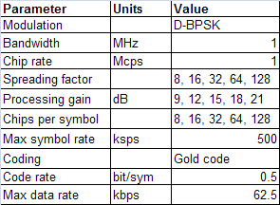
Dynamic DSSS Examples for 2.4 GHz
Slide 8

Slide 9
Bit rates and spreading factors
Spreading factor | Processing gain (dB) | Data rate (kbps)
8 | 9 | 62.5
16 | 12 | 31.25
32 | 15 | 15.625
64 | 18 | 7.8125
128 | 21 | 3.90625

Slide 10
PPDU format
Octets: variable | 2 | 1 |  | 1 |  |  | variable
Bits: variable | 16 | 7 | 1 | 4 | 1 | 3
 | Preamble | Frame Length | Extended Length | Upper Extended Address | Parity Check | Future | PSDU Includes
 |  | PHR |  |  |  |  | PHY Payload

Slide 11
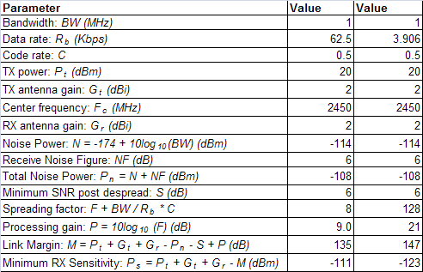
Link budget and receiver sensitivity
Up to 0.8 miles at 2.4GHz and 1.25 miles at 900MHz in Okumura-Hata suburban model, 1.5m antenna height (NIST General Purpose Propagation Loss Calculator)

Slide 12
Interference rejection measurement
Signal: -59.6 dBm.
Jammer: -48.0 dBm.
Spreading factor: 128
Processing gain: 21 dB
Co-channel rejection: 11.6 dB at an FER of about 2%

Slide 13
Complexity
Similar to 802.15.4, sub-GHz mode
Manufacturability:
Process: low-voltage, low-leakage CMOS 130nm technology node, available today
Solution can be built using a standard CMOS technology
Time to market: solution would be ready when standard is available
External components:
Battery, crystal (20 ppM), low-power timing crystal (eg. 32 kHz), standard passive components, pre-select filter, antenna

Slide 14
DSSS vs NB comparison
 | DSSS | NBFH
Max bandwidth (MHz) | 1,000 | 500
Max data rate (kbps) | 62.5 | 100
Max processing gain (dB) | 21 | 0
Max link margin (dB) | 155 | 143
Minimum RX sensitivity (dBm) | -123 | -113

Slide 15
On Ramp system measurement results
System based on current On Ramp product, not on current proposal
Star topology, uplink capacity: 60kbps
Not reliant on external infrastructure
Used to show advantage of high processing gain
Access Point location: 29th Floor of 2 Embarcadero Center
favorable propagation distance due to its relative height
extremely high amount of ISM band interference
Node functionality: transmitting GPS coordinates
Operating frequency: 2.4 GHz
Antenna gain at access point: 5 dBi
Antenna gain at node: 2 dBi
Transmit power: 100 mW
Spreading factor: 128 (equivalent to D-DSSS proposal)
Sensitivity: -123dBm
Measured range: 2miles
Spreading factor: 8192 (not in D-DSSS proposal)
Sensitivity: -142dBm
Measured range: 22miles

Slide 16
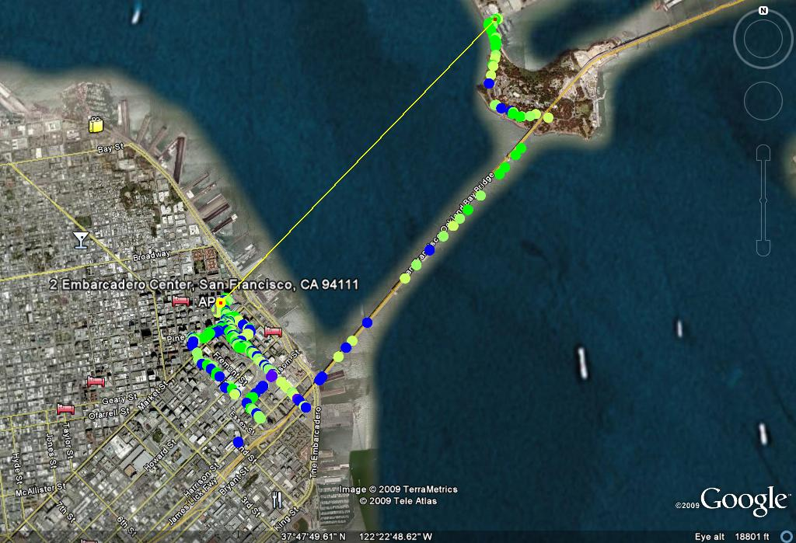
D-DSSS equivalent coverage measurement: 2 miles
2.0 Miles
21. 3 Miles
16

Slide 17
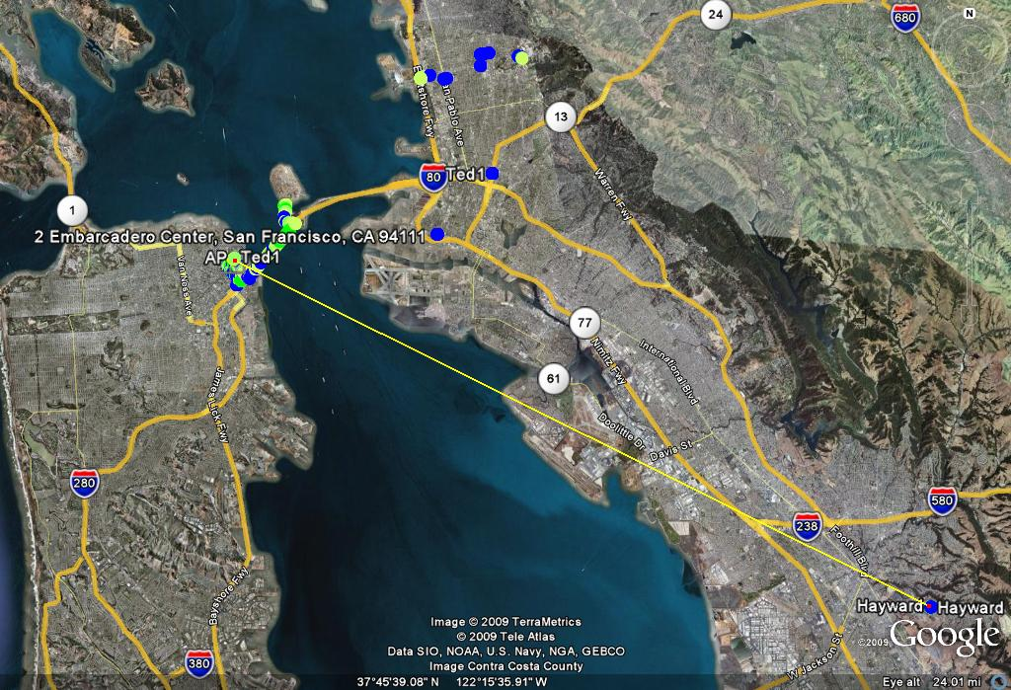
On Ramp high processing gain (not in proposal) increases range
21. 3 Miles
17

Slide 18
D-DSSS useful PHY mode for 15.4g
In real environments in the United States, FHSS network can benefit from D-DSSS to address 100% of the nodes
Following slide (and backup slides) show simulation results based on the following parameters:
900 MHz frequency
+30 dBm transmit power
Path loss due to floor/wall traversing
10 dB lognormal shadowing
D-DSSS PHY mode can address hard to reach meters not reachable by the FHSS PHY and allow a more efficient mesh network

Slide 19
-102 dBm Receive Sensitivity: 454 clusters
40 homes per square mile (Exurban Density) 1,000 Homes
8.0 km
8.0 km
CONFIDENTIAL
19

Slide 20
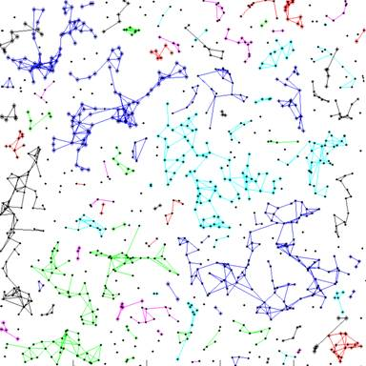
-109 dBm Receive Sensitivity : 192 clusters
40 homes per square mile (Exurban Density) 1,000 Homes
5.7 km
5.7 km
20

Slide 21
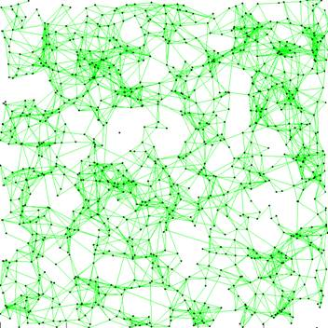
-119 dBm Receive Sensitivity: system reaches 998 of 1000 -
40 homes per square mile (Exurban Density) 1,000 Homes
8km
8km
21

Slide 22
Merge activity
DSSS proposers made good progress
Dynamic DSSS good solution for high processing gain mode in future merged proposal

Slide 23
Summary and conclusions
Very high link margin, low-power, low-complexity solution
Scalable data rates from 3.9 to 62.5 kbps
Maximum range of 0.8 miles at 2.4GHz and 1.24 miles at 900MHz, (Okumura-Hata model), 1.5m antenna height (NIST model)
PHY complies with world-wide regulations
Dynamic DSSS offers a good solution for hard to reach meters to allow 100% coverage and for battery operated gas meters
Dynamic DSSS good solution for high processing gain mode in DSSS merge proposal

