Slide 1
Project: IEEE P802.15 Working Group for Wireless Personal Area Networks (WPANs)
Submission Title: Dynamic Direct Sequence Spread Spectrum Proposal 802.15.4TG4g SUN
Date Submitted: 06 May, 2009
Source: David Howard, Ted Myers, On-Ramp Wireless, Inc.,
Address: 16885 West Bernardo Drive, Suite 255, San Diego, CA 92127, USA
Voice: +1-858-592-6008, FAX: +1-858-592-6009,
E-Mail: david.howard@onrampwireless.com,ted.myers@onrampwireless.com
Re: TG4g Call For Proposals, document number IEEE 15-09-356-004g
Abstract: Proposing a new multiple access scheme & PHY utilizing DSSS where receive sensitivity can be dynamically adapted to link conditions enabling up to 187dB of allowable path loss. Resulting in greater than 25x range and robustness over existing systems while maintaining low-power. Proposed PHY provides additional receive sensitivity for legacy 802.15.4 systems. Testing in real world metropolitan and plant environments validate key performance claims.
Purpose: This document is intended as a preliminary proposal for addressing the requirements of the TG4g standard.
Notice: This document has been prepared to assist the IEEE P802.15. It is offered as a basis for discussion and is not binding on the contributing individual(s) or organization(s). The material in this document is subject to change in form and content after further study. The contributor(s) reserve(s) the right to add, amend or withdraw material contained herein.
Release: The contributor acknowledges and accepts that this contribution becomes the property of IEEE and may be made publicly available by P802.15.

Slide 2
Wireless Challenges of Smart Utility Networks
Meters Reach to Neighbors
  Challenged meter locations will require large link budget to reach nearest neighbor
  Excess link budget will additionally be required to reach more than nearest neighbor to truly support a “mesh” that has redundancy
  From PAR: “5.5 Need for the Project: . To reach every node in the network a Wireless Smart Metering Utility Network needs the capability to vary radio range while providing for high spectral reuse” …Applications for Wireless Smart Metering Utility Network further intensify the need for maximum range as many devices are located sub-optimally. An example is Wireless Smart Metering Utility Network devices located in rural areas as at the end of electricity ‘feeders’ – where doubling range reduces cost by a factor of four as the area covered increases by the same factor An example is electricity meters located in highly obstructed, high multipath locations with inflexible antenna orientation. “
Support for Battery Powered Devices
  Battery powered devices typically must operate at less than 1 W.
  Better receive sensitivity is the only mechanism to reach in difficult propagation environments where, for example, gas meters may be located.
Support for International Market
  International regulations limit power to much less than the 36 dBm allowed in the US. For example, in Europe this limit is 16 dB less; in Japan this limit is 26 dB less.
  US-style 900 MHz is not typically available, thus most countries will have an additional propagation penalty in using the 2.4 GHz band.
  From PAR:“5.4 Purpose of Proposed Standard: To provide a global standard that facilitates very large scale process control applications such as the utility smart-grid network” … … Smart Metering Utility Network requirements for complete ubiquity – communicating with all devices within a geographic territory – explicitly requires maximum range within existing local regulations.
Capacity
  Maintaining capacity while providing long reach is key to a market that has millions of devices.
  From PAR: “5.5 Need for the Project: … Utility networking and very large scale industrial applications have requirements to keep infrastructure to a minimum, scale to millions of nodes across diverse geographical environments, and do so with carrier grade reliability
Laws of Physics and Regulations Limit Transmit Power, Receive Sensitivity Is Only Degree of Freedom Left for Long Reach
2

Slide 3
Dynamic DSSS System Components
Access Point
  This is a Full Functioned Device (FFD) that is capable of simultaneously demodulating >1000 node’s signals each at -145 dBm receive sensitivity.
  AP demodulates all chip timing hypothesis and spreading factor and uses 32 bit CRC to filter valid frames.
  Access Point is typically connected to a WAN.
Node
  This is a Reduced Function Device (RFD) that is designed for battery powered operation.
  Node capable of cold acquiring and demodulating at -139 dBm receive sensitivity which is -29 dB of SNR at digital baseband.
Micro-Repeater
    This is a Full Functioned Device (FFD) that is an integration of the Access Point PHY and Node PHY.
    Like AP PHY, capable of demodulating >1000 node’s signals each at -145 dBm receive sensitivity.
    Like Node PHY, capable of cold acquiring and demodulating at -139 dBm receive sensitivity which is -29 dB of SNR at digital baseband.

Slide 4
Proposed Smart Grid Topology
Smart Utility Network (SUN)
  Electric Meters could form the FFD mesh for the SUN.
  High aggregate data rate to/from Access Point in excess of the 40 kpbs specified in the PAR.
  Allows for very large coverage areas with either very dense or very sparse distribution of utility meters.
  MPDUs can be arbitrarily large based on fragmentation/reassembly of PPDUs.
  Gas meters and other battery challenged devices would route to the nearest FFD to make their way to the SUN.
Home Area Network (HAN)
  Electric Meters would simultaneous serve as the routing function for the HAN.
  High data rates and large battery life is enabled by closing the link at the nearest FFD. FFD will route
  MPDUs can be arbitrarily large based on fragmentation/reassembly of PPDUs.
  Much more link budget than existing 802.15.4 PHYs to guarantee robust coverage especially inside multi-family dwellings.

Slide 5
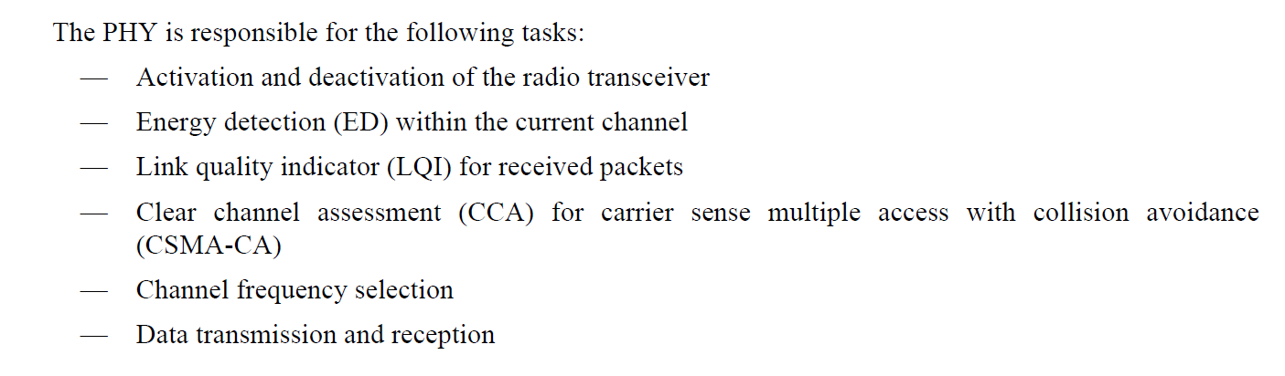
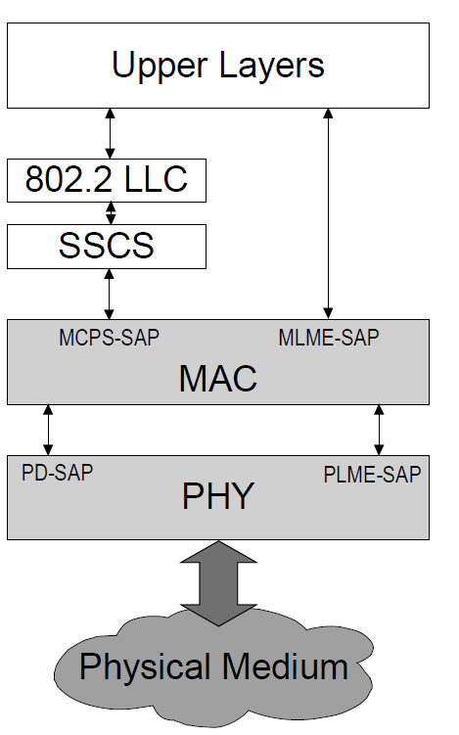
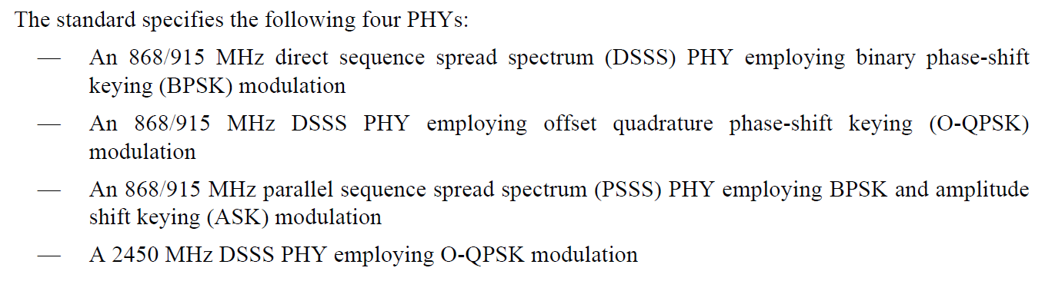
Proposing New ULP PHY as 802.15.4
D-DSSS PHY would support functions/primitives described in 802.15.4
Compatible with upper layer software including mesh routing and smart energy profiles
Propose D-DSSS PHY to be included in this list of currently supported PHYs

Slide 6
Dynamic DSSS: Up to 39 dB of Processing Gain Implemented in commodity, low power silicon
Up to - 145dBm receive sensitivity
Up to - 35 dB SNR
- Novel Multiple Access Scheme
  Simultaneously demodulating up to 1000 links
  Resilient to link contention allowing demodulation in face of extreme noise
  Results in 25x capacity improvement
39 dB of Processing Gain → 185 dB of Link Budget in US
Processing gain even more important in TX power restricted regions

Slide 7
What is RPMA?
RPMA → Random Phase Multiple Access
A new multiple access scheme used for uplink communication between node and AP.
A symbol is a complete BPSK modulated PN sequence - All symbols in all received
frames use the exact same PN sequence.
Channelization is performed by the Node choosing a random chip delay each transmission.
Successful demodulation at the AP relies upon frame reception such that time of
arrival is a chip or more apart from any other frame – Collisions are resolved based
on the re-transmission protocol.
Using the PN Despread Array, the AP demodulates ALL possible chip times of arrival
looking for valid energy assuming a valid frame. CRC is used to filter false hypothesis.
Blind Demodulation yields protocol efficiency and simplicity for the entire
communications system

Slide 8
What is RPMA? ..... continued
AP does not need to expect a transmission a priori
  Blind algorithm well suited for ad-hoc types of traffic.
  Node requires no “assignment” analogous to “codes” in CDMA.
Node makes uncoordinated decisions on optimal spreading factor.
  AP supports this by demodulating all spreading factor choices as an outer loop to chip timing hypothesis.
  Energy Control – more general than power Control in that based on RSSI, node uses minimum spreading factor to close link, then reduces transmit power to hit AP at optimal power level for capacity.
Half-Duplex system better than paired spectrum for power or energy control.
  Reciprocity holds because the channel estimates mode by the node are valid for the uplink as well.
  Eliminates the need for a high performing closed-loop power control mechanism.

Slide 9
Downlink Frame Structure
Broadcast Channel
  Predictable channel required for demanding task of acquisition in -29 dB of SNR
  Contains network parameters
Data Channel
  Used for unicast transmissions to nodes
  Variable spreading factor based on link conditions to node.
  Uses specific Gold codes mapped to each user
Preamble
  Used in “warm acquisition” states for power efficiency on node
  Allows for accurate power and frequency measurements for uplink power control and uplink frequency compensation

Slide 10
Uplink Frame Structure
Node chooses minimum processing gain to close link (6 dB to 39 dB) without any a priori coordination with AP
Node may transmit in multiple sub-slots for increased data rate
Nodes of vastly different link conditions and data rates may all transmit in same sub-slot as long as aggregate uplink data rate requirement is not exceeded.

Slide 11
Dynamic DSSS Coverage and Capacity
D-DSSS
318 km²
Examples of High Volume Applications Enabled by On-Ramp
300 km²
-142 dBm
Water/Gas Meter Monitoring
500 bytes per day/meter payload data requirement
220,000 meters per D-DSSS FFD.
Deployment Scenario
-139 dBm
FFD – 13 meter AGL
  30 dB PA
  6 dBi antenna
RFD – 1.5m AGL
  20 dB PA
  2 dBi antenna
Suburban propagation
Coverage based on Okumura-Hata model
200 km²
Electric AMI
5 KB per day/meter payload data requirement
20,000 meters per D-DSSS FFD
-136 dBm
-133 dBm
100 km²
Coverage Area
-130 dBm
50 km²
-127 dBm
-124 dBm
802.16 (@ -110dBm)
2.5 km²
-121 dBm
802.15.4 (@ -100dBm)
1.25 km²
-118 dBm
802.11 (@-100 dBm)
1.25 km²
-115 dBm
60 kbps
^{On-Ramp}
125 kbps
250 kbps
1 Mbps
10 Mbps
Uplink Capacity
11

Slide 12
Uplink Data Rate, Coverage, and Capacity
UPLINK Spreading Factor | Uplink Signal Level (dBm) | Estimated Range (mi) | Coverage Area (mi²) | Estimated Range (mi) | Coverage Area (mi²) | UPLINK Payload Data/Hr (KB/h) Per Node | UPLINK Aggregate Data Rate Access Point (KB/h)
 |  | 2.4 GHz |  | 900 MHz
16 | -114 | 1.2 | 4.9 | 2.0 | 12.3 | 4688 | 18750
32 | -117 | 1.6 | 7.7 | 2.5 | 19.4 | 2344 | 18750
64 | -120 | 1.8 | 9.7 | 3.1 | 30.8 | 1172 | 18750
128 | -123 | 2.2 | 15.4 | 3.5 | 38.8 | 586 | 18750
256 | -126 | 2.5 | 19.4 | 4.4 | 61.5 | 293 | 18750
512 | -129 | 3.1 | 30.8 | 5.0 | 77.4 | 146 | 18750
1024 | -132 | 3.9 | 48.9 | 6.3 | 122.7 | 73 | 18750
2048 | -135 | 4.4 | 61.5 | 7.9 | 194.5 | 37 | 18750
4096 | -138 | 5.6 | 97.5 | 8.8 | 244.8 | 18 | 18750
8192 | -141 | 6.3 | 122.7 | 11.1 | 388.1 | 9 | 18750
Node data rates range from 60 bps to 30 kbps. At the extreme point of -141 dBm receive sensitivity:
  After the half-duplex and overhead is factored out – this corresponds to 9 kbytes per hour which is much more than a lot of applications require.
  The aggregate uplink data rate remains at near 19 Mbytes/per hour or equivalently 60 kbps. This 60 kbps is the number that is apples-to-apples with the PAR data rate requirement since the intent of the PAR is a capacity requirement, not a peak application data rate requirement.

Slide 13
Downlink Data Rate, Coverage, and Capacity
DOWN LINK Spread Factor | Uplink Signal Level (dBm) | Estimated Range (mi) | Coverage Area (mi²) | Estimated Range (mi) | Coverage Area (mi²) | Example Distribution of Devices As Function of Spreading Factor | DOWNLINK Peak Node Payload Data/Hr Per Node (KB/h) | DOWNLINK Aggregate Data Rate at Access Point (KB/hr) CALCULATION
 |  | 2.4 GHz |  | 900 MHz
4 | -114 | 1.8 | 9.7 | 3.1 | 30.8 | 13.0% | 18750 | 1218.75
8 | -117 | 2.2 | 15.4 | 3.5 | 38.8 | 12.0% | 9375 | 562.50
16 | -114 | 1.8 | 9.7 | 3.1 | 30.8 | 12.0% | 4688 | 281.25
32 | -117 | 2.2 | 15.4 | 3.5 | 38.8 | 15.0% | 2344 | 175.78
64 | -120 | 2.5 | 19.4 | 4.4 | 61.5 | 15.0% | 1172 | 87.89
128 | -123 | 3.1 | 30.8 | 5.0 | 77.4 | 10.0% | 586 | 29.30
256 | -126 | 3.9 | 48.9 | 6.3 | 122.7 | 6.0% | 293 | 8.79
512 | -129 | 4.4 | 61.5 | 7.9 | 194.5 | 5.0% | 146 | 3.66
1024 | -132 | 5.6 | 97.5 | 8.8 | 244.8 | 6.0% | 73 | 2.20
2048 | -135 | 6.3 | 122.7 | 11.1 | 388.1 | 6.0% | 37 | 1.10
 |  |  |  |  | Example DOWNLINK Aggregate Payload KB/hr |  |  | 2371
The asymmetric uplink/downlink capacity is mitigated by several factors:
Tendency of Sensor Networking and Location Tracking Systems to be Uplink Dominated in Data Flow
Micro-Repeaters near the AP serve to additionally increase the downlink data rate
1 Watt Power Amplifier on Access Point
Use of Broadcast is inherently efficient if each node requires the same data (e.g., firmware update)
Very Efficient 1-bit uplink Acknowledgement Scheme

Slide 14
Dynamic Direct Sequence Spread Spectrum (D-DSSS) is a flexible solution satisfying the Smart Utility Network requirements
We welcome collaboration with other proposers and intend to present at the TG4g meeting on May 11-15, 2009 in Montreal.
Thank you.

Slide 15
Appendix

Slide 16
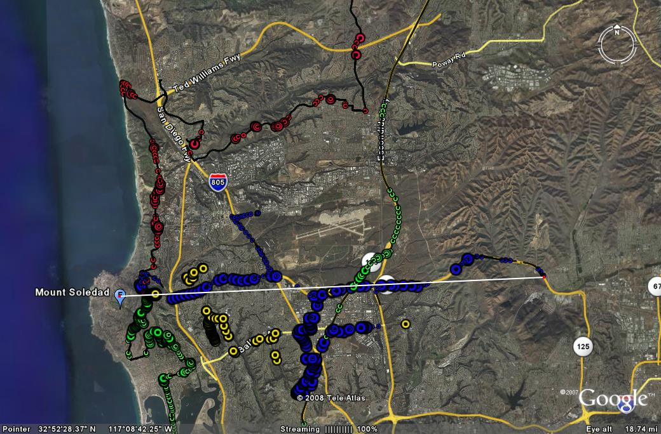
D-DSSS Metro-Scale Test 2.4 GHz:
San Diego
Elevated single A/P placement on Mount Soledad – 800 Feet
4 Simultaneous nodes tracking users in vehicles connected with GPS
Closed link consistently at ranges up to 13.9 miles
High noise floor with significant residential 2.4GHz traffic
Significant building and hilly terrain coverage in several areas impacting signal however link maintained
100s of thousands of homes covered with a single A/P
Access Point Location
13.9 Miles
Impossible with any existing technology - Contention between 1000s of relatively isolated 2.4Ghz radio signals in metro areas destroys existing multiple access schemes (e.g., CSMA used in 802.11, 802.15.4)
D-DSSS makes Metro Scale Free ISM deployments possible with multiple year battery life on commodity hardware while consuming <1MHz of spectrum
A Single D-DSSS A/P can support 1,000 nodes simultaneously or 3.6million at once per hour update rates

Slide 17
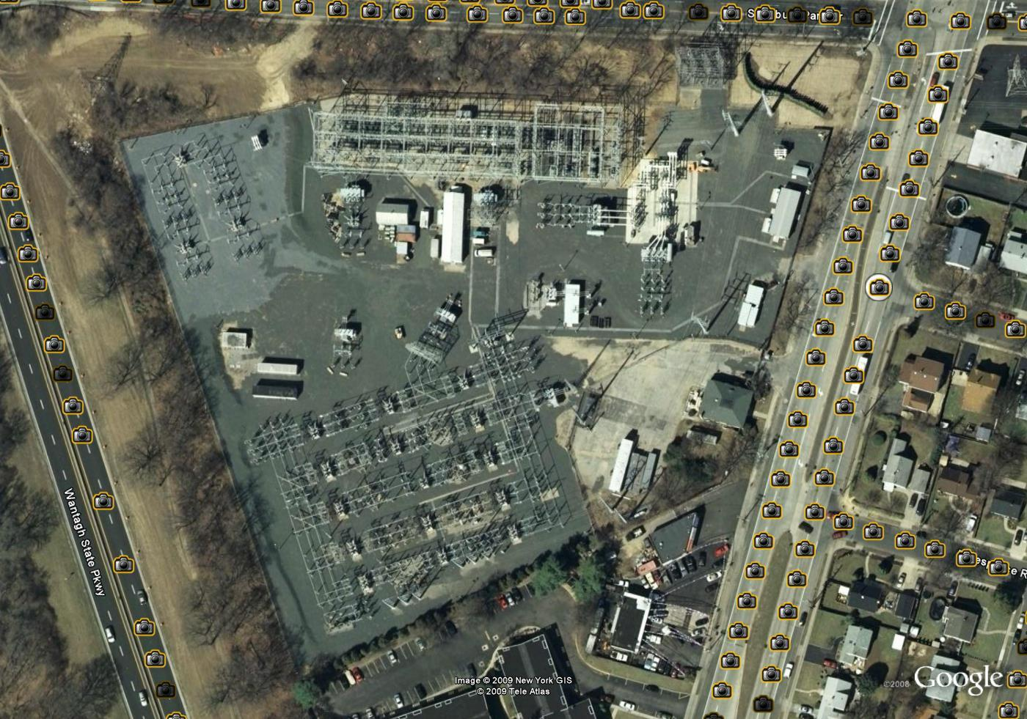
Power Plant Deployment
Field Test Sponsored by a East-Coast Utility
Wireless condition monitoring for fully operational substation
D-DSSS 2.4 GHz in star topology
Tested within the perimeter, directly on huge transformers and in metal enclosures
All nodes connected with at least 60 dB margin, not affected by magnetic and electronic fields
Literally ALL possible test points can securely and reliable connect to a single access point (AP)
Customer very satisfied with robust air link and no interference impact as well as range

Slide 18
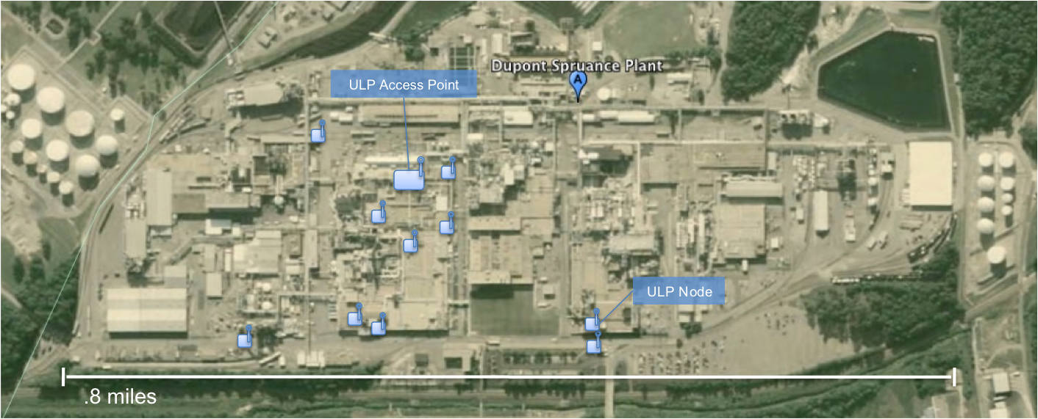

Chemical Plant Deployment Test
DuPont Plant, Richmond, VA
Application: Condition Based Monitoring / Vibration Sensor
Worst possible propagation environment – 20 separate test points
Foot wide concrete walls with rebar enforcement - Heavy machinery everywhere
Multi-level rooms with cable trays, steel railings and doors
Coverage from basements to 3rd floor rooms
1 A/Ps supports entire coverage and capacity for greater than 1000 sensors

Slide 19
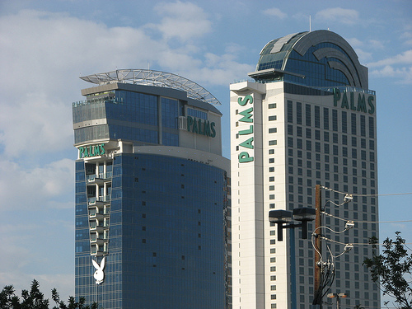
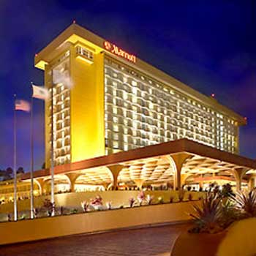
February 2009
Indoor Test Office and Hotel Buildings
Palms Tower
Marriott LAX
Palms Tower
  Access Point in hotel room on 52nd floor
  Closed link effectively through all 52 floors while never loosing connection
A single D-DSSS AP can cover most large buildings effectively with plenty of margin
Tested Zigbee and 802.11: dropped connection after one floor – At least 52 powered APs to ensure coverage at a minimum for an indoor location like the Palms Tower
Whole building HVAC, Security, automation and location tracking applications can be implemented with 10x lower TCO
Slide 19
Myers et al, On-Ramp Wireless

Slide 20
RPMA is High Capacity
Motivating Question: If you have 1,000 transmitters all needing to simultaneously communicate with an access point, is it better from a Shannon Capacity viewpoint to have them take turns and only have 20 dBm of transmit power, or is it better to have them all transmit simultaneously and take advantage of 20 dBm + 10log(1000) = 50 dBm of transmit power?
Unlike CSMA/CA - No degradation in uplink capacity irrespective of range or link conditions.
RPMA resilient to Hidden Node Problem
RPMA is capacity efficient -
  50% efficient for small packets (10 – 100 byte packets)
  CSMA/CA has a great deal of overhead yielding much smaller capacity for small packet sizes which is often the case in wireless sensor networking and telemetry.

Slide 21
Aggregate Access Point Uplink Throughput
Meter or Location Data ~ 10 bytes
100 Mbit
100 Mbit
1 Mbit
Aggregate Access Point
Throughput
ULP
ULP Repeater
100 kbit
802.11
10 kbit
802.15.4
802.15.4 Mesh
1 kbit
1 m
10 m
100 m
1 km
10 km
Range
D-DSSS Estimate for 2.4GHz frequency in 2MHz bandwidth
802.11 Protocol overhead 99% and 20MHz Bandwidth
802.15.4 98% Protocol overhead and 5Mhz Bandwidth

Slide 22
RPMA Enables Much Better Link Budget
What can 187 dB of allowable path loss buy?
  Several Orders of Magnitude Fewer Gateways and Repeaters
    Reduces System Cost
    Increases Reliability
    Makes Redundancy Much Cheaper
    Much less network planning required
  Highly resilience to interference
    Processing gain of DSSS inherently gives robustness to in-band interference
    Long frame duration additionally adds an element of time diversity which is useful in interference burst situations (very common in ISM band)
    Flexible channel bandwidth allows more options.
      E.g. for 500 kHz to 2 MHz channel bandwidth, the RPMA signal can be at the right side of the ISM band which is non-interfering to normally deployed 802.11 channels.
      Can add Frequency Hopping as outer loop process for further interference mitigation.

Slide 23
RPMA is Difficult to Jam and Intercept
Operates well below the noise floor and can not be detected by
conventional equipment
Interfering links causes only same degradation as noise
  Doesn’t experience the “extra” degradation associated with false acquisition on competing systems.
  Power/Energy Control dramatically further reduces interference from competing systems.
Link budget provides anti jamming resilience – basic concept of processing gain of DSSS systems.
DSSS difficult to intercept since spread out and coded with pseudo noise
codes -> close to Gaussian White Noise
Well suited for PHY level security

Slide 24
RPMA is Low Power
Only minimum processing gain required to close link is used.
  Same or lower power consumption as 802.15.4 for most processing gains.
  Higher processing gain is only used to mitigate interference or fading nulls.
Protocol efficiency of up to 50% for small packet size allows for minimal radio on time (low overhead)
Transceiver analog performance requirements can be relaxed due to PHY requirements for even lower power
Efficient modem architecture coupled with current Silicon technology allows for power consumption to be dominated by RF Transceiver power consumption as opposed to signal processing power.

